Slide 1
Bathroom Pro 2000
Michael Leitner, Philip Rockenschaub

Slide 2
Planning
Main integrations should work
  model
  preprocessing
  zigbee integration
POC prioritized
  integration/optimizing later

Slide 3
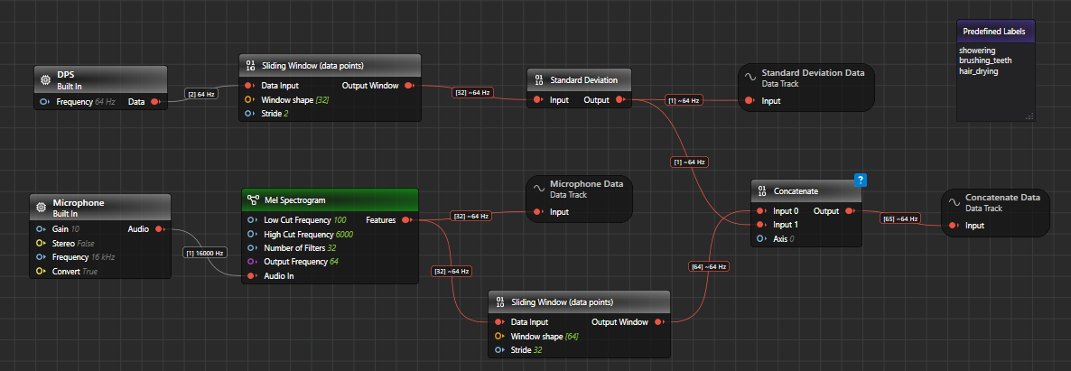
Preprocessing

Slide 4
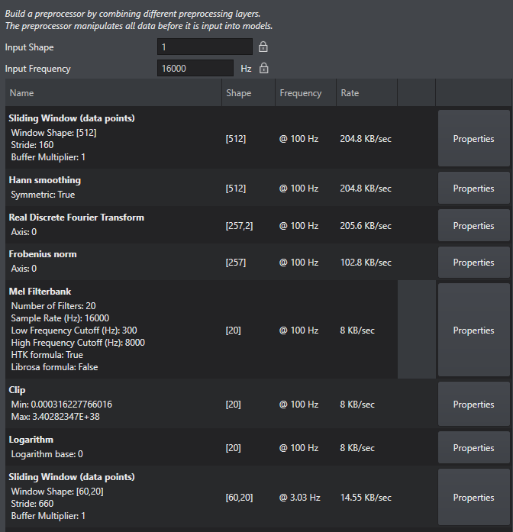

Slide 5
SmartHome Integration
HomeAssistant → HTTP? Zigbee? MQTT?
  Zigbee, existing infrastructure
  How on PSOC6?

Slide 6
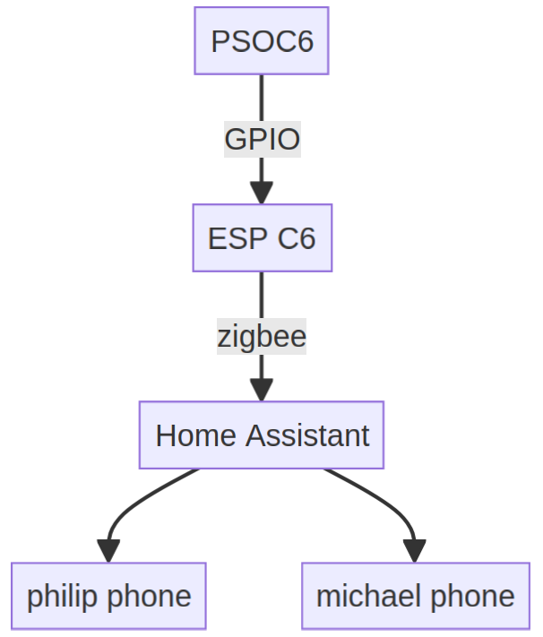

Slide 7
Model
tested lots of models (nearly all variants)
  in deepcraft studio they work
  on board they didn’t work

Slide 8
Solution
skip micropython part
integrate in C
  it worked :D

Slide 9
Resumee
lots of small undetectable, difficult to trace problems
  Commit in micropython fork destroyed model converting (NikithaR-IFX, #6bd82f9)
  Cannot enqueue (why?)
  Never dequeing (why?)
  Freezes after 3 sec (some buffer overflow?)

Slide 10
Nonetheless still lots of fun!

Slide 11
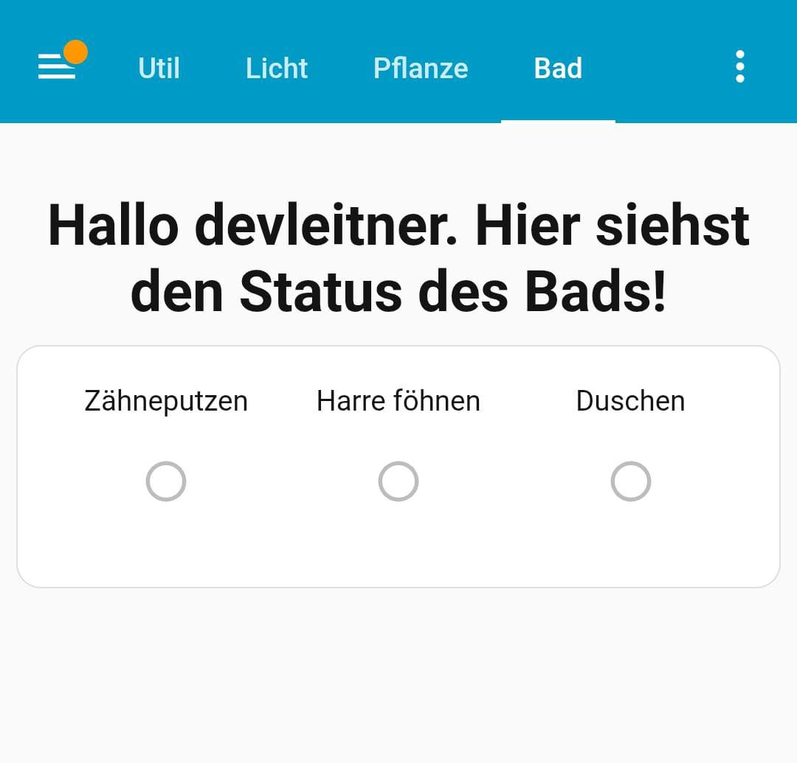
Result

Slide 12

Thank you!
We are really grateful for the opportunity to work and try out these technologies and work together with you!

