Slide 1


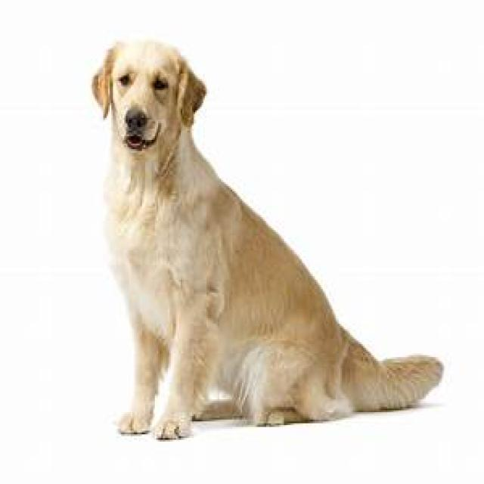
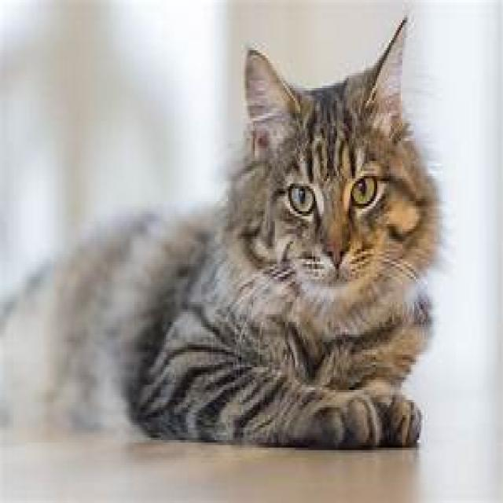
COMPUTER VISION · YOLOv11 · STREAMLIT
VisionBox
dog (sit) 0.94
AI-Powered Animal & Pose Detection
cat (laying) 0.88
Detect what an animal is — and what it's doing — from a single image, using a fine-tuned YOLOv11 model wrapped in a simple web app.
A beginner-friendly Computer Vision project
github.com/devMonkRahul/VisionBox

Slide 2
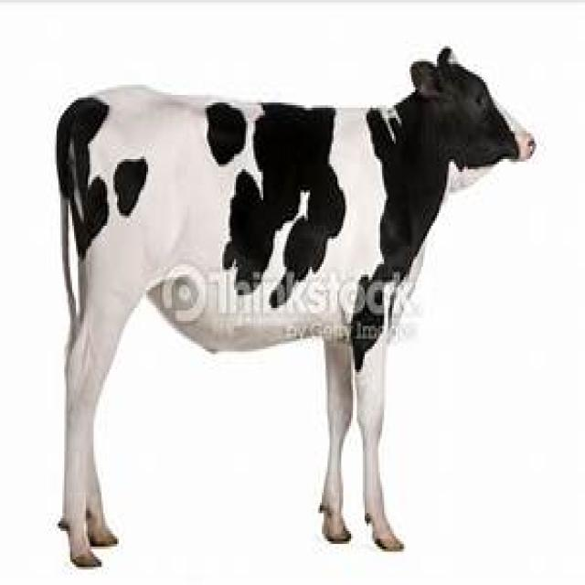

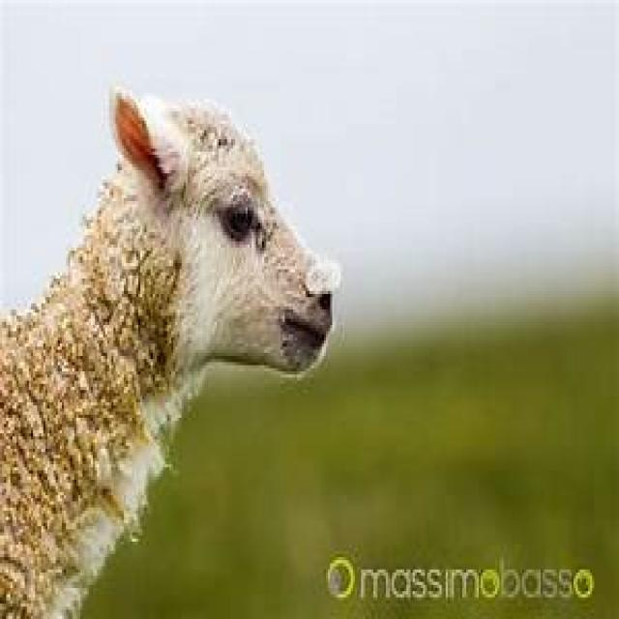


PROJECT OVERVIEW
What is VisionBox?
VisionBox is a hands-on Computer Vision app that lets you upload a photo and instantly see which animals are in it, the pose each one is in, and how confident the model is — all through a clean Streamlit web interface, with no training required from the user.
cow (stand) 0.92
Made for beginners
Designed for engineering students learning OpenCV for the first time.
sheep 0.81
Workshop
Run the app, upload an image, and understand detection end-to-end in one session.
Fine-tuned YOLOv11
One photo in → labelled animals + poses out
Uses a YOLOv11 nano model adapted to a custom animals dataset — ready to run.
VisionBox
02

Slide 3
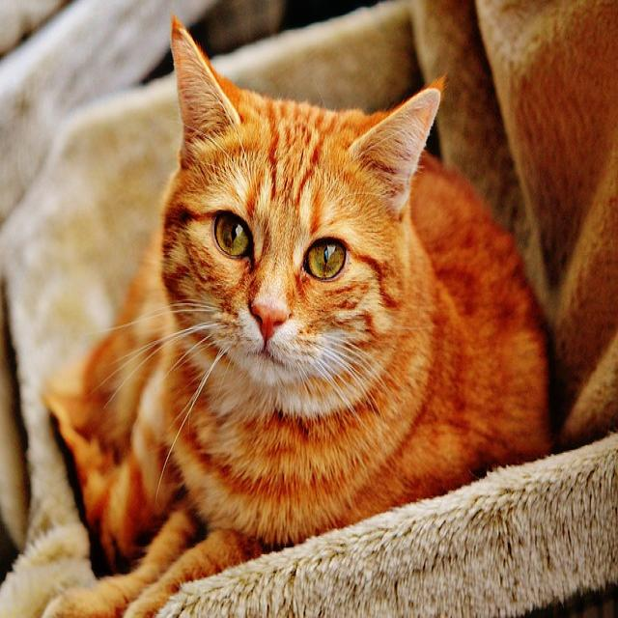


THE CONCEPT
Computer Vision & Object Detection
Object detection answers two questions at once: what is in the image, and where is it. That's the core idea VisionBox demonstrates.
Image Classification
Object Detection
One label for the whole image
Boxes + labels for every object
cat 0.96
“cat”
Answers “what is this?”
Answers “what AND where?”
No location information
Draws a bounding box per object
One prediction per image
Many objects, each with a score
VisionBox
03

Slide 4
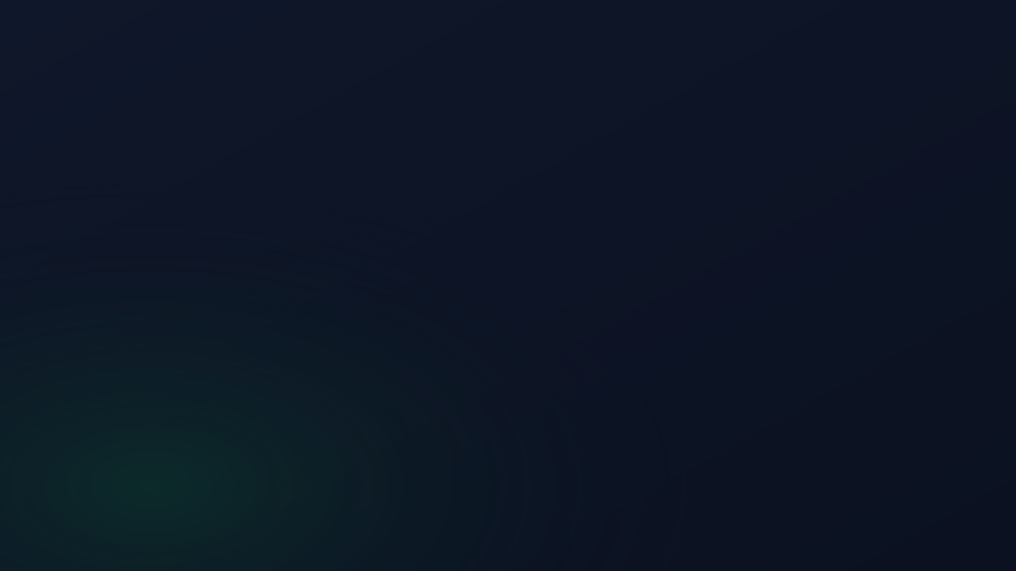
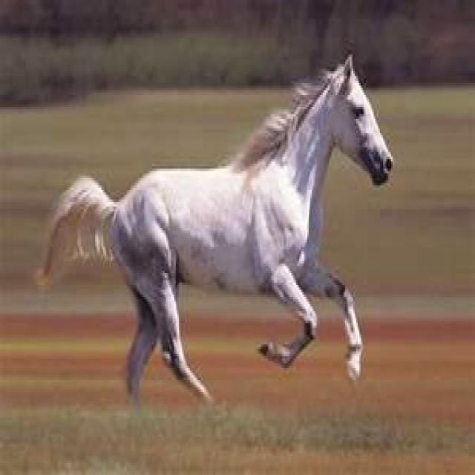
WHAT MAKES IT DIFFERENT
The Big Idea: Animal + Pose
Most detectors stop at “there is a cow.” VisionBox goes one step further: it detects the animal and what it is doing, then merges them into a single, human-readable label.
cow (stand) 0.92
cow
+
stand
=
cow (stand)
horse (run) 0.86
animal class
pose class
final detection
Each pose is matched to the animal whose box it overlaps the most, so the description stays accurate even with several animals in frame.
Animal + pose, paired automatically
VisionBox
04

Slide 5



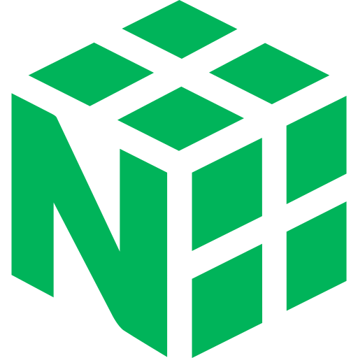

UNDER THE HOOD
The Technology Stack
VisionBox stays lightweight — a small, well-known Python stack that students can install and read in a single sitting.
Ultralytics YOLOv11
Streamlit
OpenCV
The detection engine — loads animals.pt and runs inference.
Builds the entire web UI: upload, sliders, tables, downloads.
Draws bounding boxes, labels and confidence onto the image.
pandas
NumPy
Pillow (PIL)
Turns raw detections into clean tables and statistics.
Converts images to arrays and handles box math (IoU).
Reads uploads/webcam frames and exports the result image.
VisionBox
05

Slide 6




HOW IT FITS TOGETHER
System Architecture
Three small modules, one clear flow — from the user's image to a labelled result.
User Input
app.py
detector.py
helpers.py
Streamlit UI
Controller
YOLO11 + pairing
Stats & export
Upload or webcam snapshot
Orchestrates the workflow & layout
Inference, IoU pose-pairing, boxes
Counts, top-5, downloadable image
Output: annotated image + detection table + statistics + a one-click download of the result.
VisionBox
06

Slide 7



THE DETECTION ENGINE
Powered by YOLOv11
YOLO — “You Only Look Once” — is a real-time object detector that scans the whole image in a single pass, predicting every bounding box and class together. That single-pass design is what makes it fast enough for live use.
1
10
pass over the image
trained classes
Single-pass
Looks at the image once — no slow region-by-region scanning.
0.25
300
Nano model
The smallest YOLOv11 variant: light, quick, easy to run on a laptop.
default confidence
max detections / image
Fine-tuned
Re-trained on a custom animals dataset to learn animals + poses.
VisionBox
07

Slide 8








TRAINING DATA
The Animals Dataset
The model is fine-tuned on the open-source Animals (animals-p1cov) dataset from Roboflow Universe — 10 classes split into animals and the poses they appear in.
Dataset at a glance
5 Animals
5 Poses
Source
Roboflow Universe
cat
eating
Project
animals-p1cov · v3
cow
laying
Workspace
sesese
dog
run
horse
sit
Format
YOLOv11
sheep
stand
License
CC BY 4.0
VisionBox
08

Slide 9



STEP BY STEP
How a Detection Happens
What runs each time you press “Run object detection”:
1
2
3
4
5
Read image
YOLO inference
Pair poses
Build table
Render & export
The upload or webcam frame becomes an RGB image, then a NumPy array.
model(image, conf, max_det=300) returns every box above the threshold.
Each pose box is matched to its animal using IoU overlap.
Detections become a tidy DataFrame: class, position, score, box.
Draw boxes, show stats, and offer the annotated image to download.
VisionBox
09

Slide 10

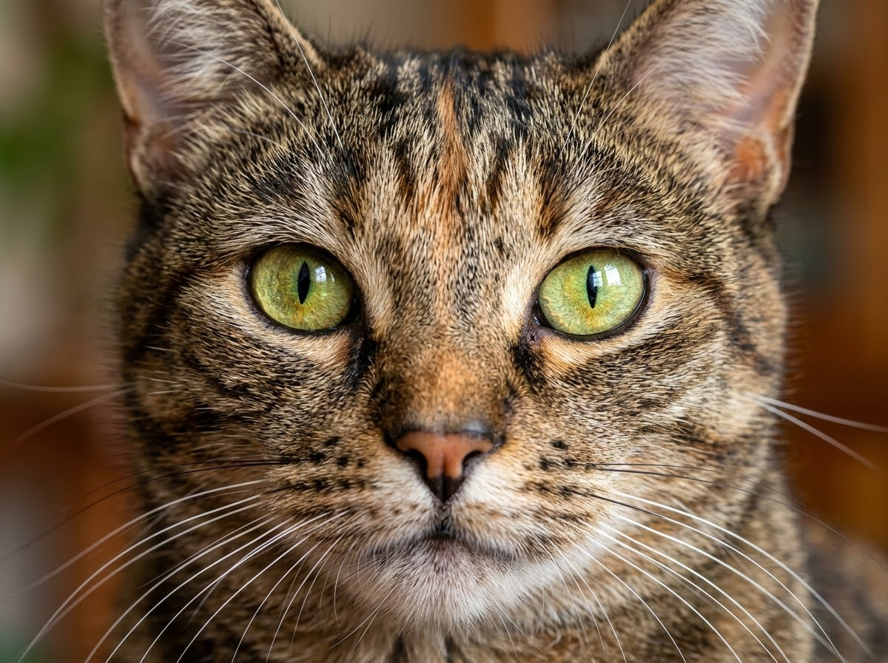
STEP 1 UNDER THE HOOD
Image to NumPy Array Conversion
How pixels translate into structural raw data for neural network consumption:
img_array = np.array(image.convert("RGB"))
Generates a structured multidimensional ndarray matching [Height, Width, Channels]
Red Channel
[[255, 120, ...] [ 84, 201, ...] [ 43, 92, ...]]
First matrix plane representing the intensity of red light per pixel (0-255).
Green Channel
[[102, 45, ...] [192, 88, ...] [ 12, 115, ...]]
Second matrix plane containing corresponding green value signals.
Blue Channel
[[ 50, 30, ...] [ 10, 15, ...] [240, 180, ...]]
Third matrix plane representing the blue color values.
→
1. The Digital Input
An uploaded image consists of visual coordinates. The framework uses libraries like Pillow or OpenCV to read the raw compressed binary file into memory as an uncompressed RGB representation.

Slide 11
THE CLEVER PART
Pairing Poses with IoU
The model returns animals and poses as separate boxes. To say “cow (stand)”, VisionBox measures how much each pose box overlaps each animal box using Intersection over Union (IoU).
animal box
IoU = Area of Overlap / Area of Union
overlap
Highest overlap wins — Each animal keeps the pose box it overlaps most.
Threshold = 0.3 — Overlaps below 0.3 IoU are ignored as too weak to pair.
pose box
Nothing is dropped — Unmatched poses are still reported on their own row.
If overlap ÷ union ≥ 0.3, the pose belongs to that animal.
VisionBox
10

Slide 12

PROJECT INTERNALS
Inside the Code
visionbox/
detect_objects()
├─ app.py
Streamlit UI & workflow
Loads animals.pt once (cached) and runs YOLO11 on the image array.
├─ animals.pt
fine-tuned YOLOv11 weights
pair_detections()
├─ utils/
Computes IoU and merges each pose with the right animal box.
├─ detector.py
inference + IoU pairing
draw_detections()
├─ helpers.py
stats & export
Uses OpenCV to paint green boxes + “class (pose) score” labels.
├─ requirements.txt
dependencies
get_detection_stats()
├─ README.md
docs & workshop notes
Unique classes, highest confidence and the top prediction.
VisionBox
11

Slide 13


WHAT YOU CAN DO
Key Features
Upload or webcam
Confidence slider
Boxes + poses
Drop in a JPG/PNG, or snap a photo straight from the browser camera.
Tune the threshold live to keep only predictions you trust.
See green bounding boxes labelled with animal, pose and score.
Detection table
Instant statistics
Download result
Class, position, confidence and exact box coordinates per object.
Object count, unique classes, top prediction and the top-5 list.
Export the annotated image as a JPEG with a single click.
VisionBox
12

Slide 14
GETTING STARTED
Clone the Starter Template
To help you skip the boilerplate setup, a complete starter repository is ready on GitHub. Follow the steps below to clone it locally and begin the workshop.
git clone https://github.com/devMonkRahul/visionbox-workshop-starter-template
1
2
3
Clone & Navigate
Install Dependencies
Launch the App
Run the clone command in your terminal, then change your working directory into the project folder: cd visionbox-workshop-starter-template
Set up your virtual environment and install all package requirements using uv or pip: uv sync
or
pip install -r requirements.txt
Start the local Streamlit server to open the interactive workshop environment in your browser: streamlit run app.py
VisionBox

Slide 15
USING THE APP
From Photo to Result in 5 Steps
1
Add an image
Upload a file or capture a webcam snapshot in the app.
dog (sit) 0.95
2
Set confidence
cow (stand) 0.9
Drag the sidebar slider to your preferred threshold.
3
Run detection
Click “Run object detection” and let YOLOv11 work.
4
Read results
Inspect the annotated image, table and statistics.
5
Download
The annotated result, ready to download
Save the labelled image to share or submit.
VisionBox
13

Slide 16



WORKSHOP VALUE
What Students Take Away
VisionBox is a teaching tool first. By the end of the session, students can explain the ideas behind every result on screen.
What Computer Vision is
Classification vs detection
How machines turn pixels into meaning.
Why “where” matters as much as “what”.
Bounding boxes & labels
Confidence scores
Reading box coordinates and class names.
How a threshold filters predictions.
Multi-class labels
Why fine-tuning helps
How animal + pose describe one subject.
Adapting a general model to a new task.
VisionBox
14

Slide 17
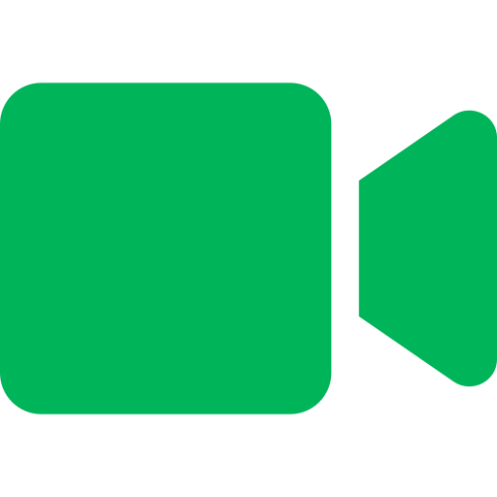

THE ROAD AHEAD
Future Improvements
Where VisionBox can grow next:
Live video detection
Short video files
Detection history
Real-time streaming via a WebRTC Streamlit component.
Run detection frame-by-frame on uploaded clips.
Save past results so students can compare runs.
Class-frequency charts
Compare model sizes
In-app quiz
Visualise how often each class appears.
Try different YOLOv11 variants side by side.
A short quiz to reinforce workshop concepts.
VisionBox
15

Slide 18
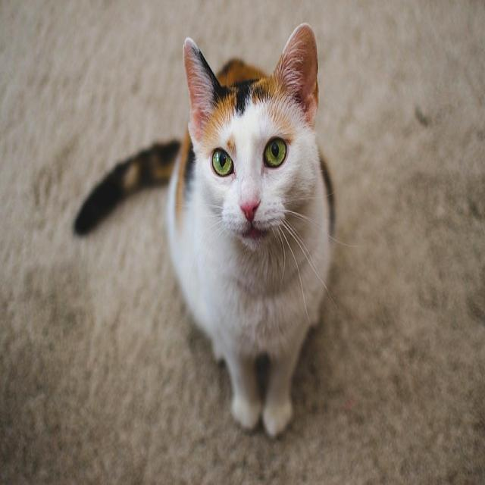
THANK YOU
See what your model sees.
VisionBox turns a single photo into labelled animals, their poses, and the confidence behind every call — a hands-on first step into Computer Vision.
cat (sit) 0.97
github.com/devMonkRahul/VisionBox

Slide 19

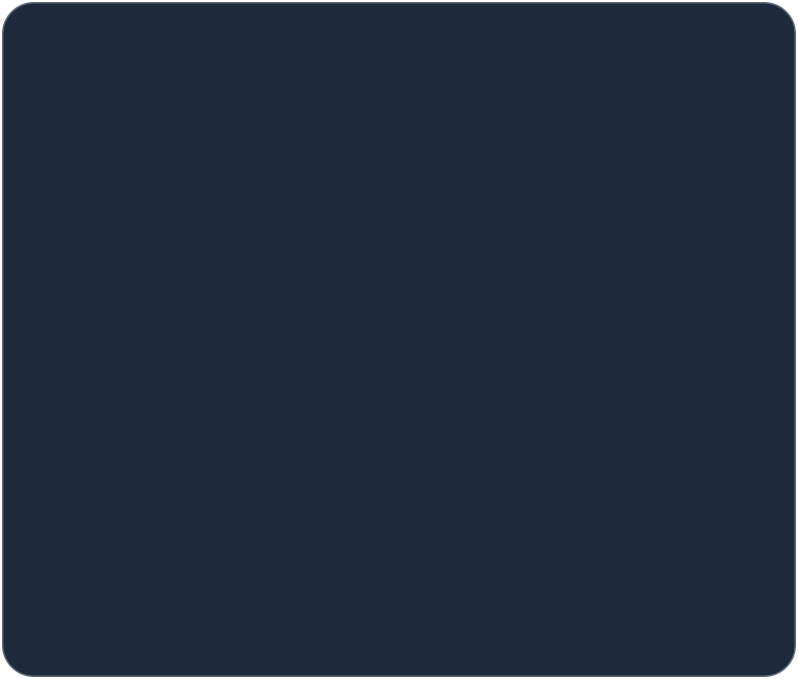
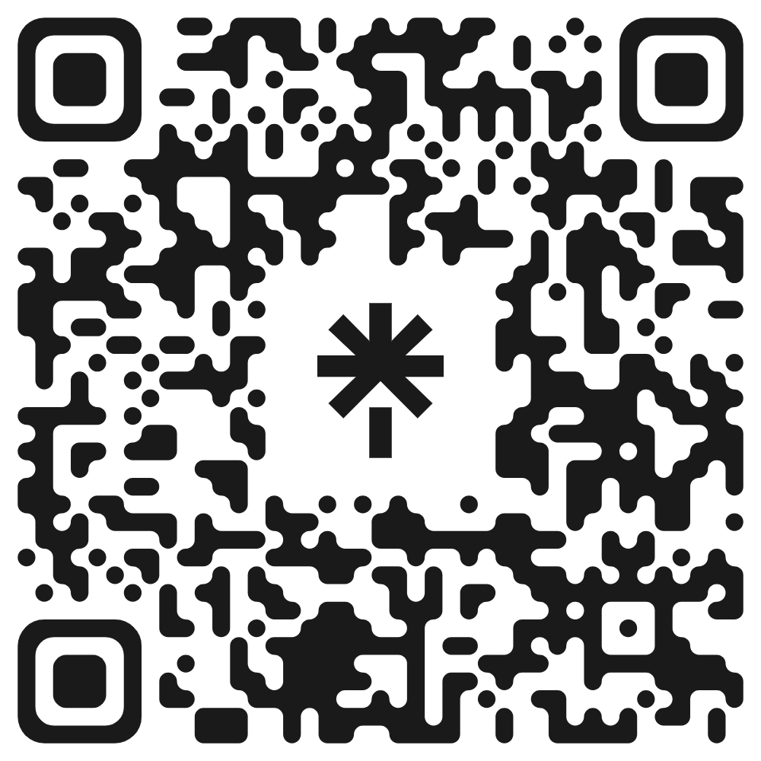
LET'S CONNECT
Stay in Touch.
Scan the QR code to connect on professional platforms, explore the repository, or discuss computer vision developments and potential collaborations.
Scan to Connect
VisionBox

