Slide 1
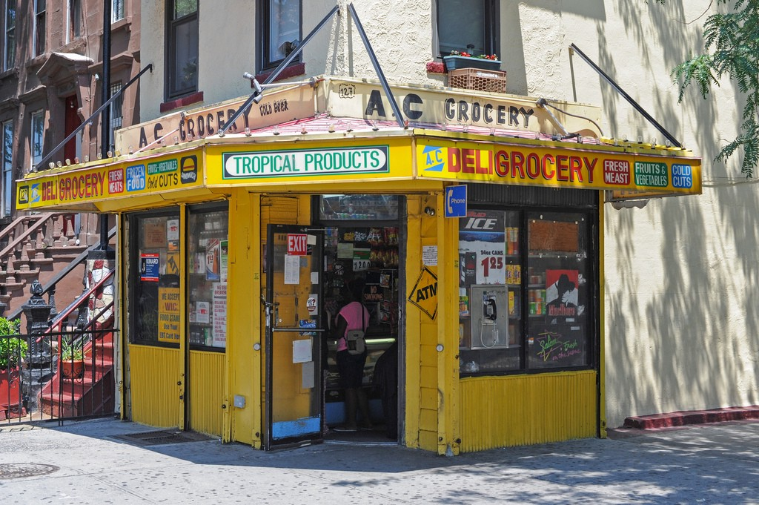
DELI GROCERY

Slide 2
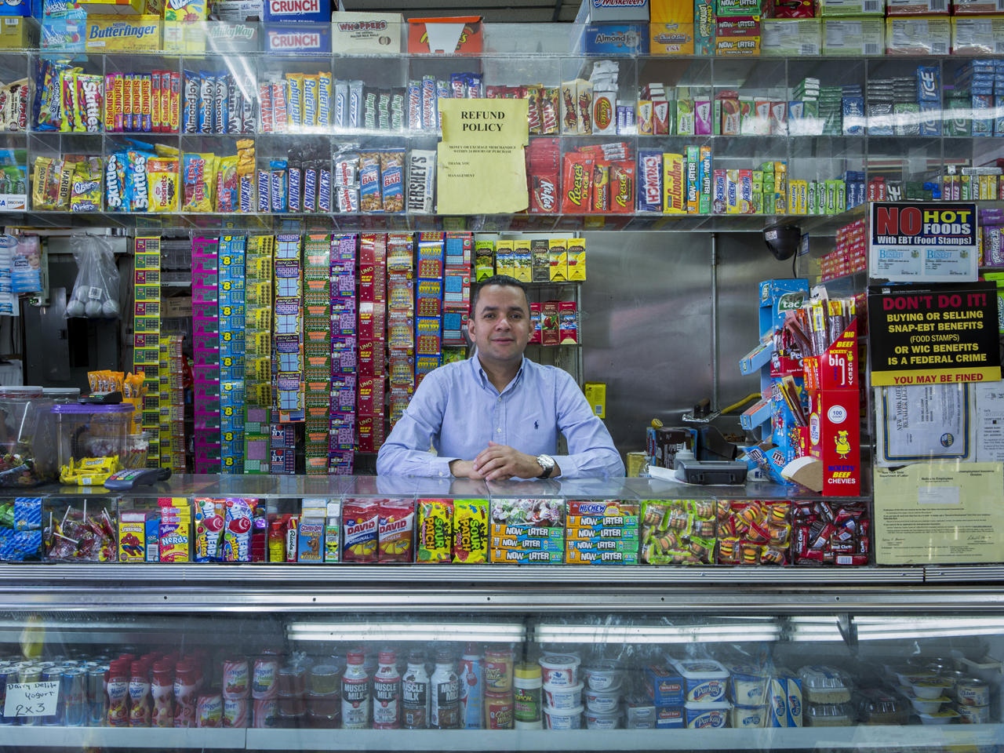
CANDY
SNICKERS
SWEDISH FISH
SUNFLOWER SEED
NOW AND LATER
CRUNCH
BUTTERFINGER
REESES
BEEF JERKY

Slide 3
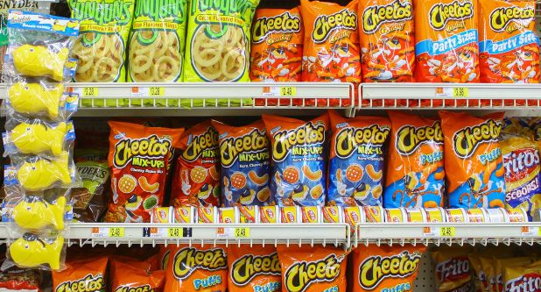
Snacks
FUNYONS
CHEETOS
FRITOS
DORITOS
CRUNCH
LAYS
SNYDER PRETZELS

Slide 4
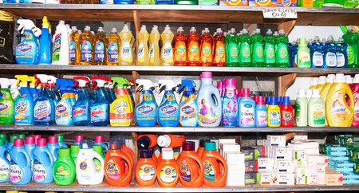
SUPPLIES
AJAX DISH SOAP
PALMOLIVE DISH SOAP
CLOROX DISENFECTANT OXICLEAN
TIDE DETERGENT
GAIN DETERGENT
DOWNY FABRIC SOFTNER

Slide 5
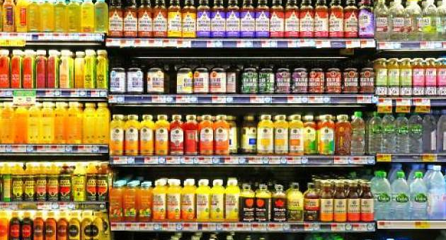
DRINKS
POLAND SPRING WATER
ESSENTIA WATER
ORANGINA
ARIZONA ICE TEA
PEPSI
ALOE VERA DRINK

Slide 6
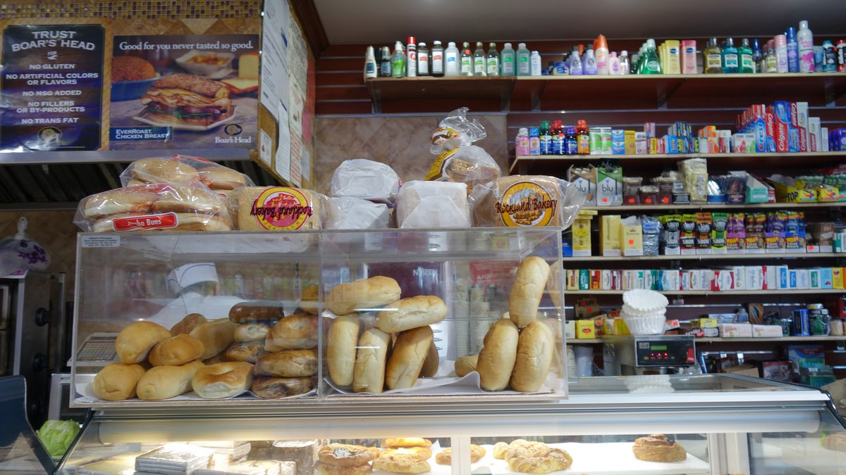
DELI
TURKEY
HAM
EGG
VEGGIE PATTIE
LETTUCE MAYONAISE MUSTARD
OIL
VINEGAR

Slide 7
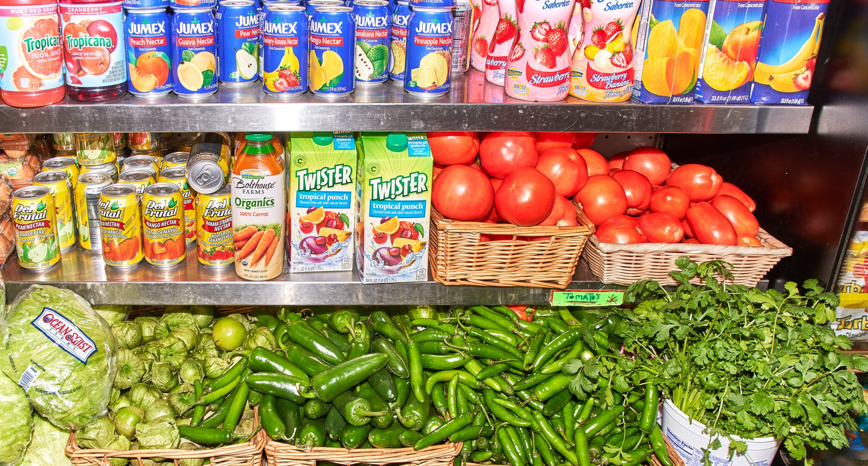

Slide 8
Make an order for pickup
Click button on that area, a list populate and click if you want to add to your pick up order.
Shoutouts
Olga, Lawrence, brian

