Slide 1
MVC in de praktijk
Jeroen Swart
.NET architect, Quintor
jswart@quintor.nl
http://blog.codeblack.nl
@codeblacknl

Slide 2
Agenda
Introductie MVC
Patterns, tips & trucs
Simplified example anti-pattern
Seperation of concerns principle
Single responsibility principle
Loose coupling pattern
Inversion of control principle
Dependency Injection pattern
Models
DRY principle
REST
Javascript & jQuery

Slide 3
Vragen

Slide 4
ASP.NET MVC

Slide 5
ASP.NET MVC
Framework voor web development
Presentation
Layer
Security
Operational Management
Communication
Browser
UI Components
UI Process Components
Business
Layer
Application Facade
Business
Workflow
Business
Workflow
Business
Workflow
Data
Layer
Data Access
Components
Service
Agents
Data
Sources
Services

Slide 6
ASP.NET MVC
Framework voor web development
Presentation
Layer
Security
Operational Management
Communication
Browser
UI Components
UI Process Components
Business
Layer
Application Facade
Business
Workflow
Business
Workflow
Business
Workflow
Data
Layer
Data Access
Components
Service
Agents
Data
Sources
Services

Slide 7
ASP.NET MVC
Onderdeel van ASP.NET
Web Forms
View Engine
Razor
View Engine
ASP.NET
Web Forms
ASP.NET
MVC
ASP.NET
Web Pages
ASP.NET

Slide 8
ASP.NET MVC
Model-View-Controller pattern
HTTP response
HTTP request
ASP.NET
ASP.NET MVC
View
Controller
Model
Business Layer

Slide 9
ASP.NET MVC
Nadruk op HTML, CSS & javascript
Presentation
Layer
Browser
Client
HTML
CSS
Javascript
UI Components
Server
UI Process Components

Slide 10
ASP.NET MVC
In samenwerking met:
Razor
jQuery
NuGet
MSDeploy

Slide 11
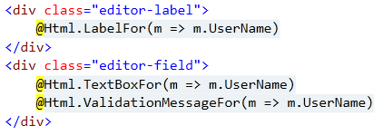
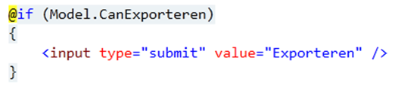
ASP.NET MVC
In samenwerking met:
Razor
jQuery
NuGet
MSDeploy

Slide 12
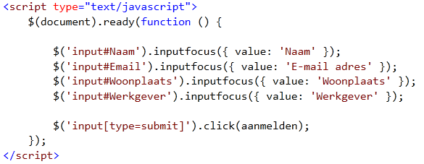
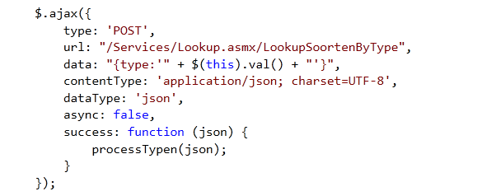
ASP.NET MVC
In samenwerking met:
Razor
jQuery
NuGet
MSDeploy

Slide 13
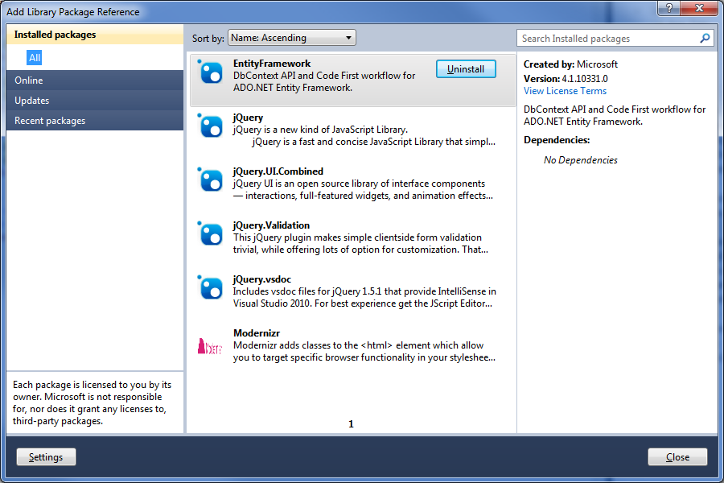
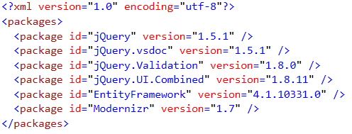
ASP.NET MVC
In samenwerking met:
Razor
jQuery
NuGet
MSDeploy

Slide 14
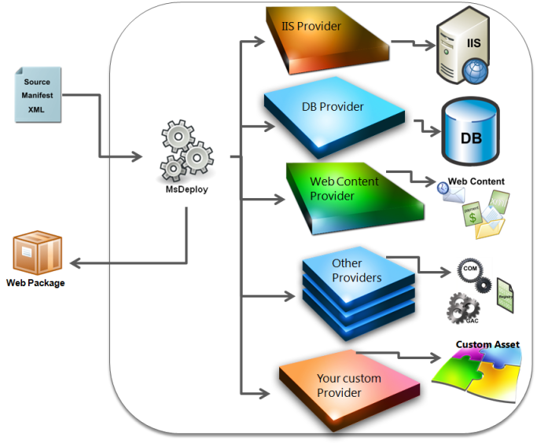
ASP.NET MVC
In samenwerking met:
Razor
jQuery
NuGet
MSDeploy

Slide 15
Patterns, tips & trucs

Slide 16
Patterns, tips & trucs
Simplified example anti-pattern

Slide 17
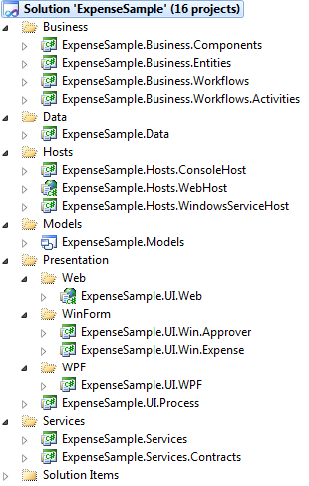
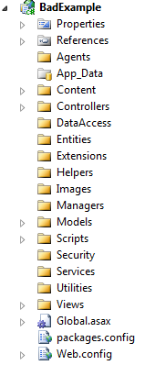
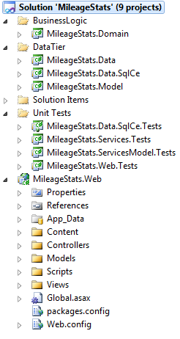
Patterns, tips & trucs
Seperation of concerns principle
Single responsibility principle
Solution
Project

Slide 18
Patterns, tips & trucs
Seperation of concerns principle
Single responsibility principle
Fat controller anti-pattern
Model View Controller pattern
Model
View
Controller
DEMO

Slide 19
Patterns, tips & trucs
Loose coupling pattern
DEMO

Slide 20
Patterns, tips & trucs
Loose coupling pattern
Inversion of control principle
Dependency Injection pattern

Slide 21

Patterns, tips & trucs
Models
Dynamic model
Domain model
View model
DEMO

Slide 22
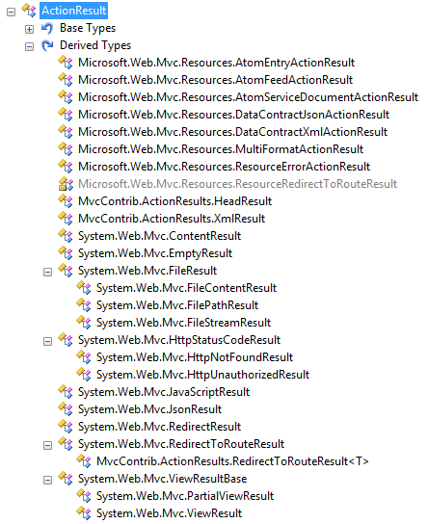

Patterns, tips & trucs
DRY principle
Partial views & actions
ActionResult
Validaties
Required
StringLength
RegularExpression
Remote
DEMO

Slide 23
Patterns, tips & trucs
REST
Resources
HTML
XML
JSON
CSV, Excel
… ?
HTTP
Methods GET, POST< PUIT, DELETE)
Status codes
Content type
DEMO

Slide 24
Patterns, tips & trucs
Javascript & jQuery
Unobtrusive
Graceful degredation of progressive enhancement
Script services

Slide 25
Vragen
Jeroen Swart
.NET architect, Quintor
jswart@quintor.nl
http://blog.codeblack.nl
@codeblacknl

