Slide 1


Embedded systems with the .NET Micro Framework
Rajen Kishna
Technical Evangelist, Microsoft
rajenki@microsoft.com
http://blog.rajenki.com
@rajen_k

Slide 2
Agenda
.NET Micro Framework
Hardware
Setup
Demos

Slide 3
.NET Micro Framework
.NET for embedded systems
300kb footprint
No OS needed
Supports common embedded peripherals and interconnects
flash memory
EEPROM
GPIO
I²C
SPI
Serial port
USB

Slide 4
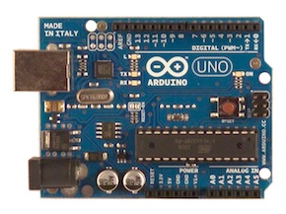
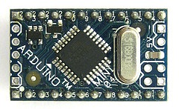
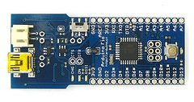
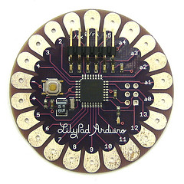
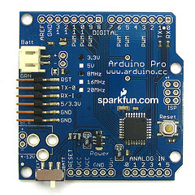
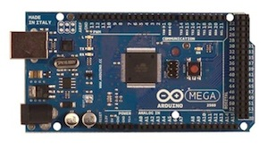
Hardware Arduino

Slide 5
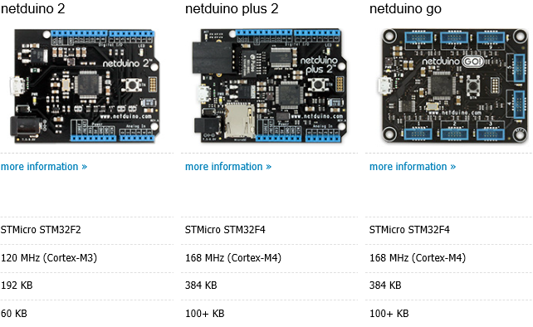
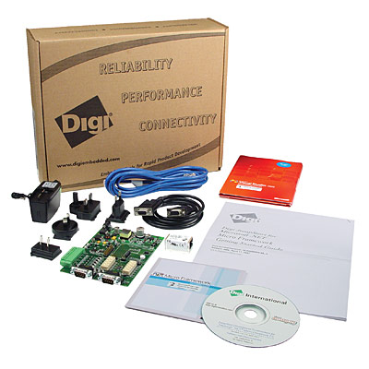
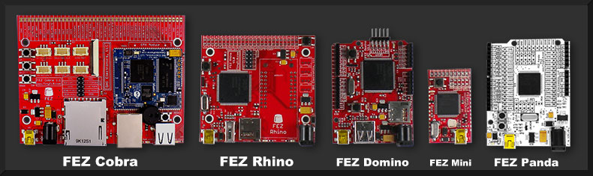
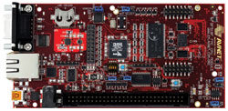
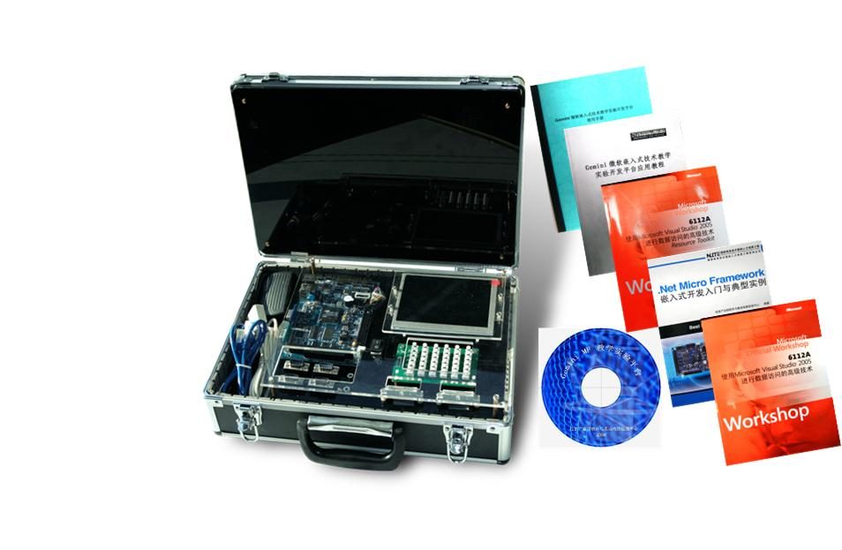
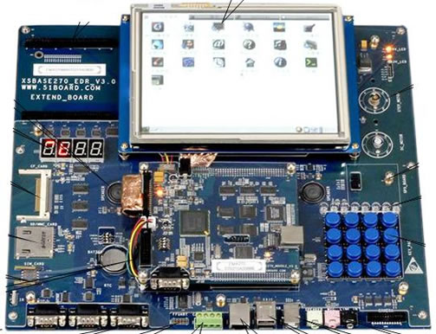
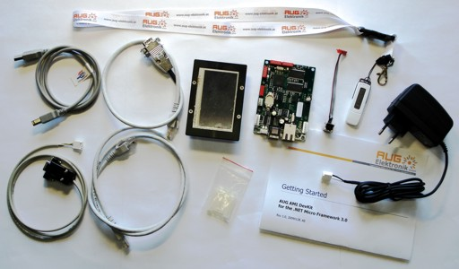
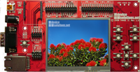
Hardware .NET Micro Framework

Slide 6
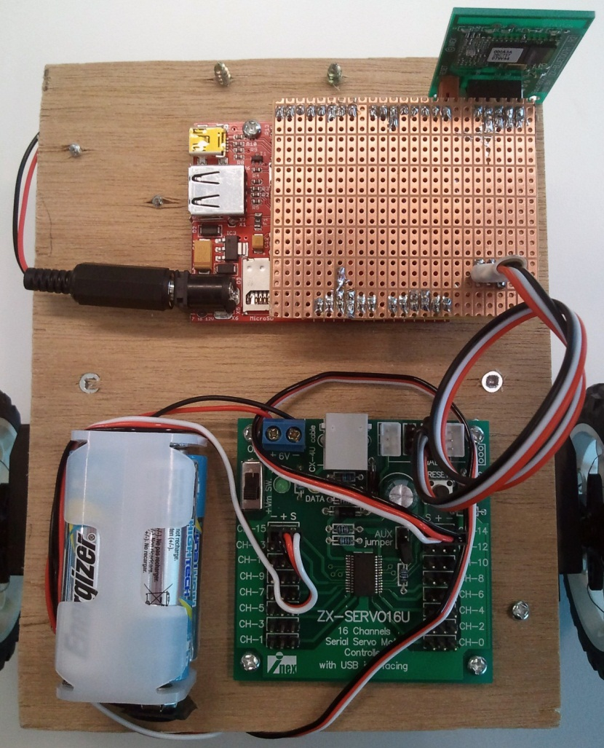
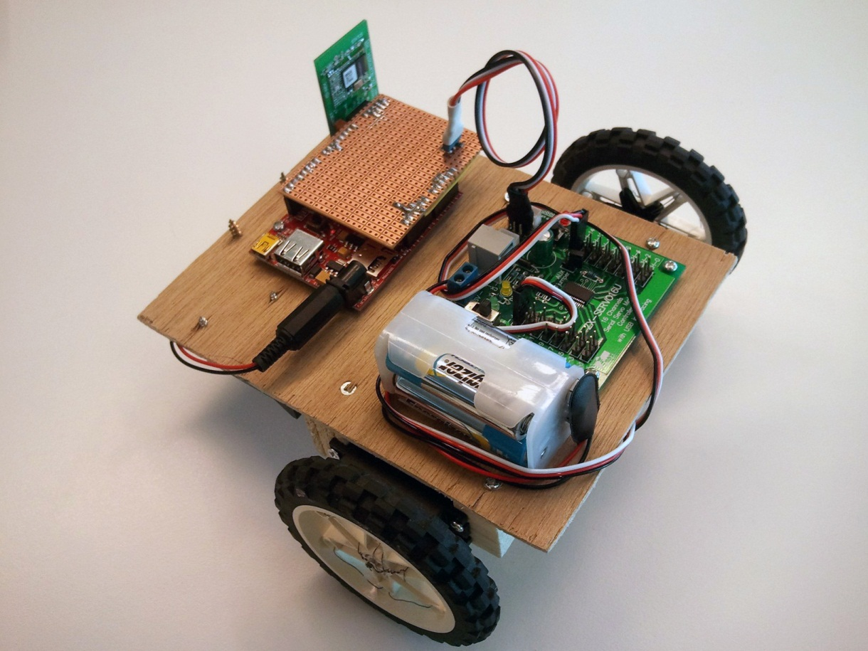
FEZ Wheelbot

Slide 7
Setup
Netduino Plus 2
.NET Micro Framework SDK
netmf.codeplex.com
Netduino SDK
www.netduino.com/downloads/MicroFrameworkSDK_NETMF43.msi
Bluetooth enabled laptop

Slide 8
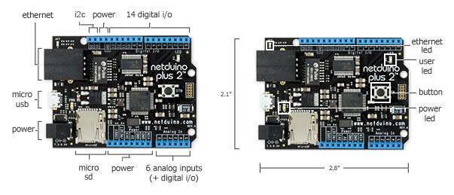
Netduino Plus 2

Slide 9
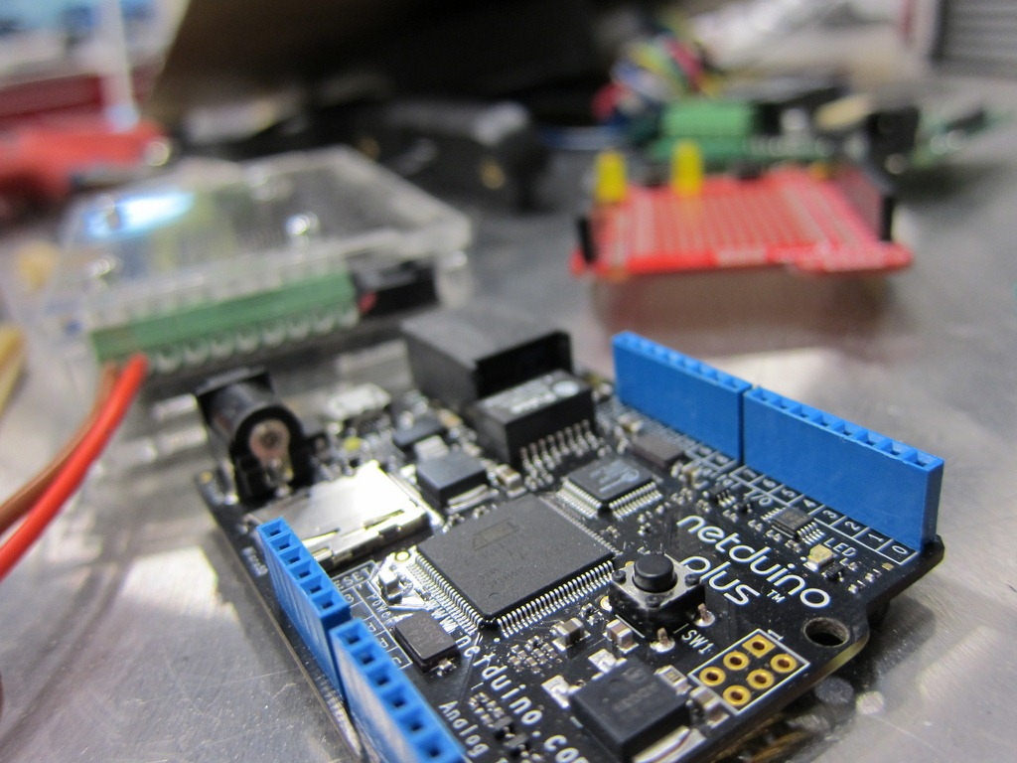
Demos

Slide 10
Questions
rajenki@microsoft.com
http://blog.rajenki.com
@rajen_k

