Slide 1
10 dingen die je niet wist over C#

Slide 2



ALM
Lezen
C#
ALM Ranger
Microsoft
Getrouwd
Auteur

Slide 3
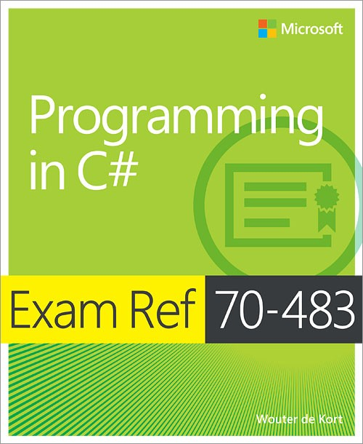

Slide 4


Slide 6
Junior

Slide 7
Medior

Slide 8
Senior

Slide 9


Slide 10
private static string A(string a, string b, string c)
{
string result = "{a:" + a + ", b:" + b + ", c:" + c + "}";
return result;
}
private static string B(string a, string b, string c)
{
StringBuilder sb = new StringBuilder(100);
string result = sb.Append("{a:").Append(a)
.Append(", b:").Append(b)
.Append(", c:").Append(c)
.Append("}")
.ToString();
return result;
}
A
B
A&B

Slide 11
static void Main()
{
CapitalLetters(null);
}
static IEnumerable<char> CapitalLetters(string input)
{
if (input == null)
{
throw new ArgumentNullException(input);
}
foreach (char c in input)
{
yield return char.ToUpper(c);
}
}
Ja
Nee

Slide 12
var result = from i in new List<int> { 0, 1, 2, 3, 4, 5, 6, 7, 8, 9 }
select i;
foreach (var r in result) Console.Write(r);
// Displays 02468
Compiler bug
Extension methods
IL rewriting

Slide 13
var a = "dev";
var b = " Net ";
var c = "Noord";
Console.WriteLine(a + b + c);
// Displays devNetNoord
Wat is var hier?
class
keyword

Slide 14
public class HomeController : Controller
{
public async Task<ViewResult>Index()
{
var pi = await Task.Run<double>(Helper.CalculatePi(1000));
return View(pi);
}
}
asynchroon
synchroon

Slide 15
private async static Task Run()
{
await A(); // A takes 1 second
await B(); // B takes 2 seconds
}
1
2
3

Slide 16
static List<Order> cache;
void Run()
{
if (cache == null)
{
cache = FetchItems();
}
// work with cache
}
1
Ja
Nee

Slide 17
static void Main()
{
int n = 0;
var up = Task.Run(() => {
for (int i = 0; i < 1000000; i++)
n++;
});
for (int i = 0; i < 1000000; i++)
n--;
up.Wait();
Console.WriteLine(n);
}
< 0
0
> 0

Slide 18
static void Foo<T>() where T : new()
{
T t = new T();
Console.WriteLine("ToString: " + t.ToString());
Console.WriteLine("GetHashCode: " + t.GetHashCode());
Console.WriteLine("Equals: " + t.Equals(t));
Console.WriteLine("GetType: " + t.GetType());
}
Foo<int>
Foo<int?>
Foo<string>

Slide 19
static void Foo<T>() where T : new()
{
A: T t = new T();
B: Console.WriteLine("ToString: " + t.ToString());
C: Console.WriteLine("GetHashCode: " + t.GetHashCode());
D: Console.WriteLine("Equals: " + t.Equals(t));
E: Console.WriteLine("GetType: " + t.GetType());
}
A
B
C
D
E

Slide 20
class Base
{
public virtual void Foo(int x) {
Console.WriteLine("Base.Foo(int)");
}
}
class Derived : Base
{
public override void Foo(int x)
{
Console.WriteLine("Derived.Foo(int)");
}
public void Foo(object o)
{
Console.WriteLine("Derived.Foo(object)");
}
}
-2147483639
new Derived().Foo(10);

Slide 21
int i1 = 2147483647 + 10;
Ja
Nee

Slide 22
int ten = 10;
int i2 = 2147483647 + ten;
Ja
Nee

Slide 23
int ten = 10;
int i2 = 2147483647 + ten;
Wat is de uitkomst?

Slide 24
public class Point(int x, int y) { private int x, y; }
public int X { get; } = x;
Do(someEnum);
public void Do(params IEnumerable<Point> points) { ... }
public double Distance => Math.Sqrt((X * X) + (Y * Y));
public Point Move(int dx, int dy) => new Point(X + dx, Y + dy);
var bestValue = points?.FirstOrDefault()?.X ?? -1;
var x = new MyClass(1, "X");
int.TryParse("123", out int x);

Slide 25
Tot zover de quiz

Slide 26

Any fool can know
The point is to understand

Slide 27
Multithreading
Performance
Syntactic sugar

Slide 28
Multithreading

Slide 29
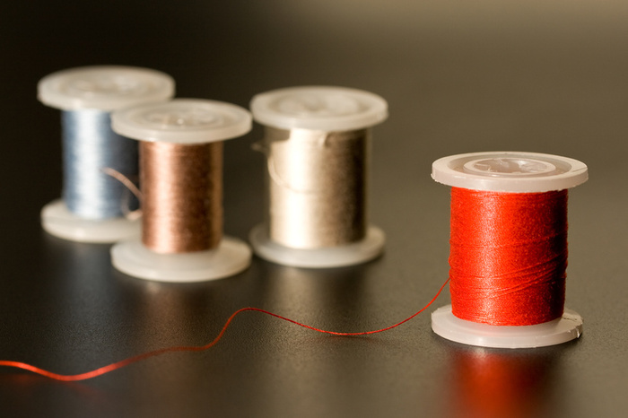

Slide 30
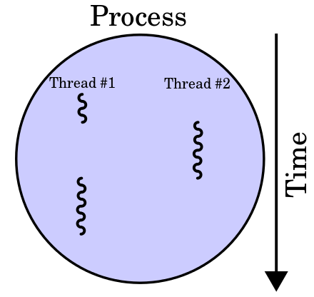

Slide 31
Async en await

Slide 32
Async?
private async static Task<int> RunCPU()
{
string content = await Task.Run<string>(() => "Hello devNetNoord!");
return content.Length;
}
private async static Task<int> RunIO()
{
HttpClient client = new HttpClient();
string result = await client.GetStringAsync("http://www.devnetnoord.nl");
return result.Length;
}

Slide 33
UIThread
Platform
ThreadPool
Client
Server
CPU
I/O
CPU
I/O

Slide 34
Async is niet parallel
private async static Task Run()
{
await A(); // A takes 1 second
await B(); // B takes 2 seconds
}
private async static Task RunParallel()
{
Task a = A(); // A takes 1 second
Task b = B(); // B takes 2 seconds
await Task.WhenAll(a, b);
}

Slide 35
Performance

Slide 36
Generation 2 objects
Allocated
Generation 1 objects
Generation 0 objects
Commited
Uncommited
Free

Slide 37
Boxing & unboxing

Slide 38
class UnmanagedWrapper : IDisposable
{
private IntPtr unmanagedBuffer;
public FileStream Stream { get; private set; }
public UnmanagedWrapper()
{
CreateBuffer();
this.Stream = File.Open("temp.dat", FileMode.Create);
}
private void CreateBuffer() { … }
~UnmanagedWrapper() { Dispose(false); }
public void Close() { Dispose(); }
public void Dispose()
{
Dispose(true);
System.GC.SuppressFinalize(this);
}
protected virtual void Dispose(bool disposing)
{
Marshal.FreeHGlobal(unmanagedBuffer);
if (disposing)
{
if (Stream != null)
{
Stream.Close();
}
}
}
}

Slide 39
using (UnmanagedWrapper u = new UnmanagedWrapper())
{ }

Slide 40
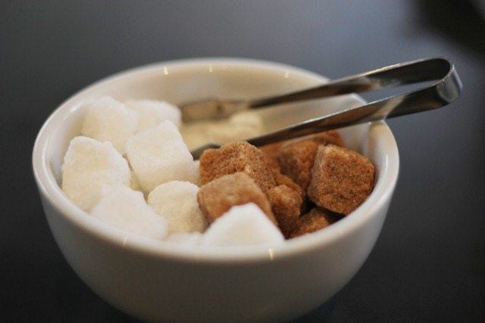
Syntactic sugar

Slide 41
C#
IL
Machine code
var numbers = new List<int> { 1, 2, 3, 4 };
init ([0] class [mscorlib] System.Collections.Generic.List`1<int32> numbers,
[1] int32 n,
[2] class [mscorlib]System.Collections.Generic.List`1<int32> '<>g__initLocal0',
[3] valuetype
mov ecx,79848540h
call FFD2FAC0
mov dword ptr [ebp-5Ch],eax
mov ecx,dword ptr [ebp-5Ch]
call 78BFBF90
mov eax,dword ptr [ebp-5Ch]
mov dword ptr [ebp-44h],eax
mov ecx,dword ptr [ebp-44h]
mov edx,1
cmp dword ptr [ecx],ecx
call 78BE24C0

Slide 42
yield
async & await
foreach
using
lock
Nullable<T>
…

Slide 43
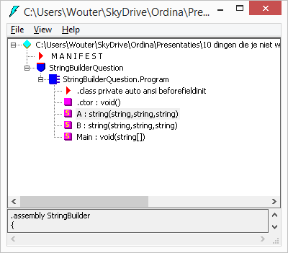
ildasm

Slide 44

En nu?
John Skeet: C# in Depth
Jeffrey Richter: CLR via C#
Eric Lippert: http://ericlippert.com/
Stackoverflow

Slide 46



@wouterdekort
wouter.de.kort@ordina.nl
http://wouterdekort.blogger.com

Slide 47


