Slide 1

Git met Visual Studio en Team Foundation Server
Arjen Steinhauer
Architect, ilionx Software Solution
asteinhauer@ilionx.com
http://www.ilionx.com

Slide 2
Begrippen
VS
TFS
VSO
TFVC
Git
- Visual Studio
- Team Foundation Server
- Visual Studio Online
- Team Foundation Version Control
- Groninger intelligentietest

Slide 3


Agenda
Source control: centraal vs. gedistribueerd
Achtergrond
Hoe werkt Git met VS en TFS/VSO
Git vs. TFVC
Team Foundation Server

Slide 4
Source control mogelijkheden
Plus punten
Beste voor
Centraal Versie
Beheer
check out
↓
edit
↓
check in
Schaalbaar naar zeer grote code-base
Autorisatie
Monitoring gebruik
Grote geïntegreerde code-bases
Gedetailleerde audit trail
edit
↓
merge
↓
commit
Off-line wijzigen mogelijk
Wijzigen buiten de IDE is mogelijk (VS, Eclipse, …)
Middel grote geïntegreerde code-bases
Gedetailleerde audit trail
Gedistribueerd
Versie Beheer
100% off-line
Complete repository met historie
Simpel branching model
Modulaire code-bases
Integratie met open-source
Gedistribueerde teams

Slide 5
Source control mogelijkheden
Centraal
Versie Beheer
Team Foundation
Source Control
Gedistribueerd
Versie Beheer

Slide 6
Waarom de keuze voor Git?
Het meest gebruikte gedistribueerd versie beheer is Git
GitHub
Git wordt gebruikt voor deployment
Git kan op verschillende platvormen worden gebruikt
Gebouwd voor Linux en Mac
Windows kan beter

Slide 7

Git is volledig geïntegreerd in Visual Studio en
Team Foundation Server / Visual Studio Online

Slide 8

Branch strategie
2.0
2.1
1.0
1.1
1.2
master
feature A
f. C
feature B
f. D
sprint 1
sprint 2
sprint 3

Slide 9
Branch strategie
2.0
2.1
1.0
1.1
1.2
master
dev/test
feature A
f. C
feature B
f. D

Slide 10
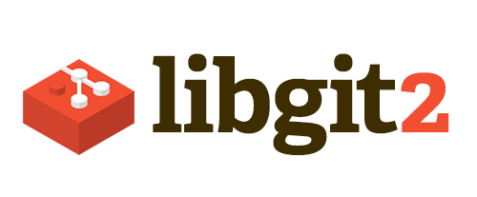
Git implementatie
Laag tussen TFVC en Git?
Git for Windows?
Open source library:
Nee!
Nee!

Slide 11
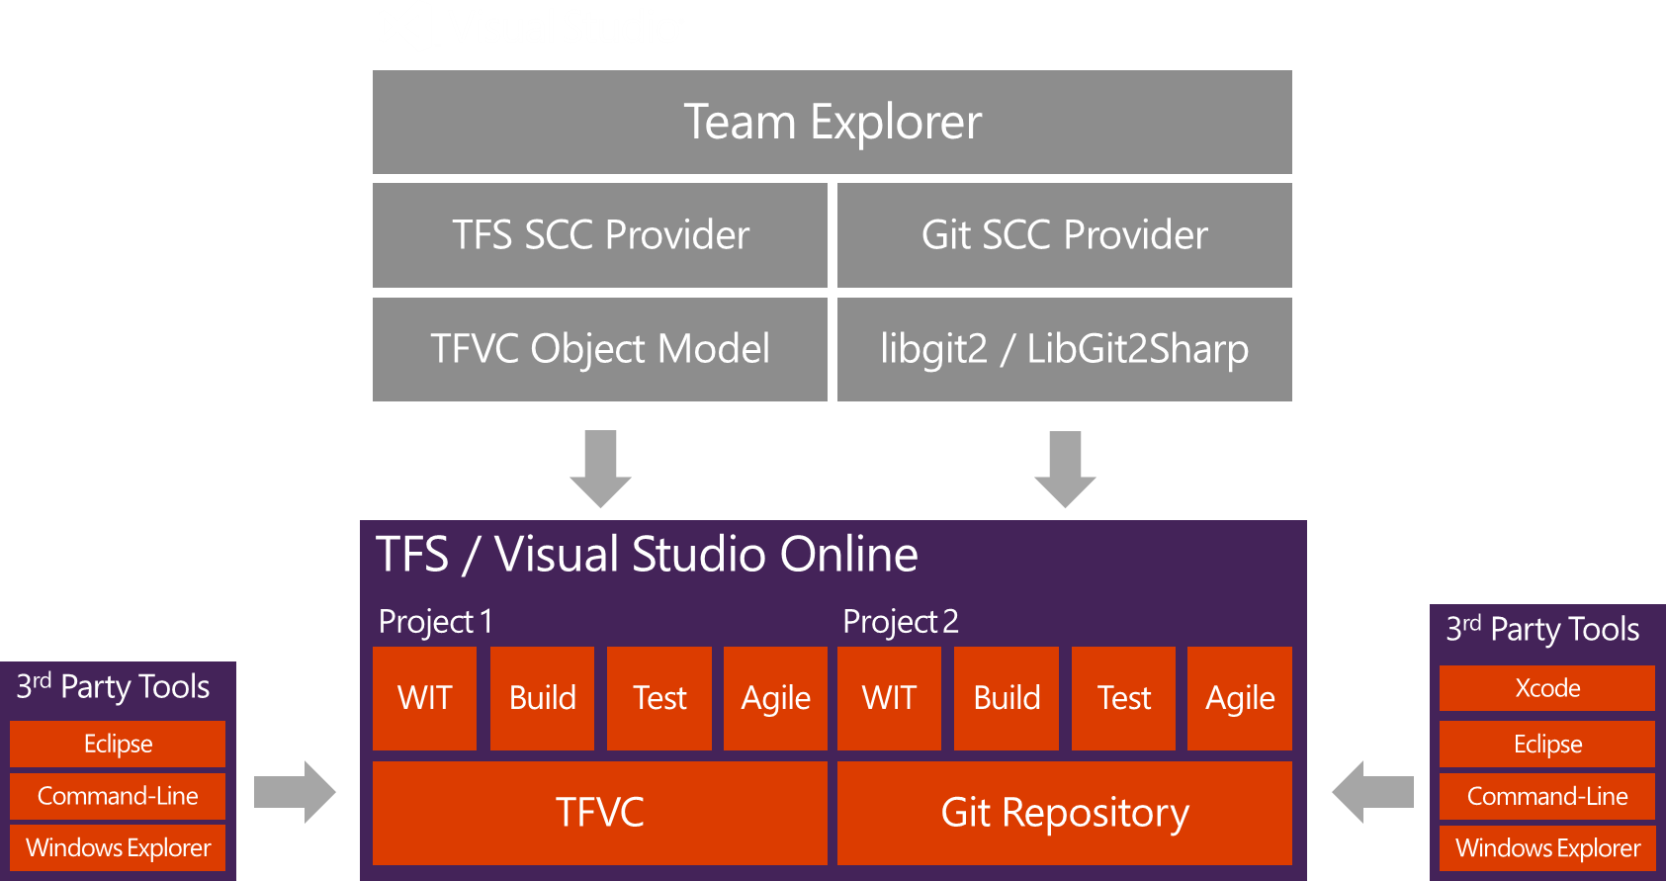
Git in Visual Studio

Slide 12
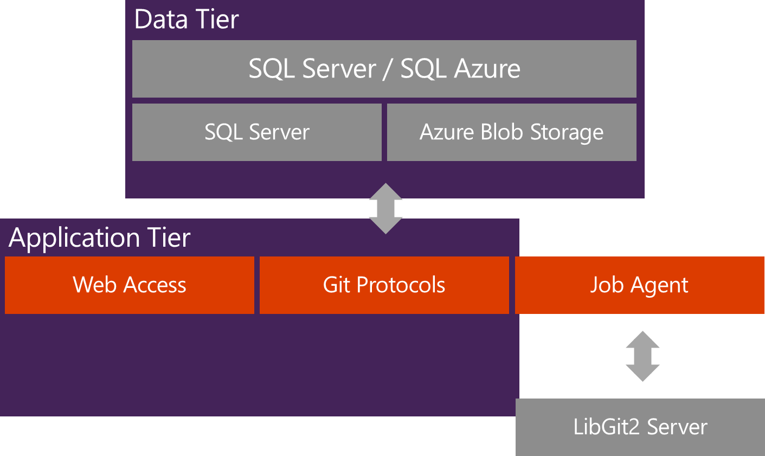
Git in TFS/VSO

Slide 13
Git vs. TFVC
(1 v/d 9)
Capability | TFVC | Git
Alerts | Team members can receive email alerts when check-ins occur. | Team members can receive email alerts when commits are pushed to the server.
Auditability | Because your team checks in all their work into a centralized system, you can identify which user checked in a changeset and use compare to see what they changed. Looking at a file, you can annotate it to identify who changed a block of code, and when they did it. | You can identify which user pushed a commit to TFS. (Anyone can claim any identity as the author or committer.) You can identify when changes were made what was changed using history, compare, and annotate.

Slide 14
Git vs. TFVC
(2 v/d 9)
Capability | TFVC | Git
Branching | Path-based branches are used mostly as long-standing constructs to isolate risk of change among feature teams and releases. Team members typically set up an additional workspace for each branch they work on. Changes in each branch are independent from each other, so you don’t have to check them in before switching from one branch to another. Merging between sibling branches requires a baseless merging. | Branching is lightweight and path independent. Many developers create a branch for each new feature they are coding, sometimes on a daily basis. You can quickly switch from one branch to another to pivot among different variations of your codebase. You can create branches that exist only on your dev machine and share them if and when you’re ready. You must commit, branch, stash, or undo changes before switching branches. Merging is simple and independent of the commit that the branch is based on.

Slide 15
Git vs. TFVC
(3 v/d 9)
Capability | TFVC | Git
Branching (continued…) | You can get visualizations of your branch structures and where your changesets have been merged. See Use branches to isolate risk in Team Foundation Version Control. | You can compare branches to see which commits exist on which branches. See Use Git branches to switch contexts, suspend work, and isolate risk.
Builds | You can use all TFBuild capabilities to build any combination of content you want within the team project collection. | You can use most TFBuild capabilities to build one team project at a time, and one or more repositories at a time. Gated check-in builds aren’t available yet. Symbols can be published, but they are not indexed yet.

Slide 16
Git vs. TFVC
(4 v/d 9)
Capability | TFVC | Git
Changes | Team members can concurrently change files on their dev machines. You upload (check-in) changesets to the server when you create them. You can upload your changes at any time. However, you might be interrupted by conflicts. You can change the comment of a changeset after you check it in. You can link changesets to work items and associate them with completed builds. | Team members can concurrently change files on their dev machines. You create commits on your dev machine independently of contributing them to the team. When you’re ready you must pull the latest commits before you upload (push) yours to the server. When you pull, you might be interrupted by conflicts. You can amend the latest local commit. You cannot change older commits. You can link commits to work items and associate them with completed builds. You can modify and combine local commits from the command prompt.

Slide 17
Git vs. TFVC
(5 v/d 9)
Capability | TFVC | Git
Code reviews | Yes; see Day in the life of an ALM Developer: Suspend work, fix a bug, and conduct a code review. For more lightweight discussions, you can also comment on and send email about a changeset from the web portal. | Yes; see Conduct a pull request. For more lightweight discussions, you can also comment on and send email about a commit from the web portal.
Conflict resolution | You might have to resolve conflicts when you get, check in, merge, or unshelve. You can resolve all types of conflicts in Visual Studio. | You might have to resolve conflicts when you pull or merge. You can resolve content conflicts in Visual Studio. Other types of conflicts can be resolved from the command prompt.

Slide 18
Git vs. TFVC
(6 v/d 9)
Capability | TFVC | Git
File storage | You can check in large binary files. You might also want to use NuGet in combination or as an alternative. | You can check in small binary files. Avoid checking in large binary files, especially those that you modify often. If possible, use NuGet as an alternative to checking in binary files.
File on Server | Each team project contains all files under a single root path (for example: $/FabrikamTFVC). You can apply permissions at the file level. You can lock files. You can browse your files on the web portal and using Source Control Explorer in Visual Studio. Your team project exists on only one server. | Each team project can contain one or more Git repositories and each Git repository can contain one or more branches. The most granular permissions you can apply are to a repository or a branch. Files cannot be locked. You can browse your files on the web portal. You can push commits to multiple remote repositories.

Slide 19
Git vs. TFVC
(7 v/d 9)
Capability | TFVC | Git
Files on DEV | You can browse your files using Source Control Explorer in Visual Studio, or using Windows File Explorer or the command prompt. | You can browse your files using Windows File Explorer or the command prompt. You cannot yet browse files in Visual Studio.
Manage work on your dev machine | Pending changes and my work pages. | Changes, commits, and branches pages.
Suspend your work | You can suspend from my work page or shelve your changes. | You can create a branch from (from Visual Studio or the command prompt) or stash (from the command prompt)
Tag your files | You can apply labels to a version of one or more files from either Visual Studio or the command prompt. Each file can have label applied to a different version. | You can apply tags from the command prompt to individual commits. View tags in the Visual Studio history window.

Slide 20
Git vs. TFVC
(8 v/d 9)
Capability | TFVC | Git
History | File history is not replicated on the client dev machine and so can be viewed only when you’re connected to the server. You can view history in Visual Studio and on the web portal. You can annotate files to see who changed a line, and when they changed it. | File history is replicated on the client dev machine and can be viewed even when not connected to the server. You can view history in Visual Studio and on the web portal. You can annotate files to see who changed a line, and when they changed it.
Roll back changes | You can roll back one or more changesets. | You can revert a commit.
Scale | You can work on small or very large scale projects using local workspaces. Supports massive scale (millions of files per branch and large binary files) projects using server workspaces. | You can quickly begin small projects. You can scale up to very large projects, but you have to plan ahead to modularize your codebase. You can create multiple repositories in a team project.

Slide 21
Git vs. TFVC
(9 v/d 9)
Capability | TFVC | Git
Quality gates | You can use CI builds, gated check-in builds and check-in policies. | You can use CI builds. Gated check-in builds aren’t available yet.
Visual Studio compatibility | All versions of Visual Studio. | Git is built into with Visual Studio 2015 and Visual Studio 2013. You can also use Visual Studio 2012 Update 4 (you must also install Visual Studio Tools for Git).
Release Management | When using vNext deployment, every release contains the change history (backlog items) | Change history (backlog items) in every release is not supported yet.

Slide 22
Adoptie van Git
Git is anders dan TFVC
Neem de tijd om te wennen
Neem de tijd om te onderzoeken
Migratie van historie is mogelijk: Git-TF
Is het nodig om historie mee te nemen?
Let op bij grote source repositories
Verwijder project references over solutions en binaire references → NuGet
Refactor naar componenten
MSDN (https://msdn.microsoft.com/en-us/Library/vs/alm/code/overview)
Third-party Git tools (http://www.woodwardweb.com/)

Slide 23


