Slide 1
CashFlow API Architecture - Overview
We use two microservices:
cashflow-api handles transaction creation (debit/credit) on the primary database.
cashflow-report-api generates user reports using the read replica.
With this aproach, we have:
Scalable: separates heavy read traffic from writes
Resilient: reports dont affect core operations
Faster: avoids performance hits on the primary DB
Safer maintenance: optimize replica independently
Secure: follows clear roles and access policies

Slide 2
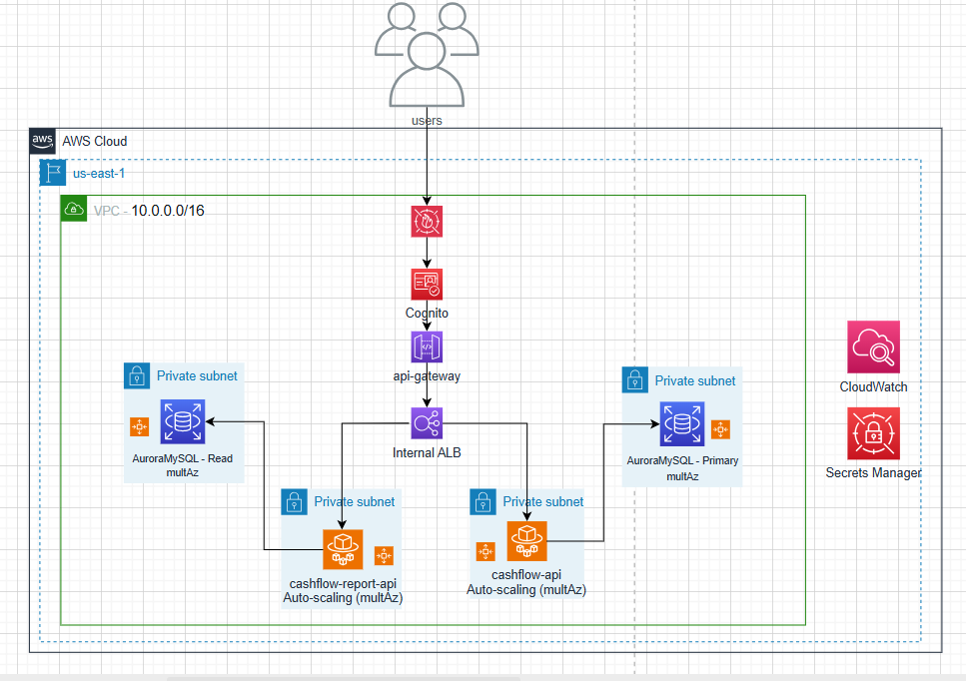
Architecture Overview

Slide 3
Current Decisions - Scalability / Resilience
Health check on ecs task
ECS Fargate for apis with auto scale
RDS MySQL primary with Read Replica
RDS with MultAZ deployment
Balancing requests with ALB

Slide 4
Current Decisions - Security / Observability
Cognito for JWT authentication
Web Application Firewall
Shield to prevent DDoS (Standard mode)
CloudWatch for logging & monitoring
Secrets Manager for credentials
One public entry point

Slide 5
Future Considerations
Migrate to Aurora Multi-AZ
RDS Proxy
Implement VPC Endpoints for AWS services
Enable Shield Advanced, mTLS on API GW
Add X-Ray tracing & custom dashboards
Cloudformation on other resources (Aurora, etc)
Elasticache
Custom cloudwatch alarms
CI/CD with cloudformation + github actions

