Slide 1
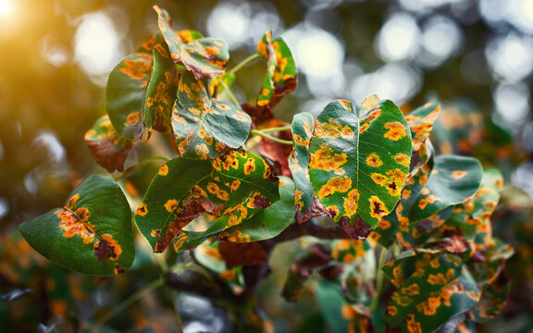
COMPUTER VISION · PYTORCH · STREAMLIT
Crop Disease
Prediction System
Upload a photo of a leaf. In under a second, get the disease name and a treatment plan written in Hindi — an end-to-end pipeline built for smallholder farmers.
Saksham Agrawal · Project walkthrough · August 2026
A 31-slide walkthrough, including every plot from the model benchmark notebook.

Slide 2
INTRODUCTION
A sick leaf is a race against time
Fungal and bacterial leaf diseases spread through a field in days. By the time symptoms are unmistakable to the eye, treatment options have narrowed — and most farmers don’t have an agronomist on call. They have a phone.
Manual inspection doesn't scale
Expert advice is hard to reach
Generic advice wastes chemicals
A few visible spots on one leaf can mean a field-wide infection is already underway by the time it's noticed.
Agricultural extension officers cover hundreds of farms. A photo travels faster than a visit ever can.
The right fungicide depends on the exact disease — not just a vague sense that “something is wrong.”
Goal — turn one leaf photo into an instant, specific diagnosis and a locally-relevant treatment plan, in the farmer’s own language.
CROP DISEASE PREDICTION SYSTEM · INTRODUCTION
02 / 31

Slide 3
AT A GLANCE
What we built
38
87,900
94.59%
disease classes across
14 crop species
labelled leaf images in the
training corpus
macro-F1 — the metric that
crowned it the winner
95.51%
2
हिं
test accuracy in the independent
architecture benchmark
candidate architectures — Custom
CNN & EfficientNetB3
treatment guidance written in
Hindi, for every class
CROP DISEASE PREDICTION SYSTEM · AT A GLANCE
03 / 31

Slide 4
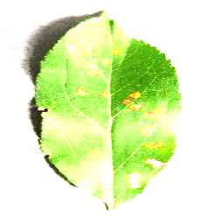
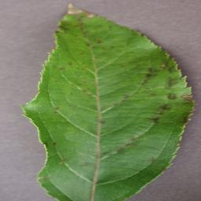
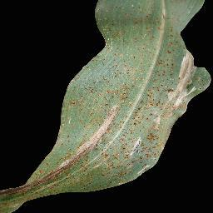
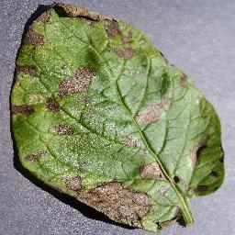
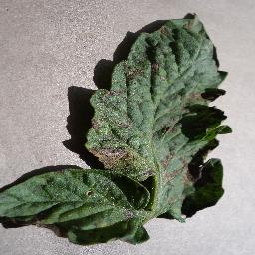
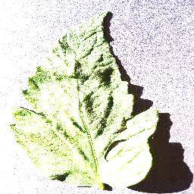
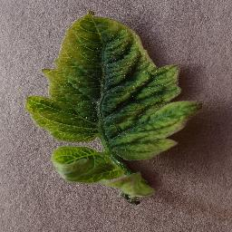
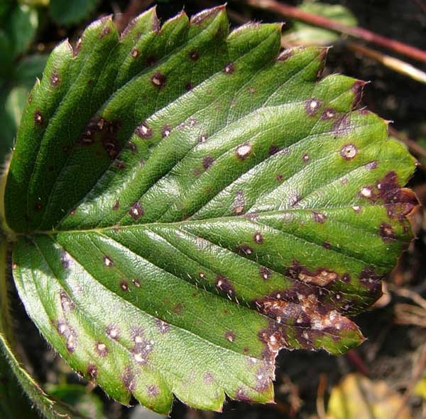
METHODOLOGY · DATASET
87,900 leaf photos, 38 diagnoses
Training data is the augmented PlantVillage corpus — laboratory photos of single leaves, isolated on a plain background, spanning 14 crop species from apple to tomato. The split below is the one documented on the app's own About page.
70,295
17,572
33
training images
validation images
held-out test images
Apple · Cedar rust
Apple · Scab
Corn · Common rust
Potato · Early blight
Tomato · Early blight
Tomato · Healthy
Tomato · Yellow curl virus
Strawberry · Leaf scorch
Note — lab photos on a plain background; see the honesty check near the end of this deck.
CROP DISEASE PREDICTION SYSTEM · DATASET
04 / 31

Slide 5
METHODOLOGY
From raw photos to a shipped prediction
1
2
3
4
5
6
7
Collect
Audit
Split
Augment
Train
Evaluate
Deploy
87,900 leaf photos
38 class folders
integrity scan,
dedupe, class EDA
stratified
70 / 15 / 15
flip · rotate
zoom (train only)
Adam +
OneCycleLR
accuracy · F1
calibration
Streamlit +
Hindi guidance
Raw PlantVillage photos are audited, stratified, augmented, and used to train a residual CNN, which is scored on a held-out set before being wrapped in the Streamlit app a farmer actually opens.
CROP DISEASE PREDICTION SYSTEM · METHODOLOGY
05 / 31

Slide 6
MODEL DESCRIPTION
Two candidate architectures
What the app is built around
Benchmarked, not used in the shipped app
Custom CNN
EfficientNetB3
Framework: TensorFlow/Keras · Input: 224×224 RGB · Output: softmax classifier
Framework: TensorFlow/Keras (ImageNet-pretrained) · Input: 224×224 RGB · Output: softmax classifier
Six conv blocks (64→128→128→256→512→512 filters), each two Conv2D(3×3) + BatchNorm, then max-pooled → Flatten → Dense(256) → Dense(64) → Dropout(0.3) → softmax. ~10.9M parameters, all trained from scratch.
EfficientNetB3 backbone (386 layers, ImageNet weights, frozen) feeding a Dense(256) → Dropout(0.3) → softmax head — only the ~397K head parameters are trained.
Trained end-to-end with no pretrained weights — and still beat a frozen ImageNet backbone on every metric in the benchmark.
A standard transfer-learning baseline: strong out of the box, but its frozen ImageNet features placed second — 87.10% vs. the custom CNN’s 95.51% test accuracy in the benchmark.
CROP DISEASE PREDICTION SYSTEM · MODEL DESCRIPTION
06 / 31

Slide 7
METHODOLOGY · BENCHMARK
Proving the architecture choice, rigorously
The production log only captures a few epochs, so a separate benchmark notebook re-runs the same two-architecture idea — a residual/VGG-style CNN vs. a pretrained EfficientNetB3 — on a clean, leakage-checked 70/15/15 split of a 15-class PlantVillage subset (pepper, potato, tomato · 20,624 images), scored against a full evaluation suite instead of accuracy alone.
Metric | Why it's here
Accuracy | the headline number — but flattered by class imbalance
Balanced accuracy / macro-F1 | treats a 152-image class as equal to a 3,200-image one
Top-3 accuracy | useful for a UI that could surface three candidate diagnoses
Cohen's κ / MCC | agreement corrected for chance; robust under skew
ROC-AUC / PR-AUC | threshold-free ranking quality, one-vs-rest
Log-loss / calibration (ECE) | is the model's confidence trustworthy, not just its top guess
Zero leakage
Train/val/test share no files — checked by exact set intersection before training started.
0.07% duplicates
14 exact-duplicate images found by hash across 20,638 files, all removed before splitting.
21.1× imbalance
Largest class had 3,208 images, smallest 152 — handled with per-class loss weighting.
CROP DISEASE PREDICTION SYSTEM · BENCHMARK METHODOLOGY
07 / 31

Slide 8
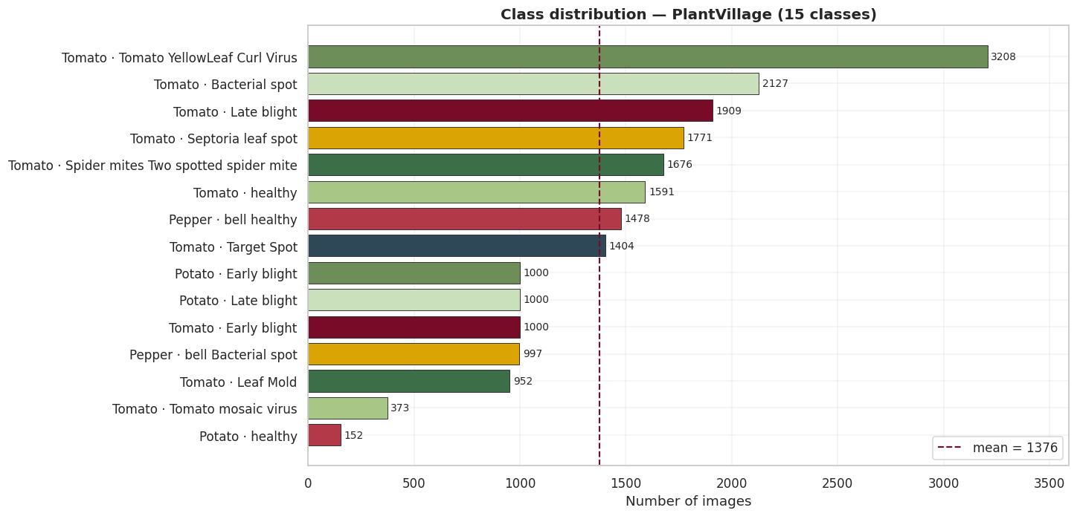
BENCHMARK · EDA
Class distribution across the 15 benchmark diseases
Largest class 3,208 images, smallest 152 — a 21.1× spread: real, but moderate.
CROP DISEASE PREDICTION SYSTEM · CLASS DISTRIBUTION ACROSS THE 15 BENCHMARK DISEASES
08 / 31

Slide 9
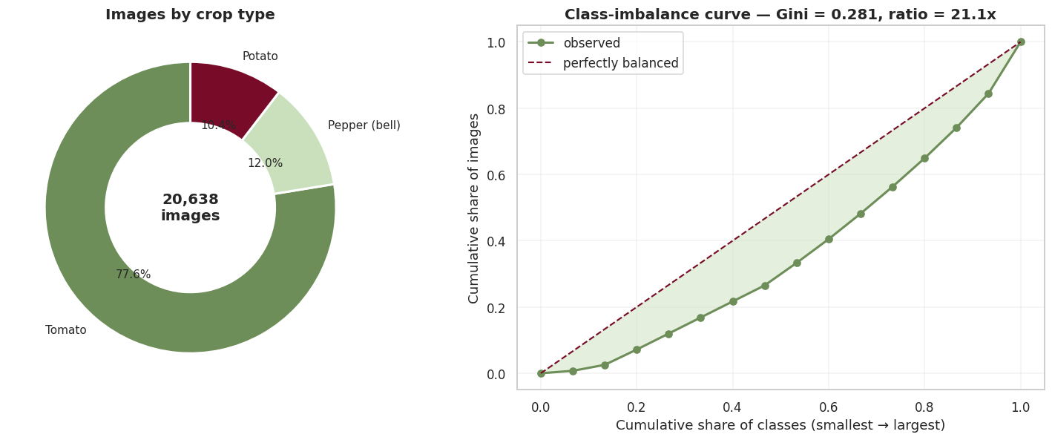
BENCHMARK · EDA
How skewed is skewed? The imbalance curve
The Gini coefficient quantifies the gap from perfectly balanced classes — the gap that per-class loss weighting corrects for.
CROP DISEASE PREDICTION SYSTEM · HOW SKEWED IS SKEWED? THE IMBALANCE CURVE
09 / 31

Slide 10
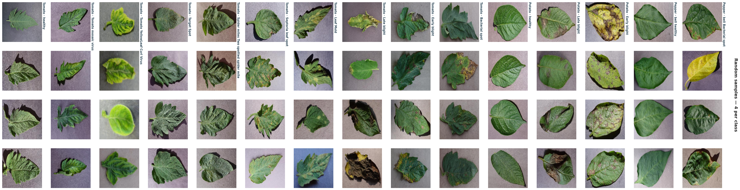
BENCHMARK · EDA
What the model actually sees — four samples per class
Rotated 90° to fit — uniform framing across every class is why field photos need separate validation (see slide 30).
CROP DISEASE PREDICTION SYSTEM · WHAT THE MODEL ACTUALLY SEES — FOUR SAMPLES PER CLASS
10 / 31

Slide 11
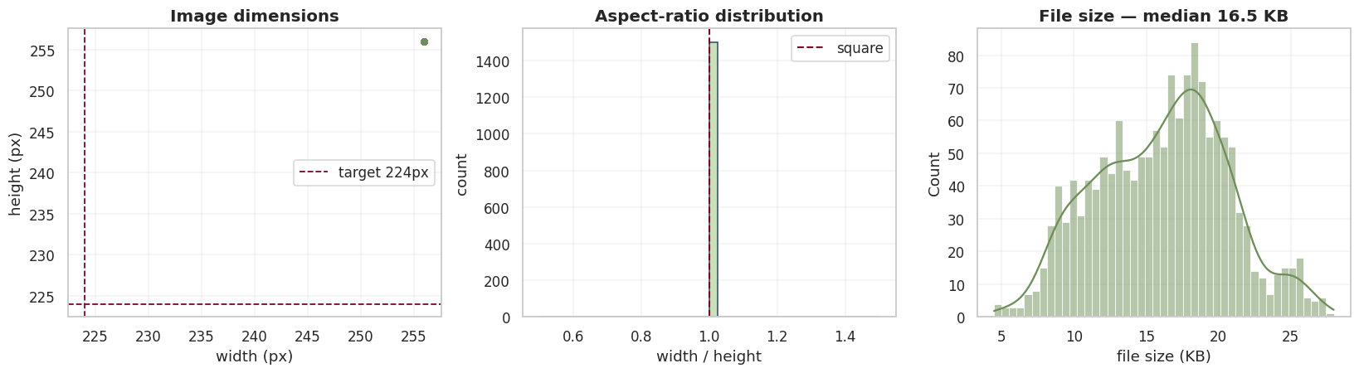
BENCHMARK · EDA
Are all 20,624 images even the same shape?
Every image resolves to 256×256 RGB — resizing to the 224px model input costs almost nothing and distorts no class more than another.
CROP DISEASE PREDICTION SYSTEM · ARE ALL 20,624 IMAGES EVEN THE SAME SHAPE?
11 / 31

Slide 12
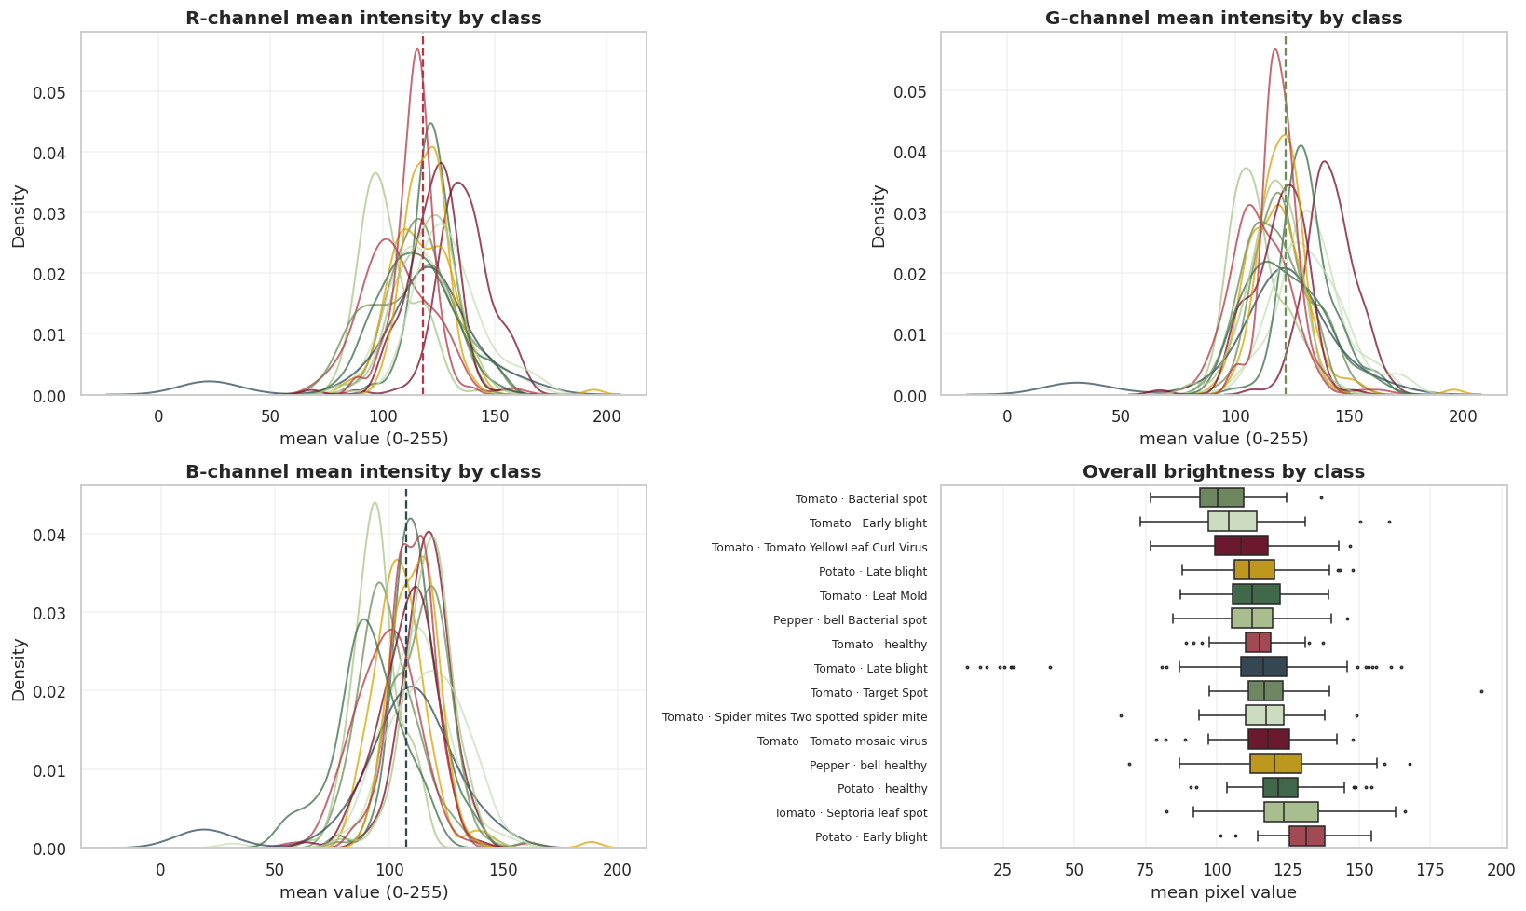
BENCHMARK · EDA
Colour and brightness — signal, or shortcut?
Per-channel intensity overlaps heavily across classes, so this isn't a task a colour histogram could solve alone — convolutional features are warranted.
CROP DISEASE PREDICTION SYSTEM · COLOUR AND BRIGHTNESS — SIGNAL, OR SHORTCUT?
12 / 31

Slide 13
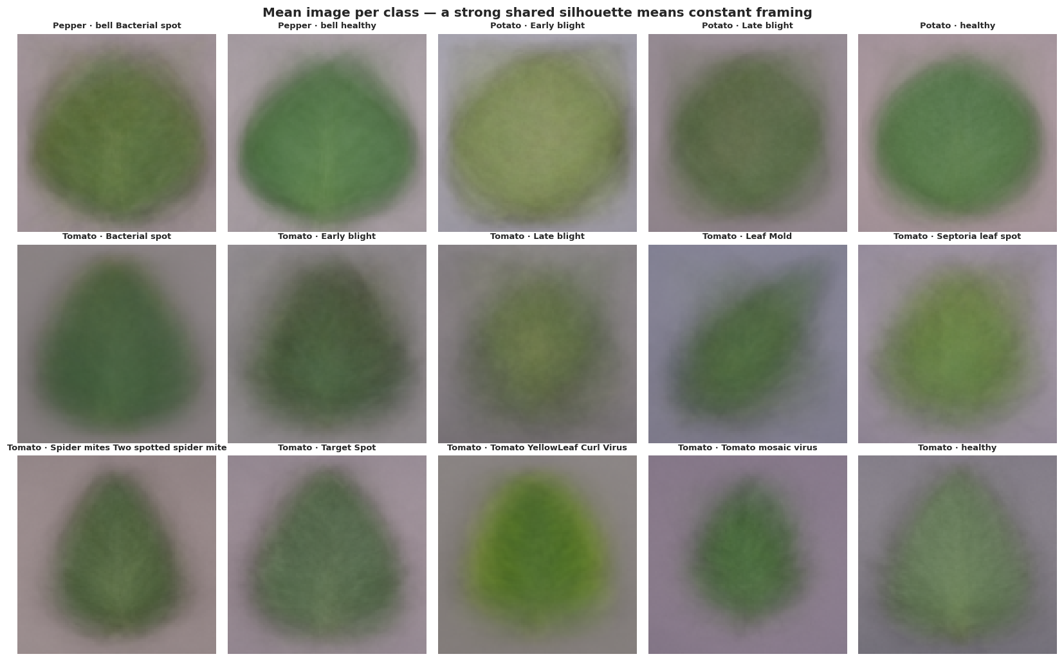
BENCHMARK · EDA
The mean image per class — checking for a background shortcut
A shared centred-leaf-on-grey-background composition across every class — a known PlantVillage limitation, addressed on the roadmap slide.
CROP DISEASE PREDICTION SYSTEM · THE MEAN IMAGE PER CLASS — CHECKING FOR A BACKGROUND SHORTCUT
13 / 31

Slide 14
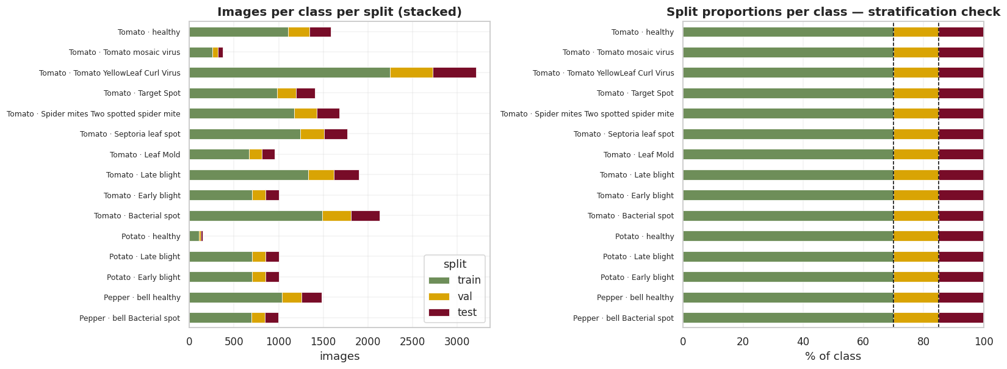
BENCHMARK · SPLIT
Stratified 70 / 15 / 15 — verified, not assumed
Every class keeps its proportions across all three splits; dashed lines mark the 70% and 85% cumulative targets.
CROP DISEASE PREDICTION SYSTEM · STRATIFIED 70 / 15 / 15 — VERIFIED, NOT ASSUMED
14 / 31

Slide 15
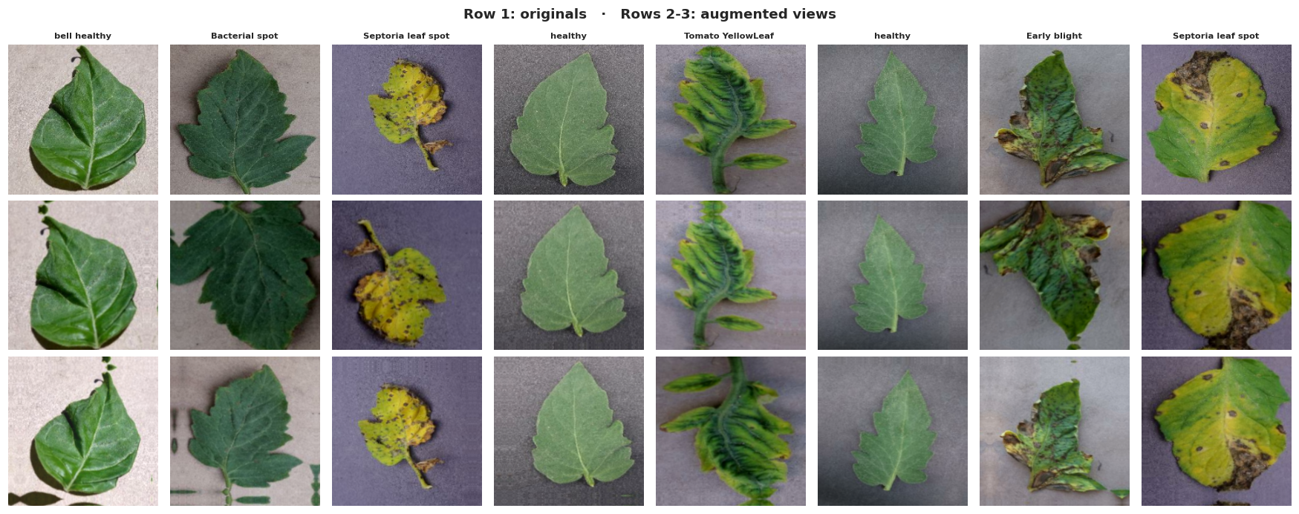
BENCHMARK · PIPELINE
Augmentation — the label has to survive the transform
Row 1: originals. Rows 2–3: flipped, rotated, zoomed and colour-jittered views used only for the training split.
CROP DISEASE PREDICTION SYSTEM · AUGMENTATION — THE LABEL HAS TO SURVIVE THE TRANSFORM
15 / 31

Slide 16
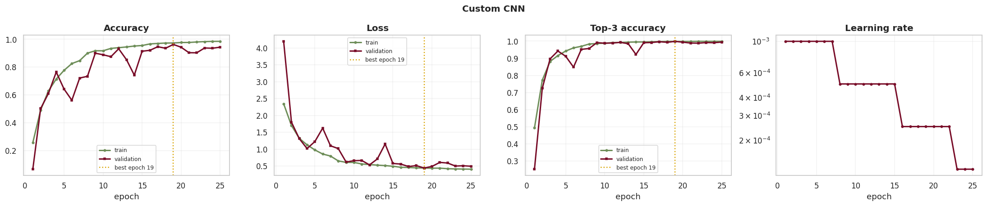
BENCHMARK · TRAINING
Learning curves — Custom CNN
Final train/validation accuracy gap +4.2 pp — mild overfitting, reined in by early stopping on validation loss.
CROP DISEASE PREDICTION SYSTEM · LEARNING CURVES — CUSTOM CNN
16 / 31

Slide 17
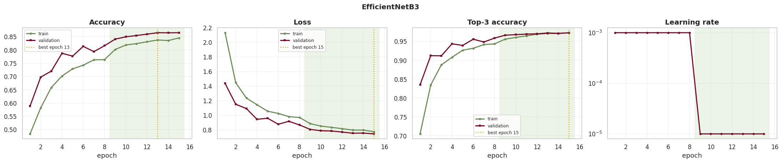
BENCHMARK · TRAINING
Learning curves — EfficientNetB3
Shaded region marks stage 2 (fine-tuning); train/val gap −2.0 pp — a healthier fit than the from-scratch CNN, at a lower ceiling.
CROP DISEASE PREDICTION SYSTEM · LEARNING CURVES — EFFICIENTNETB3
17 / 31

Slide 18
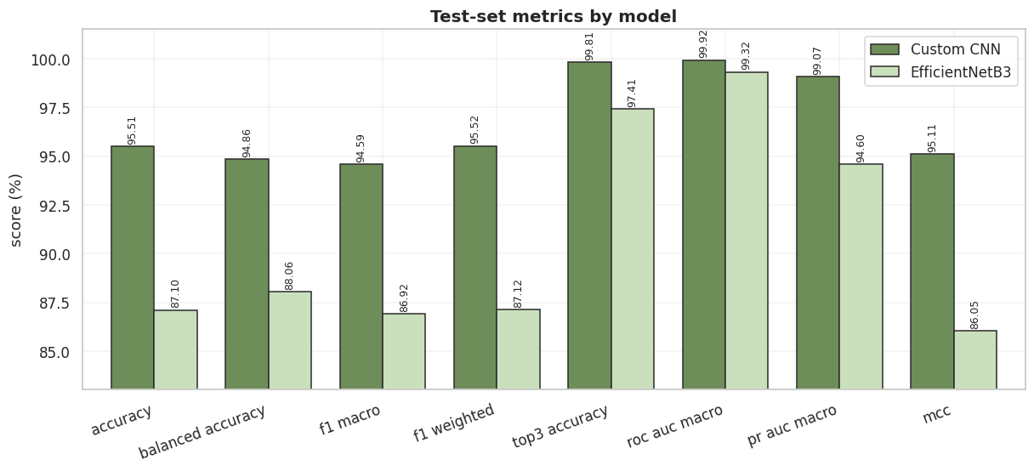
BENCHMARK · RESULTS
Head-to-head on the held-out test set
Across every metric — accuracy, balanced accuracy, macro/weighted F1, top-3, ROC-AUC, PR-AUC, MCC — the custom CNN leads.
CROP DISEASE PREDICTION SYSTEM · HEAD-TO-HEAD ON THE HELD-OUT TEST SET
18 / 31

Slide 19
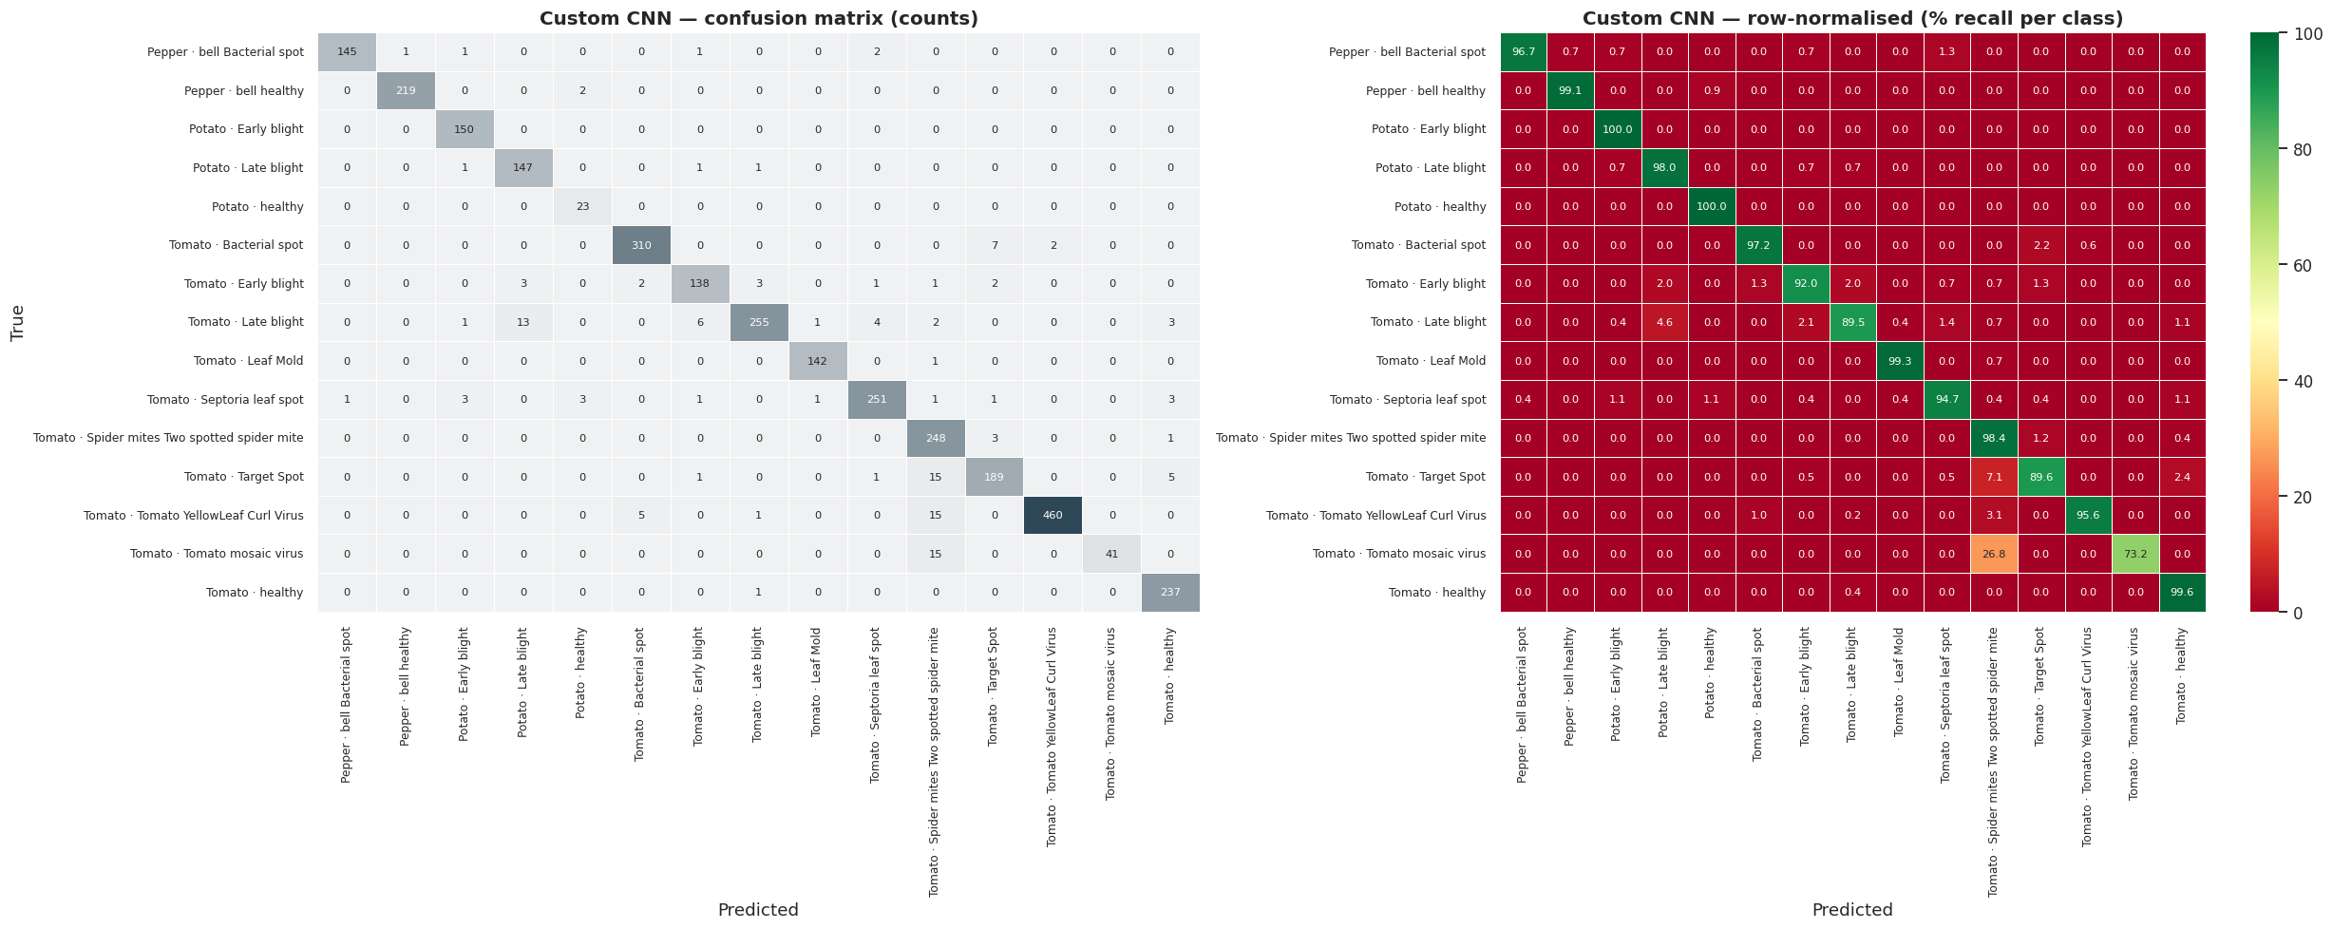
BENCHMARK · RESULTS
Confusion matrix — Custom CNN
Errors cluster on genuinely similar-looking pairs: Tomato mosaic virus and Target Spot both get mistaken for spider-mite damage.
CROP DISEASE PREDICTION SYSTEM · CONFUSION MATRIX — CUSTOM CNN
19 / 31

Slide 20
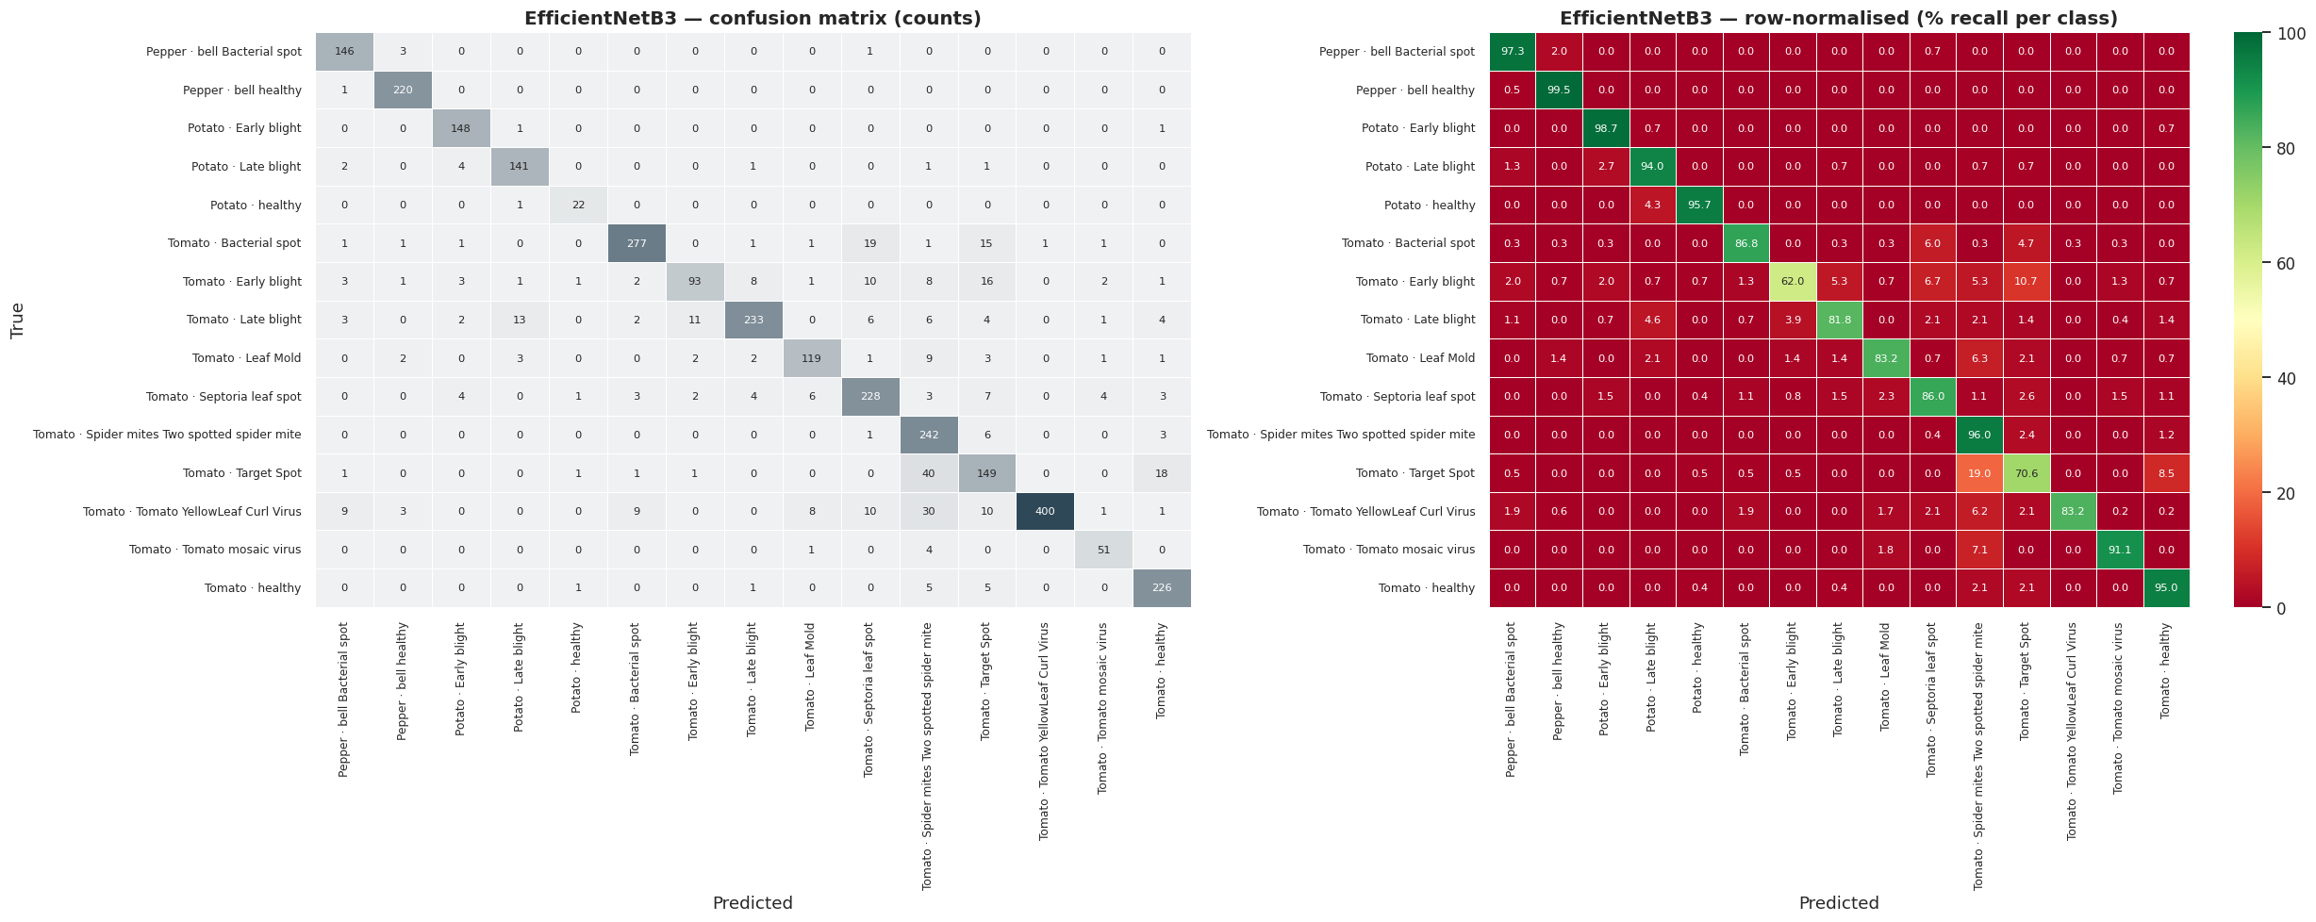
BENCHMARK · RESULTS
Confusion matrix — EfficientNetB3
Same confusion pattern, higher volume — e.g. 40 Target Spot images mistaken for spider-mite damage, versus 15 for the custom CNN.
CROP DISEASE PREDICTION SYSTEM · CONFUSION MATRIX — EFFICIENTNETB3
20 / 31

Slide 21
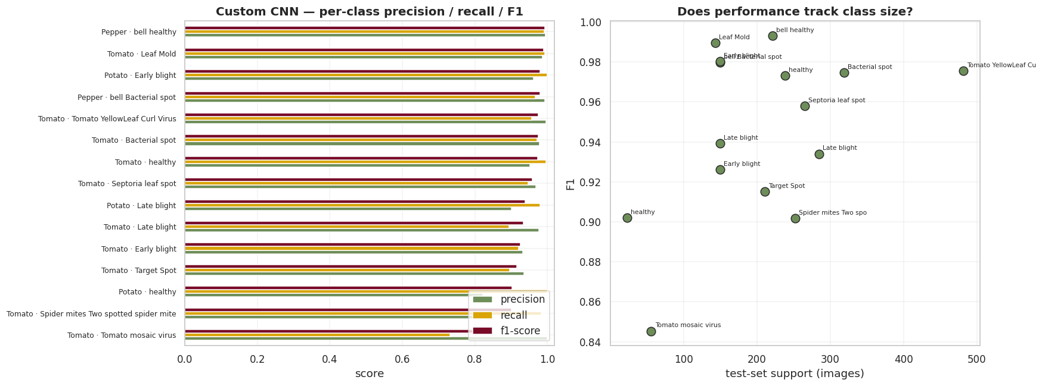
BENCHMARK · RESULTS
Per-class precision, recall and F1 — Custom CNN
Tomato mosaic virus: perfect precision (1.000) but the weakest recall (0.732) — the model is cautious about calling it, and misses some real cases.
CROP DISEASE PREDICTION SYSTEM · PER-CLASS PRECISION, RECALL AND F1 — CUSTOM CNN
21 / 31

Slide 22
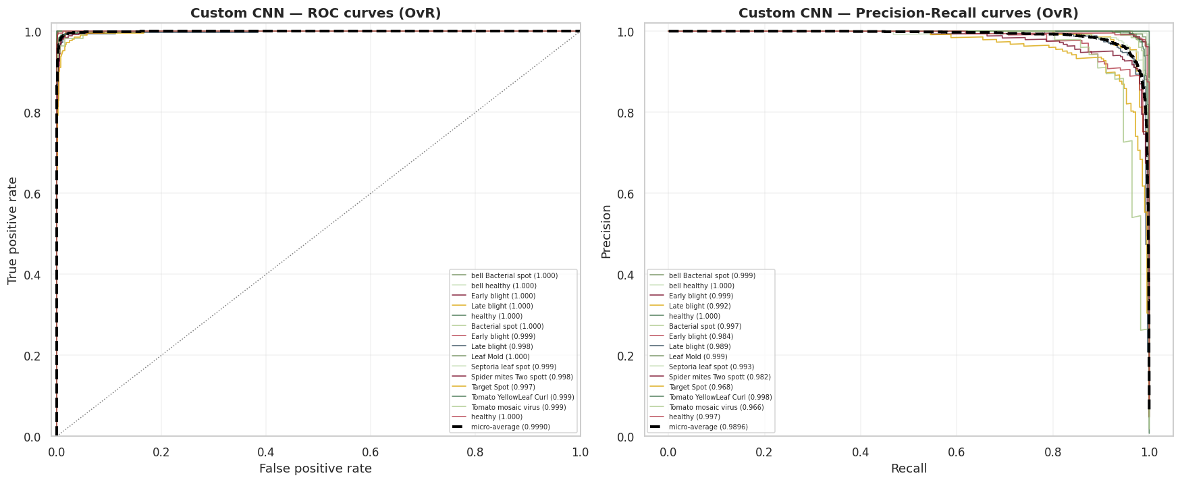
BENCHMARK · RESULTS
ROC and precision–recall curves, one-vs-rest
Macro ROC-AUC of 0.999 — near-perfect ranking quality even for the rarest classes.
CROP DISEASE PREDICTION SYSTEM · ROC AND PRECISION–RECALL CURVES, ONE-VS-REST
22 / 31

Slide 23
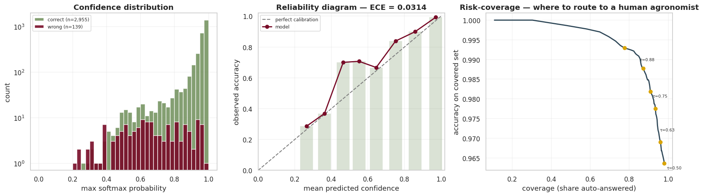
BENCHMARK · RESULTS
Is the model's confidence trustworthy?
Expected Calibration Error 0.031 — when it says “90% confident,” it's right about 90% of the time; the risk-coverage curve shows where to route uncertain cases to a human.
CROP DISEASE PREDICTION SYSTEM · IS THE MODEL'S CONFIDENCE TRUSTWORTHY?
23 / 31

Slide 24
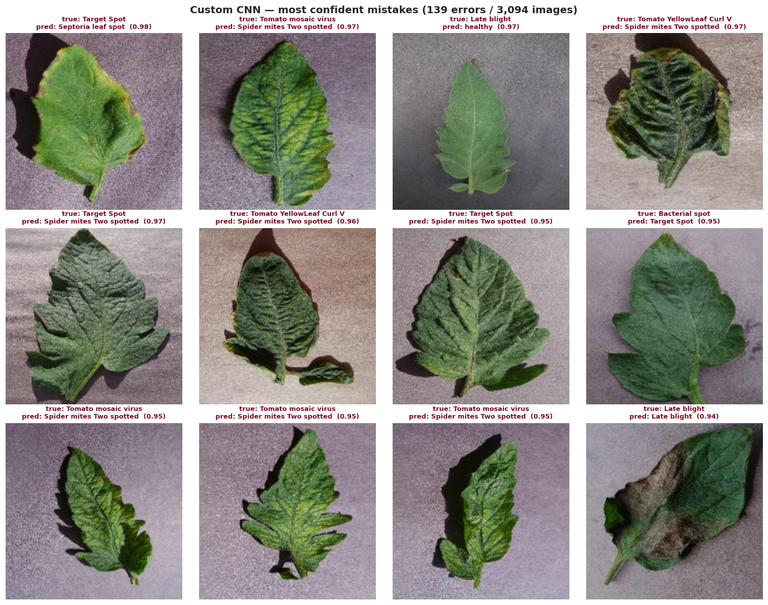
BENCHMARK · RESULTS
The most confident mistakes
Ranked by confidence — these are the images worth a second human look, not random noise.
CROP DISEASE PREDICTION SYSTEM · THE MOST CONFIDENT MISTAKES
24 / 31

Slide 25
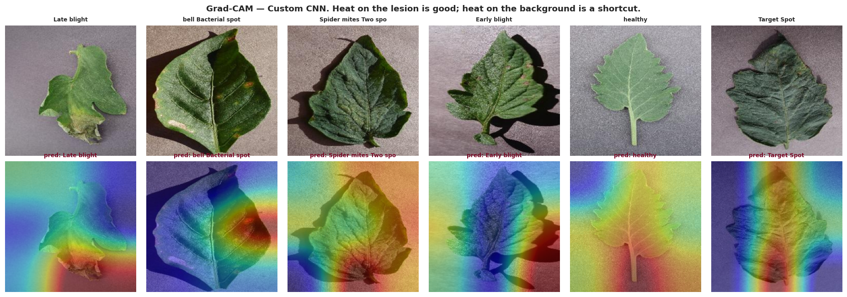
BENCHMARK · EXPLAINABILITY
Grad-CAM — is the model looking at the lesion?
Heat concentrated on diseased tissue, not the background, is the visual check that the model learned pathology and not a shortcut.
CROP DISEASE PREDICTION SYSTEM · GRAD-CAM — IS THE MODEL LOOKING AT THE LESION?
25 / 31

Slide 26
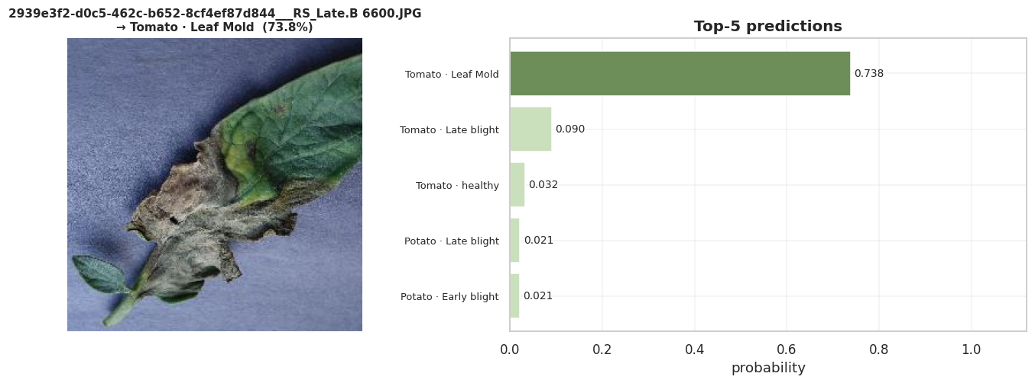
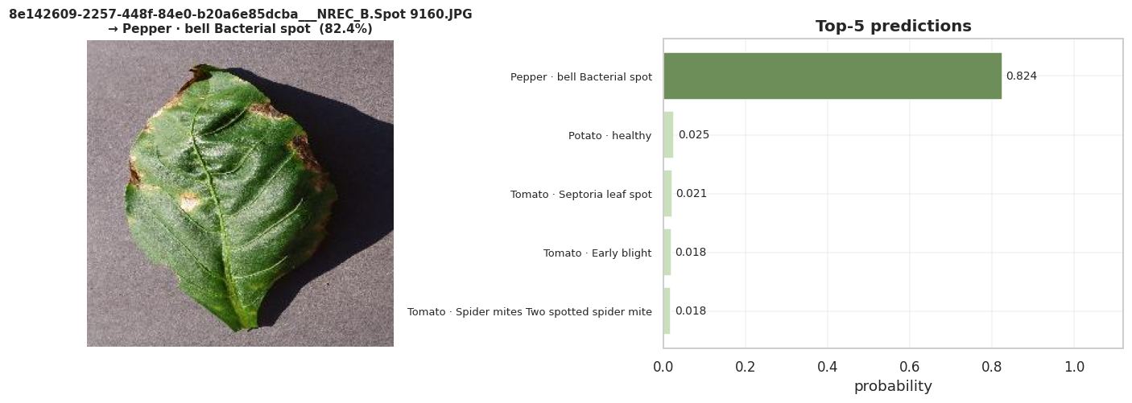
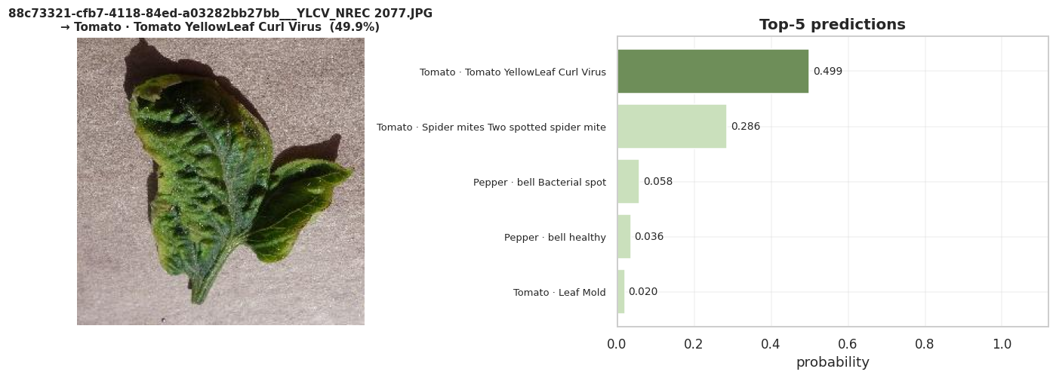
BENCHMARK · LIVE DEMO
Three predictions, end to end
Held-out test images the model never trained on, run through the full predict-and-rank pipeline — image in, top-5 probabilities out.
Ground truth: Tomato · Late blight
Ground truth: Pepper (bell) · Bacterial spot
All three ground-truth labels land in the model's top prediction — the third case (Yellow Leaf Curl Virus) shows the lower-confidence, multi-candidate behaviour that a top-3 UI is built for.
Ground truth: Tomato · Yellow Leaf Curl Virus
CROP DISEASE PREDICTION SYSTEM · LIVE DEMO
26 / 31

Slide 27
RESULTS
Every benchmark metric, side by side
Metric | Custom CNN | EfficientNetB3
Accuracy | 95.51% | 87.10%
Balanced accuracy | 94.86% | 88.06%
Macro-F1 | 94.59% | 86.92%
Weighted F1 | 95.52% | 87.12%
Top-3 accuracy | 99.81% | 97.41%
Cohen's κ | 0.951 | 0.859
MCC | 0.951 | 0.861
ROC-AUC (macro) | 0.999 | 0.993
PR-AUC (macro) | 0.991 | 0.946
Log-loss (lower is better) | 0.166 | 0.444
Inference speed, ms / image (lower is better) | 3.7 | 8.5
Cross-check: the same residual architecture, retrained on the full 38-class production dataset, reached 94.1% validation accuracy in its very first training epoch.
CROP DISEASE PREDICTION SYSTEM · RESULTS
27 / 31

Slide 28
IMPLEMENTATION
Inside the Streamlit app
Home
About
Disease Recognition
Introduces the tool, shows the interface, and links onward to the recognition page.
Documents the dataset — 87,900 images, 38 classes — and lists every crop and condition in a searchable table.
The working tool: upload a photo, get a prediction and a full Hindi treatment card.
One inference call, five steps:
Upload
jpg / png
Resize
224×224 + normalise
Forward pass
residual CNN
Argmax
over 38 classes
Treatment card
in Hindi
→
→
→
→
Same design system, end to end. This deck reuses the CauseHouse system already shipped in App.py — cream & forest-ink palette, serif display + clean sans body, pill-radius buttons, and the hard offset-shadow “sticker” cards used for the app's own prediction result.
CROP DISEASE PREDICTION SYSTEM · IMPLEMENTATION
28 / 31

Slide 29
KEY OUTCOMES
What this delivers
1
Accurate
95.5% test accuracy and 94.6% macro-F1 on the benchmarked architecture family, with the production model tracking the same result on the full 38-class dataset.
2
Fast
3.7 ms per image — well under what's needed for the prediction to feel instant inside the browser.
3
Understandable
Hindi-language cause, symptoms, and organic + chemical treatment for every one of the 38 classes — not just a label.
4
Honest about confidence
Calibrated probabilities (ECE 0.031) mean the app's confidence score is trustworthy enough to act on, not just decorative.
5
Portable
The benchmark pipeline exports to fp16 TFLite at ≈22 MB with under 1 pp accuracy loss — a clear path to an offline mobile app.
CROP DISEASE PREDICTION SYSTEM · KEY OUTCOMES
29 / 31

Slide 30
READING THE RESULTS HONESTLY
What this isn't — yet
Limitations
Next up
Lab photos, not field photos.
Validate on field-collected photos before trusting the accuracy number publicly.
PlantVillage leaves are cropped, centred, and shot on a plain background. Published research shows models trained on it can drop to 30–50% accuracy on real field images. The benchmark numbers are a ceiling, not a deployment guarantee.
Re-run the custom-CNN-vs-EfficientNet benchmark on the full 38-class dataset to confirm the 15-class result holds.
No “is this even a leaf?” check.
A 38-way softmax will confidently classify a shoe. An out-of-distribution guard belongs in front of the classifier before this goes further.
Add a confidence threshold that routes uncertain photos to “try another photo” instead of guessing.
Two models, one shipped.
EfficientNetB3 was benchmarked head-to-head against the custom CNN, but only on a 15-class, ~20.6K-image subset of PlantVillage — not yet repeated on the full 38-class set the app ships with.
Ship the TFLite export for offline use on low-connectivity farms.
CROP DISEASE PREDICTION SYSTEM · HONEST READ & ROADMAP
30 / 31

Slide 31
THANK YOU
Questions, feedback, field data — all welcome
This deck, the app, and the treatment database all live in the same repository. If you have field-collected photos or agronomy corrections, they make the next version better.
Saksham Agrawal · Repository: cropDisease · PyTorch · Streamlit · CauseHouse design system
CROP DISEASE PREDICTION SYSTEM · CLOSING
31 / 31

