Slide 1


ZEROTH
Mini database management system
-CUI based C-project
A C-project submission for first semester /first year
Bachelor’s in computer Engineering

Slide 2




OUR TEAM MEMBERS
Sidharth Karn
Sushil Sharma
Umesh Kumar Sah
Shyam Sundar Sahu

Slide 3
OBJECTIVE
· Develop a lightweight database system that can function without external dependencies.
· Provide a complete set of CRUD (Create, Read, Update, Delete) operations for managing records.
· Implement file handling mechanisms for structured data storage and retrieval.
· Create an intuitive command-line interface (CLI) for users to interact with the database easily.

Slide 4
ZEROTH is a custom database system designed to handle data storage ,retrieval ,and management efficiently .
Goal:
The goal is to provide a robust and scalable solution tailored for various applications ,ensuring speed ,reliability ,and flexibility in data operations.

Slide 5
WHY CUSTOM DATABASE?
A lightweight, custom-built database system eliminates these complexities by focusing on:
Simple file-based storage, eliminating the need for external software.
Direct and efficient record handling, reducing computational overhead.
Customization, allowing for tailored data management according to application needs.

Slide 6
FEATURES
6.1 Functional Scope
The database system will support:
Data Entry & Management: Users can add, modify, and delete content and files.
File Storage Mechanism: Data will be stored in structured files.
User-Friendly Interface: A command-line interface for ease of use.
Users can connect web applications with the database system and store the data.

Slide 7
PROJECT SHOW

Slide 8
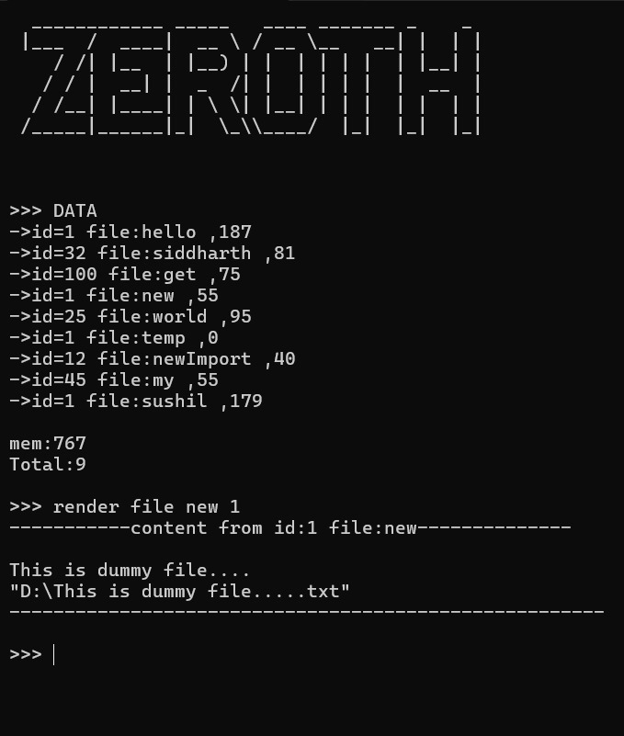
User Screen

Slide 9
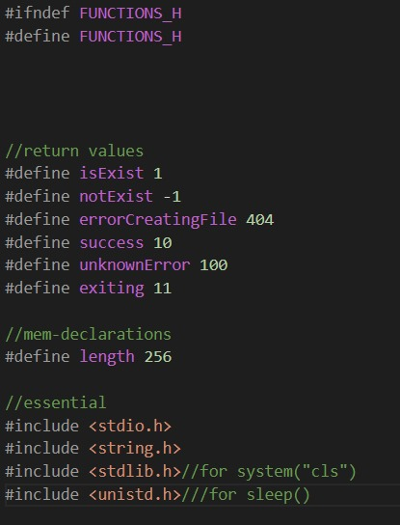
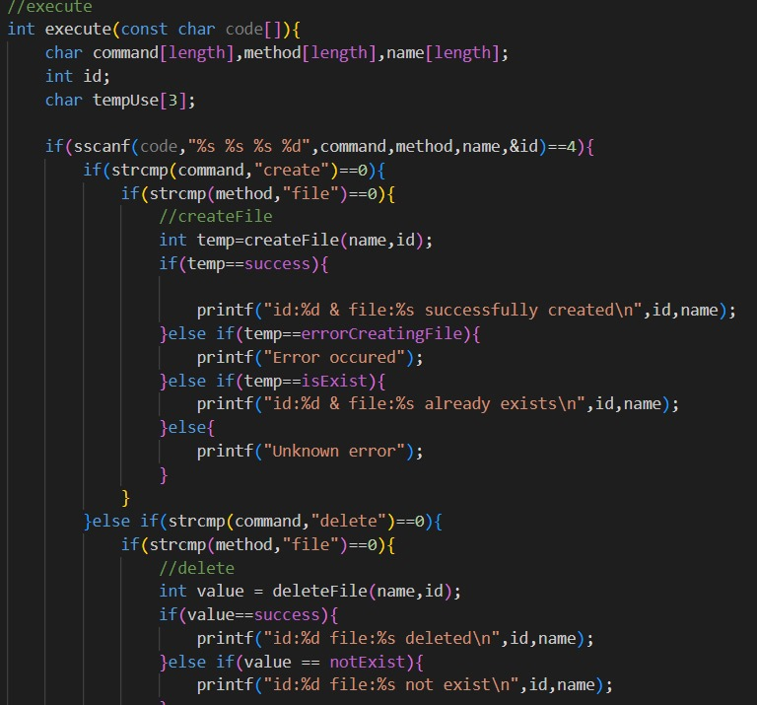
Libraries Used
Command Parser

Slide 10
PRoJECT LIMITATIONS
The database system is intended for small to medium-sized datasets
Version control became tougher to implement
Searching is not possible because of unconsistency of datas.
The initial version will be a command-line-based application.
No version control system for file management.
Future enhancements may include a graphical interface and encryption features.

Slide 11
CONCLUSION:
In this project , we successfully designed and implemented a custom database system in c, focusing on essential functionalities such as data storage ,retrieval ,modification . Through efficient file handling and structure data management , we amied to create a lightweight yet professional database solution
REFERENCES:
www.geeksforgeeks.org
www.stockoverflow.com
www.github.com

