Slide 1
Foundation of Data Science Project Report
Soham Deo

Slide 2
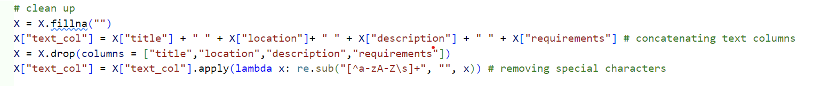
Preprocessing
Concatenating and cleaning text columns:
Concatenating the text columns and getting removing special characters.

Slide 3
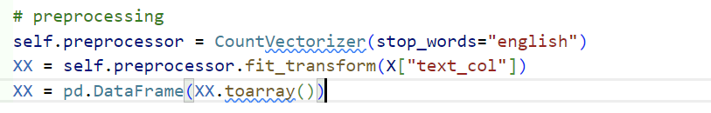
Preprocessing
Using CountVectorizer on combined text column

Slide 4
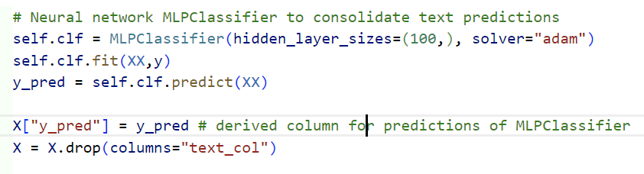
Preprocessing
Using MLPClassifier to generate a derived feature column which is a prediction based only on the text columns.
dropping text column to have a purely numerical feature set

Slide 5
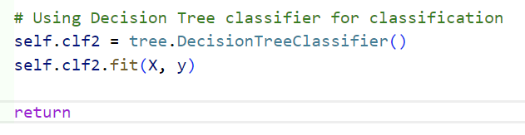
Model Training
Using a basic Decision Tree Classifier for final classification.

Slide 6
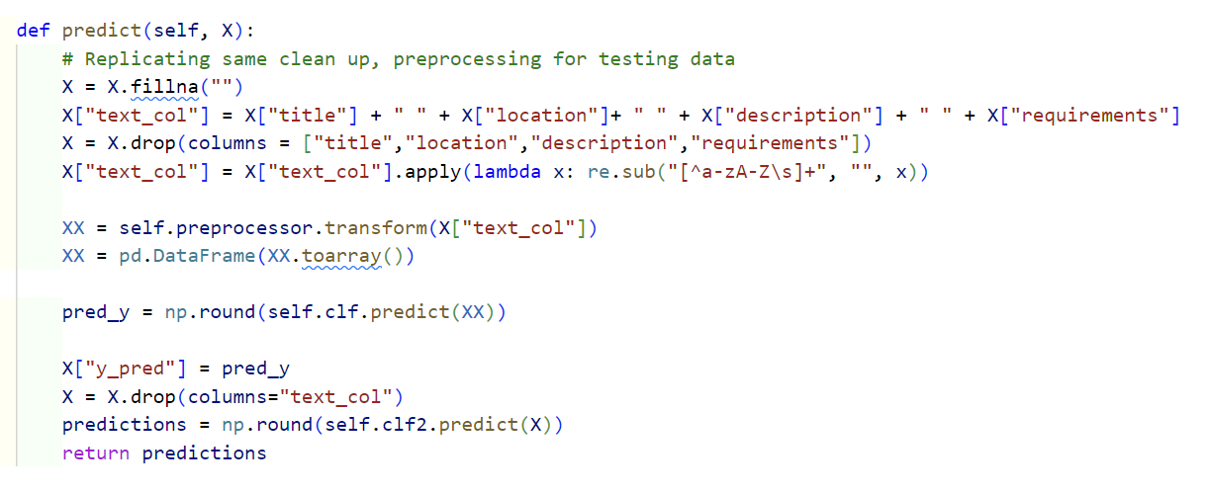
Predictions
Apply the preprocessor
Generate the derived feature column for test data
Return predictions using Decision Tree classifier

Slide 7
Model Evaluation
F1 score:
around 0.74
Runtime:
5.5972 min

