Slide 1

Twitter Feed Analyzer DBMS (BCSE0452)
Department of Computer Science and Engineering
(Submitted To: Ms. Sana Anjum)
Student Name | Roll Number | Department and Section
Suryansh Singh | 2301330100208 | BTECH, CSE A

Slide 2

Index
Introduction
Literature Survey/Existing System
Problem Statement
Proposed Methodology
Flowcharts and Use Case/ER Diagrams
Feasibility Study
Hardware /Software Requirement
Results and Conclusion
Refrences

Slide 3
Introduction
Twitter Feed Analyzer is a data-driven web application designed to fetch, store, analyze, and visualize tweets in real-time. Built using Python and Streamlit for the front-end, and MongoDB for backend storage, the project focuses on delivering a user-friendly platform for performing sentiment analysis and gaining insights from Twitter data. It supports keyword-based tweet search, user authentication, sentiment classification using AI models from Hugging Face, and stores tweet history for further analysis. The system is built to be scalable, modular, and secure—making it suitable for social media monitoring, opinion mining, and trend analysis.

Slide 4
Literature Survey/Existing System
Traditional approaches to social media analysis often require technical expertise, involve complex tools, or lack real-time capabilities. Many existing solutions are either costly, lack customization, or do not offer seamless integration of tweet fetching, storage, and AI-powered sentiment analysis. This project addresses these gaps by building a lightweight, accessible, and cost-effective platform using Python, Streamlit, and MongoDB, enabling users to analyze Twitter data in real-time without deep technical know-how.

Slide 5
Problem Statement
Manual analysis of Twitter data can be time-consuming, error-prone, and lacks scalability. This project aims to build an automated Twitter Feed Analyzer using Python, Streamlit, and MongoDB to streamline the process of fetching, storing, and analyzing tweets. It enables users to perform keyword-based searches, visualize sentiment trends, and access search history in a simple and interactive interface.

Slide 6
Proposed Methodology
User Authentication: Allows users to securely sign up and log in using hashed passwords.
Tweet Search: Enables users to search for tweets in real-time using keywords or hashtags.
Sentiment Analysis: Analyzes the emotional tone of tweets (positive, negative, neutral) using NLP models.
Search History Tracking: Stores each user's past keyword searches for easy reference.
Data Visualization: Displays tweet statistics, sentiment distribution, and trends using charts.
Tweet Storage: Saves fetched tweets in MongoDB for future analysis and reporting.
Interactive Dashboard: Provides users with a unified view of their searched topics, sentiment insights, and past activity.

Slide 7
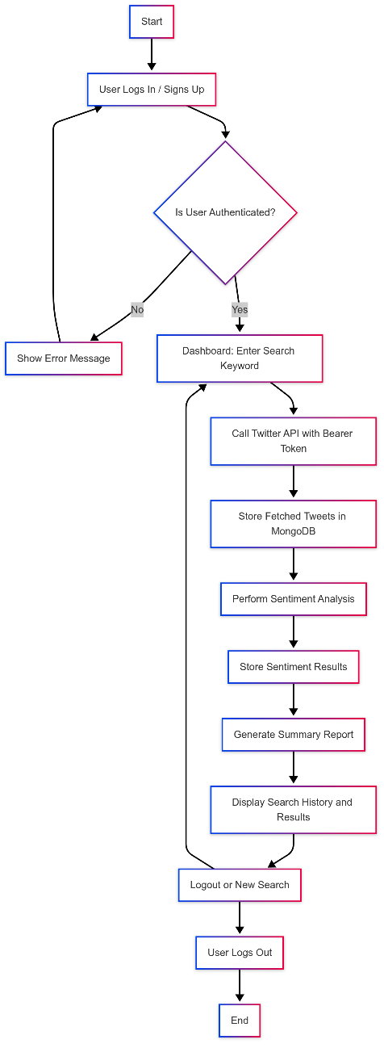
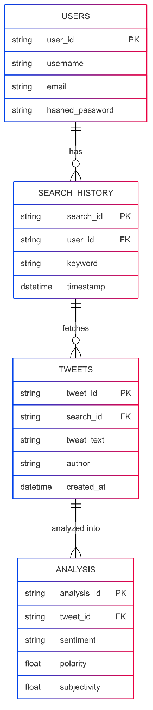
Flowcharts and Use Case/ER Diagrams

Slide 8
Feasibility Study
Technical Feasibility: The system is technically sound, leveraging Python for data processing and analysis, Streamlit for building an interactive UI, and MongoDB as a scalable NoSQL backend. All chosen technologies are reliable, open-source, and well-documented.
Operational Feasibility: The platform provides a clean and intuitive interface, enabling users to easily search tweets, analyze sentiment, and view results—making it suitable for both technical and non-technical users interested in social media analytics.
Economic Feasibility: The project is cost-effective, relying on open-source tools and free-tier cloud services (like MongoDB Atlas), minimizing the need for expensive infrastructure or licensing.

Slide 9
Hardware /Software Requirement
Processor: Intel Core i3 or equivalent (minimum)
RAM: 4 GB or higher
Storage: 50 GB HDD or SSD
Display: 14-inch monitor or larger
Input Devices: Keyboard and Mouse
Internet: Stable connection (required for fetching live tweets and cloud database access)

Slide 10
Hardware /Software Requirement
Operating System: Windows 10 / Linux / macOS
Frontend: Python with Streamlit
Backend: MongoDB (Cloud or Local Instance)
IDE: VS Code / PyCharm
Other Tools: Web Browser (Chrome/Firefox), MongoDB Compass (for DB inspection)
Libraries: streamlit, pymongo, hashlib, pandas, matplotlib, transformers (for sentiment analysis)

Slide 11
Results and Conclusion
The Twitter Feed Analyzer successfully performs all core functions including user authentication, tweet fetching based on keywords, sentiment analysis, and storing search history. The system ensures secure data handling using hashed credentials and full CRUD operations integrated with a MongoDB backend. The user interface built with Streamlit is intuitive and responsive, meeting the goals of usability, performance, and scalability.
This project demonstrates how a Python-based solution, combined with MongoDB and NLP models, can help users analyze public sentiment, visualize tweet insights, and explore social media trends effectively.

Slide 12
References
Twitter Developer Platform – https://developer.twitter.com
MongoDB Documentation – https://www.mongodb.com/docs
Python Official Documentation – https://docs.python.org
Streamlit Documentation – https://docs.streamlit.io
Hugging Face Transformers – https://huggingface.co/docs/transformers
Pandas Documentation – https://pandas.pydata.org/docs
NumPy Documentation – https://numpy.org/doc
Matplotlib & Seaborn for Data Visualization – https://matplotlib.org/stable/contents.html, https://seaborn.pydata.org
PyMongo – https://pymongo.readthedocs.io

Slide 13
Thank You

