Slide 1

Agent Reliability Lab
Controlled Fault Injection and Failure Analysis for AI Agents
Department of Computer Science and Engineering
(Supervisor: Mr. Pradeep Kumar)
Design/Implementation Phase Progress Review | Group CSE/CSPROJECT/2027/G053 | 17 October 2026
Name of Member | Roll Number | Role
Suryansh Singh | 2301330100208 | Team Lead: architecture, harness, fault injection, store, CLI
Simran Kumari | 2301330100200 | Metrics, failure analysis, statistics, optimization
Tanishka Sahu | 2301330100210 | Task suites, baseline agents, reports, testing
Notes:
Presenter: Suryansh
Greet the panel. Group G053, Agent Reliability Lab, supervisor Mr. Pradeep Kumar. Introduce Simran and Tanishka and say who presents which part.

Slide 2

Index
Problem, Idea and Objectives
Proposed System
Software Requirement Analysis and Modules
Design: Class, Sequence, DFD, ER, Gantt
Implementation: Algorithms and Code Snapshots
Implementation Output and Preliminary Results
Research Paper and Work Status
References
Notes:
Presenter: Suryansh
Walk the agenda in one breath: requirements, design diagrams, implementation with code and output, results, paper status.

Slide 3
Problem, Idea and Objectives
The problem
AI agents now plan, call tools, and retry, yet benchmarks report one number: did the agent finish?
That number hides why runs fail, how consistent the agent is, and what reliability costs.
Our idea: a crash-test lab for AI agents
Break tools on purpose, the same way for every agent, and run every task several times.
Explain each failed run with evidence, then pick the cheapest setup that stays reliable.
Objectives and status
O1 Evaluate: success, pass^k, consistency, cost, latency, recovery, steps (done)
O2 Explain: five failure modes with evidence, seeded fault injection (done)
O3 Optimize: paired tests, Pareto front, cheapest reliable setting (done; live LLM study next)
Notes:
Presenter: Suryansh
One sentence problem, one sentence idea. Stress that pass or fail hides the reason. Map each objective from the synopsis to what is now implemented.

Slide 4
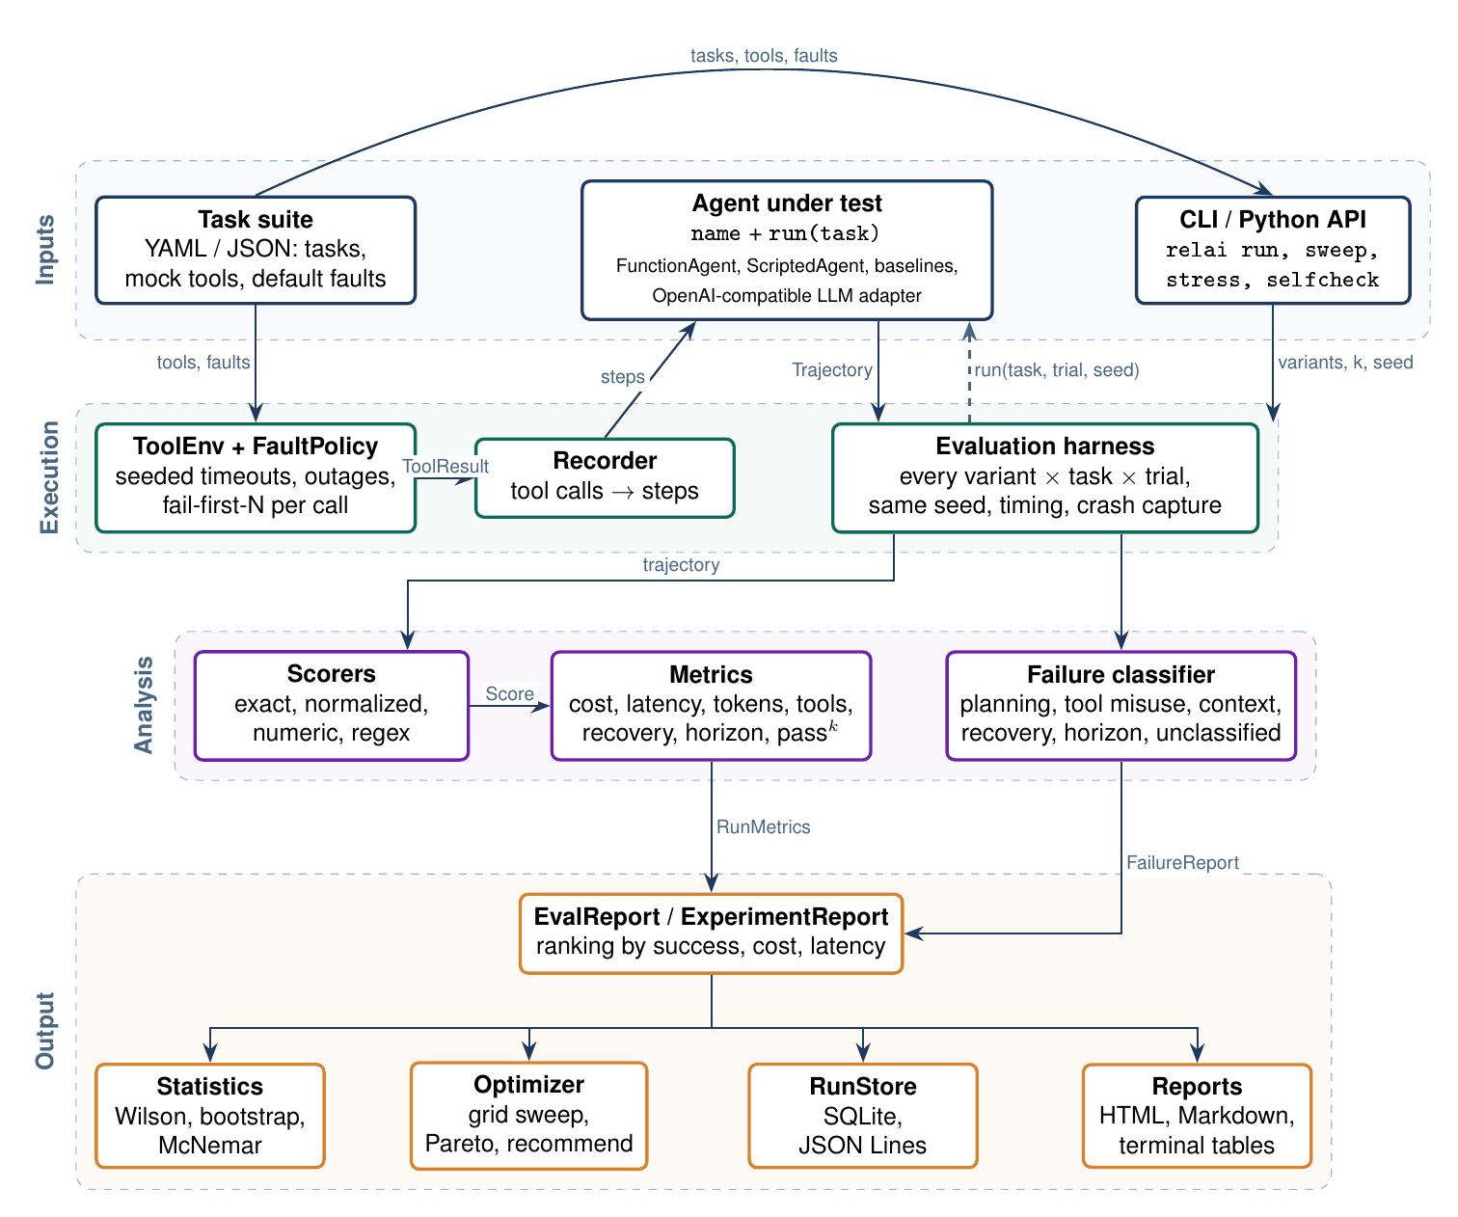
Proposed System
Four layers
Inputs: YAML task suites with mock tools and faults, and any agent with name + run(task)
Execution: the harness runs every variant x task x trial; ToolEnv injects seeded faults
Analysis: scorers, metrics, and the failure classifier only read trajectories
Output: ranking with confidence intervals, paired test, Pareto sweep, SQLite store, HTML report
Runs anywhere
Offline, CPU only, no API key; live LLMs plug in through an OpenAI-compatible adapter
Notes:
Presenter: Suryansh
Point at each layer top to bottom. Key design rule: only the execution layer calls agents, so every number can be recomputed from stored runs.

Slide 5
Software Requirement Analysis
Functional requirements
FR1 Load suites (YAML/JSON) with tools, faults, step budgets
FR2 Run any agent through name + run(task)
FR3 Inject reproducible timeouts, outages, fail-first faults
FR4 Repeat tasks k times; report pass@k, pass^k, consistency
FR5 Score answers: exact, normalized, numeric, regex
FR6 Diagnose failures with evidence; keep unknowns unclassified
FR7 Compare variants with intervals and a paired test
FR8 Sweep settings; return Pareto front and recommendation
FR9 Store runs (SQLite, JSONL); render HTML and Markdown
FR10 Offer a CLI and a Python API
Non-functional requirements
Reproducibility: same seed, same faults, same numbers
Fairness: every variant meets the identical fault schedule
Performance: about 6,500 scored runs per second; 81 tests in under 1 s
Portability: Python 3.11 to 3.13, any OS, 2 runtime dependencies
Extensibility: new agents, scorers, suites, modes without harness changes
Robustness: an agent crash becomes a failed run, not a crashed experiment
Security: no eval(), escaped HTML, offline by default
Maintainability: typed models, lint, CI on three Python versions
Notes:
Presenter: Tanishka
Read two or three FRs aloud, not all ten. For NFRs, explain fairness: the same fault hits every agent, which is what makes comparisons valid.

Slide 6
Major Modules and Functionalities
Module | What it does | Owner
Domain types and agent seam | Task, Step, Trajectory; FunctionAgent, ScriptedAgent | Suryansh
Tool environment | Tools, seeded FaultPolicy, Recorder of steps | Suryansh
Evaluation harness | Trials, timing, crash capture, pass@k, pass^k, experiments | Suryansh
Metrics and scorers | Cost, latency, tokens, recovery, horizon; five scorers | Simran
Failure analysis | Five modes, root cause, evidence, unclassified | Simran
Statistics and optimizer | Wilson, bootstrap, McNemar; sweep, Pareto, recommend | Simran
Suites and baseline agents | YAML suites, planted-defect agents, classifier self-check | Tanishka
Reports and tests | HTML and Markdown reports, 81 tests, examples | Tanishka
Store, CLI, LLM adapter | SQLite and JSONL, relai commands, OpenAI-compatible agent | Suryansh
Notes:
Presenter: Tanishka
Each row is a file in src/relai. Mention owners so the panel knows whom to ask. Total: about 3,300 lines of code and 1,100 lines of tests.

Slide 7
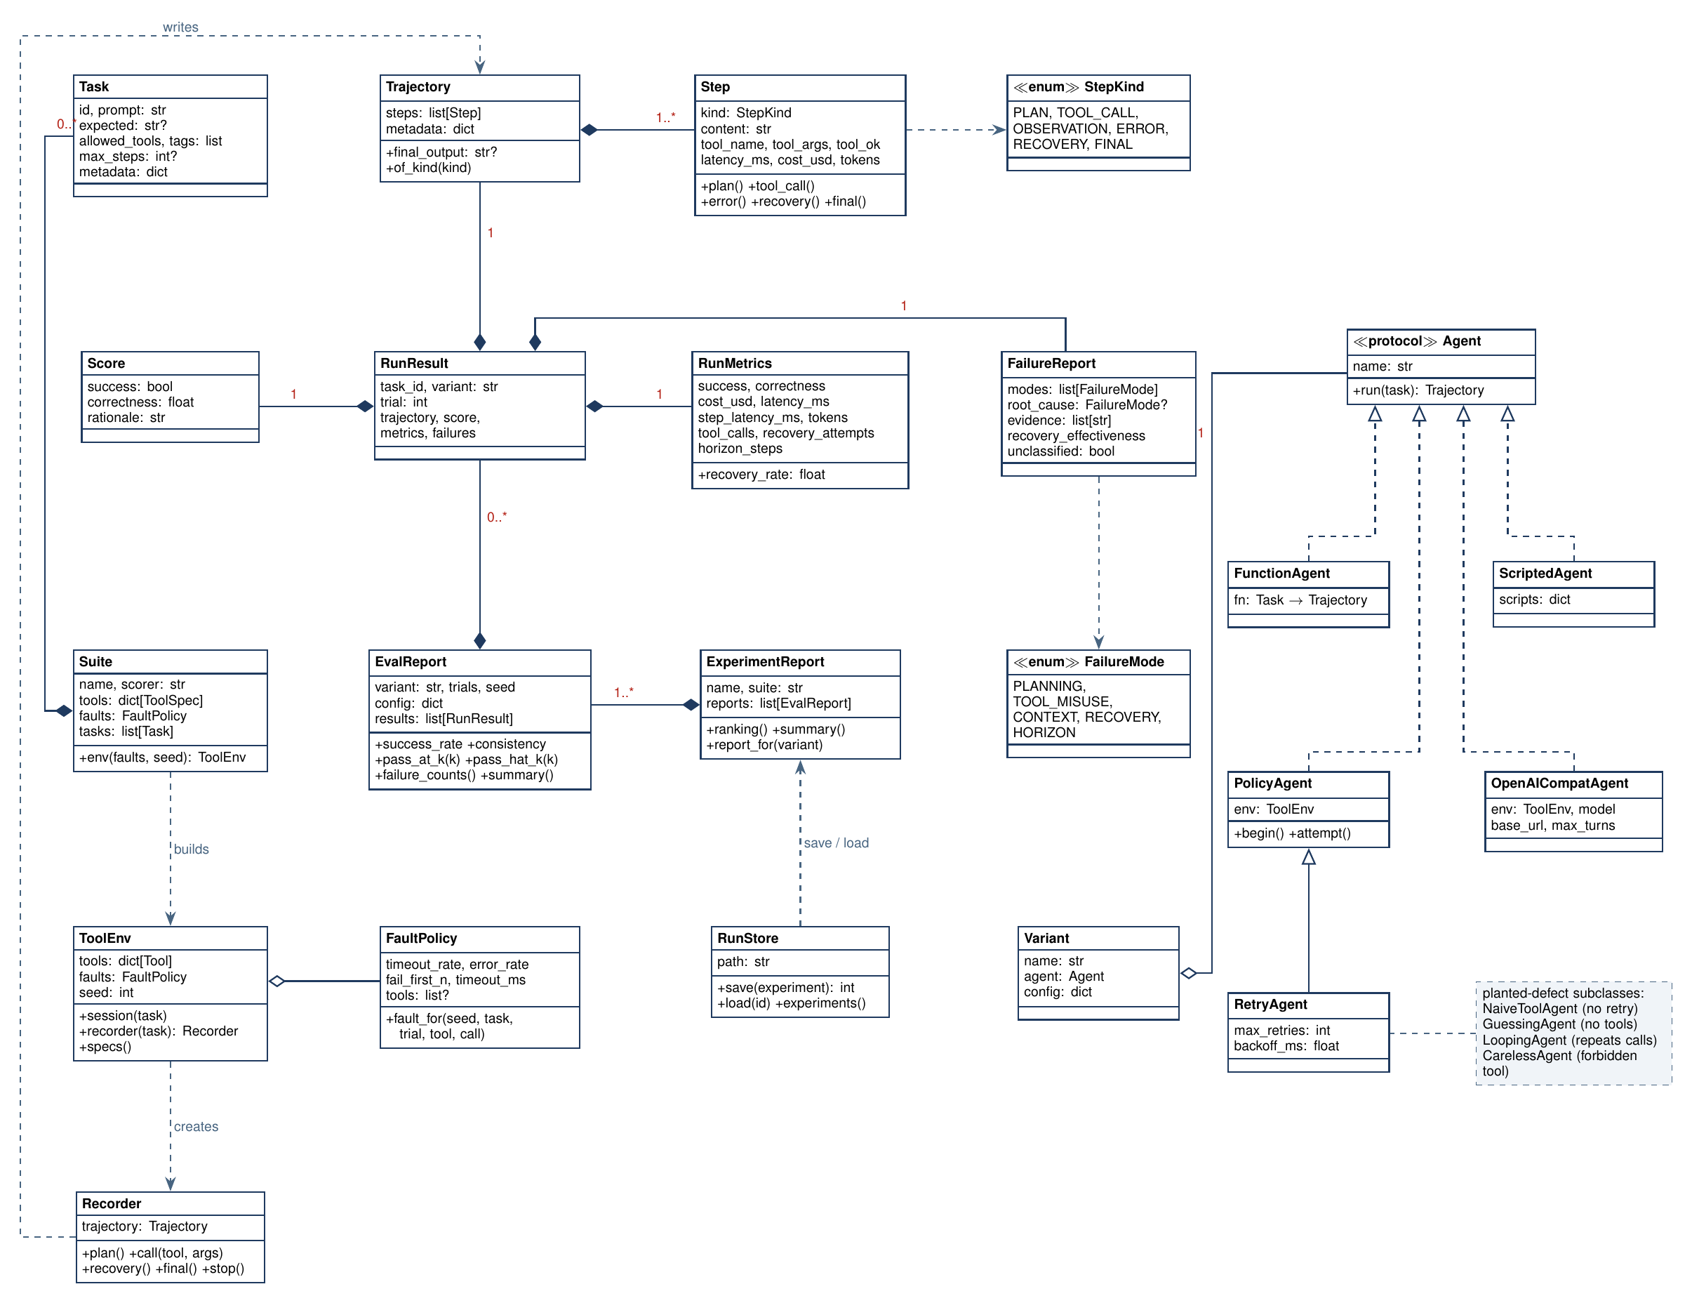
Class Design
Notes:
Presenter: Suryansh
Left: trajectory data. Middle: RunResult composes Score, RunMetrics, FailureReport; EvalReport and ExperimentReport group them. Right: every agent implements the Agent protocol; baselines inherit PolicyAgent.

Slide 8
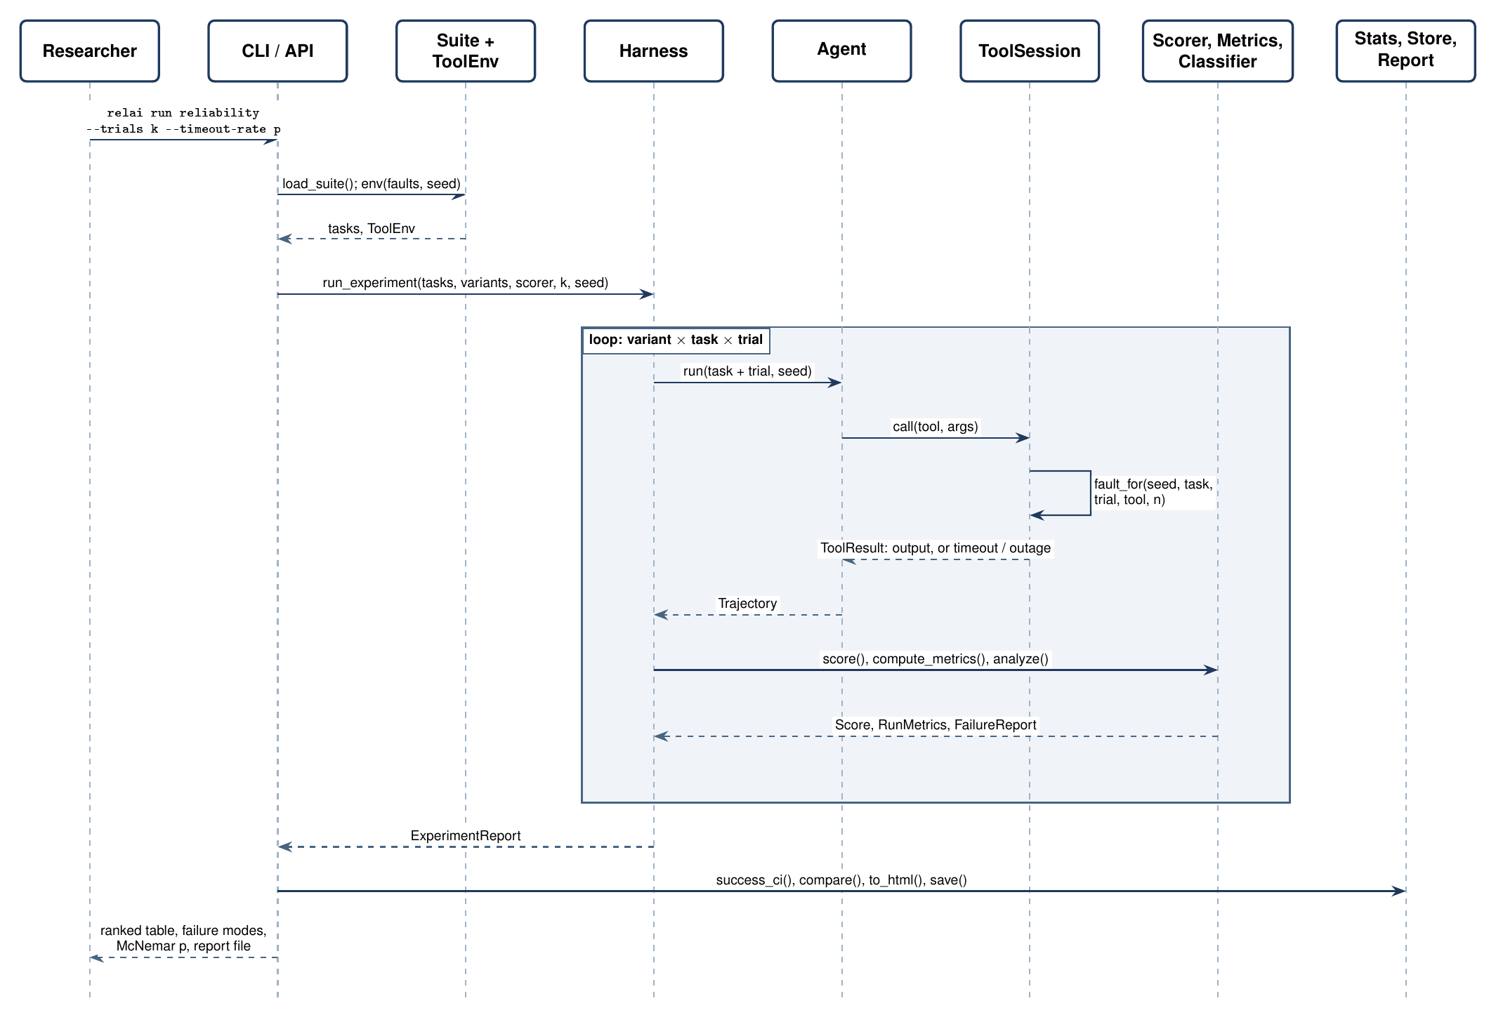
Sequence Diagram: relai run
Notes:
Presenter: Suryansh
Follow one run: CLI loads the suite, harness loops variant x task x trial, the tool session decides the fault from the seed, analysis scores and classifies, then stats and reports.

Slide 9
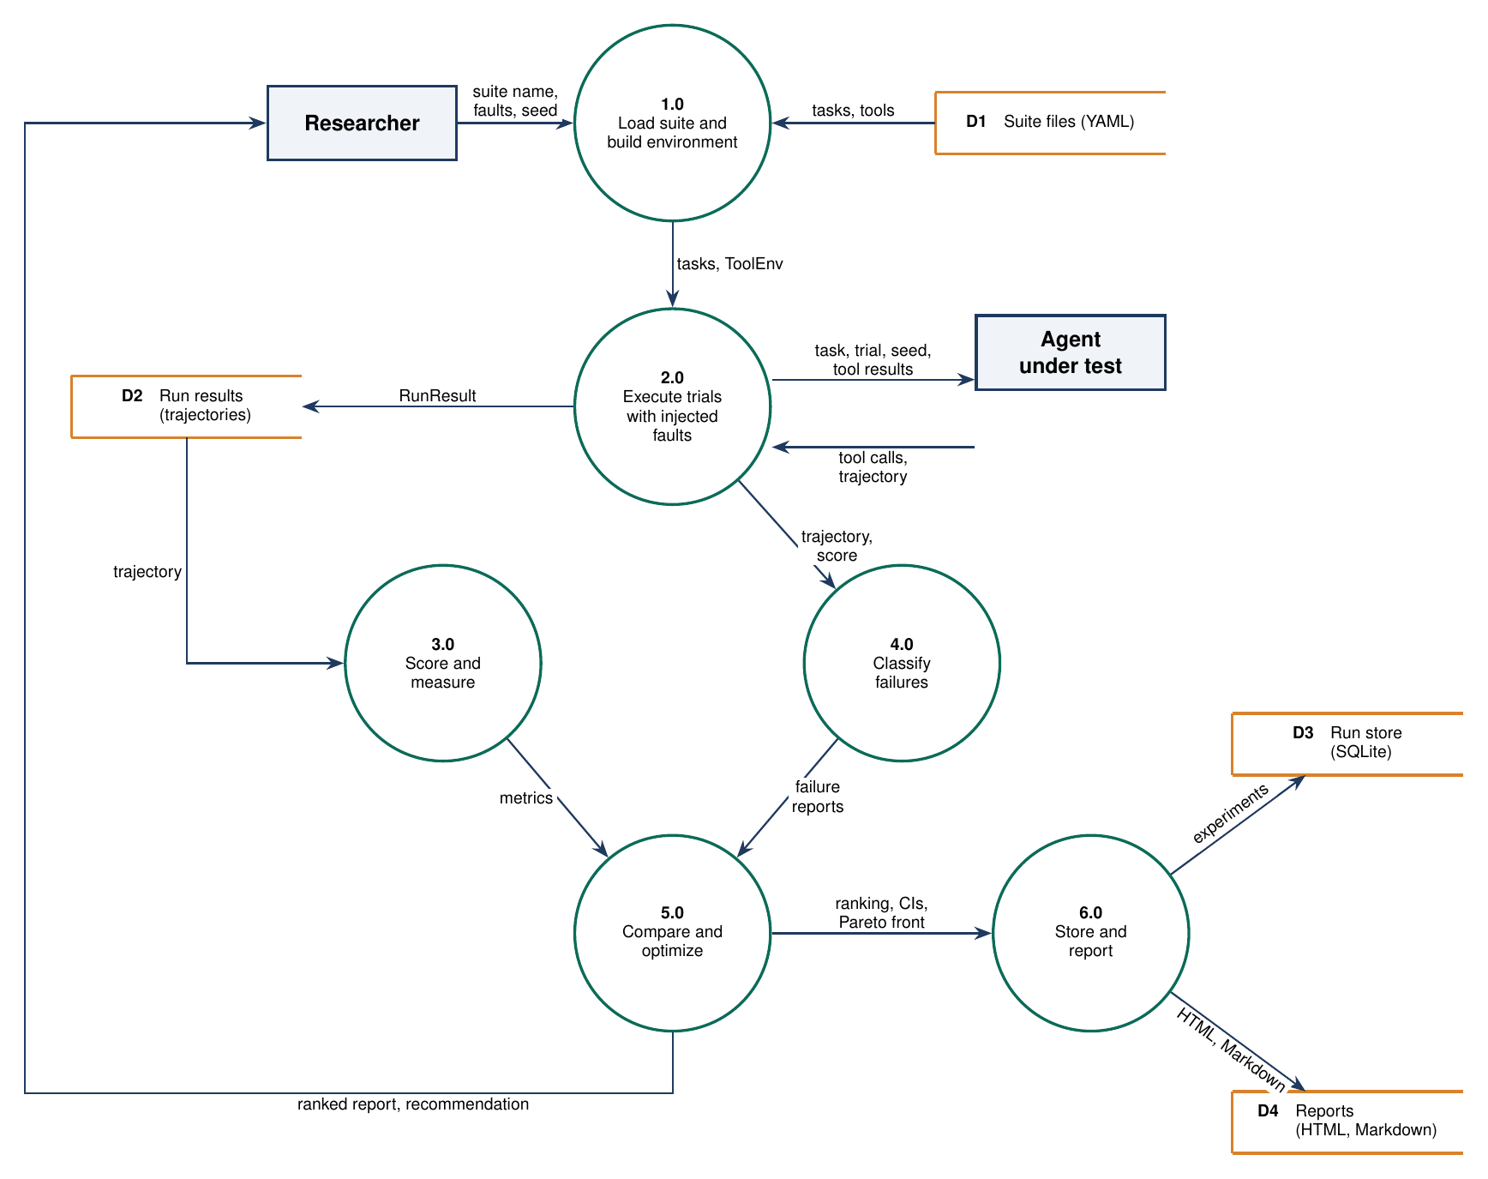
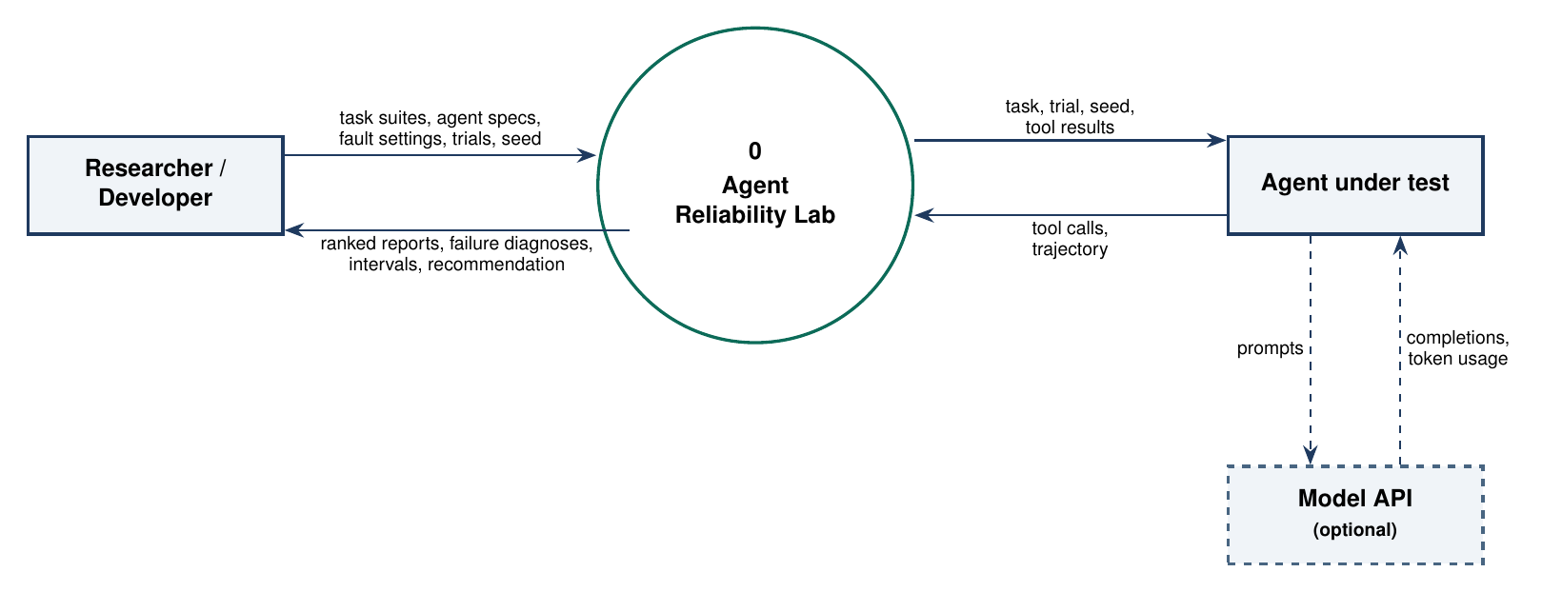
Data Flow Diagrams: Level 0 and Level 1
Level 0: context diagram
Level 1: six processes and four data stores. Analysis reads stored run results, never the agent.
Notes:
Presenter: Tanishka
Level 0 shows the researcher, the agent under test, and an optional model API. Level 1 splits the lab into load, execute, score, classify, compare, and store.

Slide 10
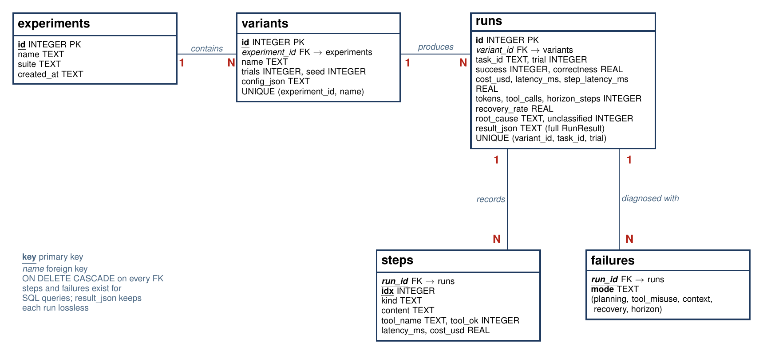
Database Design: ER Diagram
SQLite run store: experiments contain variants, variants produce runs, runs record steps and failure modes. result_json keeps each run lossless.
Notes:
Presenter: Tanishka
One-to-many all the way down. Foreign keys cascade on delete. The steps and failures tables exist so failure counts can be queried in SQL.

Slide 11
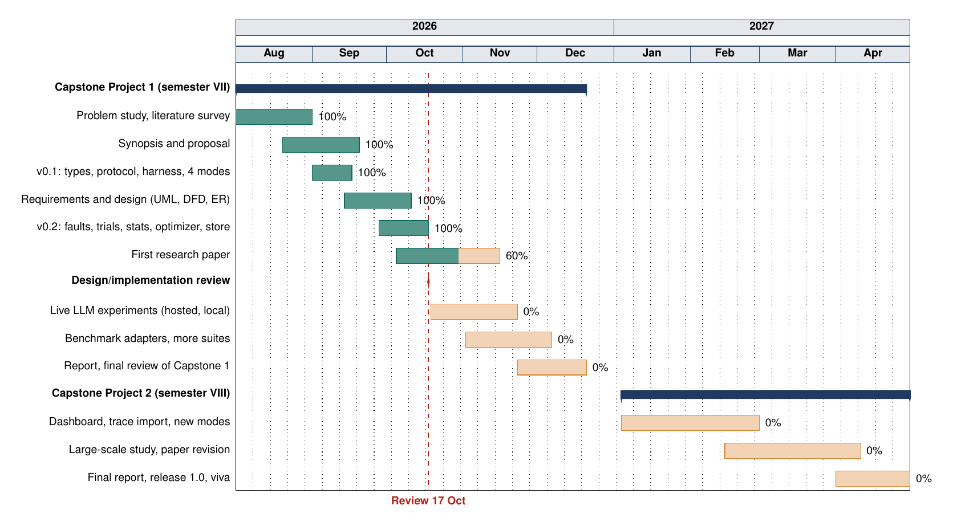
Gantt Chart
Notes:
Presenter: Tanishka
Green is done, amber is planned. We are at the red line: design and v0.2 implementation are complete; live LLM experiments and the paper results come next.

Slide 12
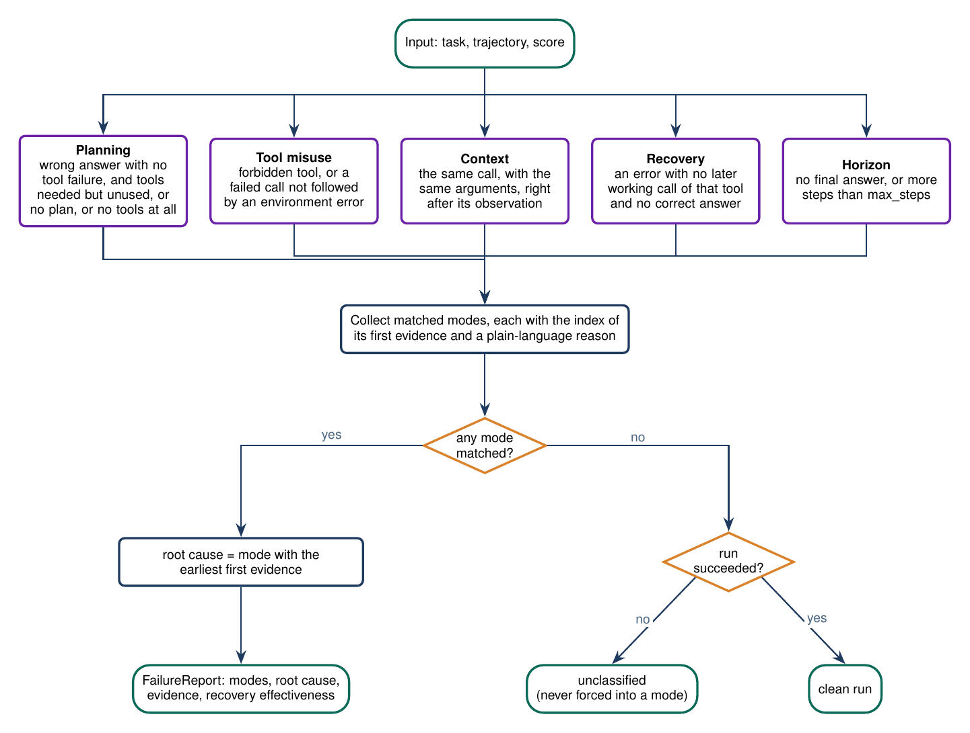
Implementation of Core Algorithms
Fault schedule: u = hash(seed, task, trial, tool, call n); timeout if u < p. Every agent meets the same faults.
Repeated trials: pass^k = C(c,k) / C(n,k) for c passes in n trials; pass@k = 1 - C(n-c,k) / C(n,k).
Classification: five detectors; root cause = mode with the earliest evidence; no match means unclassified.
Paired test: exact McNemar on runs that only one variant passed.
Optimization: keep the Pareto front over success, cost, latency; recommend the cheapest setting that meets the target.
Notes:
Presenter: Simran
Explain why pass^k matters: 0.77 success can mean only 0.33 of tasks pass all five times. Walk the flowchart: detectors, earliest evidence wins, unknown stays unknown.

Slide 13
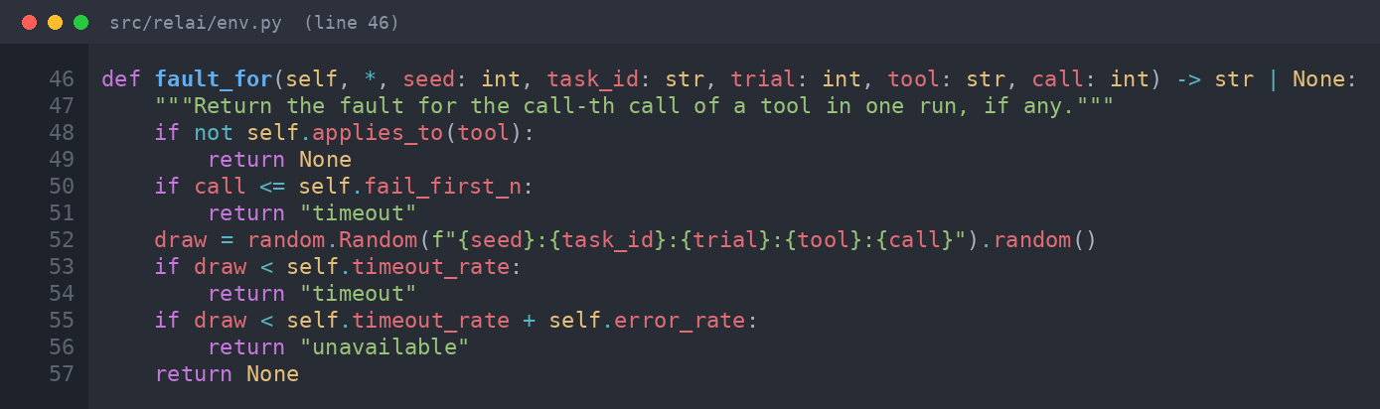
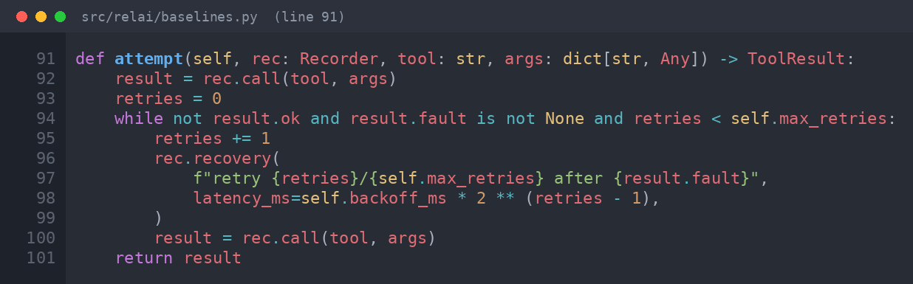
Code Snapshots: Fault Injection and Retry
Notes:
Presenter: Suryansh
Top: the fault depends only on seed, task, trial, tool, and call number, never on the agent. Bottom: the retry agent retries only environment faults, with optional backoff.

Slide 14
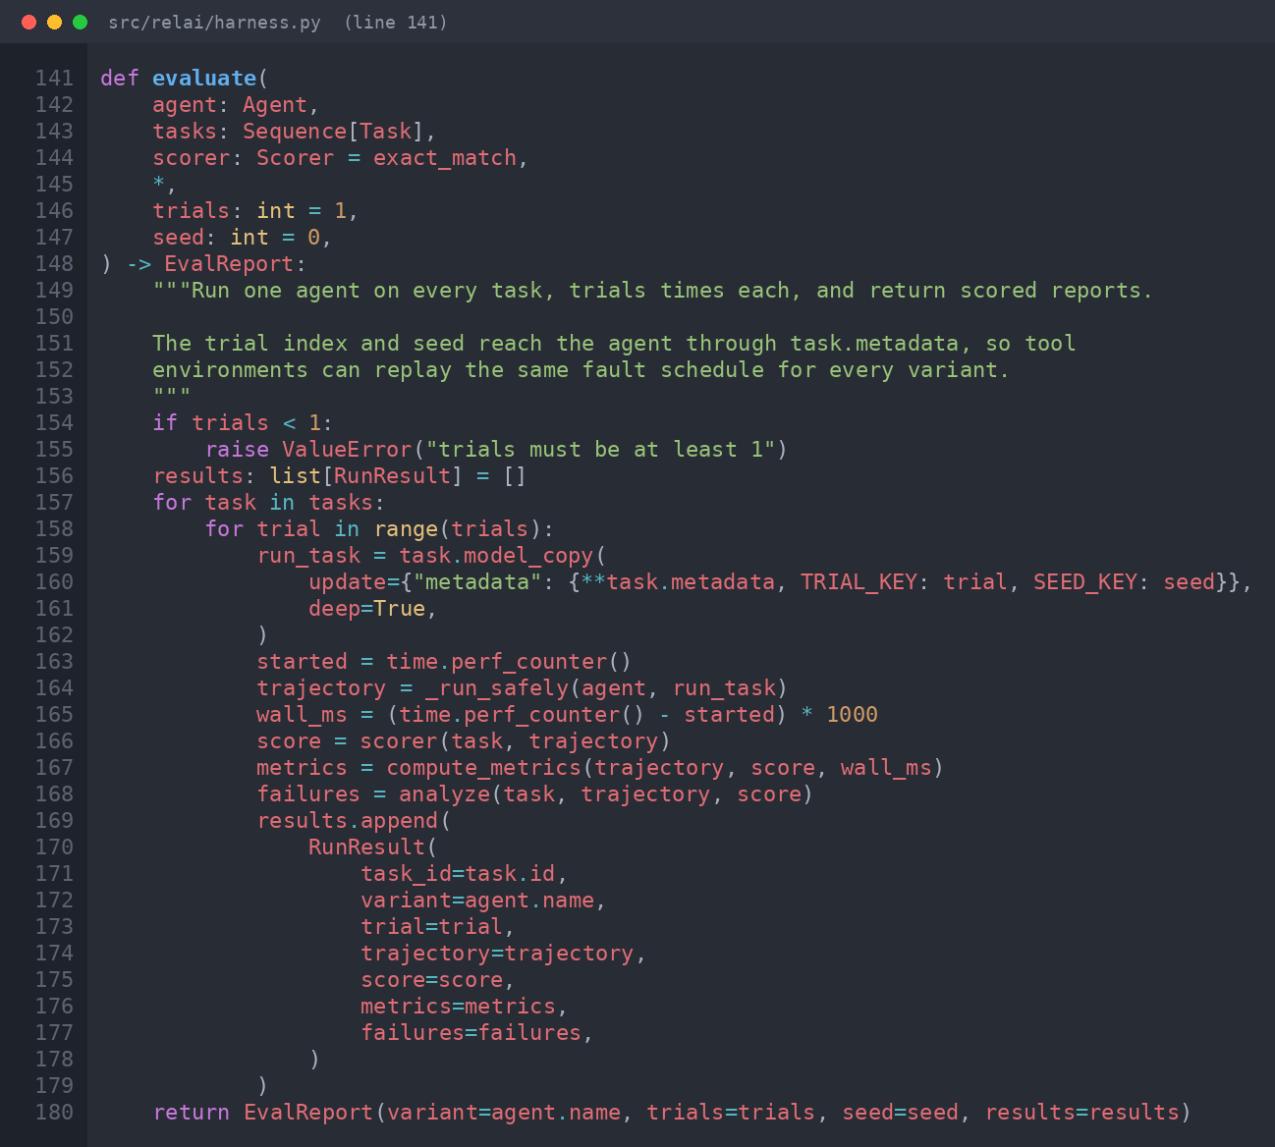
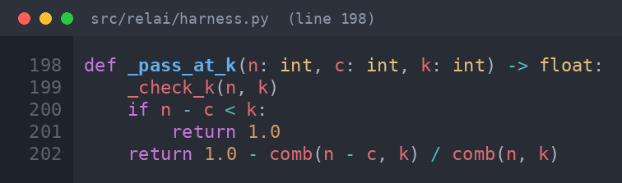
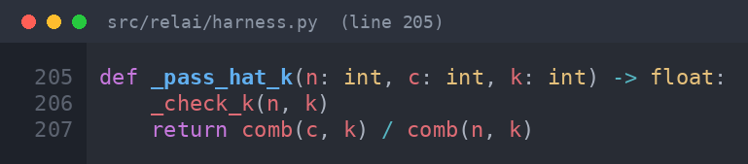
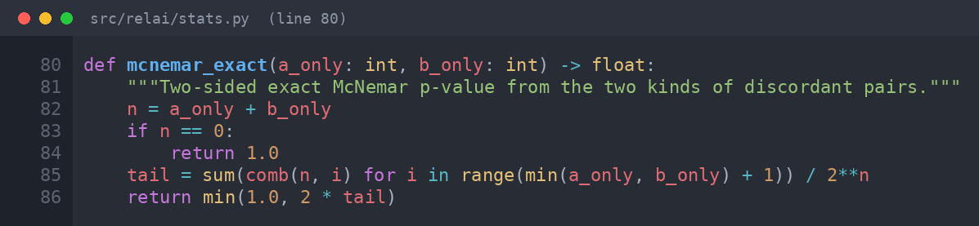
Code Snapshots: Evaluation Loop and Statistics
Notes:
Presenter: Simran
Left: the harness loop passes trial and seed through task metadata and turns crashes into failed runs. Right: the two estimators and the exact McNemar p-value.

Slide 15
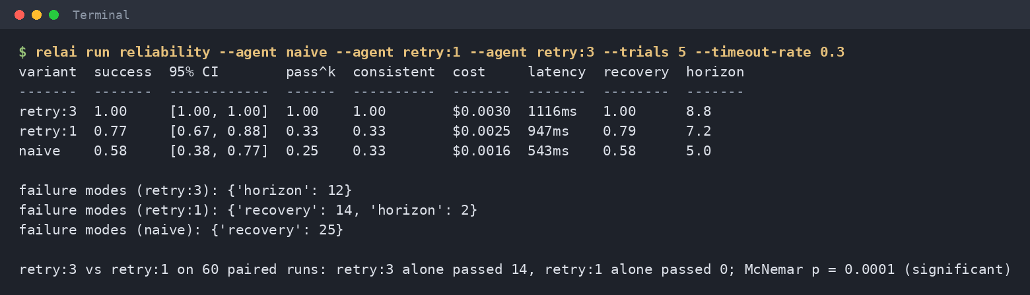
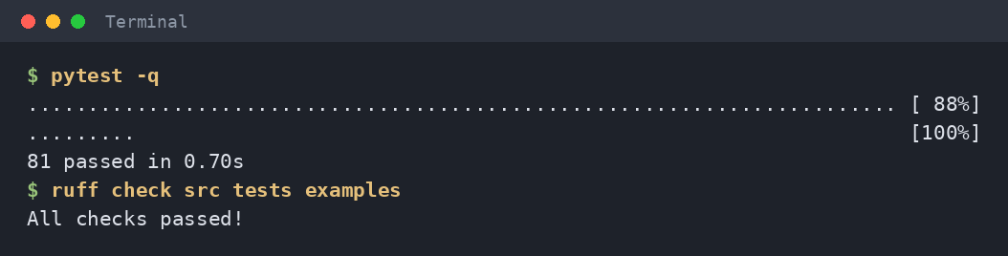
Implementation Output
30% of tool calls time out, 12 tasks, 5 trials each
Naive agent: 0.58 success but pass^5 only 0.25
Three retries: 1.00 success, about 2x cost and latency
McNemar p = 0.0001: the difference is real
Notes:
Presenter: Tanishka
Live demo if time allows: relai run reliability --agent naive --agent retry:1 --agent retry:3 --trials 5 --timeout-rate 0.3. Otherwise read this table. Then show 81 tests and lint passing.

Slide 16
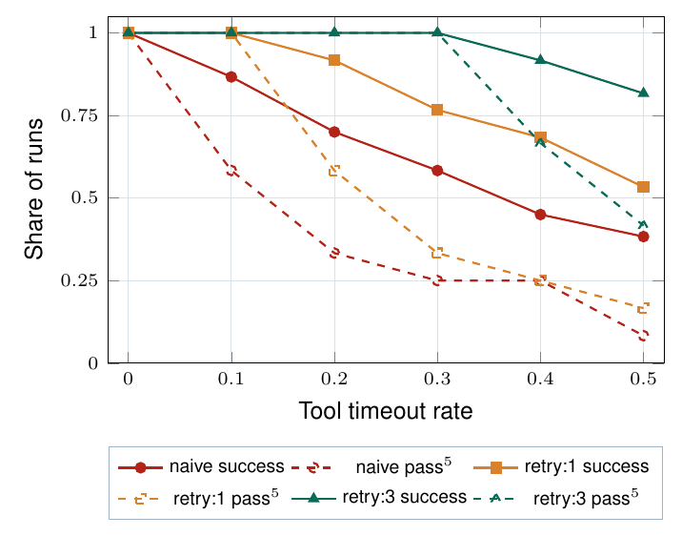
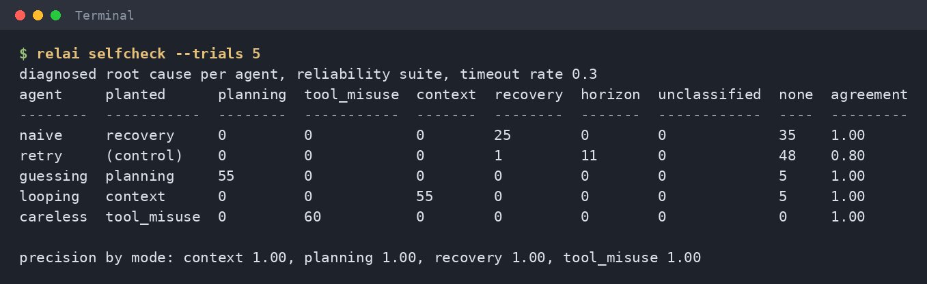
Preliminary Results
Classifier self-check: every planted defect is found, precision 1.00 for all four modes
Fault injector matches theory: success (1 - p)^L, e.g. 0.33 measured vs 0.34 expected for 3 calls
Sweep: 2 retries is the cheapest setting with success >= 0.95
Success (solid) and pass^5 (dashed) as timeouts rise
Notes:
Presenter: Simran
Be clear these are offline reference agents: they validate the instrument, they do not rank LLMs. Live model runs are the next phase.

Slide 17
Research Paper and Work Status
First research paper (IEEE format)
Agent Reliability Lab: Controlled Fault Injection and Evidence-Based Failure Analysis for Tool-Using Language Agents
Done: Abstract, Introduction, Related Work, Problem Statement, Proposed Methodology
Added: preliminary results with 3 tables and 3 figures
Next: live LLM results, then submission
Done
v0.2 package: 17 modules, 81 tests, CI, docs
SRS, class, sequence, DFD, ER, Gantt
Next (Oct to Dec)
Live LLM study: hosted and local models
Suites adapted from public benchmarks
More fault kinds: rate limits, corrupted outputs
Semester VIII: dashboard, trace import, release 1.0
Notes:
Presenter: Suryansh
Hand over the hard copy of the paper here. Be honest about what is next: the instrument is finished, the live model study is the next milestone.

Slide 18
References
[1] S. Yao, J. Zhao, D. Yu et al., "ReAct: Synergizing Reasoning and Acting in Language Models", ICLR, 2023.
[2] S. Yao, N. Shinn, P. Razavi, K. Narasimhan, "tau-bench: A Benchmark for Tool-Agent-User Interaction in Real-World Domains", arXiv:2406.12045, 2024.
[3] S. Kapoor, B. Stroebl, Z. S. Siegel, N. Nadgir, A. Narayanan, "AI Agents That Matter", arXiv:2407.01502, 2024.
[4] S. Kapoor et al., "Holistic Agent Leaderboard: The Missing Infrastructure for AI Agent Evaluation", ICLR, 2026.
[5] S. Rabanser, S. Kapoor, P. Kirgis et al., "Towards a Science of AI Agent Reliability", ICML, 2026.
[6] M. Cemri et al., "Why Do Multi-Agent LLM Systems Fail?", arXiv:2503.13657, 2025.
[7] "ToolMisuseBench: An Offline Deterministic Benchmark for Tool Misuse and Recovery in Agentic Systems", arXiv:2604.01508, 2026.
[8] "AgentChaos: Chaos Engineering for Agent Systems via Programmatic Fault Injection", arXiv:2608.06790, 2026.
[9] M. Chen et al., "Evaluating Large Language Models Trained on Code", arXiv:2107.03374, 2021.
[10] Q. McNemar, "Note on the Sampling Error of the Difference Between Correlated Proportions or Percentages", Psychometrika, 1947.
[11] E. B. Wilson, "Probable Inference, the Law of Succession, and Statistical Inference", J. Amer. Statist. Assoc., 1927.
[12] A. Basiri et al., "Chaos Engineering", IEEE Software, vol. 33, no. 3, 2016.
Notes:
Presenter: Simran
No need to read these. Mention that the paper cites 25 sources and positions the work against 2025 and 2026 reliability research.

Slide 19
Thank You
Notes:
Presenter: Suryansh
Thank the panel and invite questions. Each member answers questions on the modules they own.

Slide 20
Feedback from the Panel
The panel wants the team to :
Notes:
Presenter: All
Leave blank; write the panel's feedback here after the review.

