Slide 1

TrendStrength Fitness Tracker
Riley Taylor, Eli Dayney, Smit Patel, Ty Anderson, J.P. Saia, Alex Fowler, Justin Palumbo

Slide 2
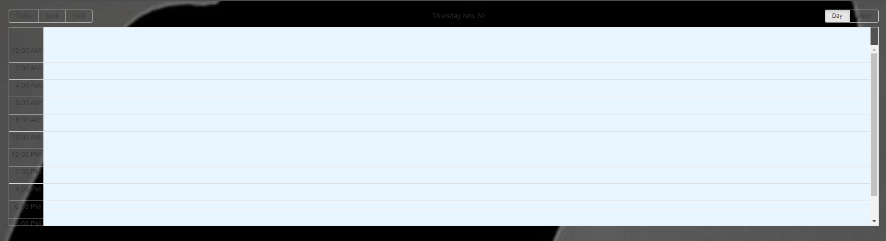
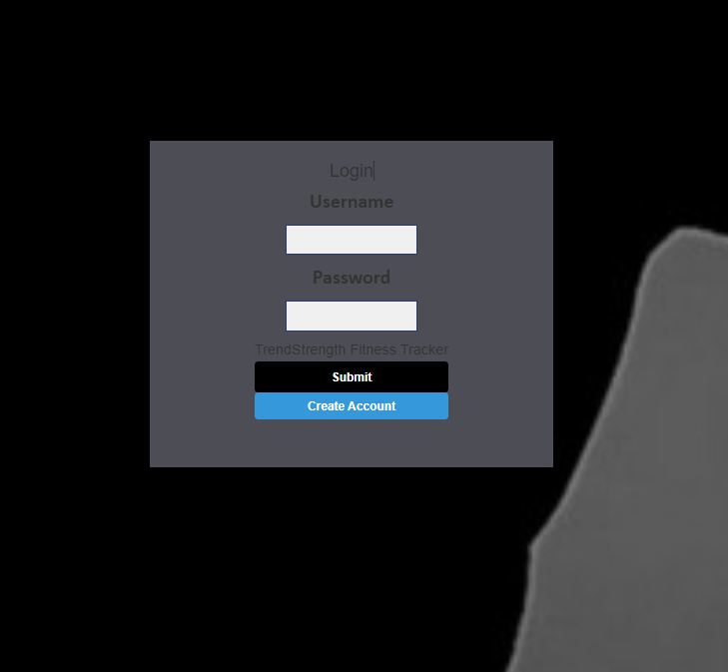
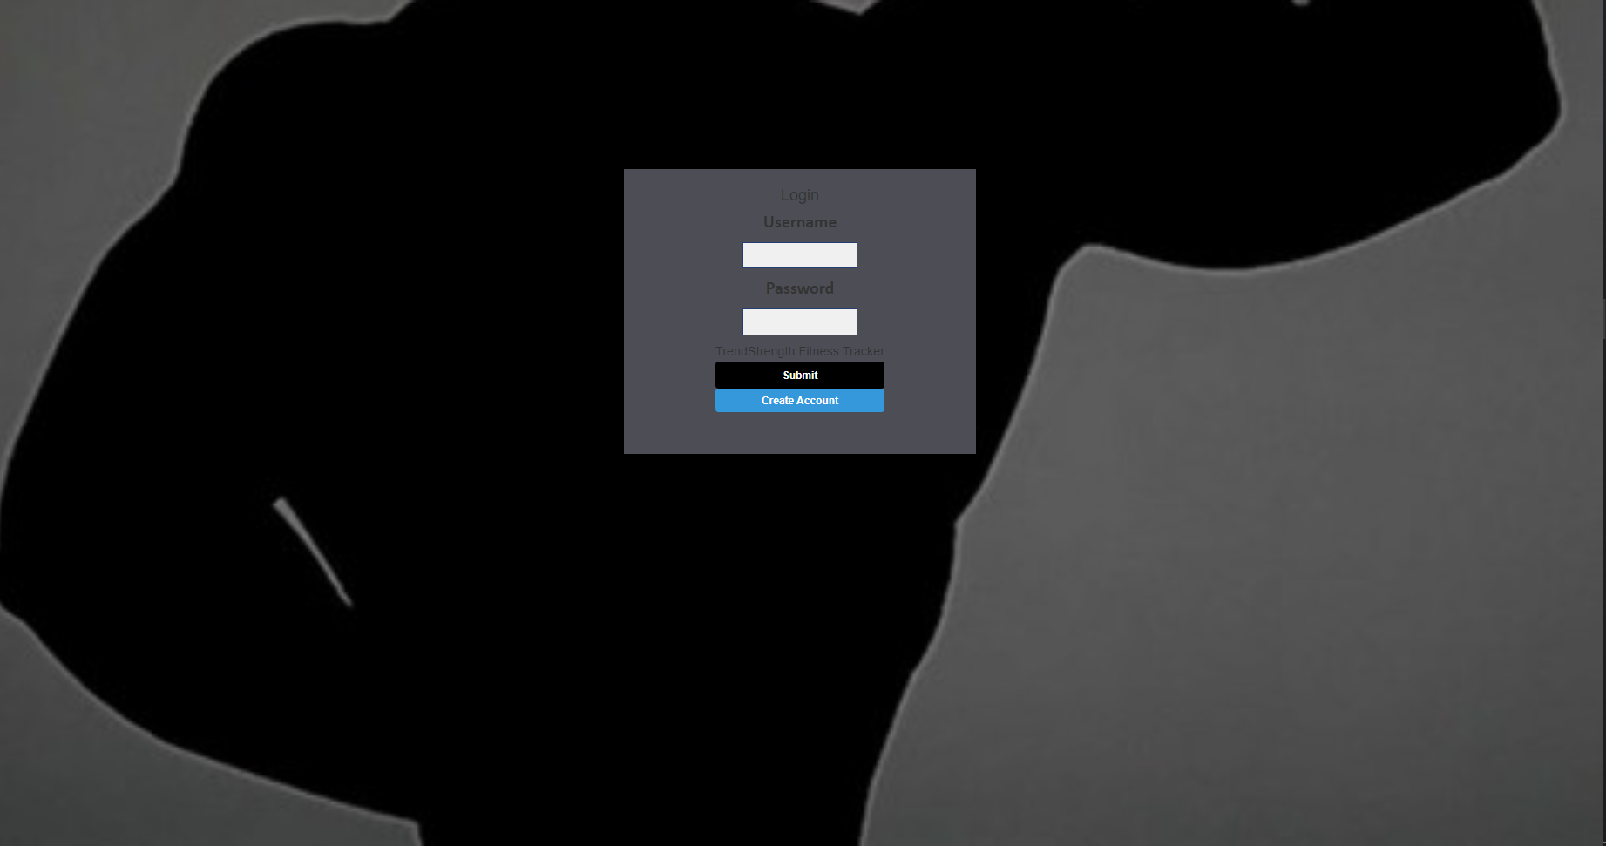
Login Page/Calendar front end

Slide 3
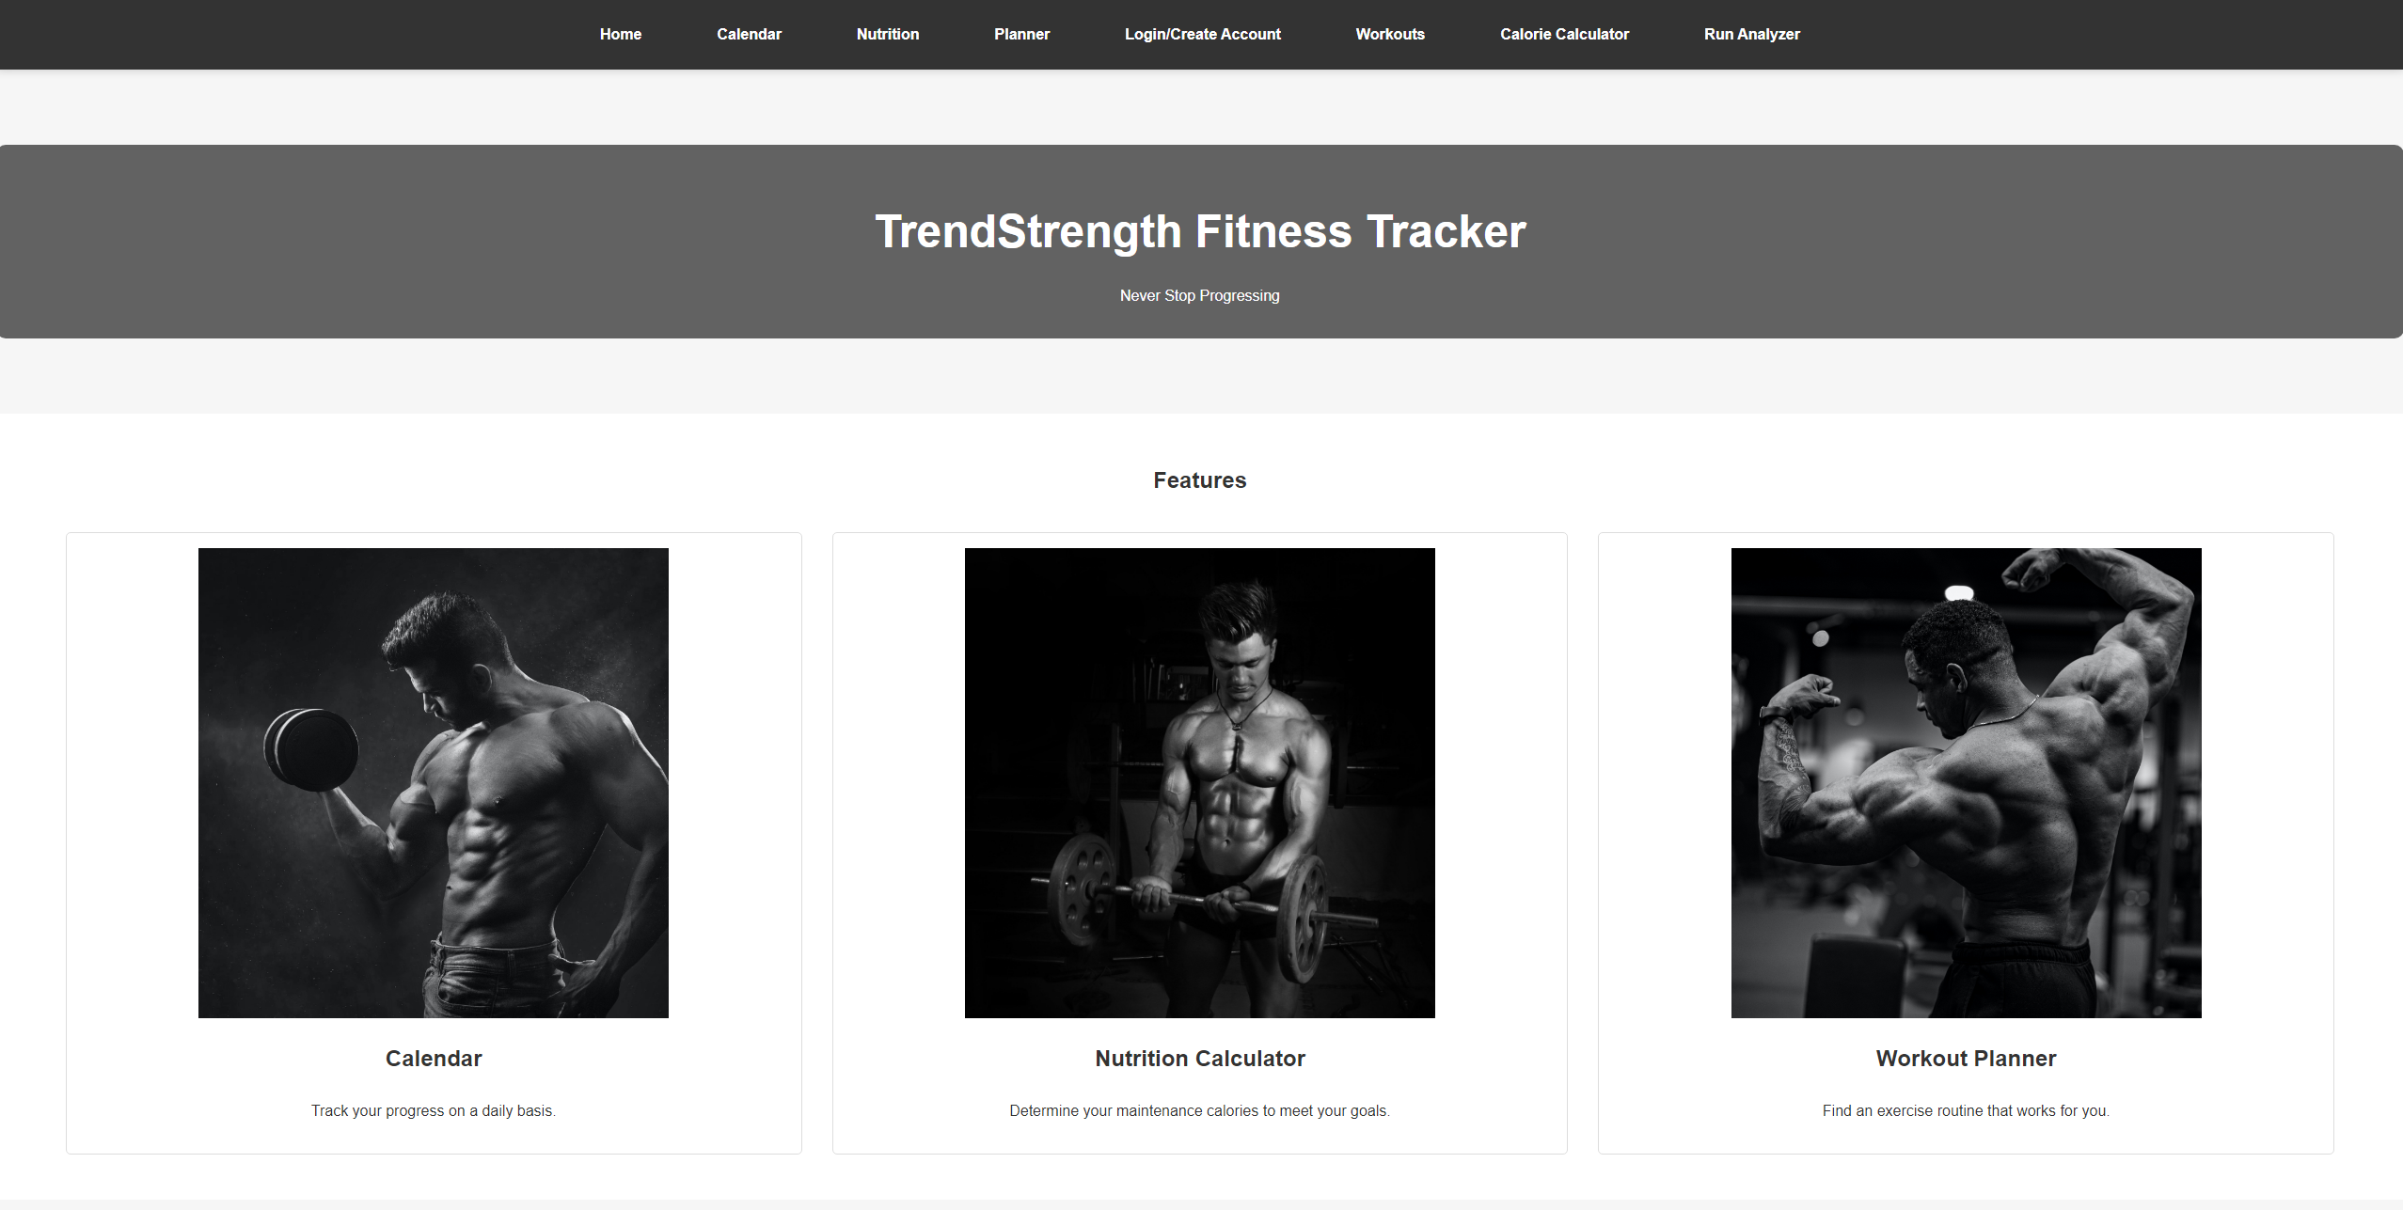
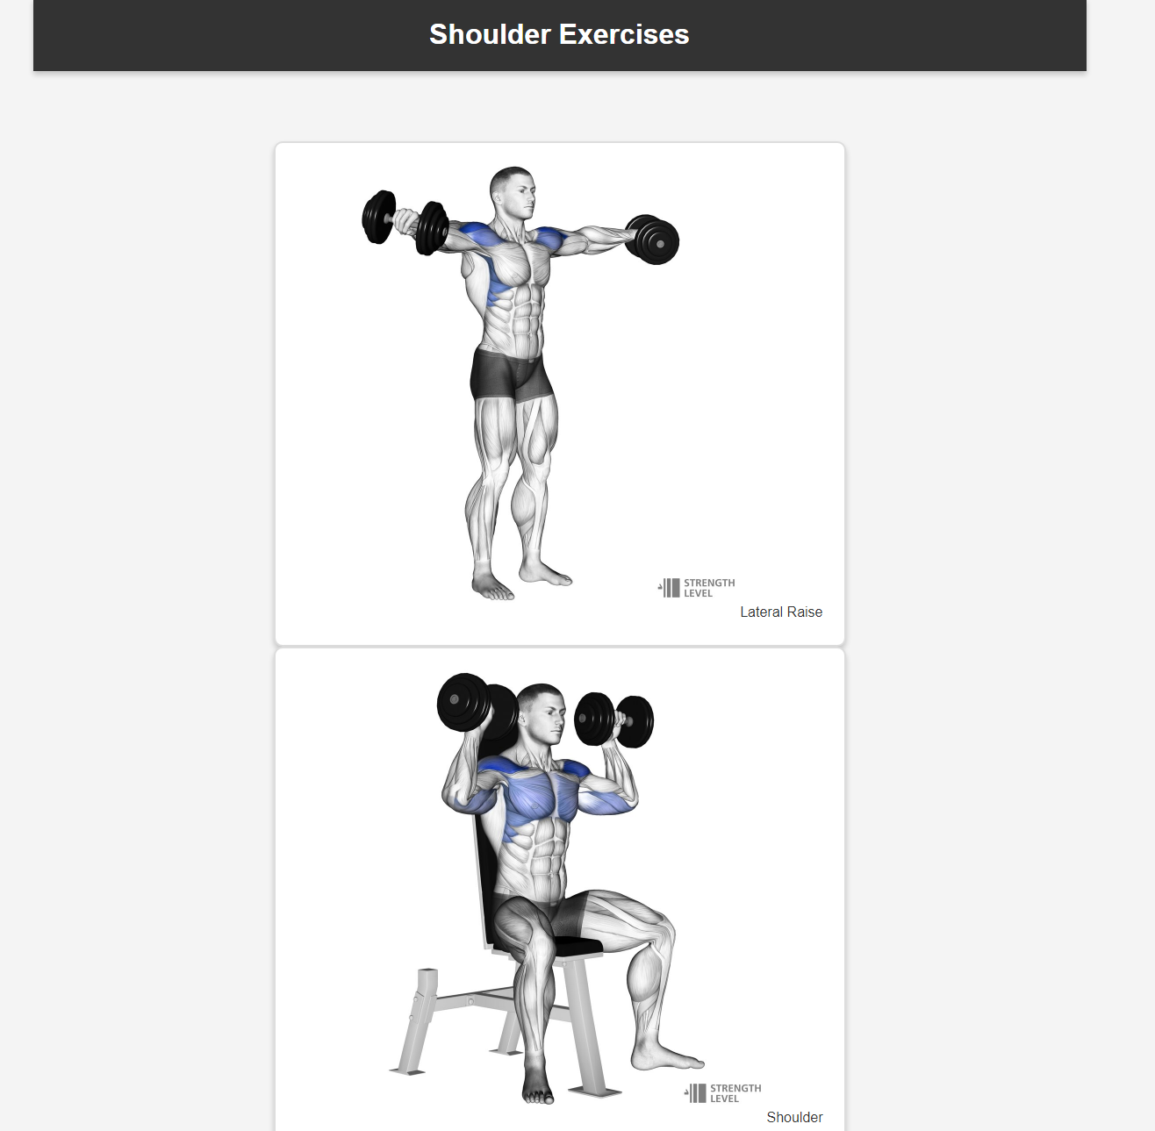
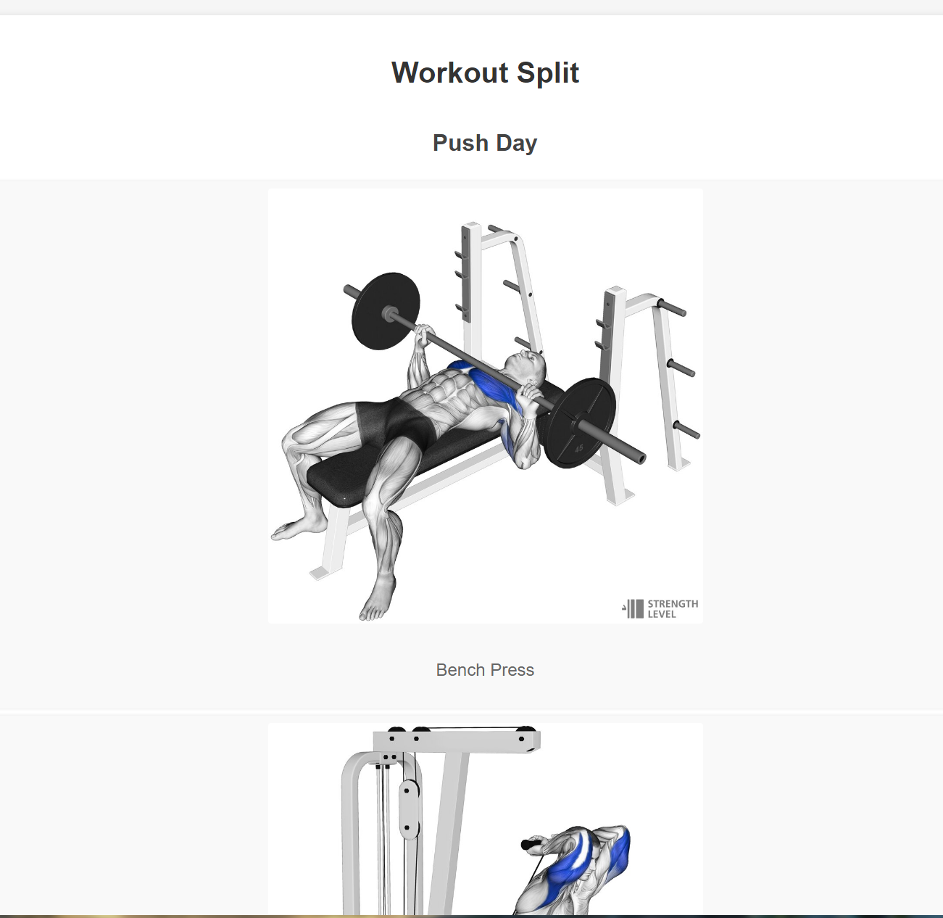
Homepage/Planner/Fitness Gallery
The Homepage is the center of our app. This is where the user can navigate to all other features in the app.
The Planner gives exercises for the workout split push/pull/legs. This is good for people who are just starting at the gym and need to find a workout.
The Fitness Gallery is where the users can find workouts for every body part.
The Gallery has clickable images that, when clicked on, take the user to a screen with workouts for the selected body part.

Slide 4
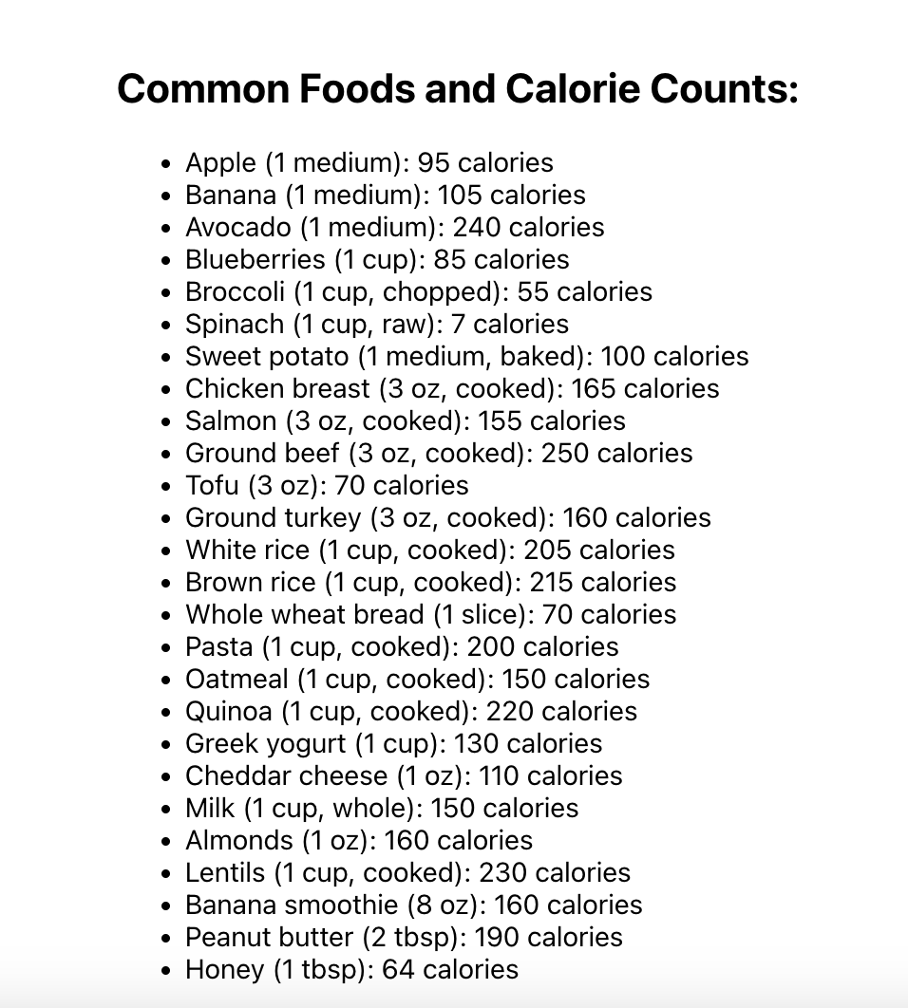
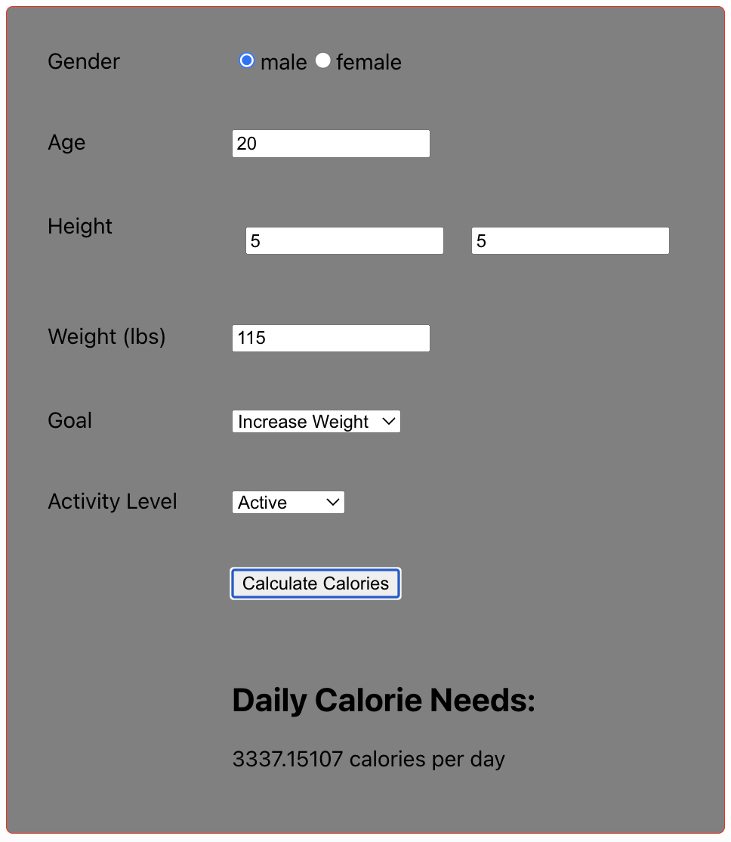
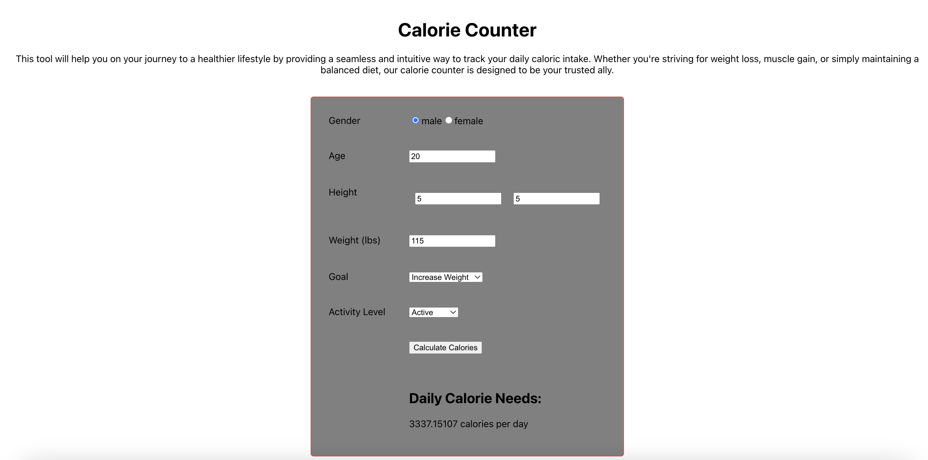
Calorie Counter
Gives user an estimated daily calorie consumption based on their inputs.

Slide 5
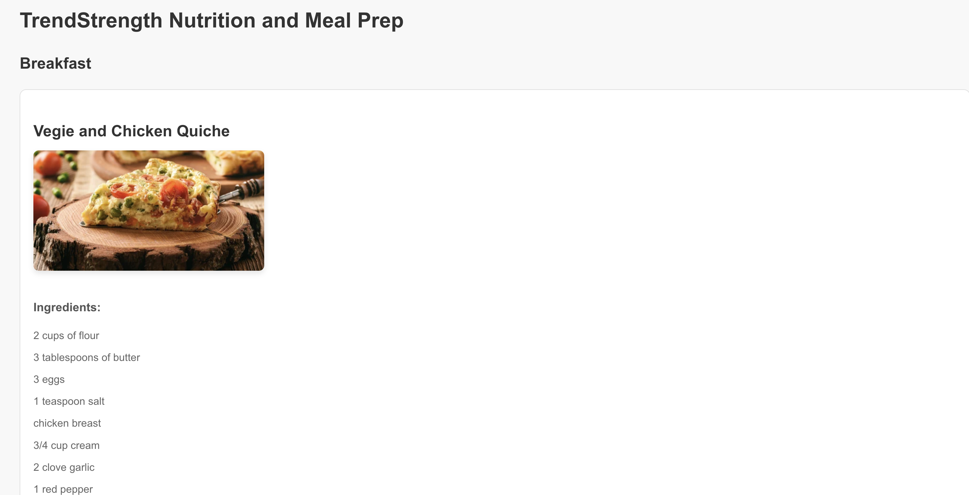
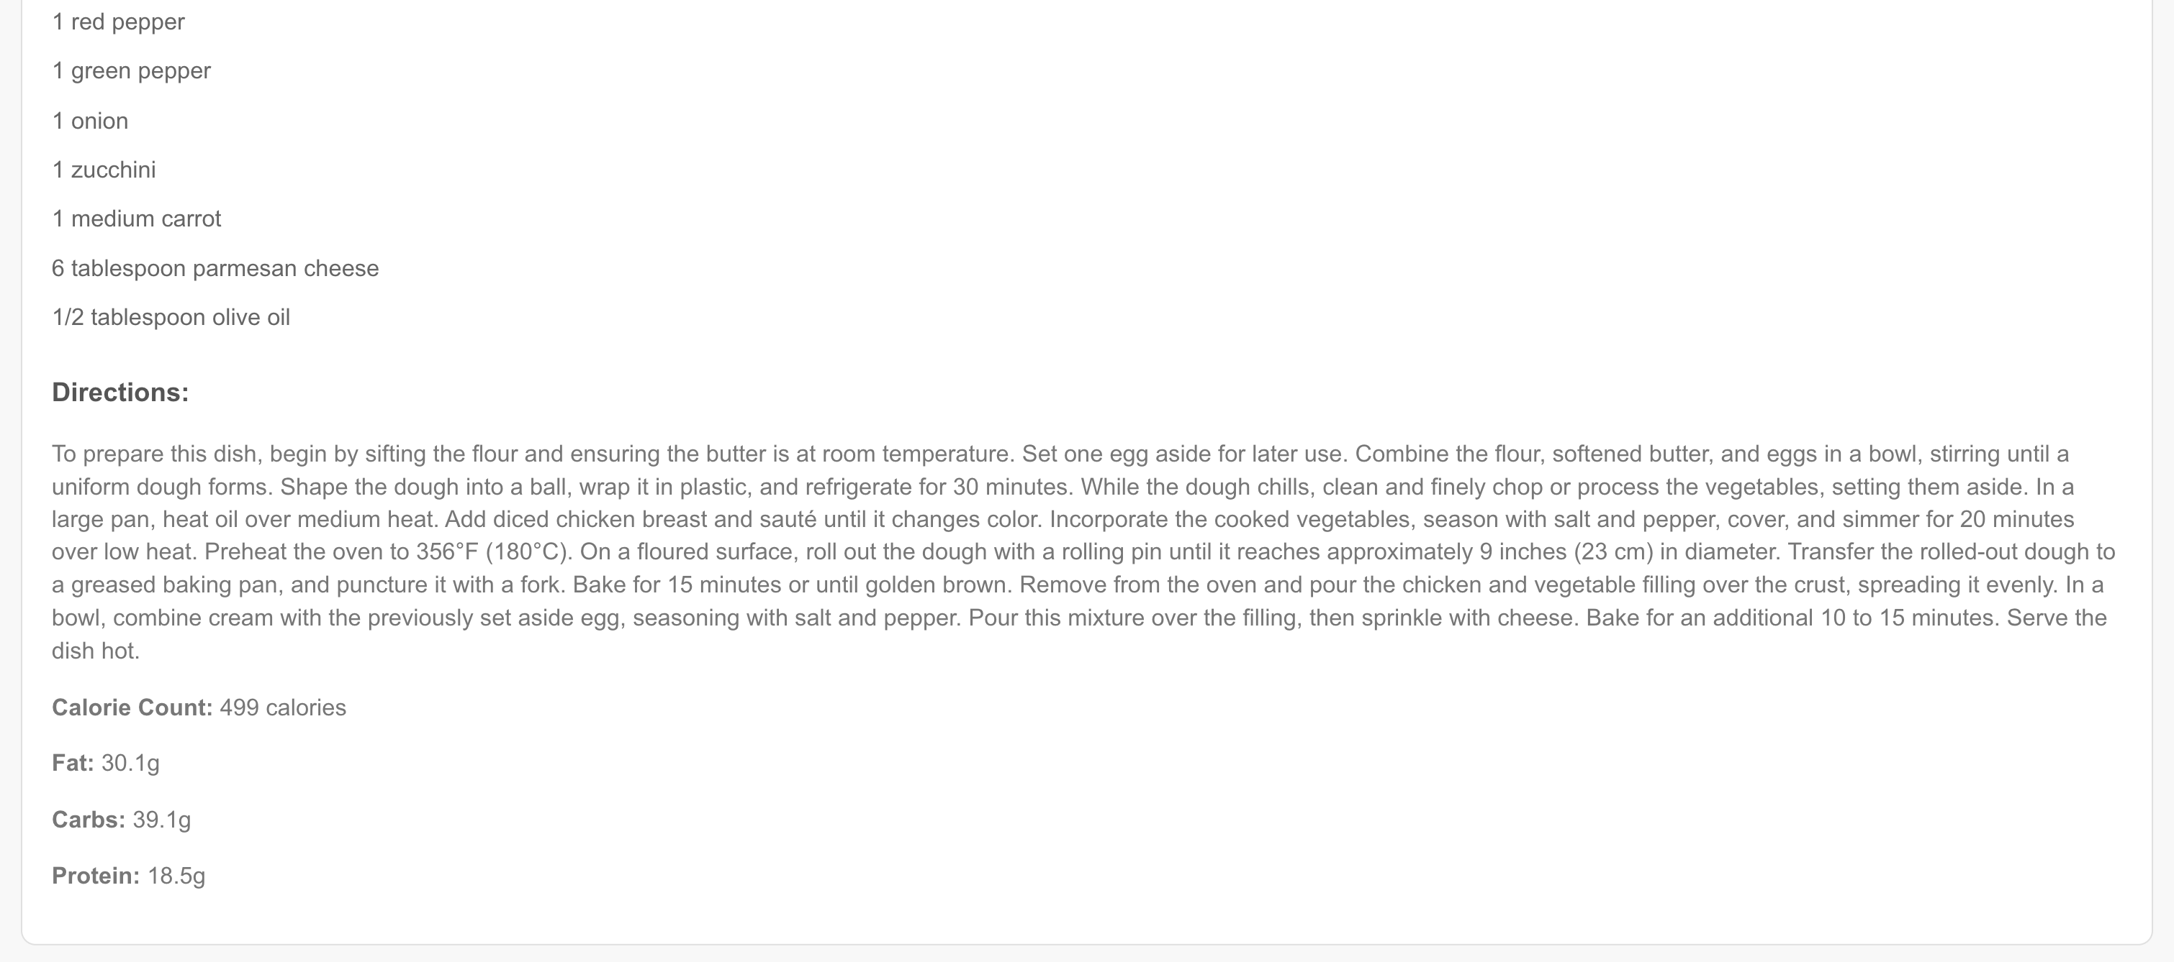
Nutrition Page
Meal Planning sectioned for breakfast, lunch and dinner
Each meal has an ingredient list and directions.
Includes calorie count for each meal and other nutritional data like amount of carbs, fats, and protein.

Slide 6
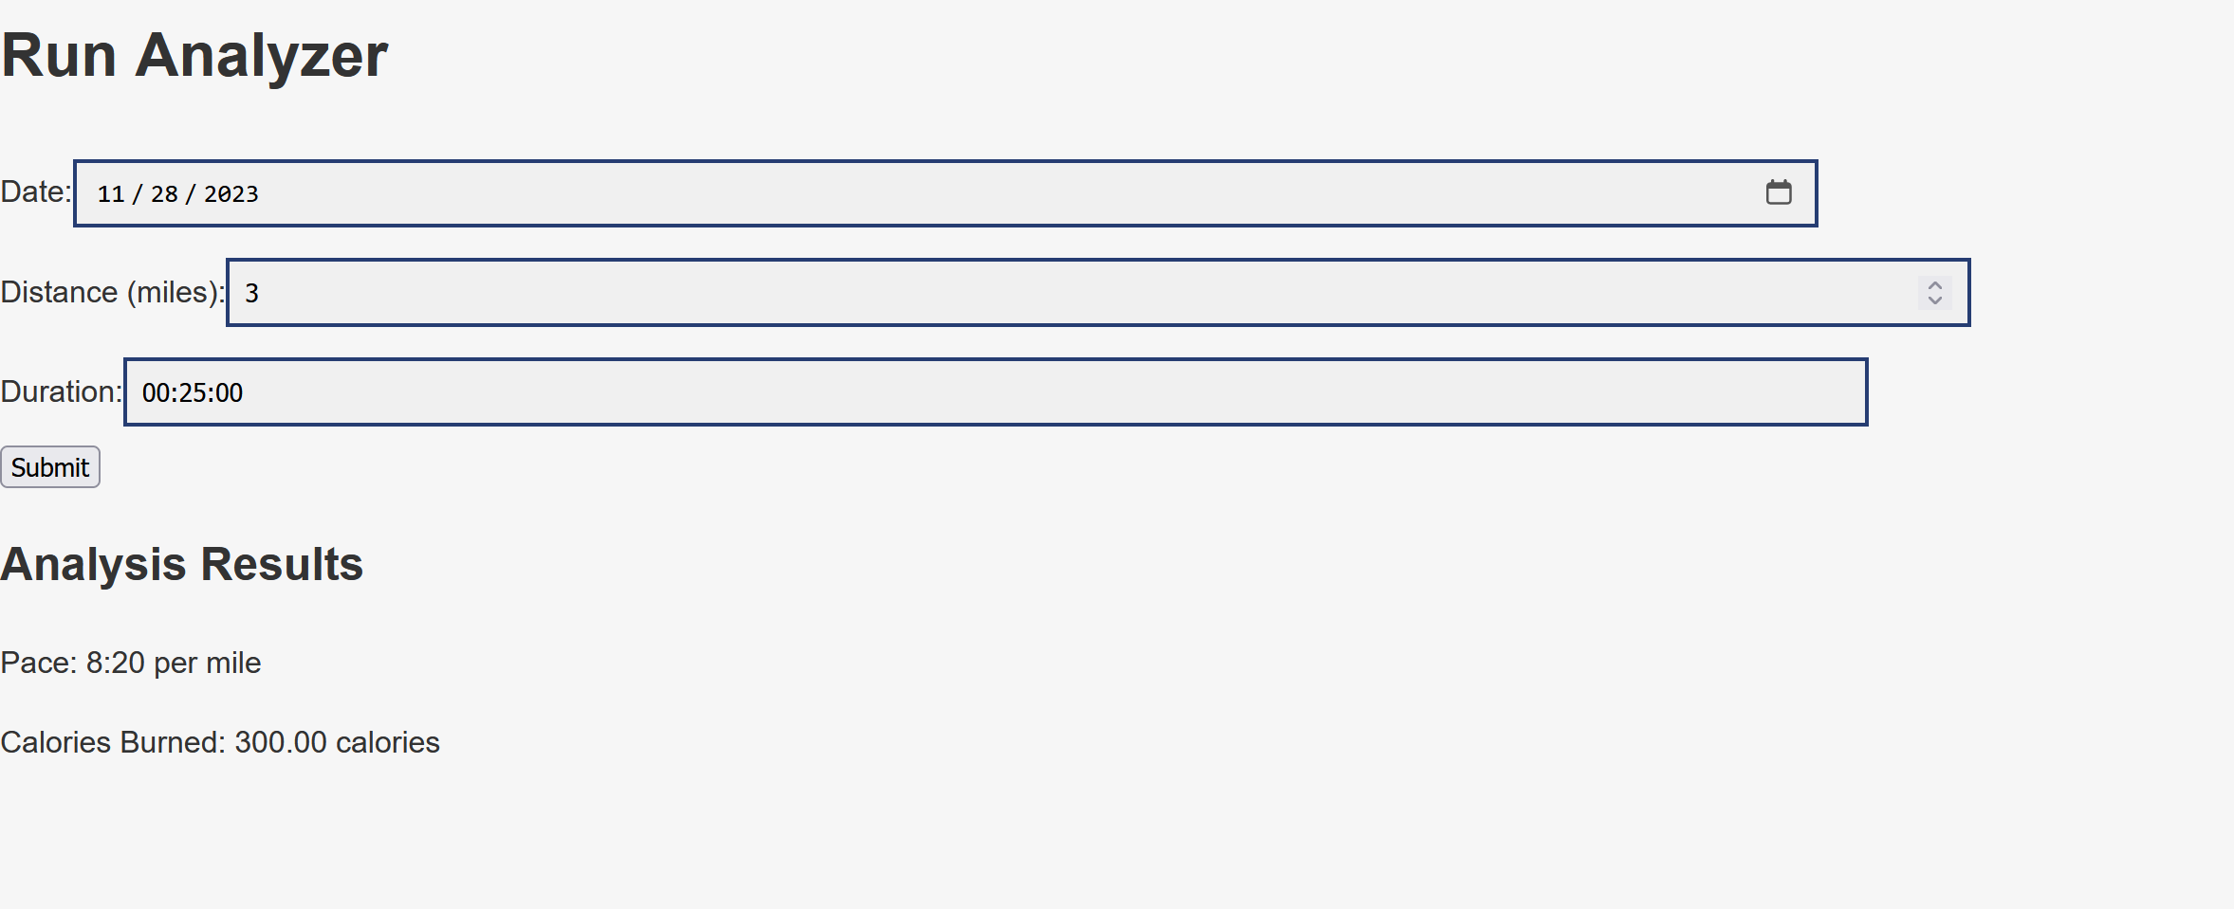

Frontend/Backend
Run analyzer page
takes mileage/time
shows mile pace and calories burned
Backend
MongoDB
user data
run data
Helped with authentication

Slide 7
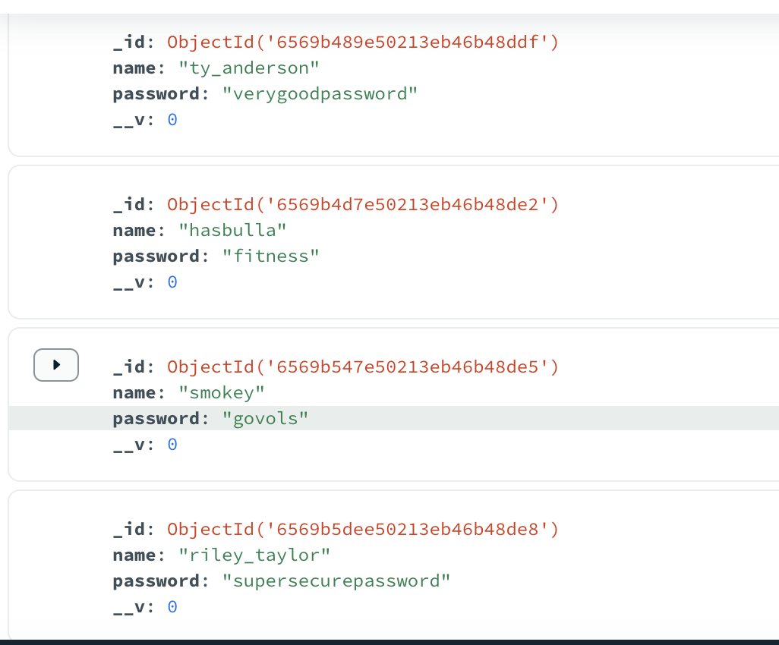
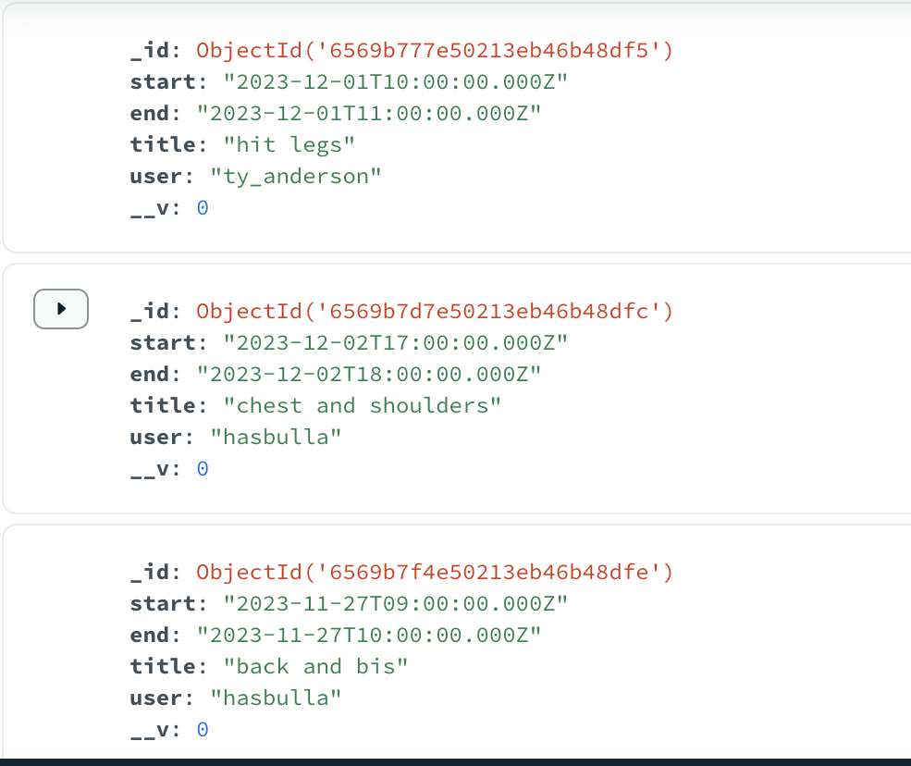
API and Storing User Data

