Slide 1

MECHANISTIC GUI ANALYSIS
When attention
stops being generic
Action-token attribution for static GUI grounding and multi-turn visual memory
Holo 3.1 4B · local Metal traces · 21 Sep 2026
Notes:
0:00–0:35 — Frame the question: what is specific to the current instruction after removing generic image saliency, and can the same machinery follow evidence across a multi-turn trajectory? The visual is the final prompt-differential map for the ScreenSpot visual hit. Source: data/attributions/screenspot-powerpoint_windows_59/analysis.json.

Slide 2
EVALUATION
02
Static grounding and trajectory memory expose different failures
STATIC
MULTI-TURN
ScreenSpot-Pro
Synthetic hotel search
One screenshot, one instruction, one click
Four model calls retain every earlier screenshot
Visual hit
Grounding miss
01
SCROLL
500 px
Psychedelic vibrant
Create new slide
02
SCROLL
500 px
03
SCROLL
500 px
These examples share PowerPoint on Windows, but use different images and prompts. They illustrate failure modes rather than form a matched causal pair.
04
CLICK
miss
Target: Signal Quay Rooms at $172
ScreenSpot-Pro supplies real GUI cases · the deterministic hotel fixture supplies replayable trajectories
Notes:
0:35–1:25 — Separate the two settings. ScreenSpot gives real high-resolution grounding examples. The synthetic hotel task gives exact replay and multi-frame memory. The two PowerPoint examples are not a same-image success/failure pair, so use them to motivate hypotheses rather than causal claims. The hotel trace is a Holo failure after three scrolls and one click. Sources: docs/screenspot-case-study.md and data/attributions/traj-20260919T164806Z-ba81a14a16/trajectory.json.

Slide 3
CALCULATION
03
From generated coordinate tokens back to image patches
1
VALUE-NORM
2
CROSS-LAYER ROLLOUT
3
TOKEN → PARAMETER
A′ = normalize(A ⊙ ‖V‖₂)
Rₗ = ½I + ½A′ₗ
R = Rₗ ··· R₁
M(x,y) = meanₛ Rₛ
Suppress high attention paths carrying little value signal
Compose all 8 captured full-attention blocks with residual flow
Average x/y value-token maps; token length cannot inflate a parameter
Two baselines ask different questions
CAUSAL PREVIOUS-TOKEN
SAME-IMAGE INSTRUCTION ENSEMBLE
Dtoken = M(x,y) − mean(M(s < start(x)))
Dprompt = Mtarget − mean(Mcontrol,k)
What is above the generation state already present before the coordinate sequence?
What is specific to this instruction after subtracting inherent image saliency?
Implementation: docs/attention-attribution.md · tests/test_attribution.py · tests/test_contrast.py
Notes:
1:45–3:10 — Walk left to right. Value-norm changes the routing matrix before rollout. Rollout mixes attention and identity 50/50 and multiplies the eight conventional full-attention layers in model order. Then average only the generated x/y value tokens. Emphasize strict causality for the token baseline and exact same image/settings for prompt controls. Hybrid linear-attention blocks are omitted because they expose no square softmax matrix.

Slide 4

VISUAL GROUNDING HIT
04
Subtracting image saliency reveals the selected template
“Create a Psychedelic vibrant presentation”
RAW ROLLOUT
TARGET − PROMPT BASELINE
TARGET LIFT
PEAK
TARGET LIFT
PEAK
3.85×
outside
16.08×
inside
raw rollout
generic top-left saliency
instruction differential
3.2% of frame diagonal away
Local trace: powerpoint_windows_59 · 4 same-image controls · LOO cosine 0.925 mean / 0.828 minimum
Notes:
2:35–3:45 — This slide establishes the measurement we use from here onward. The raw map is dominated by stable top-left saliency. With four diverse same-image prompts averaged after per-request L1 normalization, the peak moves inside the annotated template and lift rises from 3.85× to 16.08×. Leave-one-control-out cosine is 0.925 mean and 0.828 minimum. The repaired click is visually correct at (1394, 632), but the original tool syntax is malformed, so official correctness remains false. Source: data/attributions/screenspot-powerpoint_windows_59/analysis.json.

Slide 5
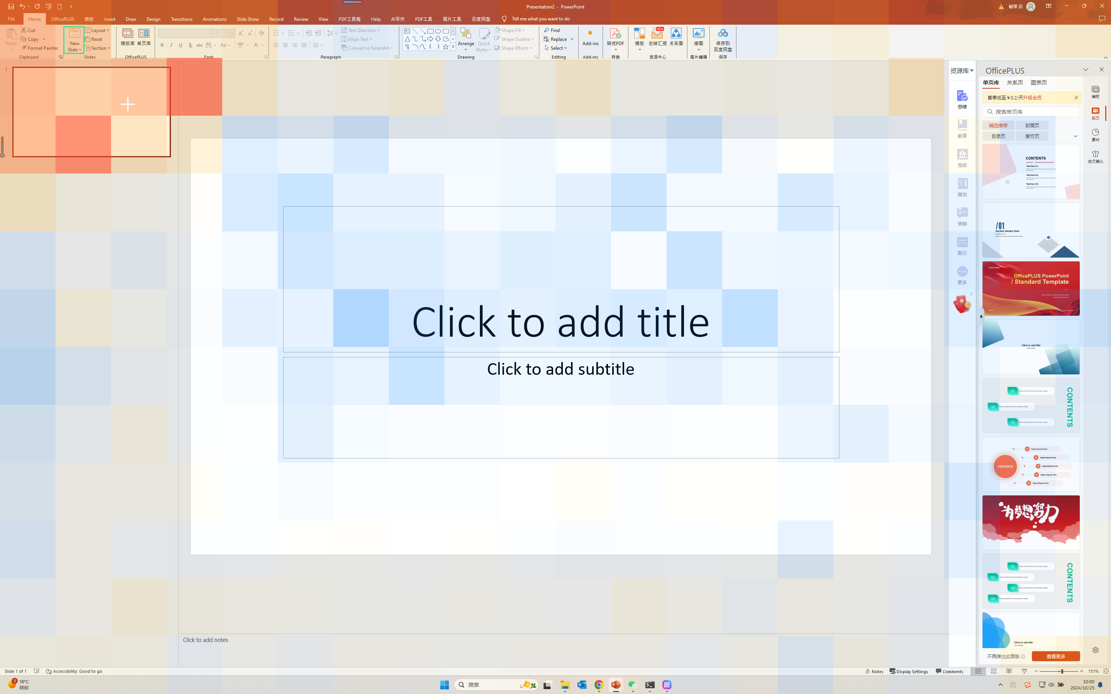
GROUNDING MISS
05
The right region wins, but the wrong affordance receives the click
Instruction: Create new slide
GROUNDING MISS
The differential map concentrates in the correct top-left task region…
…but its peak lands on the slide thumbnail, not the tiny New Slide button.
Predicted click
(331, 270)
Prompt-diff peak
9.9% diag away
The model resolves the intent class, but not the target binding needed for action.
Local trace: powerpoint_windows_48 · prompt-baseline stability 0.970 mean / 0.953 minimum
Notes:
3:45–4:45 — From this point, headline the same-image instruction differential rather than raw attention. The differential favors the top-left slide and ribbon region, yet its peak is on the slide thumbnail and the click lands there. The target itself is only 0.074% of the frame. This is compatible with fine-grained binding or localization failure after coarse semantic routing. Source: data/attributions/screenspot-powerpoint_windows_48/analysis.json.

Slide 6
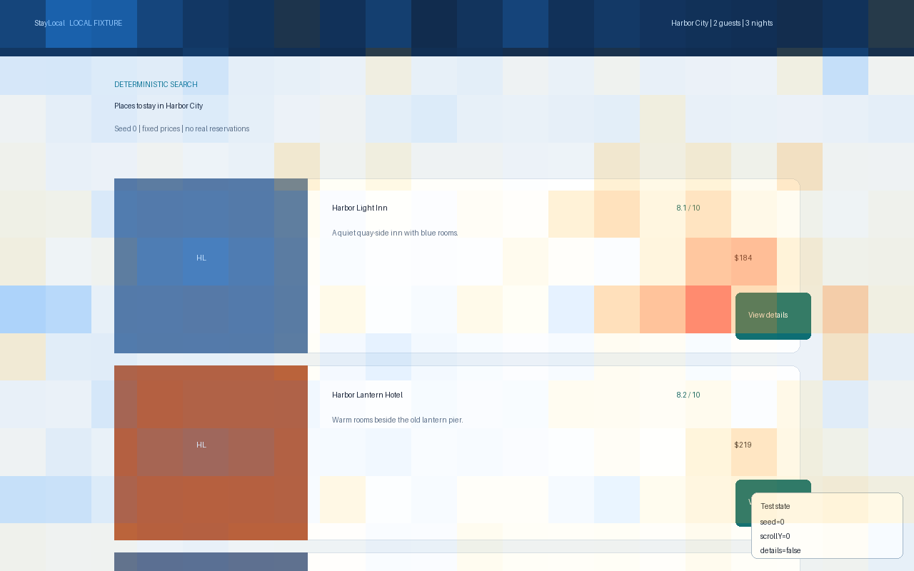
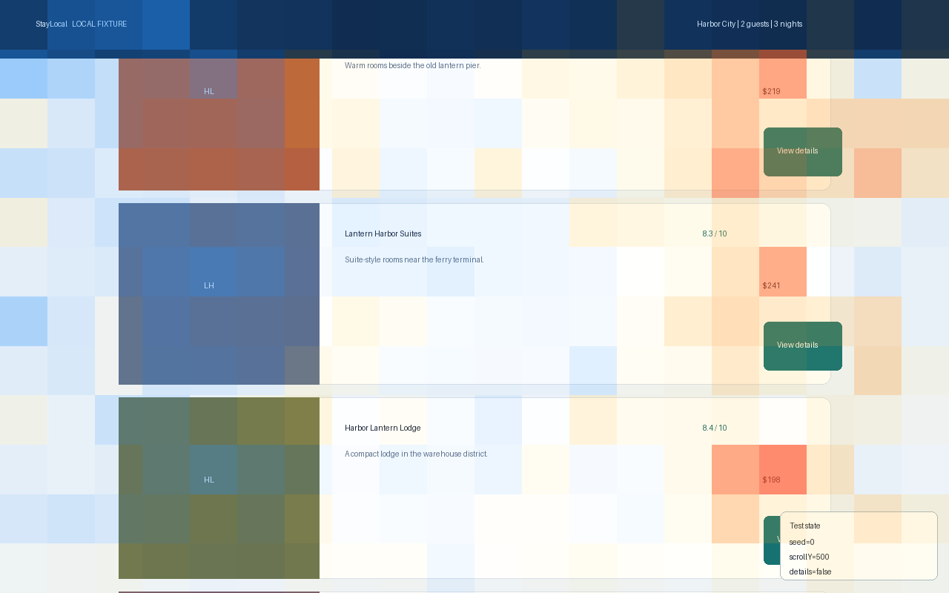
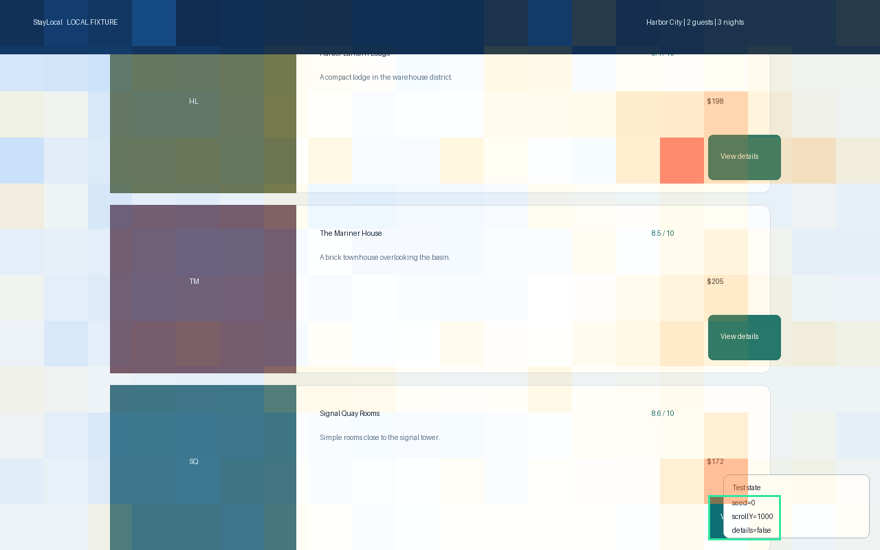
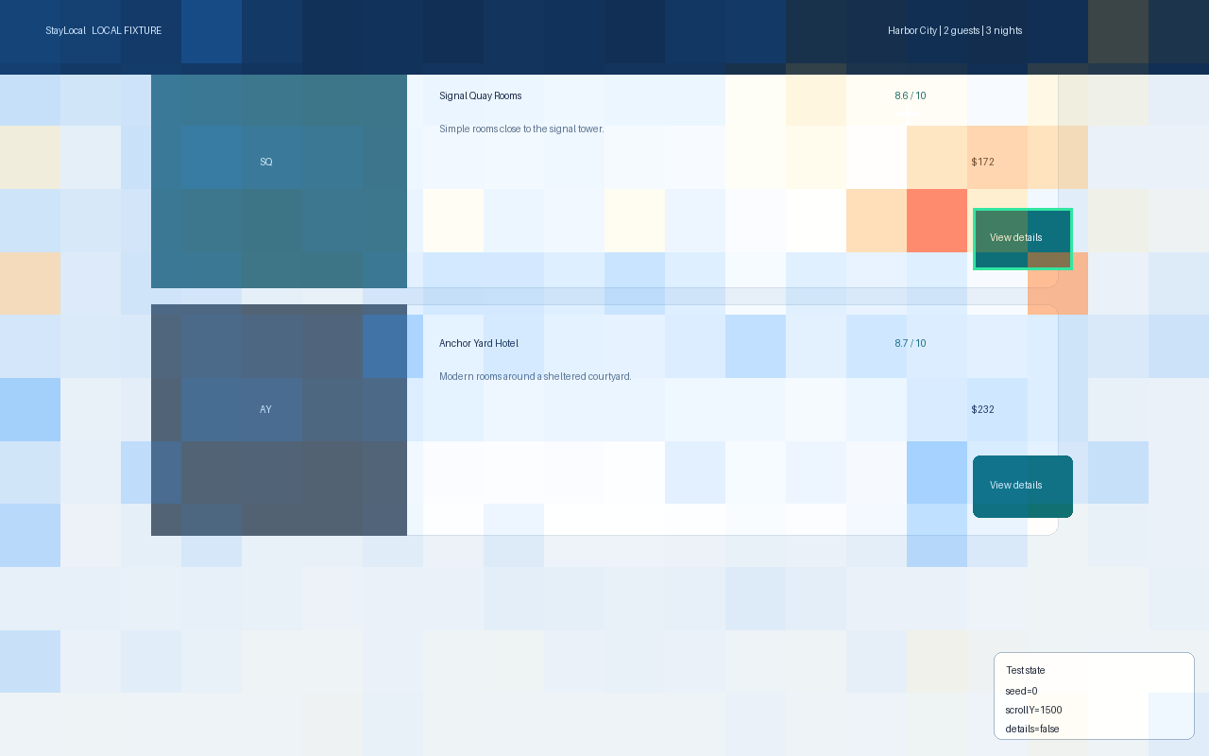
MULTI-TURN PROMPT BASELINE
06
The right hotel is retrieved, then its button is missed
Target minus same-history instruction ensemble for the final x/y coordinate tokens
FRAME 0 · START
FRAME 1 · SCROLL 500
FRAME 2 · TARGET APPEARS
FRAME 3 · CLICK
EARLIER-FRAME TARGET LIFT
CURRENT-FRAME TARGET LIFT
ISSUED CLICK
2.78×
8.59×
MISS
frame 2: target button at viewport edge
frame 3: prompt differential
(960,120): correct card, wrong affordance
Interpretation
Peak remains outside the button. Attention is diagnostic evidence, not a causal explanation of the miss.
Semantic retrieval survives across frames; precise action binding does not.
3 included controls · 1 excluded without a y span · LOO cosine 0.898 mean / 0.769 minimum
Notes:
4:45–6:05 — Every probe receives the identical four screenshots and identical three-scroll action history. Only the requested click target changes. We normalize each request across every patch in all four frames, average three usable control maps, then subtract. The cheapest hotel button has 2.78× lift when it first appears at the bottom of frame 2 and 8.59× in the current frame. Yet the peak stays outside the button and Holo clicks (960,120), on the Signal Quay card rather than View details. One fourth control was excluded because generation omitted a y parameter span. The cautious claim is semantic retrieval with failed affordance localization, not causal proof. Source: data/attributions/hotel-cheapest-multiframe-contrast/analysis.json.

Slide 7
LAYER LENS
07
Mid-late routing may be an early correctness feature
LAYER 19
38.99×
static hit
10.47×
hotel miss
2.88×
static miss
Prospective test
Fit a tiny outcome or ambiguity readout on frozen layer features.
Evaluate held-out Brier score, ECE, and selective risk. N=3 examples cannot establish confidence.
Per-head rows use direct value-norm attention; multiplied rollout has no unique head identity
Notes:
6:05–7:20 — Add the hotel miss to the layer view. The visual hit separates sharply at layers 15 to 27, while the two misses remain lower, although the hotel miss has a moderate layer-19 signal. This suggests a candidate feature family, not a calibrated confidence score. A proper experiment freezes the backbone, fits a tiny readout on training cases, and evaluates Brier score, expected calibration error, and selective risk on a held-out split. Head-level examples remain direct value-norm attention because cross-layer rollout destroys unique head identity. Sources: layer_head_statistics in the three local analysis files.

Slide 8
RESEARCH DIRECTIONS
08
Turn a diagnostic into testable model improvements
01
CALIBRATED DECISION HEADS
02
CAUSAL VALIDATION
Predict action success, ambiguity, and safety-refusal risk. Train with proper scoring rules; trigger clarification or abstention by calibrated thresholds.
Mask, patch-swap, ablate, or activation-patch the highlighted regions. Ask whether changing the routed evidence changes the action.
03
LONG-HORIZON VISUAL MEMORY
04
FINE-TUNING DELTA LENS
Measure which historical frame supplies evidence, then learn retrieval or compression that preserves task-relevant patches without full-frame quadratic cost.
Teacher-force identical action tokens through base Qwen and Holo. Compare where instruction-specific routing appears, disappears, or sharpens.
TRAINING LOOP
Oracle SFT → measured mid-training lift → GRPO + LoRA with verifiable environment reward
Use attribution for audit and diagnosis, not as the reward target.
The highest-value next result is an intervention, not a prettier heatmap
Notes:
7:20–8:35 — Four directions follow directly from the evidence. First, calibrated heads can support success prediction, ambiguity clarification, and safety refusal, but must be judged by proper scoring rules and held-out selective risk. Second, causal interventions test faithfulness. Third, the full-resolution four-frame probe exposed a quadratic memory bottleneck, motivating learned visual memory retrieval or compression. Fourth, a teacher-forced base-Qwen versus Holo comparison can localize what tool fine-tuning changed. The training program remains oracle SFT, measured lift, then GRPO plus LoRA with verifiable reward. Do not optimize the heatmap itself.

Slide 9
TAKEAWAYS
09
A baseline-first story, with falsifiable next steps
01
Remove general awareness
Same-image instruction controls make target-specific routing visible.
LIVE DEMO · 90 SECONDS
1
Static hit: raw → prompt difference
Peak enters the selected template.
02
Separate retrieval from binding
Both misses find a relevant region but fail at precise affordance selection.
2
Static miss: inspect click binding
Correct task region, wrong tiny affordance.
3
Hotel trace: step through four frames
03
Treat layers as candidate features
Evidence appears before the failed final click.
Calibrate and intervene before calling them confidence or mechanism.
4
Sort layer and head statistics
Turn observations into intervention hypotheses.
Next decisive experiment: patch intervention across a frozen, matched evaluation split
Viewers: ScreenSpot hit + miss · artifacts/screenspot-presentation/live/hotel-cheapest-multiframe/viewer.html
Notes:
8:35–10:00 — Close on three defensible conclusions. The prompt ensemble changes the measurement materially. Correct and incorrect cases can share coarse routing while differing in precise binding. Layer patterns are candidate readout features, not confidence by themselves. In the live demo, show raw versus prompt differential on the hit, the static miss, then step through all four hotel frames and point out the earlier-frame and final-frame target lift. Finish with the intervention experiment. Q&A: attention is a routing diagnostic, the controls are matched but small, and these three cases are hypothesis-generating rather than population estimates.

