Slide 1

MECHANISTIC GUI ANALYSIS
When attention
stops being generic
Action-token attribution for static GUI grounding and multi-turn visual memory
Holo 3.1 4B · local Metal traces · 21 Sep 2026
Notes:
0:00–0:35 — Frame the question: what is specific to the current instruction after removing generic image saliency, and can the same machinery follow evidence across a multi-turn trajectory? The visual is the final prompt-differential map for the ScreenSpot visual hit. Source: data/attributions/screenspot-powerpoint_windows_59/analysis.json.

Slide 2
EVALUATION
02
Static grounding and trajectory memory expose different failures
STATIC
MULTI-TURN
ScreenSpot-Pro
Synthetic hotel search
One screenshot, one instruction, one click
Four model calls retain every earlier screenshot
Visual hit
Grounding miss
01
SCROLL
500 px
Psychedelic vibrant
Create new slide
02
SCROLL
500 px
03
SCROLL
500 px
These examples share PowerPoint on Windows, but use different images and prompts. They illustrate failure modes rather than form a matched causal pair.
04
CLICK
miss
Target: Signal Quay Rooms at $172
ScreenSpot-Pro supplies real GUI cases · the deterministic hotel fixture supplies replayable trajectories
Notes:
0:35–1:15 — Separate the two settings. ScreenSpot gives real high-resolution grounding examples. The synthetic hotel task gives exact replay and multi-frame memory. The two PowerPoint examples are not a same-image success/failure pair, so use them to motivate hypotheses rather than causal claims. The hotel trace is a Holo failure after three scrolls and one click. Sources: docs/screenspot-case-study.md and data/attributions/traj-20260919T164806Z-ba81a14a16/trajectory.json.

Slide 3
FULL BENCHMARK REPLICATION
03
65.9% overall, with icon targets driving most errors
Holo3.1-4B, official element-localization harness, all 1,581 ScreenSpot-Pro items
65.9%
ACCURACY BY TARGET UI
WEAKEST LABELED CELL
44.0%
Icon + file actions
1,042 correct out of 1,581
36.1%
13 / 36 correct
Reported 4B reference ≈ 66.5%
79.4%
Difference: −0.6 percentage point
The larger icon + navigation cell is also low: 40.3% on 149 items.
100% valid JSON responses
UI TYPE × INSTRUCTION ACTION FAMILY
Accuracy with item count in each cell
UI TYPE | NAVIGATE REVEAL | SELECT ACTIVATE | CREATE INSERT | EDIT FORMAT | REMOVE CLOSE | FILE TRANSFER | OTHER
ICON | 40.3% n=149 | 52.6% n=76 | 43.2% n=81 | 45.0% n=80 | 59.6% n=52 | 36.1% n=36 | 39.2% n=130
TEXT | 77.0% n=161 | 80.8% n=151 | 80.3% n=152 | 79.4% n=180 | 85.1% n=47 | 86.0% n=43 | 77.4% n=243
Action families use a fixed keyword dictionary and are diagnostic, not official ScreenSpot-Pro labels. Windows icons: 39.6% on 379 items.
Notes:
1:15–2:10 — This is the complete local replication, not a selected subset: 1,581 items, 1,042 strict point-in-box successes, no request failures, and 100% valid JSON. The 65.9% result is 0.6 percentage point below the approximately 66.5% Holo3.1-4B reference supplied by the project owner. The large split is target representation: text targets reach 79.4%, while icons reach 44.0%. Windows icon targets are the largest weak platform cell at 39.6% over 379 items. The bottom matrix uses a deterministic diagnostic taxonomy: tokenize the English instruction, scan left to right, and assign the first recognized verb from a fixed dictionary. Icon plus file or transfer actions are lowest at 36.1% on 36 items. Icon plus navigation or reveal is the larger weak cell at 40.3% on 149 items. Text targets stay between 77.0% and 86.0% across action families. Sources: data/remote-results/run/screenspot-full-official/summary.json and scripts/summarize_screenspot_benchmark.py. The action taxonomy is not an official ScreenSpot-Pro label.

Slide 4
CALCULATION
04
From generated coordinate tokens back to image patches
1
VALUE-NORM
2
CROSS-LAYER ROLLOUT
3
TOKEN → PARAMETER
A′ = normalize(A ⊙ ‖V‖₂)
Rₗ = ½I + ½A′ₗ
R = Rₗ ··· R₁
M(x,y) = meanₛ Rₛ
Suppress high attention paths carrying little value signal
Compose all 8 captured full-attention blocks with residual flow
Average x/y value-token maps; token length cannot inflate a parameter
Two baselines ask different questions
CAUSAL PREVIOUS-TOKEN
SAME-IMAGE INSTRUCTION ENSEMBLE
Dtoken = M(x,y) − mean(M(s < start(x)))
Dprompt = Mtarget − mean(Mcontrol,k)
What is above the generation state already present before the coordinate sequence?
What is specific to this instruction after subtracting inherent image saliency?
Implementation: docs/attention-attribution.md · tests/test_attribution.py · tests/test_contrast.py
Notes:
2:10–3:20 — Walk left to right. Value-norm changes the routing matrix before rollout. Rollout mixes attention and identity 50/50 and multiplies the eight conventional full-attention layers in model order. Then average only the generated x/y value tokens. Emphasize strict causality for the token baseline and exact same image/settings for prompt controls. Hybrid linear-attention blocks are omitted because they expose no square softmax matrix.

Slide 5

VISUAL GROUNDING HIT
05
Subtracting image saliency reveals the selected template
“Create a Psychedelic vibrant presentation”
WHITE RING = ISSUED CLICK
RAW ROLLOUT
TARGET − PROMPT BASELINE
TARGET LIFT
PEAK
TARGET LIFT
PEAK
3.85×
outside
16.08×
inside
raw rollout
generic top-left saliency
instruction differential
3.2% of frame diagonal away
Local trace: powerpoint_windows_59 · 4 same-image controls · LOO cosine 0.925 mean / 0.828 minimum
Notes:
3:20–4:20 — This slide establishes the measurement we use from here onward. The raw map is dominated by stable top-left saliency. With four diverse same-image prompts averaged after per-request L1 normalization, the peak moves inside the annotated template and lift rises from 3.85× to 16.08×. Leave-one-control-out cosine is 0.925 mean and 0.828 minimum. The repaired click is visually correct at (1394, 632), but the original tool syntax is malformed, so official correctness remains false. Source: data/attributions/screenspot-powerpoint_windows_59/analysis.json.

Slide 6
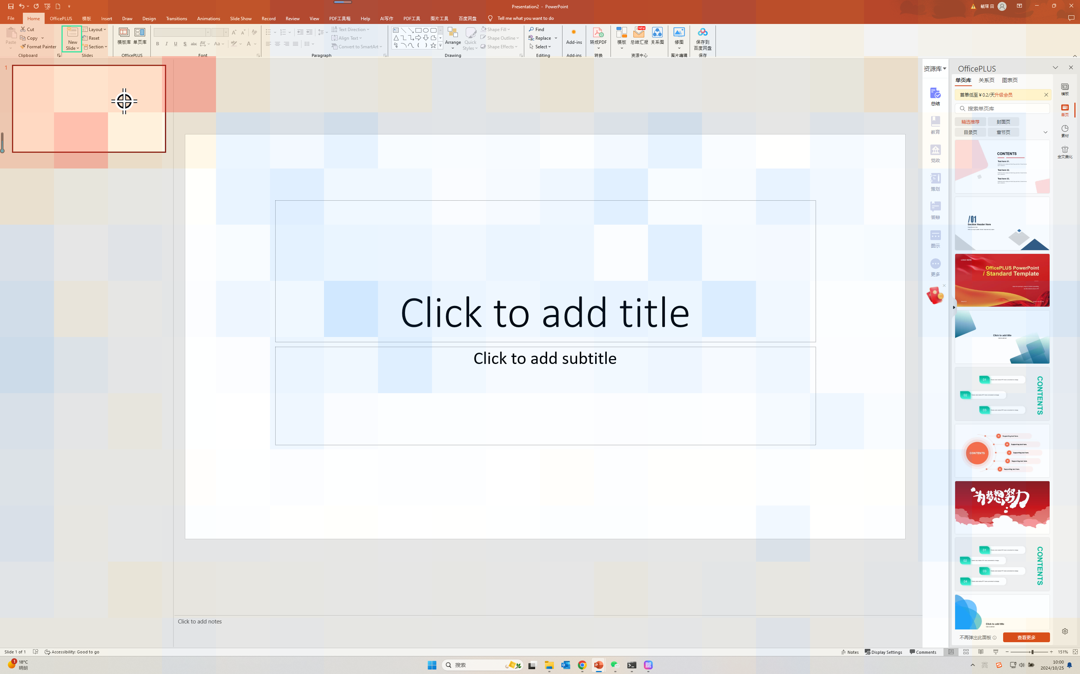
GROUNDING MISS
06
The right region wins, but the wrong affordance receives the click
Instruction: Create new slide
WHITE RING = ISSUED CLICK
GROUNDING MISS
The differential map concentrates in the correct top-left task region…
…but its peak lands on the slide thumbnail, not the tiny New Slide button.
Predicted click
(331, 270)
Prompt-diff peak
9.9% diag away
The model resolves the intent class, but not the target binding needed for action.
Local trace: powerpoint_windows_48 · prompt-baseline stability 0.970 mean / 0.953 minimum
Notes:
4:20–5:15 — From this point, headline the same-image instruction differential rather than raw attention. The differential favors the top-left slide and ribbon region, yet its peak is on the slide thumbnail and the click lands there. The target itself is only 0.074% of the frame. This is compatible with fine-grained binding or localization failure after coarse semantic routing. Source: data/attributions/screenspot-powerpoint_windows_48/analysis.json.

Slide 7
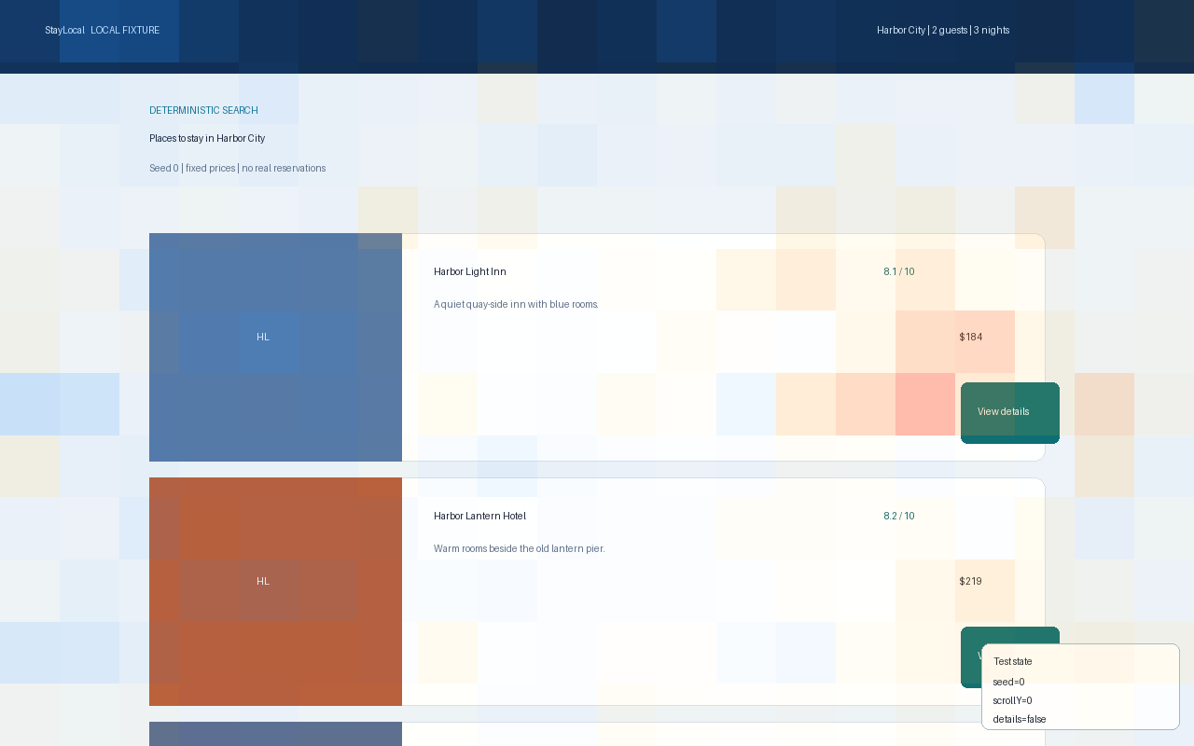
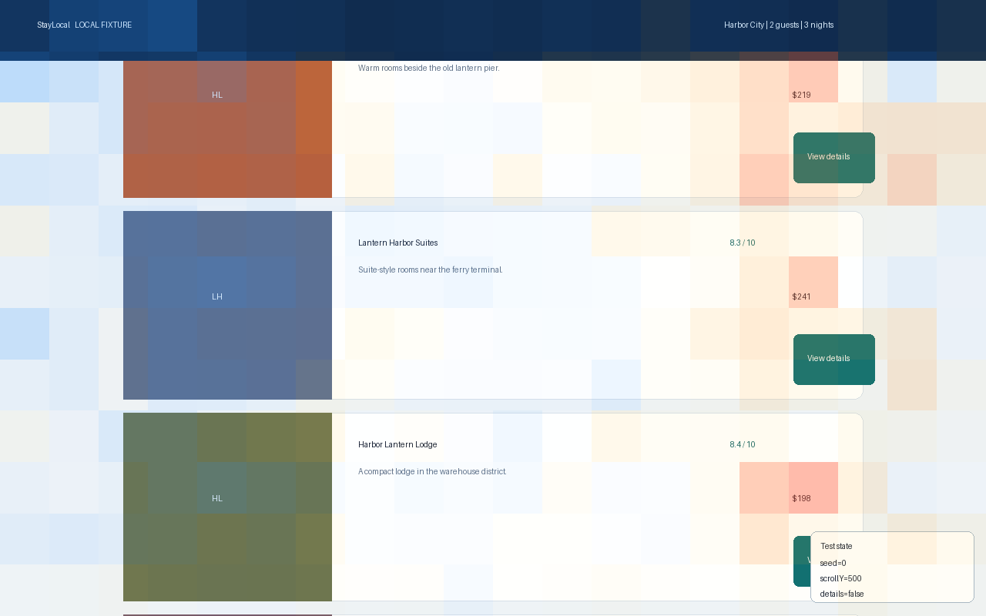
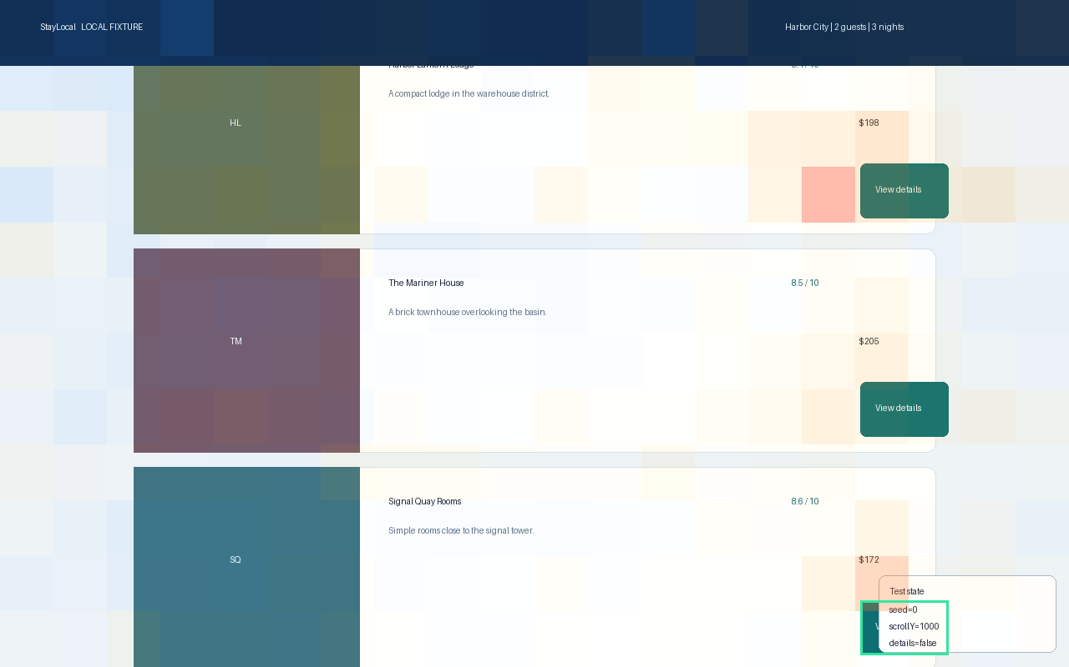
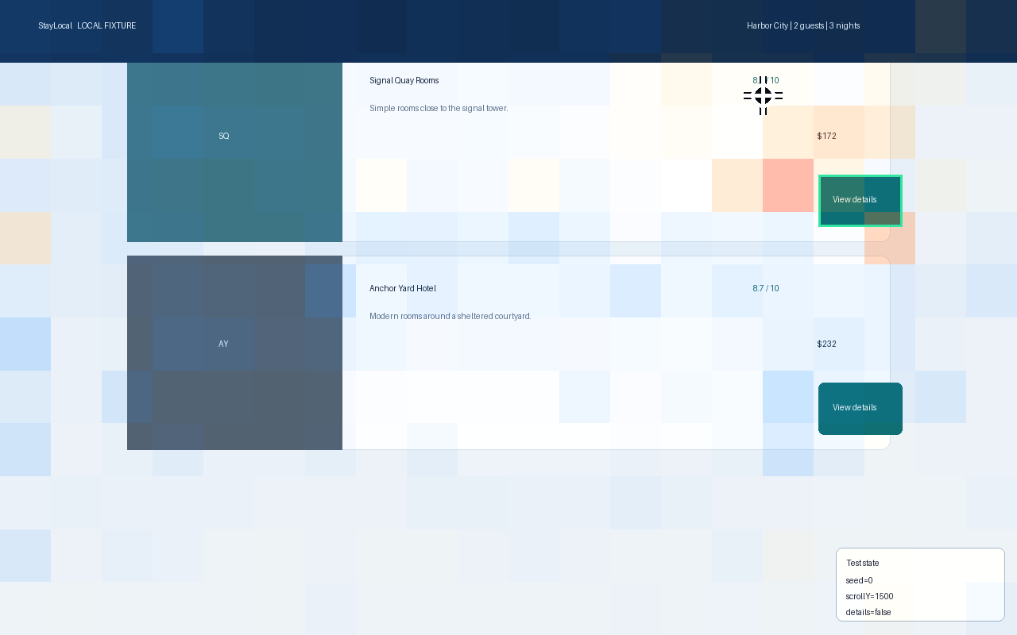
MULTI-TURN PROMPT BASELINE
07
The right hotel is retrieved, then its button is missed
Target minus same-history instruction ensemble for the final x/y coordinate tokens
WHITE RING = CLICK
FRAME 0 · START
FRAME 1 · SCROLL 500
FRAME 2 · TARGET APPEARS
FRAME 3 · CLICK
EARLIER-FRAME TARGET LIFT
CURRENT-FRAME TARGET LIFT
ISSUED CLICK
2.78×
8.59×
MISS
frame 2: target button at viewport edge
frame 3: prompt differential
(960,120): correct card, wrong affordance
Interpretation
Shifted-layout follow-up: £122 gets 4.12× causal lift vs 0.81× for £135, yet the malformed click still misses.
Semantic retrieval survives across frames; precise action binding does not.
Resolution caveat: 1280×800 source → 640×384 vision raster → 20×12 merged-token map · button ≈ 1.6×1.0 token
Notes:
5:15–6:25 — Every probe receives the identical four screenshots and identical three-scroll action history. Only the requested click target changes. We normalize each request across every patch in all four frames, average three usable control maps, then subtract. The cheapest hotel button has 2.78× lift when it first appears at the bottom of frame 2 and 8.59× in the current frame. Yet the peak stays outside the button and Holo clicks (960,120), on the Signal Quay card rather than View details. Resolution is an important confound: after patch merging, this 105×65-pixel control spans only about 1.6×1.0 visual tokens, so coarse retrieval can survive while precise binding degrades. The four-frame history and longer prompt also co-vary, so this case does not isolate resolution causally. In a separate single-frame diagnostic, frozen item test-0035 moves the price column from roughly 80% to 58% of viewport width and enlarges the UI. The £122 target price receives 4.12× causal previous-token lift for x versus 0.81× on the £135 runner-up; y is 4.01× versus 0.91×. Holo still emits malformed, off-target coordinates. This supports position-robust price selection but is not a same-image prompt-baseline proof. Three controls are included in the multi-frame map; one is excluded because generation omitted a y span. LOO cosine is 0.898 mean / 0.769 minimum. Sources: data/attributions/hotel-cheapest-multiframe-contrast/analysis.json and data/attributions/hotel-test-0035-large-ui-final/target-viewer/viewer.html.

Slide 8
BALANCED LAYER AND HEAD LENS
08
Layer 19 survives the pilot, but not alone
Same-image prompt-differential target lift. 1× means spatially uniform positive residual mass. Official harness, n=4: 2 hits and 2 misses.
MEAN TARGET LIFT BY FULL-ATTENTION LAYER
L3
3.3×
WHAT REPLICATED
6.8×
L19 ranks #1
L7
L11
85.1×
158.4× mean, only 1.05× above L15
L15
151.4×
TOP HEADS FORM AN L19 CLUSTER
L19
158.4×
H11 312.1× H14 293.8×
L23
125.0×
H10 264.7× H2 245.6×
L27
94.6×
H10 ranks third within L19 and is never the top L19 head on an individual item.
L31
67.0×
ITEM | OUTCOME | L19 LIFT | L19 RANK | L19/H10 | H10 RANK
PowerPoint text | HIT | 373.0× | #3 | 661.1× | #3
PowerPoint text | MISS | 2.2× | #5 | 1.4× | #7
Windows icon | HIT | 214.3× | #1 | 353.2× | #3
Windows icon | MISS | 44.3× | #1 | 43.2× | #6
Four-item matched pilot. L19 bootstrap range for this frozen cohort: 23.2× to 293.7×. Routing diagnostic, not causal proof.
Notes:
6:25–7:30 — This slide replaces the earlier three selected matrices with the balanced official-protocol pilot. Each item uses four visible same-image control instructions and the same 2,097,152-pixel eager-attention profile. Target lift is the positive target-minus-control mass inside the benchmark box divided by box area fraction; 1× is spatially uniform. Across the two hits and two misses, Layer 19 ranks first at 158.4× mean, but Layer 15 is close at 151.4×. Layer 19 is top on two of four items and has median per-item rank 2. The strongest heads are a cluster: H11, H14, H10, and H2 are the top four aggregate heads. H10 remains a strong intervention candidate, but it is third within Layer 19 and never the top Layer 19 head on an individual pilot item. The hit mean is 293.7× versus 23.2× for misses, a descriptive split that requires a larger frozen cohort. This is attention routing evidence, not a correctness classifier or causal effect. Source: data/remote-results/attention-layer19-balanced-v1/aggregate/aggregate.json.

Slide 9


CAUSAL TEST
09
A tile swap isolates the coordinate decision
Instruction: Create a Psychedelic vibrant presentation
CLEAN
0.91% OF PIXELS SWAPPED
Requested tile at (482,351)
Requested tile moves to (406,351)
SEQUENCE LOG-LIKELIHOOD RATIO
Δcoord = Σ ln p(original target-slot x/y tokens) − Σ ln p(distractor-slot x/y tokens)
CLEAN
CORRUPTED
+1.70
−2.64
1 nat changes the probability ratio by e ≈ 2.72
5.47× target
14.07× distractor
Six coordinate tokens per candidate; syntax excluded; later tokens use each candidate’s own prefix
Lossless equal-size tile swap · 12×20 visual-token grid · 4 target patches vs 4 matched distractor patches
Notes:
7:30–8:20 — Introduce the matched causal pair. The pixel corruption crops both equal-size tiles from the original before either paste, then exchanges them without resizing or resampling; 0.91% of pixels change. This is activation patching: later slides inject one clean internal activation into the corrupted forward pass, then ablate the same component in the clean pass. The metric is a teacher-forced sequence log-likelihood ratio over six x/y value tokens. A nat is a natural-log unit, so exp(margin) is the target-to-distractor sequence-probability ratio. +1.70 nats means 5.47× target preference. −2.64 nats means 14.07× distractor preference. Source: artifacts/causal-intervention/powerpoint_windows_59_swap/results.json.

Slide 10
MECHANISM AND FINE-TUNING
10
Target residual causality and fine-tuning deltas
CAUSAL SUPPORT
33.2%
of the 4.34-nat gap recovered additively
1.48 nats
lost when those patches are ablated
DELTA LENS
5 / 5
ScreenSpot probes shift toward the oracle
Mean final shift: +1.14 nats/token. 3 cross zero.
Hotel steps: −1.13 / +6.37 / +0.37
Causal bars: one matched tile swap · Delta lens: mean log probability per scored token, Holo minus base Qwen
Notes:
8:20–9:25 — Read the causal and fine-tuning tests together. Patching all clean layer-19 visual-token residuals into the corrupted run restores 1.85 nats, or 42.7% of the additive clean–corrupt log-margin gap. Restricting the patch to four target-overlapping tokens restores 1.44 nats, or 33.2%. Mean-replacing those same clean tokens removes 1.48 nats. The layer-19/head-10 patch restores only 0.024 nats, so the defensible causal claim stays regional and residual-stream level. The delta lens teacher-forces identical action candidates through official Qwen3.5-4B and Holo3.1-4B with the Holo processor and prompts held fixed. Across five ScreenSpot probes, every final oracle-margin shift is positive. The mean is +1.14 nats per scored token, with a +0.31 to +2.42 range, and three probes move from a negative base margin to a positive Holo margin. The hotel steps are mixed at −1.13, +6.37, and +0.37 nats per token. Each checkpoint uses its own final RMSNorm and language-model head, so the layerwise delta includes residual and readout changes. Four ScreenSpot distractors are exploratory prior Holo clicks. Source: artifacts/causal-intervention/powerpoint_windows_59_swap/results.json and data/remote-results/delta-lens-qwen35-vs-holo31-20260921-dcd8c5e5/run/delta-lens-qwen35-vs-holo31-20260921-dcd8c5e5/delta-lens.json.

Slide 11
RESEARCH DIRECTIONS
11
From one intervention to a causal evaluation set
01
MATCHED INTERVENTION SPLIT
02
CAUSAL SUBSPACE SEARCH
Freeze a diverse set of target–distractor swaps, pre-register coordinate margins, and report effect distributions with bootstrap intervals.
Test multi-head and low-rank residual subspaces. A single salient head was neither necessary nor sufficient in this case.
03
LONG-HORIZON VISUAL MEMORY
04
DELTA-LENS DECOMPOSITION
Patch target evidence across historical frames to identify when retrieval succeeds but precise action binding fails.
Separate residual changes from final norm and unembedding changes. Scale beyond five ScreenSpot probes and one hotel trace.
TRAINING LOOP
Oracle SFT, followed by measured causal recovery and GRPO + LoRA with verifiable reward
Use attribution to choose interventions, not as the reward target.
Scale the matched protocol before making a population-level mechanism claim
Notes:
9:25–10:20 — The single-case intervention and eight-case delta lens change the agenda. Scale the matched protocol across a frozen split and report effect distributions. Search causal subspaces because the salient head was not sufficient by itself. Extend patching across historical frames to separate memory retrieval from action binding. For the delta lens, separate residual-stream changes from changes in each checkpoint’s final norm and unembedding, then expand beyond five ScreenSpot probes and one hotel trace. The training program remains oracle SFT, measured causal effects, then GRPO plus LoRA with verifiable reward. Do not optimize the heatmap itself.

Slide 12
TAKEAWAYS
12
Attribution narrows the search and intervention tests the mechanism
01
Remove general awareness
Same-image instruction controls make target-specific routing visible.
LIVE DEMO · 90 SECONDS
1
Static hit: raw versus prompt difference
Peak enters the selected template.
02
Separate routing from mechanism
The strongest attention head did not carry the coordinate effect by itself.
2
Static miss: inspect click binding
Correct task region, wrong tiny affordance.
3
Hotel trace: step through four frames
03
Patch the target evidence
Evidence appears before the failed final click.
Four target residual tokens recover one-third of the matched corruption gap.
4
Matched tile swap
Compare target-patch recovery with the head-level null.
Next decisive result: repeat the matched intervention across a frozen evaluation split
Viewers: ScreenSpot hit + miss · causal result: artifacts/causal-intervention/powerpoint_windows_59_swap/results.json
Notes:
10:20–11:30 — Close on three defensible conclusions. The prompt ensemble exposes target-specific routing. Correct and incorrect cases can share coarse routing while differing in precise binding. In the matched intervention, regional layer-19 residuals pass both restoration and ablation tests, while the strongest direct-attention head does not. In the live demo, show raw versus prompt differential on the hit, the static miss, the hotel frames, then the clean/corrupted pair and intervention chart. The result is one matched case, so the next claim requires a frozen evaluation split.

