Slide 1

REVENUE AND EXPANSION INSIGHTS
TATA INSIGHTS AND QUANTS
DEVADHARSHINI n – CONSULTANT, TATA

Slide 2
AGENDA
Introduction
Data Processing
Exploratory Data analysis :-
Revenue by months of 2011
Top 10 countries by revenue and quantity
Top 10 customers by revenue
Revenue by countries
Recommendations
Conclusions

Slide 3
Introduction
This analysis will highlight the metrics that can evaluate business performance.
The analysis can help in giving insights in expansion and showing revenue information of the company.
The insights primarily focuses on essential insights that will satisfy the set of questionaries given.
The data visuals and key points will provide an overview of the extracted key insights
These information will definitely provide a way to generate best business strategies and decisions.

Slide 4
Data Processing
The data is processed with excel and power BI query editor by sorting ,filtering and adding new relevant columns that will best support the visualization to gain essential insights.
Values from the quantity column that shows negative values and unit prices that are below $0 were removed.
There were product information that has question marks which was considered as unknown and later removed during analysis.
After performing the data cleaning process, it accurate and relevant that can provide answer to the required the business tasks.

Slide 5
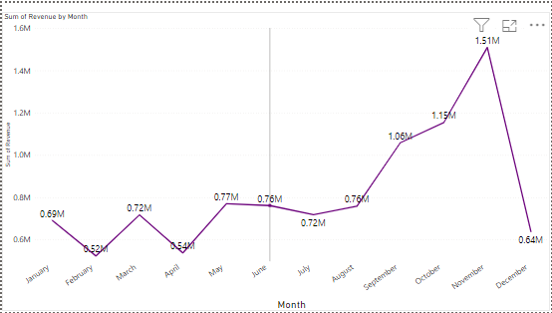
REVENUE BY MONTH - 2011
1st 8 months stable revenue
Average of 21.8% increase from September to November
November holds the highest sales
August – December shows seasonality influence
Exact seasonality undetermined due to irrelevant December month data.

Slide 6
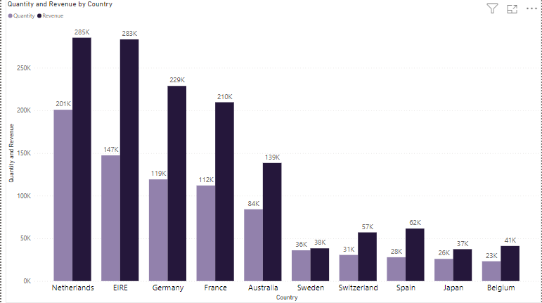
TOP 10 COUNTRIES BY THEIR REVENUE & QUANTITY
Representation excluding United Kingdom
High purchasing power is noticed in these countries
Countries with high potential
Netherland – Highest revenue generator
Top 3 – Netherland, Ireland and Germany

Slide 7
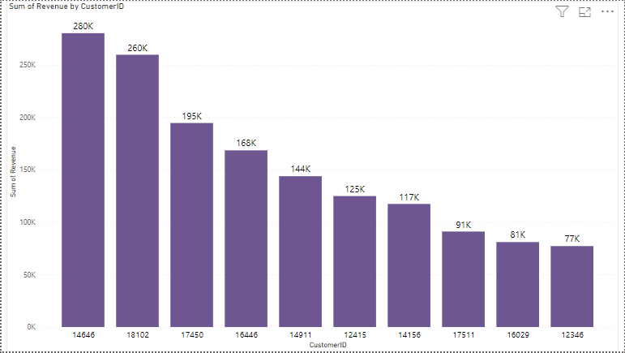
TOP 10 CUSTOMERS BY REVENUE
Top customer revenue generation
– $280,206
Average revenue generated by Id ‘12346’ – 77k & ‘16446’ - 56k
Maximum contribution of revenue – 18.22% of the whole
Id ‘14646’ and ‘18102’ – Highest revenue contributors
Minimum contribution of revenue – 5.02% of the whole

Slide 8
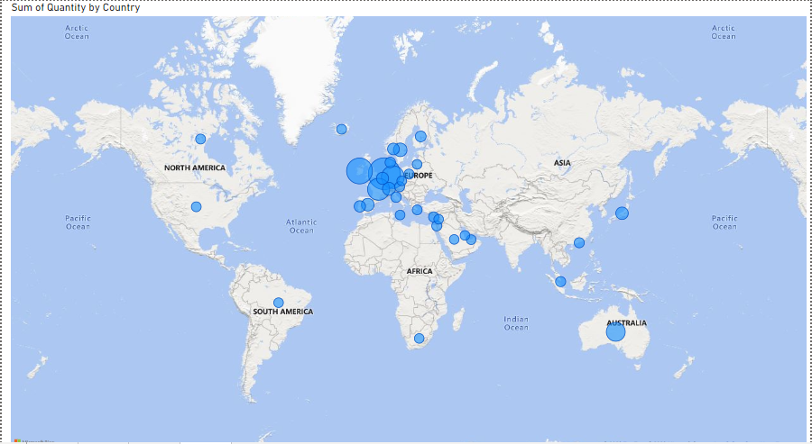
REVENUE BY COUNTRY
Active European market
Inactive zone –Russia, Asia and Africa
Netherland – 200937 highest quantity
Ireland and It’s neighbours are promising areas
Netherland, Germany, France has a good customer base

Slide 9
Recommendations
Ireland and the surrounding areas has generated great revenue and the company has a significant customer base that we can tap into for expansion opportunities.
The top customers has an average revenue starting with $77,183 then $56,157 then drastically falls from $13,000 to $2,000 range.
The company should consider the top-revenue generating customers to strengthen the relationship.

Slide 10
Conclusion
The company can involve in making strategies that aims at stocking and advertising seasonal products to maximize the sales which suits up the demand.
The company can work more on identifying the most demand products during less sale period, by which essential marketing strategies can be introduced to boost up the sales.
Concentrating more on region based product purchase and revenue marketing strategies can be assigned which will lead to enormous rise in sales.
The European market has a promising potential of growth and company should aim on marketing strategies that will lead to a raise in company’s demand and position in the region.

