Slide 1
When a model fails, every dashboard can stay green
A drift-aware MLOps pipeline for EV charge-session energy and dwell-time prediction
66,745 real charging sessions · 3 workplace sites · 2018 – 2021
Validated against a real, dated regime change: the April 2020 workplace shutdown
Deva Prakash J · upGrad MLOps — Bring Your Own Capstone
github.com/deva-prakash-j/ev-charge-mlops
Notes:
Open with the question: how would you know your model had stopped working? In April 2020 the charging API kept returning HTTP 200 with flat latency while its energy error rose 43%. This project builds the controls that make that failure visible, block bad releases, and allow rollback — and measures them on real data.

Slide 2
THE STAKE
April 2020: the API answered every request. The model was wrong.
−86% / −97%
+43%
HTTP 200
Monthly sessions at sites 0001 / 0002 vs reference median
Energy error after the shift (4.40 → 6.27 kWh MAE)
Status and latency unchanged — invisible to uptime checks
Who depends on the prediction made at plug-in
Site energy manager
Driver app
Smart-charging scheduler
Data governance
Demand-limit headroom and site load forecast
“Ready-by” time shown to every driver
Power allocation across occupied bays
Provenance, PII audit and release approval
Owner: MLOps engineer — deployment, promotion, rollback, monitoring, alert response, retraining (acting: Deva Prakash J). Approver: charging operations accepts or rejects retrained candidates.
Drift-aware MLOps for EV charge-session prediction · Deva Prakash J
2
Notes:
Three facts frame the problem: demand collapsed, error rose 43%, and nothing in service monitoring changed. Then name who is hurt: the site energy manager (demand-limit headroom), the driver app (ready-by time), the scheduler, and audit.

Slide 3
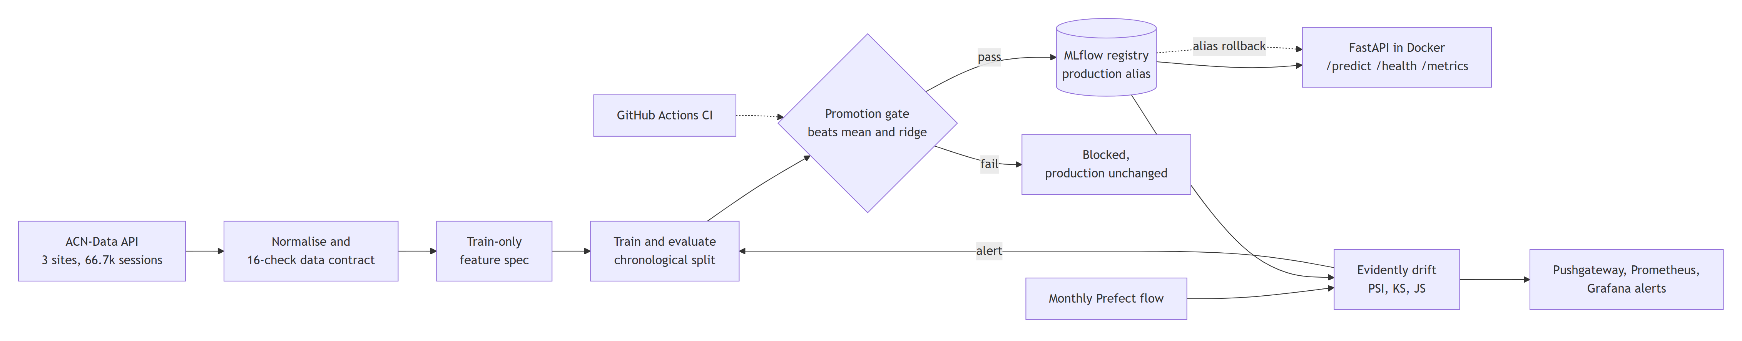
METHODOLOGY · ARCHITECTURE
One control loop: validate → train → gate → serve → watch → retrain
Data
Model lifecycle
Serving
Monitoring
ACN-Data API, 3 sites, 66,745 sessions; 16-check contract, 2 rows quarantined with reason
Chronological split; MLflow tracking; staging/production aliases; CI gate
FastAPI in Docker Compose; /predict, /health, /metrics; JSONL prediction log
Monthly Prefect flow; Evidently PSI/KS/JS; Pushgateway → Prometheus → Grafana
Drift-aware MLOps for EV charge-session prediction · Deva Prakash J
3
Notes:
Walk the loop left to right. Data contract with 16 checks quarantines bad rows. Training uses a strictly chronological split. A promotion gate guards the MLflow production alias. FastAPI serves from Docker. A monthly Prefect flow scores drift with Evidently and exports to Prometheus/Grafana; an alert triggers the quality-gated retraining flow.

Slide 4
METHODOLOGY · DECISIONS
Design decisions — and what each one costs
Decision | Why it protects the business | Cost / trade-off
Chronological split (never random) | Honest post-shift score; random splits leak future regimes | Smaller, later validation window
One feature module for train + serve | No train/serve skew; 1,000-session parity test | API imports training code
Gate: beat mean & Ridge, ≤ 10% regression | Complexity must earn its place; bad models blocked | Can block marginal gains
MLflow aliases + image-tag rollback | Known-good model restored without retraining | Needs disciplined image tagging
HistGradientBoosting (not LightGBM) | LightGBM crashed with pyarrow on Windows; native NaN | Fewer tuning knobs
Monthly batches, PSI > 0.2 | 0 false alarms in 8 stable months | Up to one month of lag
Data-free repo + hash manifests | Respects publisher registration; provenance by SHA-256 | Evaluators need a free token
Drift-aware MLOps for EV charge-session prediction · Deva Prakash J
4
Notes:
Each decision is justified against a named alternative in STACK.md. Emphasise the trade-off column: the gate may block marginal improvements; the data-free repo means evaluators need a free token; monthly batches mean up to a month of detection lag.

Slide 5
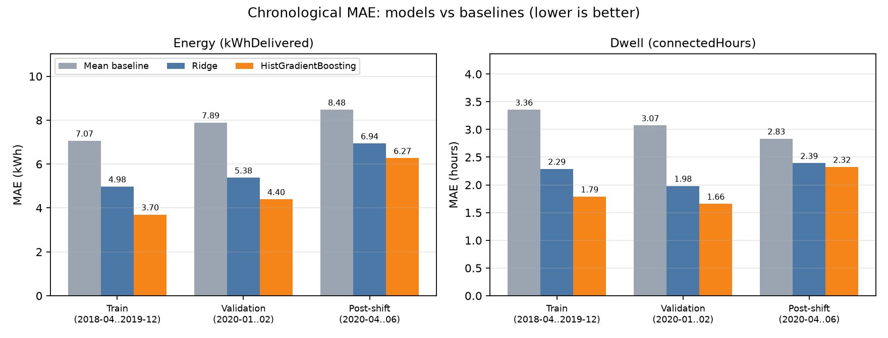
IMPLEMENTATION · RESULTS
The model beats naive baselines by 44% — until the regime changes
4.40 kWh
Energy MAE (mean 7.89, Ridge 5.38); R² 0.58
1.66 h
Dwell MAE (mean 3.07, Ridge 1.98)
6.27 kWh
Same energy model after April 2020 (+43%)
Bias the average hides: site 0019 validation MAE 10.3 kWh (R² −0.48) vs 4.7 and 3.0 at the larger sites. It has < 2% of training rows. Treat its predictions as advisory.
Licensed extract · train 48,957 · validation 4,815 · post‑shift 942 rows
Drift-aware MLOps for EV charge-session prediction · Deva Prakash J
5
Notes:
Energy MAE 4.40 kWh against 7.89 for the mean and 5.38 for Ridge. The same model scored after April 2020 rises to 6.27 kWh. Dwell model: 1.66 h vs 3.07 h. The per-site slice shows site 0019, the smallest site, is under-served — a bias the aggregate hides.

Slide 6
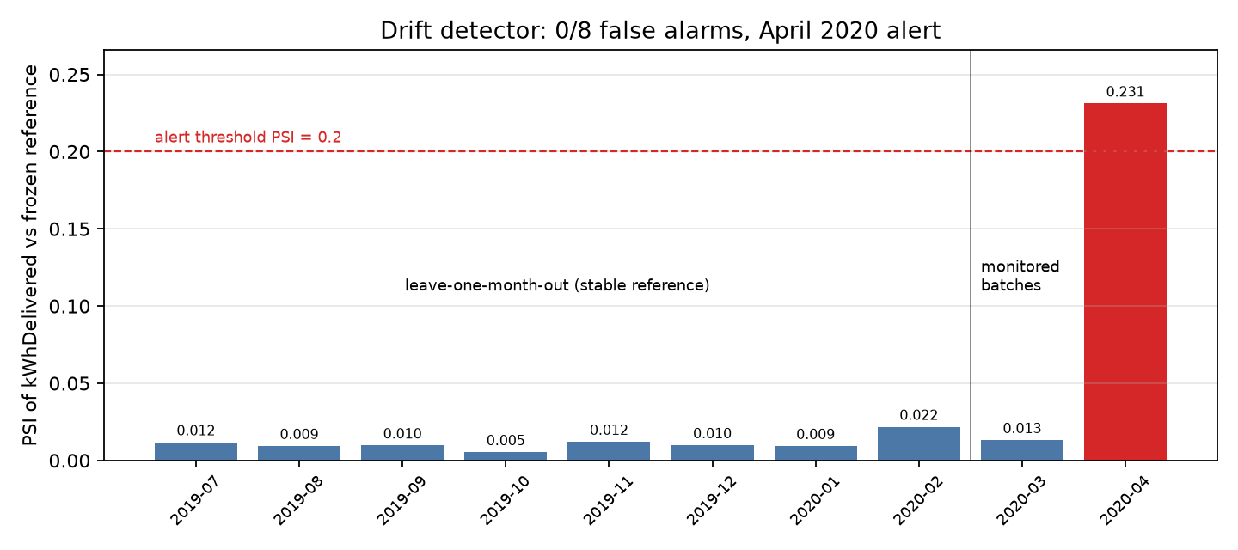
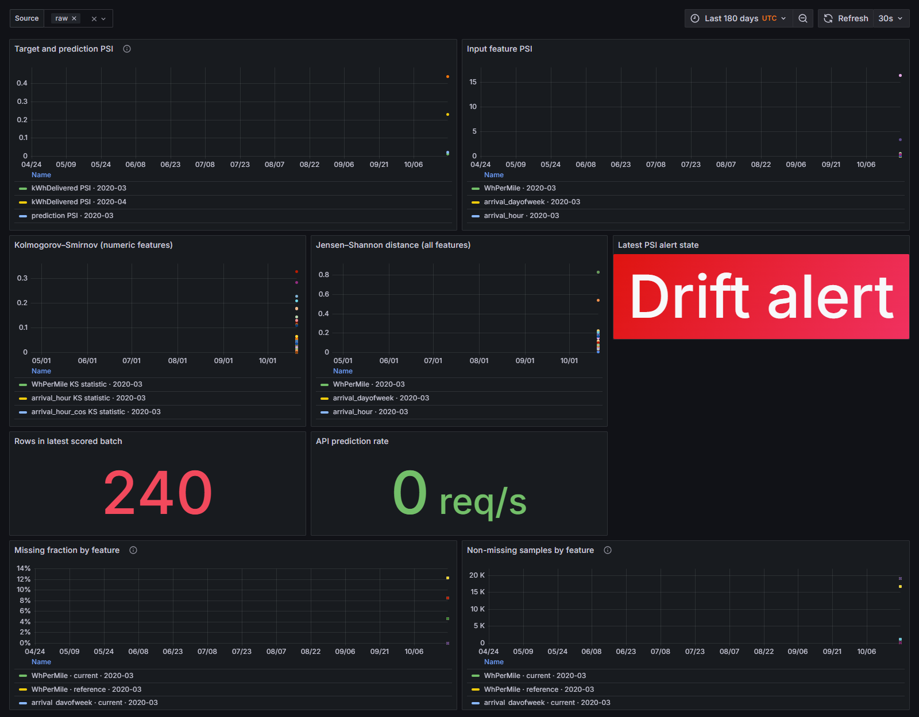
IMPLEMENTATION · MONITORING DEMO
The detector fired on the real shift — and stayed quiet for 8 stable months
PSI 0.231
0 / 8
April 2020 delivered energy > 0.20 threshold
False alarms in stable months (PSI ≤ 0.022)
• Controlled sensitivity: first alert at +30% injected energy shift
• March 2020 not flagged — monthly batches lag by up to a month
Drift-aware MLOps for EV charge-session prediction · Deva Prakash J
6
Notes:
Thresholds were declared before scoring (docs/drift_hypotheses.md). April 2020 PSI 0.231 crossed 0.2 with KS p = 3.5e-7. Leave-one-month-out on the reference window gave zero false alarms. Be honest: March 2020 was not flagged, and the controlled sensitivity study first alerts at a +30% shift. Grafana shows the live alert state.

Slide 7
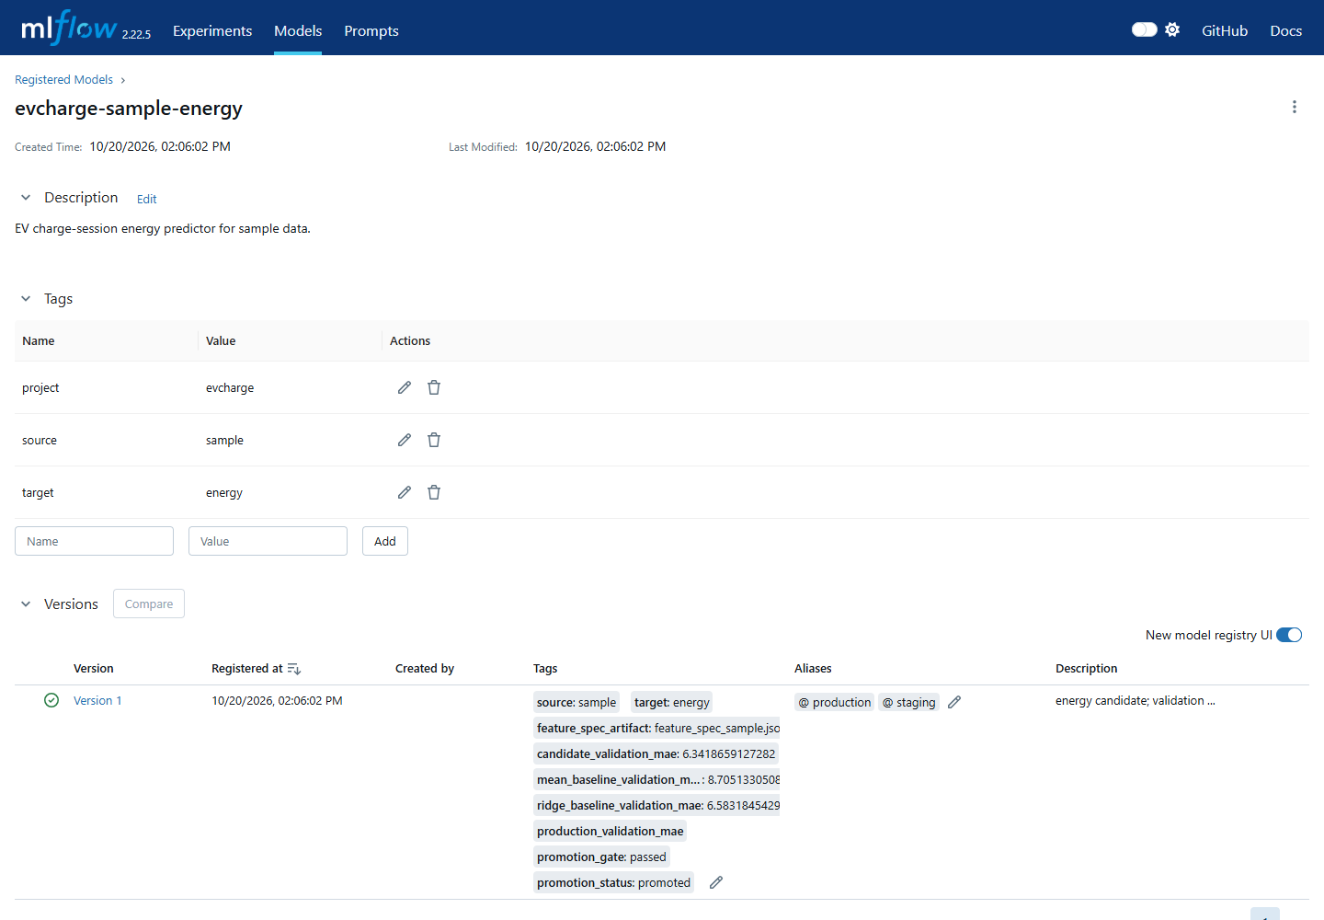
IMPLEMENTATION · RELEASE SAFETY DEMO
Bad models cannot reach the scheduler; good ones can be restored
CI promotion gate (GitHub Actions, every push)
Candidate | Validation MAE | Decision
Production (sample) | 6.342 kWh | stays v1
Degraded candidate | 13.515 kWh | BLOCKED
• Failed: beats mean · beats Ridge · ≤ 10% regression
• Every decision appended to promotion_decisions.jsonl
Rollback drill (isolated Compose project)
Step | Production alias | /health · /predict
Known-good | v1 | ok · 10.49 kWh
Candidate promoted | v2 | ok · served v2
Rolled back | v1 + previous image digest | ok · 10.49 kWh
Drift-aware MLOps for EV charge-session prediction · Deva Prakash J
7
Notes:
Every push runs Ruff, 108 tests, the sample contract and pipeline, then registers a deliberately degraded candidate. The build fails if that candidate is promoted. The rollback drill moved production v1→v2→v1 on an isolated Compose project and restored the captured previous image digest. It tests mechanics, not model quality.

Slide 8
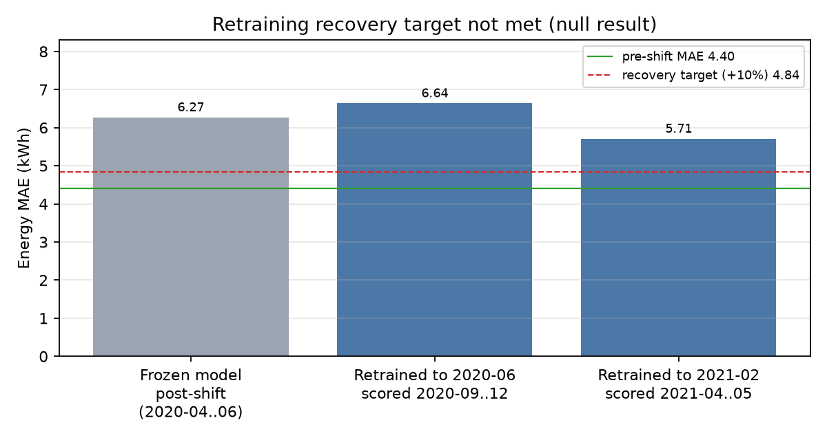
LESSONS · HONEST RESULT
Retraining did not recover pre-shift accuracy — and that is reported
≤ 4.84 kWh
Target: within 10% of pre-shift 4.40 kWh MAE
6.64 kWh
Trained through 2020-06, scored 2020-09..12 (869 rows)
5.71 kWh
Trained through 2021-02, scored 2021-04..05 (2,055 rows), +29.8%
Implication: a regime change needs model work — site-aware or recency-weighted training, the deferred occupancy feature — not just a scheduled retrain on mostly old-regime data.
Drift-aware MLOps for EV charge-session prediction · Deva Prakash J
8
Notes:
The proposal set a recovery target: post-shift MAE within 10% of 4.40 kWh, so at most 4.84. Two chronological retrains with held-out later windows reached 6.64 and 5.71 kWh. Neither met it. The pipeline detects, blocks and rolls back; it does not claim recovery it has not demonstrated. The implication is a budget for model work after a major alert.

Slide 9
LESSONS · TRADE-OFFS
What I learned, and what I traded away
Lessons
Trade-offs
• Monitoring outlives any single model. Accuracy decays silently; the detector and gate protect every future version.
• Real feeds break contracts. siteID typed as int and string on 2,081 rows; sessions of 245 h — quarantined with a reason, not dropped.
• Declare thresholds before scoring. It is what makes the null recovery result credible.
• Averages hide bias. Site 0019's error is 2.2–3.4× the larger sites'.
Chose | Gained | Gave up
Monthly batches | Stable, cheap scores | ≤ 1 month lag
PSI threshold 0.2 | 0 false alarms | Misses < +30% shifts
Docker Compose | One-laptop reproducibility | No HA / autoscale
Defer occupancy | No unaudited leakage | A likely useful signal
Data-free repo | Licence-respecting | Token to reproduce
Drift-aware MLOps for EV charge-session prediction · Deva Prakash J
9
Notes:
Lessons: monitoring is the durable asset; real feeds break contracts (siteID typed two ways on 2,081 rows, 245-hour sessions); pre-declared thresholds make a null result credible; aggregate metrics hide per-site bias. Trade-offs are deliberate and documented.

Slide 10
CONCLUSIONS · IMPACT
What this buys a charging operator
≈ 272 kWh/day
≈ 1.4 h
≤ 1 month
0
Less forecast error to buffer vs a naive average
Closer ready-by estimate per driver
From regime change to alert (previously undetected)
Degraded models promoted — gate runs on every push
Assumes ~78 sessions/day (reference period). Error totals are upper bounds; no monetary value is claimed because ACN-Data carries no tariff or demand-charge data.
Recommendation
• Adopt now: drift monitoring, the CI promotion gate and alias + image rollback.
• Treat site 0019 as advisory until it has more data or a site-specific model.
• Fund model work before relying on automatic retraining — the measured recovery gap is 29.8%.
Drift-aware MLOps for EV charge-session prediction · Deva Prakash J
10
Notes:
Translate errors into operations at the reference volume of about 78 sessions per day (19,144 sessions in 244 days). Summed absolute error is an upper bound on hedged energy; site-level errors partly cancel. ACN-Data has no tariffs, so no currency figure is invented; an operator multiplies avoided headroom by their own demand-charge rate.

Slide 11
CONCLUSIONS · FUTURE WORK
From capstone to production
Platform
Operations
Model
• MLflow on a database + object store
• Images by digest in a registry
• TLS, auth, secrets vault
• Alertmanager → staffed on-call rota
• Named charging-ops approver
• Latency SLO and load tests
• Site-aware / recency-weighted training
• Audited rolling-occupancy feature
• Prediction intervals for headroom
Thank you — questions?
Repository: github.com/deva-prakash-j/ev-charge-mlops · Report: docs/deliverables/
Credential-free demo: python -m evcharge.pipeline --source sample · docker compose up --build -d
Drift-aware MLOps for EV charge-session prediction · Deva Prakash J
11
Notes:
Close with the production gap and the ask. Point to the repository: README for quick start, docs/deliverables for this deck and the technical report, and the reproduction path for licensed results. Invite questions; the hidden appendix covers per-site, sensitivity, data contract, features, architecture detail and proposal changes.

Slide 12
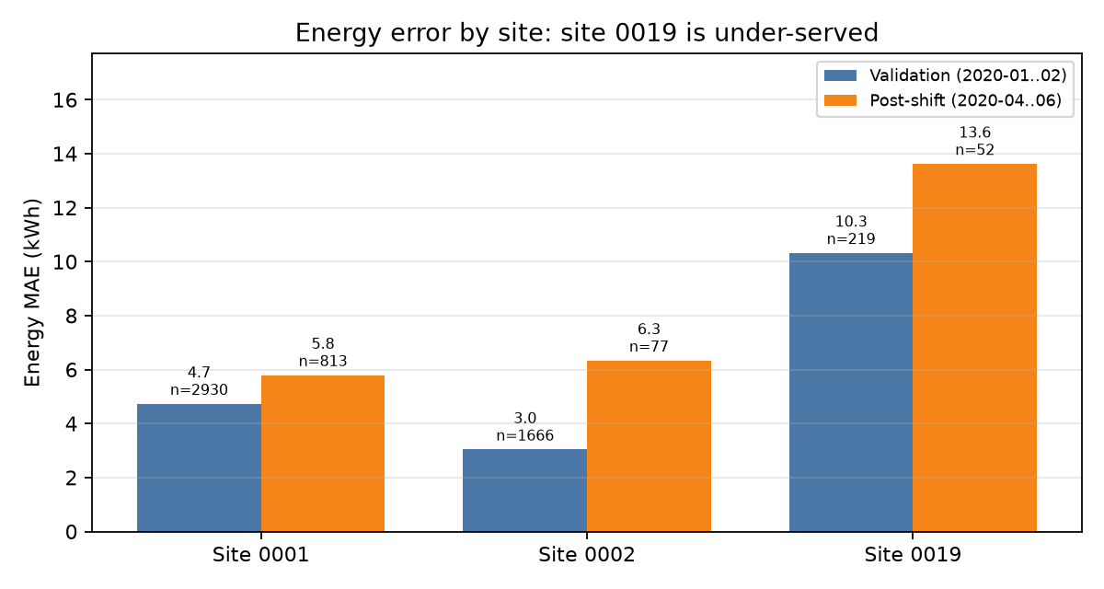
APPENDIX · Q&A
Per-site error: where the model is weakest
Site | Validation MAE | Post-shift MAE
0001 Caltech | 4.73 (n 2,930) | 5.80 (n 813)
0002 JPL | 3.04 (n 1,666) | 6.33 (n 77)
0019 office | 10.32 (n 219) | 13.62 (n 52)
• Site 0019: < 2% of training rows; R² −0.48 on validation
• Only 45 reference-period sessions there carry a positive energy request
• Per-site slices are logged to MLflow on every run
Drift-aware MLOps for EV charge-session prediction · Deva Prakash J
Appendix · 12
Notes:
Use if asked about fairness or bias across sites.

Slide 13
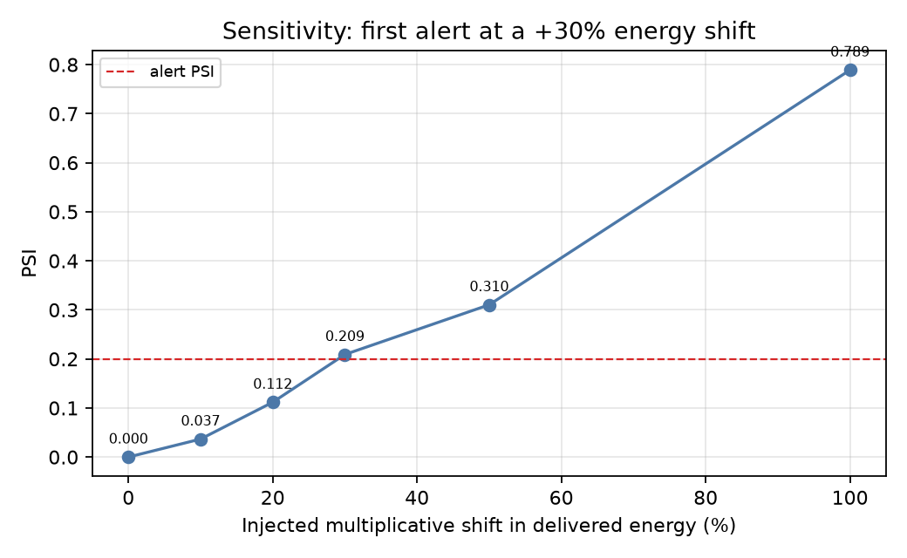
APPENDIX · Q&A
Detector sensitivity: controlled injected shifts
Injected shift | PSI | Alert
0% | 0.000 | No
+10% | 0.037 | No
+20% | 0.112 | No
+30% | 0.209 | Yes
+50% | 0.310 | Yes
+100% | 0.789 | Yes
H2 (request p90) mixed: site 0002 +57.5%, site 0001 −0.4%. H3 (declared vs delivered gap) supported: median 6.35 → 10.12 kWh, PSI 0.261.
Drift-aware MLOps for EV charge-session prediction · Deva Prakash J
Appendix · 13
Notes:
Deterministic multiplicative shifts to delivered energy, not SDV synthetic data.

Slide 14
APPENDIX · Q&A
Data contract, privacy and licensing
Defect in the real feed | Scale | Handling
siteID as int 2 and string "0002" | 2,081 rows | Coerced; blocking expectation
clusterID mixed int/string | Crashed Parquet write | Coerced; blocking expectation
Sessions of 245 h and 214 h | 2 rows | Quarantined with reason
Timestamp order, namespaces, plausibility | 16 checks total | Site-specific domains
• PII audit: no direct PII; userID is a pseudonymous publisher ID. Prediction log stores encoded features only.
• ACN-Data: educational/research use, citation required (Lee, Li, Low — e-Energy '19). Records never committed; SHA-256 manifests prove provenance.
• History audit before submission: identifiers from one real session used as test inputs were replaced and disclosed in DATA_LICENCE.md.
Drift-aware MLOps for EV charge-session prediction · Deva Prakash J
Appendix · 14
Notes:
Use if asked how data quality and licensing were handled.

Slide 15
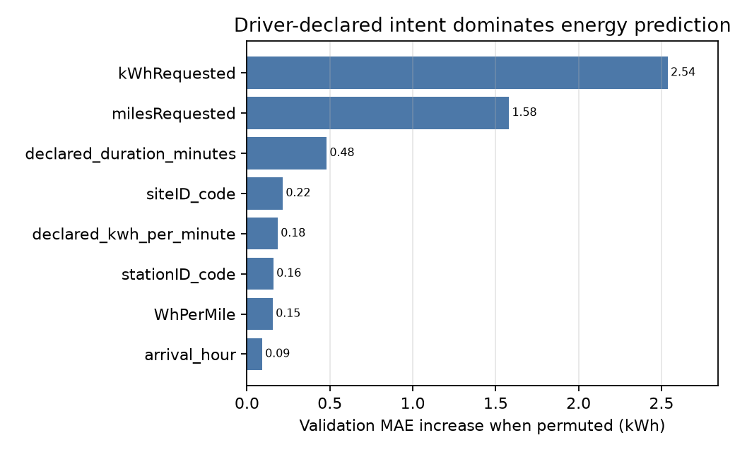
APPENDIX · Q&A
Features and leakage controls
• Only plug-in-time information: earliest userInputs entry; disconnect/done times and targets rejected by feature builder and API
• Declared intent dominates: kWhRequested, milesRequested, declared duration
• Missing requests (~27% of sessions) stay NaN; HGB handles them natively
• Station/cluster vocabularies fitted on training data only; unseen → explicit unknown code
• Rolling occupancy deferred until a point-in-time join passes a parity and leakage audit
Drift-aware MLOps for EV charge-session prediction · Deva Prakash J
Appendix · 15
Notes:
Use if asked what drives predictions or how leakage was prevented.

Slide 16
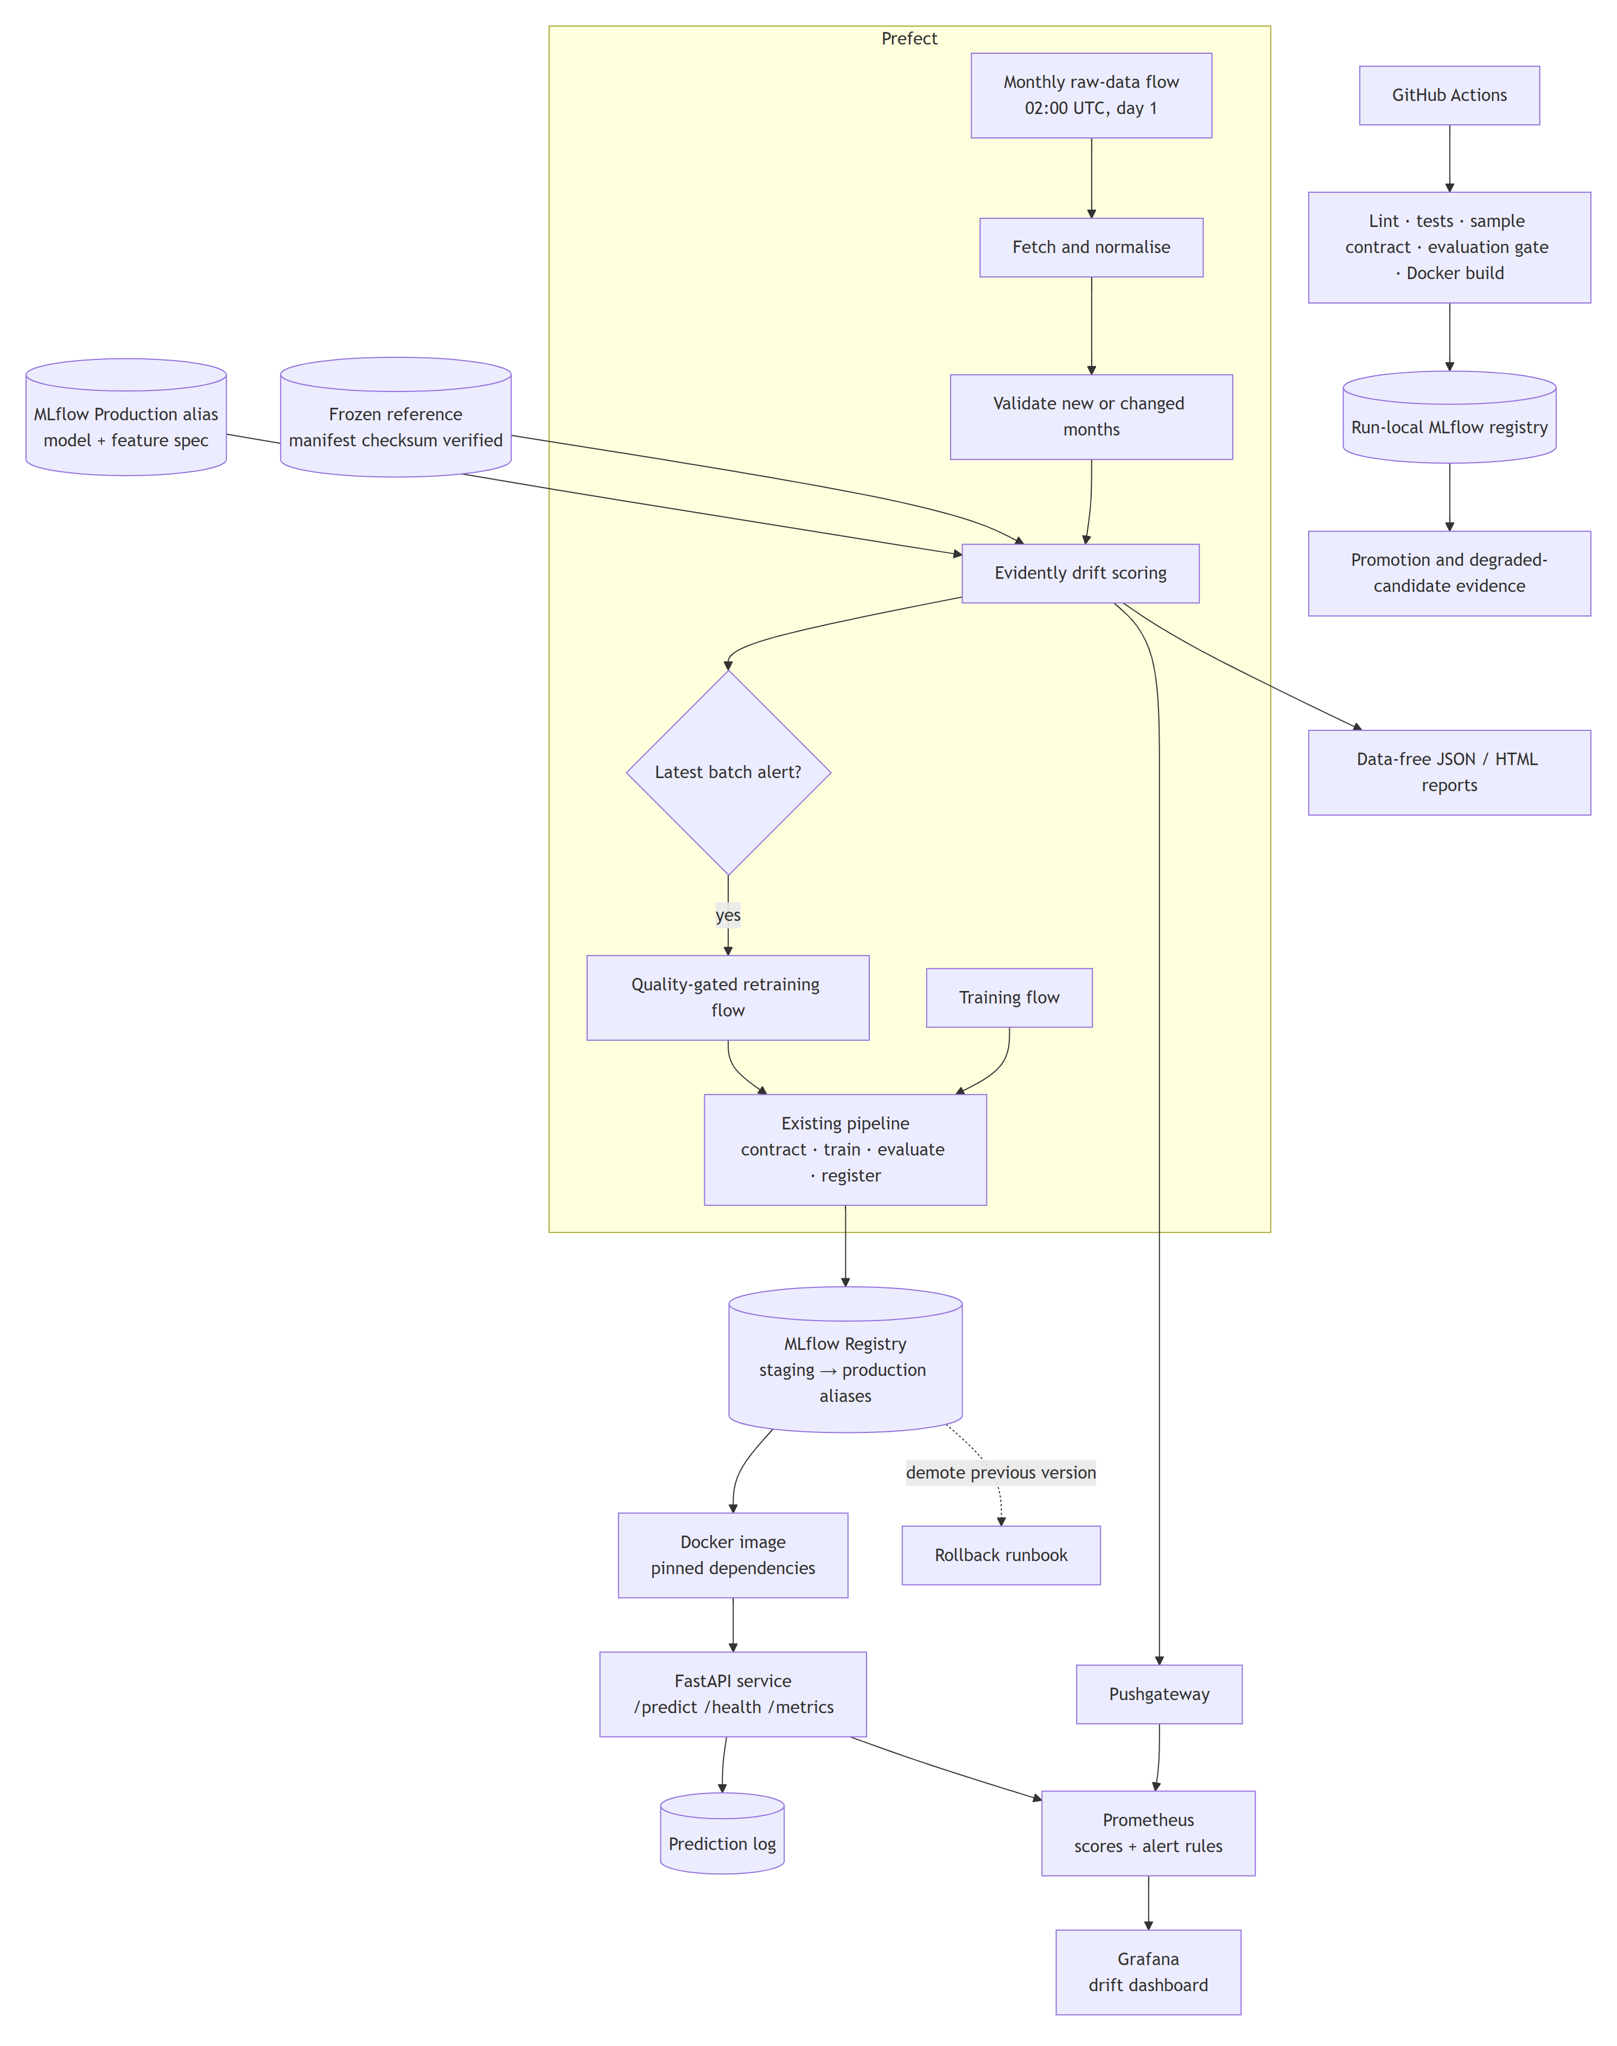
APPENDIX · Q&A
Detailed V2 architecture
Drift-aware MLOps for EV charge-session prediction · Deva Prakash J
Appendix · 16
Notes:
Component-level view from docs/architecture.md.

Slide 17
APPENDIX · Q&A
Changes from the accepted proposal
Proposal | Delivered | Reason
LightGBM | HistGradientBoosting | Windows OpenMP crash when pyarrow loads first
Prefect 2 | Prefect 3 | Current supported major version
SDV drift scenarios | Deterministic multiplicative shifts | Exact, reproducible magnitudes
Rolling occupancy feature | Deferred | Point-in-time join not yet audited
Data snapshot to upGrad | Data-free repo + manifests + token | Repository-only submission; respects registration
Drift-aware MLOps for EV charge-session prediction · Deva Prakash J
Appendix · 17
Notes:
Each change is recorded with its reason in the report and STACK.md.

Slide 18
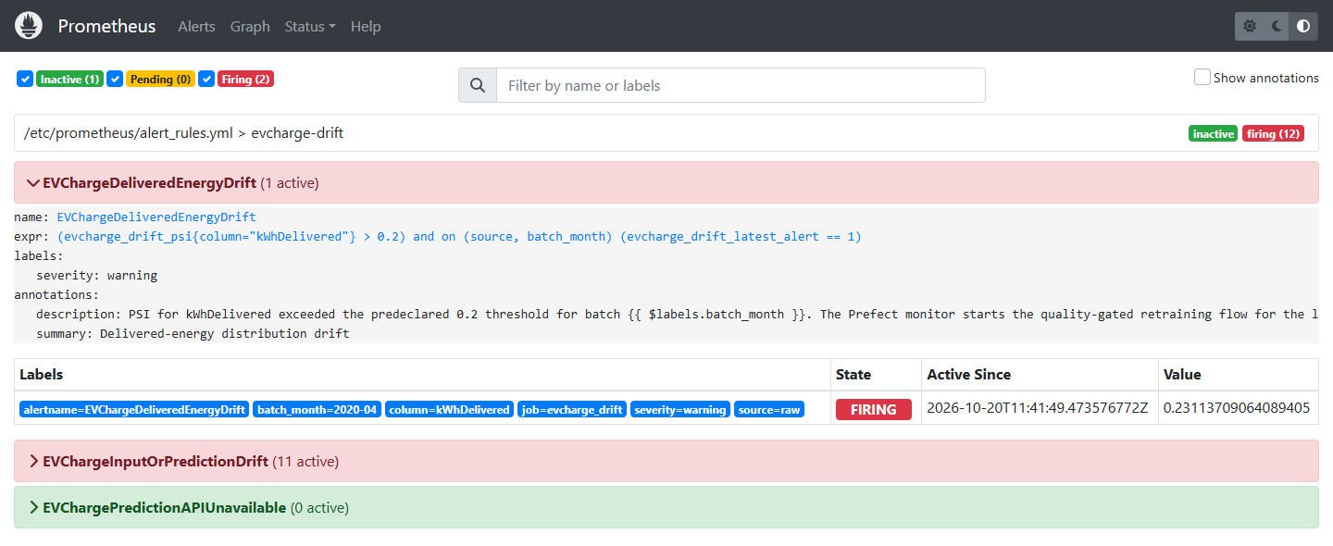
APPENDIX · Q&A
Live alerting: Prometheus firing on the April 2020 batch
EVChargeDeliveredEnergyDrift firing for batch 2020-04 with PSI 0.2311; EVChargePredictionAPIUnavailable inactive.
Drift-aware MLOps for EV charge-session prediction · Deva Prakash J
Appendix · 18
Notes:
Screen from the local Docker Compose stack; aggregate scores only.

Slide 19
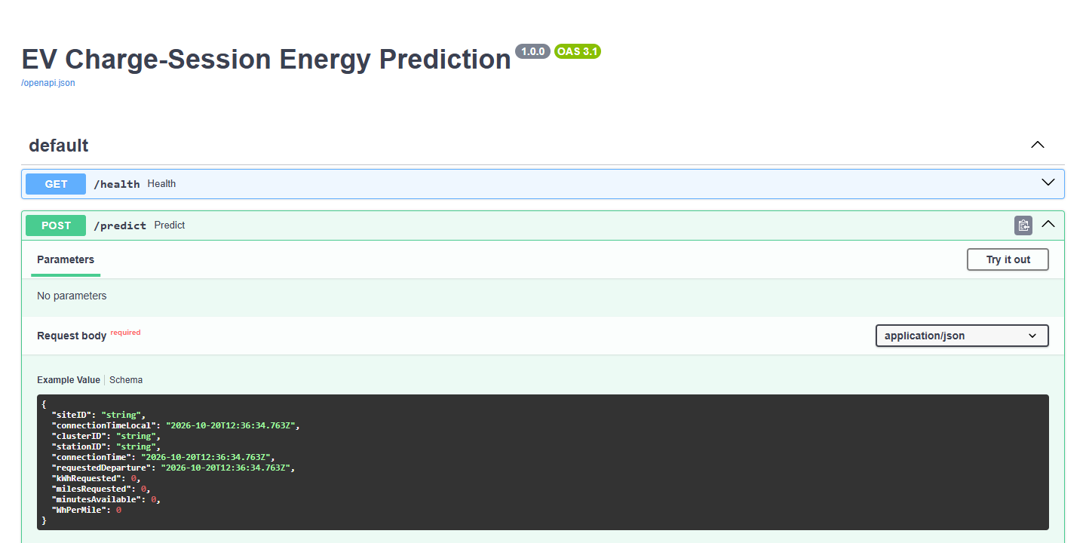
APPENDIX · Q&A
Served API contract
/predict validates a Pydantic schema that rejects post-hoc fields; /health reports the served model version; /metrics exposes Prometheus counters.
Drift-aware MLOps for EV charge-session prediction · Deva Prakash J
Appendix · 19
Notes:
FastAPI /docs from the local Docker Compose stack. The example request returns 14.23 kWh from evcharge-sample-energy v1.

