Slide 1

ElderShield
Predictive Digital Twin for Stroke and Fall Prevention in Geriatric Care
Team The_Glitch
Deva Pandit, Team Leader
R R P G College
Puneet Singh, Member
Noida Institute of Engineering and Technology
AI | Healthcare | Data Science | Digital Health
Notes:
Introduce the team and the one-line idea: a digital twin for every elderly person that predicts stroke risk, explains it, and alerts caregivers.

Slide 2



The problem: help arrives too late
Stroke risk goes unnoticed
Falls go unseen
Caregivers see snapshots
Age and blood pressure build risk quietly. Nobody tracks it day to day.
An elder living alone can lie on the floor for a long time before anyone knows.
Families see check-up numbers, not the trend in between.
Notes:
Three gaps: risk is invisible, falls are unseen, and caregivers only get snapshots. ElderShield closes all three.

Slide 3




ElderShield: one digital twin per elder
Predict
Explain
What-if
Monitor
Stroke risk score with Low, Medium and High bands.
SHAP shows why: age, blood pressure, smoking.
See how risk moves if hypertension or smoking changes.
Live vitals and fall events trigger caregiver alerts.
Decision support for caregivers, not a diagnosis.
Notes:
Four capabilities: predict, explain, what-if, monitor. Stress that it supports caregivers and does not replace a doctor.

Slide 4





How it works
Data
AI engine
FastAPI
Dashboard
Alert
Kaggle stroke dataset and simulated vitals
XGBoost risk model and SHAP reasons
predict, whatif, live and fall endpoints
Risk card, live graph, what-if table
Caregiver card on ALERT or fall
Everything runs locally, so the demo needs no internet.
Notes:
Data flows left to right. The dashboard and alerts all call one FastAPI backend that wraps the model.

Slide 5

AI/ML and tech stack
AI / ML
Tech stack
XGBoost with class-imbalance weighting
Monotonic constraints add medical common sense
SHAP gives a per-patient "why"
What-if re-scores with changed inputs
Low, Medium, High risk bands
Python, pandas, scikit-learn
FastAPI and Uvicorn REST API
HTML/JS dashboard with live charts
Data: Kaggle Stroke set, 5,109 patients
Simulated vitals stream (ESP32 planned)
Notes:
Monotonic constraints force the model to respect basic medical logic (more age or hypertension never lowers risk). This also improved the metrics.

Slide 6
Explainable AI: why, and what if
Example patient: age 72, hypertension, smoker, BMI 31. Risk score 0.76 (HIGH). What-if values are model-based estimates, not guaranteed outcomes.
Notes:
Left: SHAP shows age is the biggest driver, then hypertension and smoking. Right: re-scoring with one change at a time lowers the score. Say clearly these are model estimates.

Slide 7
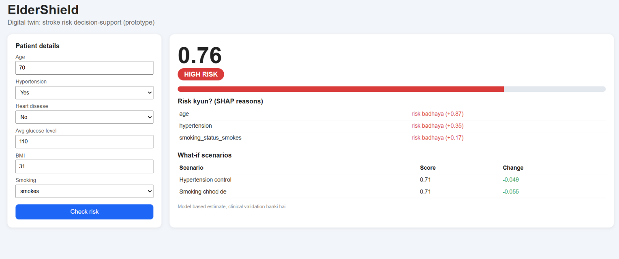
Demo 1: risk, reasons, what-if
1
Risk score and band
0.76 shown as HIGH RISK.
2
SHAP reasons
Age, hypertension and smoking push risk up.
3
What-if
Controlling hypertension or quitting smoking lowers the score.
Sample patient: age 70, hypertension, smoker, BMI 31.
Notes:
Click Check risk. Explain the band, then the SHAP reasons, then the what-if rows. Say it is a model-based estimate, clinical validation is pending.

Slide 8
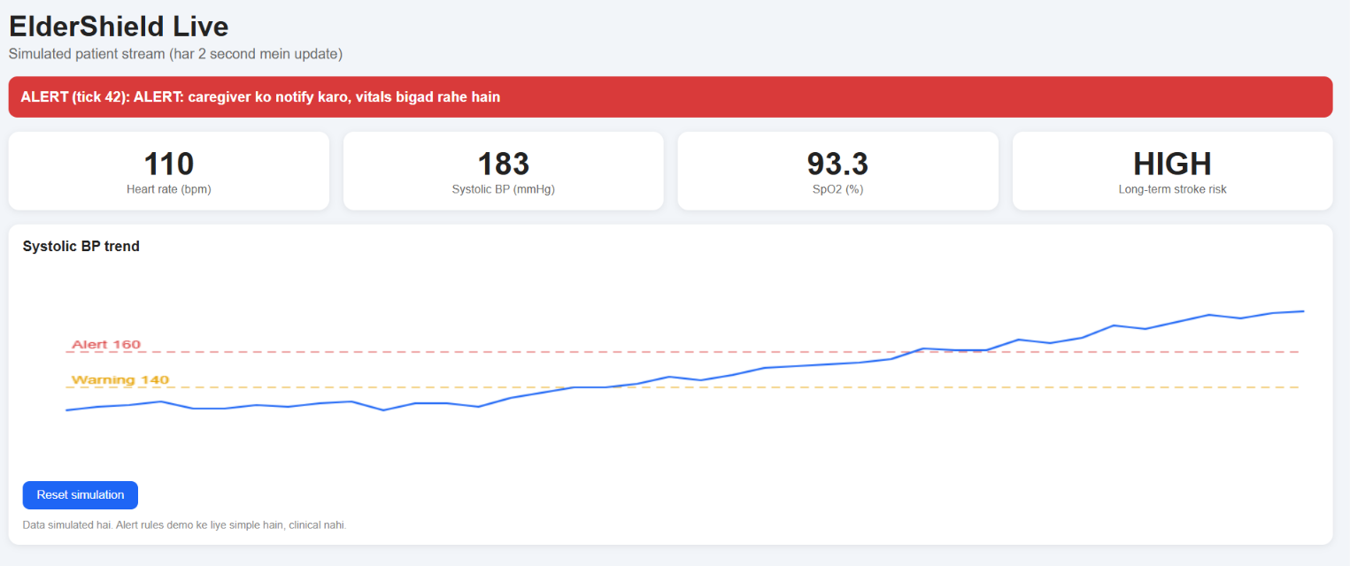
Demo 2: live monitoring and alerts
1
Vitals vs baseline
BP, heart rate and SpO2 checked every 2 seconds.
2
Three states
Status moves from STABLE to WARNING to ALERT.
3
Fall alert
One click sends a caregiver card with name and time.
STABLE
WARNING
ALERT
Vitals and the fall event are simulated for this demo.
Notes:
Press Reset simulation about 40 seconds before this slide so WARNING and ALERT appear on their own. Then press Simulate fall.

Slide 9
Results on held-out test data
0.817
AUROC
separates high and low risk well
0.22
PR-AUC
4.5x better than random (0.049)
0.80
Recall at 0.3
40 of 50 stroke cases caught
Test set: 1,022 patients, 50 strokes. Accuracy is not used because only about 5% are strokes. Lower threshold catches more strokes but raises false alarms, so we show risk bands.
Notes:
Use recall and PR-AUC, not accuracy, because the data is imbalanced. Numbers can shift a little because the test set has only 50 stroke cases.

Slide 10


Honest limits, clear next steps
Limitations
Next steps
Decision support, not a diagnosis
Only 249 stroke cases in the dataset
Needs validation on Indian elders
Vitals and fall alert are simulated
What-if is a model estimate, not causal
Real fall model on SisFall (1D-CNN)
Wearable: ESP32, MPU6050, MAX30102
SMS and WhatsApp caregiver alerts
Privacy: consent, DPDP Act 2023
Validate and calibrate with clinicians
Notes:
Be upfront about limits; it builds trust. Close with the roadmap: real fall model, wearable, alerts, privacy.

Slide 11
Team The_Glitch
DP
Deva Pandit
Team Leader
PS
Puneet Singh
Team Member
R R P G College
Noida Institute of Engineering and Technology
Thank you | Questions welcome
Notes:
Close by thanking the judges and inviting questions.

