Slide 1
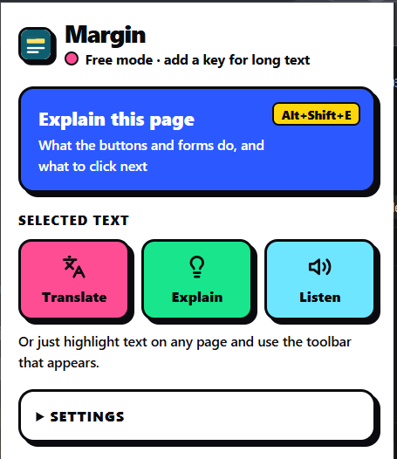
Bootup - Hackathon
MARGIN
Read the web in
your own language.
A browser companion that helps people translate, understand and hear the web — and navigate unfamiliar interfaces with confidence.
Translate • Explain • Listen • Navigate
TEAM GHOSTRIDERS
MARGIN • TEAM GHOSTRIDERS
01

Slide 2
01 / THE CHALLENGE
The web is not equally accessible to everyone
Language barriers and confusing interfaces can turn simple online tasks into frustrating experiences.
LANGUAGE BARRIER
INTERFACE CONFUSION
BROKEN WORKFLOW
A reader encounters English-only content, unfamiliar terminology or complex instructions.
A first-time user sees many buttons, links and forms without knowing what each one does.
Copying text into another tool interrupts the task — and most translators do not explain controls.
The opportunity
Make understanding part of browsing — without forcing users to leave the page.
MARGIN • TEAM GHOSTRIDERS
02

Slide 3
02 / OUR SOLUTION
Meet Margin
One lightweight Chrome extension. Four ways to make online information easier to use.
Translate
Convert selected text into a language the reader understands.
Explain
Turn difficult sentences and jargon into plain, friendly language.
Listen
Hear selected text read aloud using speech for the relevant script.
Page guide
Understand what visible buttons, links and form fields do — and what to click next.
MARGIN • TEAM GHOSTRIDERS
03

Slide 4
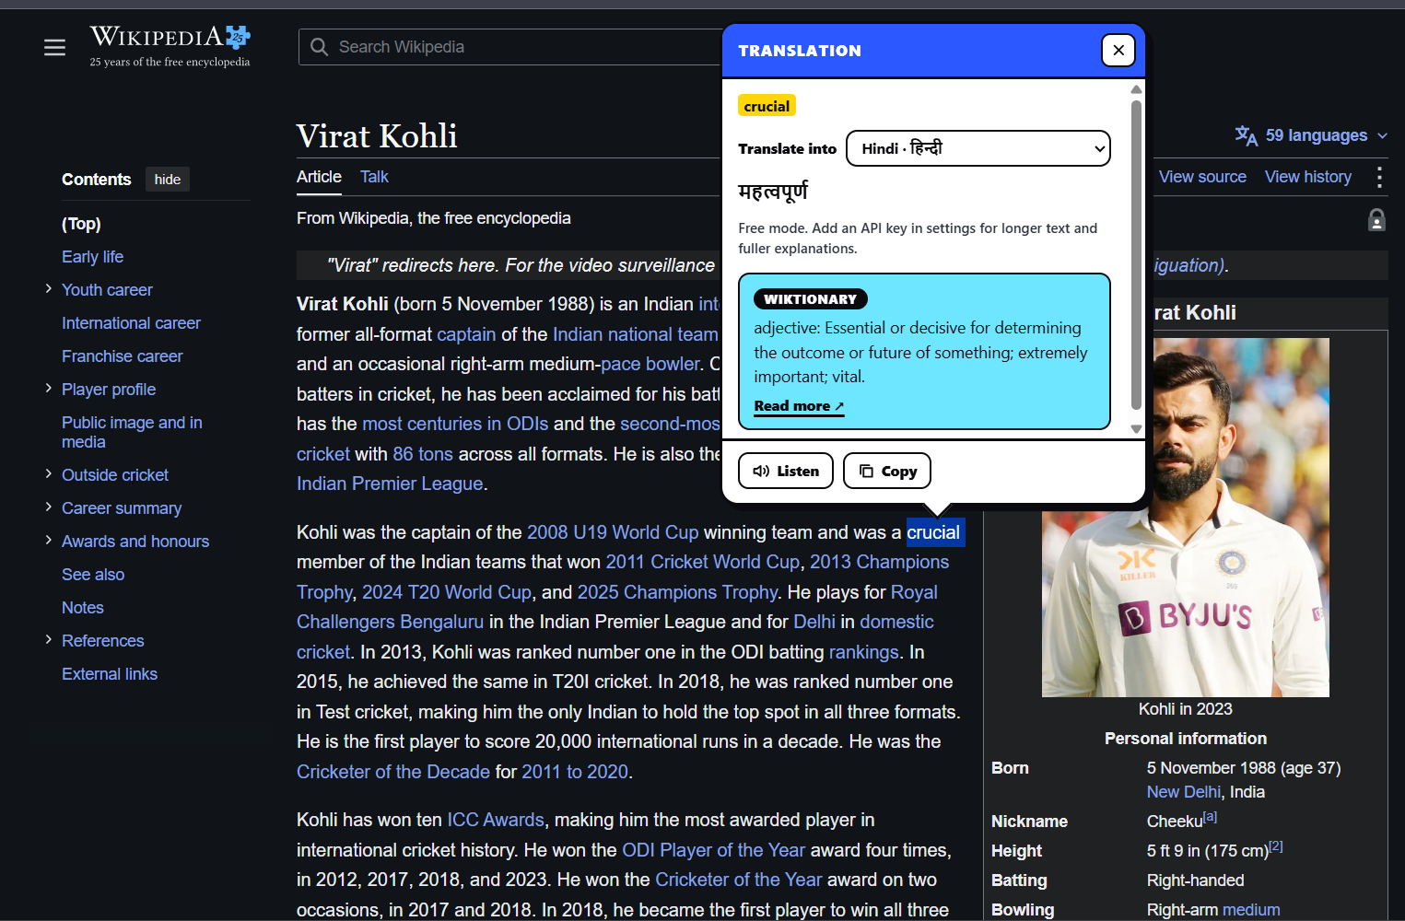
03 / FEATURE SPOTLIGHT
Translate in context
Select a word or passage and get the translation in a card beside the original content.
LANGUAGE SUPPORT
Keep your place
The result appears alongside the selected text, so the reader can stay in the flow of the page.
Word meanings can also link to Wiktionary and Wikipedia.
MARGIN • TEAM GHOSTRIDERS
04

Slide 5
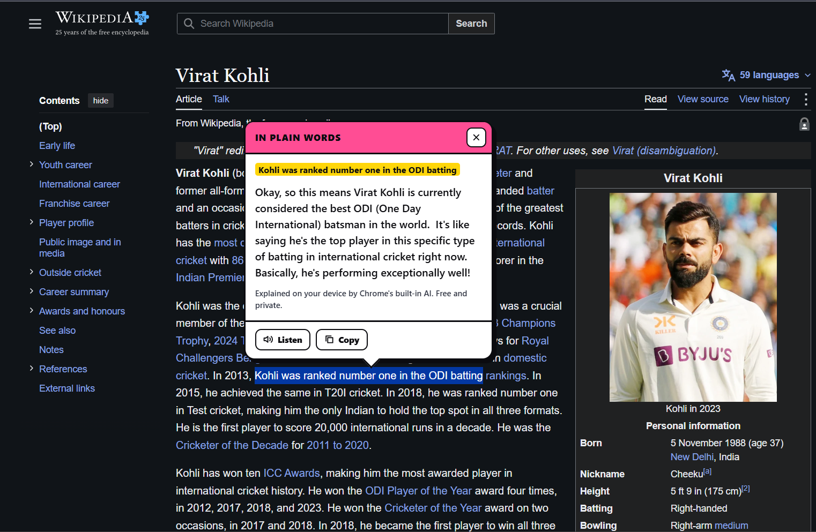
04 / FEATURE SPOTLIGHT
Make difficult text plain and understandable
Margin explains the meaning — not just the words.
FROM COMPLEX…
“ranked number one in the ODI batting rankings”
…TO CLEAR
A short, friendly explanation in everyday language.
MARGIN • TEAM GHOSTRIDERS
05

Slide 6
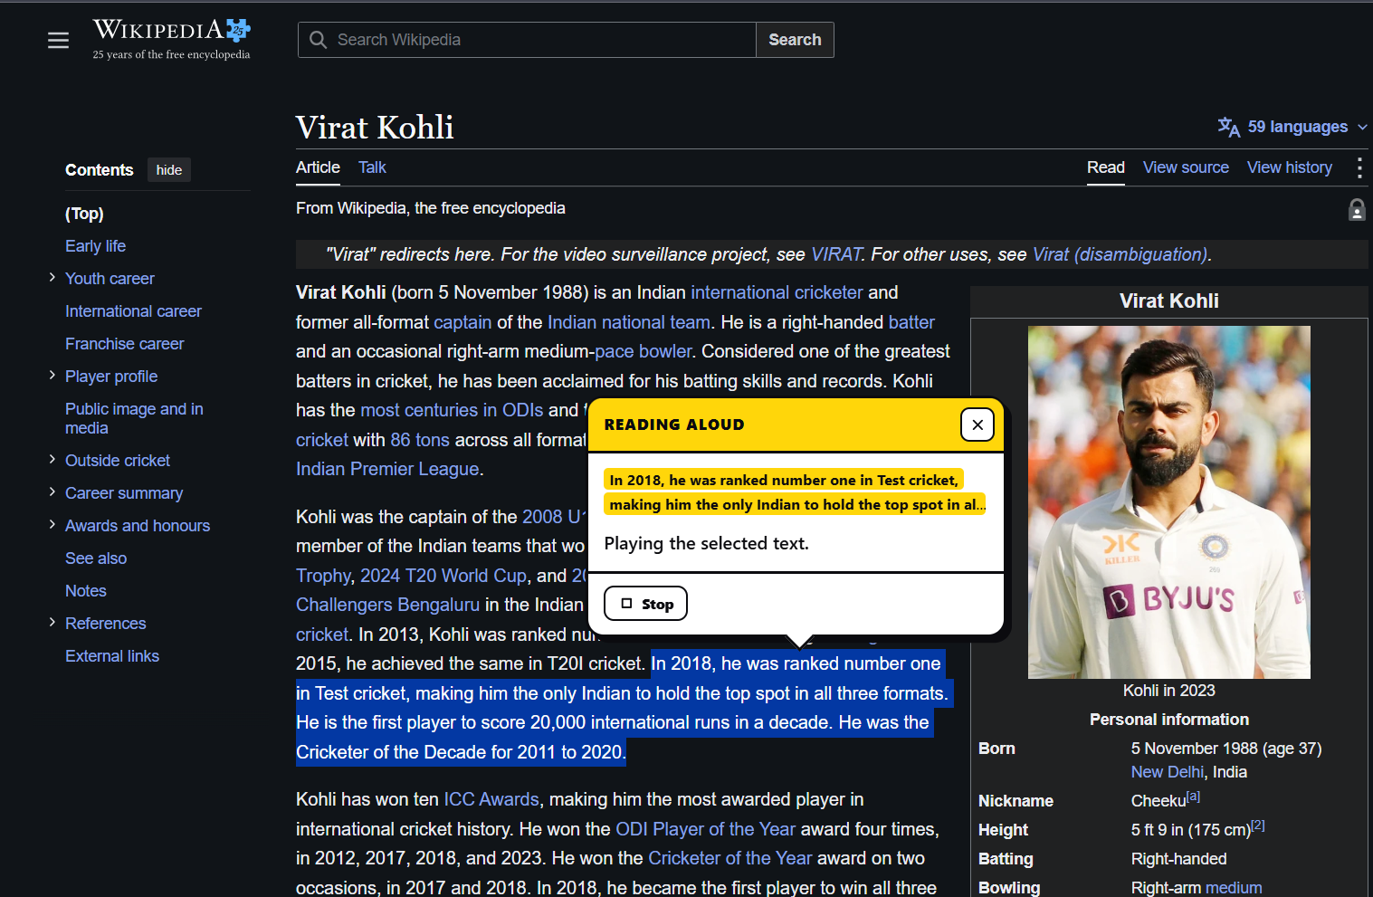
05 / FEATURE SPOTLIGHT
Read, hear and learn
Support different reading preferences and help users build vocabulary.
LISTEN
Turn selected text into spoken audio with a voice suited to its script.
WORD MEANINGS
Look up a selected word, or surface tricky words in a longer passage.
MARGIN • TEAM GHOSTRIDERS
06

Slide 7
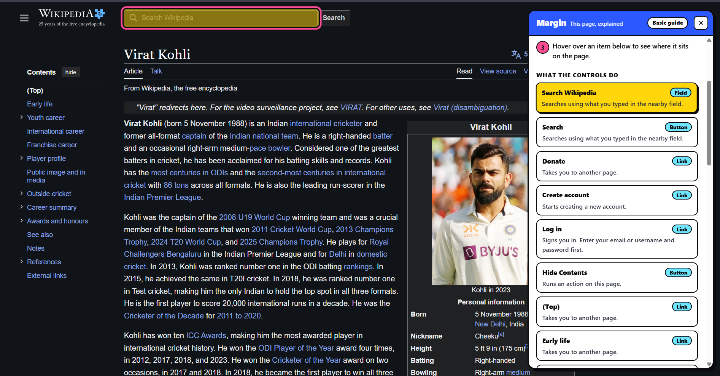
06 / DIFFERENTIATOR
A guide to the page itself
Press Alt + Shift + E to understand controls and decide what to do next.
01
Read visible controls
Titles, headings, text excerpts and button labels.
02
Explain each control
A numbered guide describes what each item does.
03
Find it on the page
Hover over a guide item to highlight the real element.
The guide can also flag actions that cost money or are difficult to undo.
MARGIN • TEAM GHOSTRIDERS
07

Slide 8
07 / UNDER THE HOOD
A lightweight extension with a clear request flow
Built with Chrome Extension Manifest V3 and vanilla JavaScript.
Gemini API
USER ACTION
CONTENT.JS
BACKGROUND.JS
With user API key
→
→
Highlight text
or press shortcut
Toolbar, result card
and page guide
Routes messages
to the right service
Free services
MyMemory + dictionaries
Chrome on-device AI
For sentence explanations
Other integrations: Wikipedia • Wiktionary • Web Speech API
Responses return through the background service worker to the page UI.
MARGIN • TEAM GHOSTRIDERS
08

Slide 9
08 / TRUST & ACCESSIBILITY
Useful before setup. Clear about data.
Margin offers a free mode, with optional AI-powered capabilities when a user adds a Gemini API key.
FREE MODE
WITH GEMINI API KEY
• Short translations via MyMemory
• Dictionary lookups for single words
• Sentence explanations via Chrome on-device AI
• Rule-based page guide that works offline
• Translation for text of any length
• Fuller plain-language explanations
• AI page guide tailored to the specific page
PRIVACY PRINCIPLES
Passwords and form-field entries are never read or sent. The README states what selected text and visible page information may be sent to connected services.
MARGIN • TEAM GHOSTRIDERS
09

Slide 10
09 / GETTING STARTED
Easy to install. Honest about current limits.
A simple developer-mode setup gets the prototype running in Chrome.
QUICK START
KNOWN LIMITATIONS
01
Download the repository ZIP or clone the GitHub repository.
• Does not run on chrome:// pages, Chrome Web Store or the built-in PDF viewer.
• Free translation is limited to roughly 450 bytes per request.
• On-device AI answers in English, Spanish, French or German; other languages get a translated answer.
02
Open chrome://extensions and enable Developer mode.
03
Choose Load unpacked and select the Margin folder.
04
Optionally add a Gemini API key in Margin Settings for longer text and AI page guides.
MARGIN • TEAM GHOSTRIDERS
10

Slide 11
10 / THE TEAM
Team Ghostriders
Built with creativity, collaboration and a shared vision: a more accessible web.
Advait
Devansh
Omkar
Atishay
@advaitFlux
@deva23015
@leluchvigeass-svg
@atishya-jain-1708
OUR MISSION
Break language barriers and make the web easier for everyone to navigate.
MARGIN
One team. One vision. A more accessible web.
MARGIN • TEAM GHOSTRIDERS
11

