Slide 1
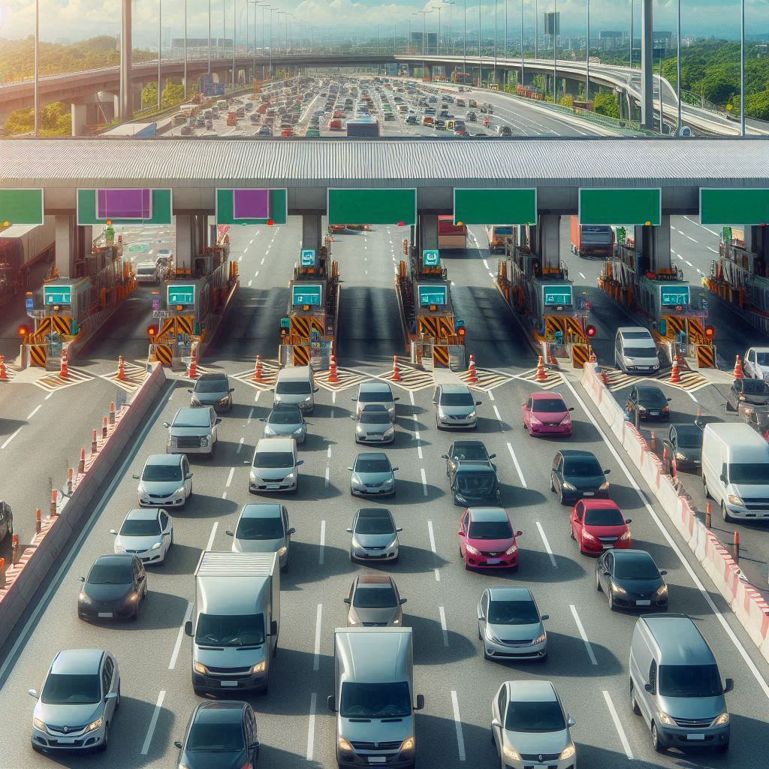
INTEL® UNNATI INDUSTRIAL TRAINING PROGRAM 2024
PIXEL PIONEERS
GPS TOLL-BASED SYSTEM SIMULATION USING PYTHON
SUBMISSION DATE – 10/07/2024
USING PYTHON

Slide 2

PROBLEM STATEMENT :
Managing dynamic toll charges and vehicle movements in a simulated environment.
Visualizing vehicle paths, toll zones, and associated financial impacts.

Slide 3

UNIQUE IDEA BRIEF (SOLUTION)
Key features
Dynamic Toll Calculation:
Based on congestion levels and distance traveled.
Adaptive toll rates for low, medium, and high congestion scenarios.
Real-Time Simulation:
Vehicles moving from start to end locations.
Detailed tracking of vehicle paths and toll zone crossings.
Technical Implementation
Core Algorithms:
Haversine formula for distance calculation between coordinates.
Polygon containment algorithm for determining toll zone crossings.
Simulation Details:
Multiple vehicles with unique start and end locations.
Step-wise movement simulation ensuring realistic travel paths.

Slide 4
Visualization Tools
Folium for Map Visualization:
Interactive maps displaying vehicle paths and toll zones.
Dynamic highlighting of toll zone crossings.
Matplotlib for Data Representation:
Bar charts showing initial balances, final balances and toll charges.
Clear visual representation of financial impact on each vehicle.
User Interface
Tkinter Dashboard:
Integrated graph and data table for comprehensive analysis . Interactive button to open and view the map in a web browser.
Outcomes and Benefits
Enhanced Understanding:
Clear visualization of vehicle movements and financial deductions.
Insightful data on the impact of dynamic toll charges.
Practical Application:
Potential use in real-world toll management systems.
Basis for further development in traffic and toll management solutions.

Slide 5
Features Offered
Dynamic Toll Calculation
Adaptive Toll Rates:
Calculates tolls based on current congestion levels (low, medium, high).
Ensures fair and dynamic tolling in varying traffic conditions.
Distance-Based Calculation:
Utilizes the Haversine formula to compute distances traveled.
Accurate toll charges proportional to the distance covered by each vehicle.
Real-Time Vehicle Simulation
Step-Wise Movement:
Vehicles move from start to end locations in defined steps.
Realistic simulation of vehicle travel paths over time.
Vehicle Tracking:
Continuous monitoring of vehicle locations.
Detection of toll zone crossings for dynamic
toll application.

Slide 6
Advanced Visualization
Interactive Maps with Folium:
Visual display of vehicle paths and toll zones on a map.
Highlighted zones and paths for easy identification of crossings.
Graphical Data Representation with Matplotlib:
Bar charts showing initial balances, final balances, and toll charges for each vehicle.
Clear and concise visual representation of
financial data.
Comprehensive User Interface
Integrated Dashboard with Tkinter:
Combines map visualization, data charts, and detailed tables.
User-friendly interface for easy interaction and analysis.
Interactive Map Link:
Button to open and view the map in a web browser.
Enhances accessibility and user engagement with the simulation data.

Slide 7
Detailed Financial Tracking
Account Management:
Initial and final balance tracking for each vehicle.
Detailed recording of toll charges and remaining balances.
Transaction Transparency:
Provides a clear breakdown of toll deductions and balances.
Ensures transparency and accountability in toll charge
calculations.
Scalability and Flexibility
Expandable Features:
Designed to handle more vehicles and complex toll zones in future iterations.
Future-Ready
Real-Time Data Integration:
Potential for incorporating live traffic data for real-time simulations.
Enhanced User Experience:
Planned improvements for more interactive and user- friendly interface elements.

Slide 8
Technologies Used
Programming Languages
Python-Core language for implementing simulation logic, toll calculations, and data handling.
Extensive libraries for visualization and GUI development.
Libraries and Frameworks
Simulation and Mathematical Calculations
Math Library - Provides functions for mathematical operations and calculations, such as the Haversine formula for distance computation.
Random Library - Used for generating random start and end locations for vehicles, ensuring diverse simulation scenarios.

Slide 9
Geospatial Visualization
Folium - Python library for creating interactive maps.
Used to visualize vehicle paths and toll zones on a map, with features like polygons and markers.
Data Visualization
Matplotlib - Comprehensive library for creating static, animated, and interactive visualizations in Python . Used to generate bar charts showing financial data (initial balances, final balances, toll charges
Graphical User Interface (GUI)
Tkinter - Standard Python interface to the Tk GUI toolkit.
Used to create an integrated dashboard that displays graphs, tables, and interactive buttons.
Data Handling
Collections - Used for efficient data storage and manipulation, such as dictionaries for vehicle paths and account data.dictionaries for vehicle paths and account data.

Slide 10
Additional tools
Web Browser Interaction
Web browser Module - Provides a high- level interface to allow displaying web- based documents & to open the interactive map in the default web browser to users.
Operating System Interaction
OS Module - Provides a way of using operating system.Used to manage file paths and ensure the map file is correctly located and opened.
Subprocess Module - Allows spawning new processes, connecting to their input/output/error pipes, and obtaining their return codes. Used to open the map file in specific applications based on the operating system (e.g., Safari on macOS).

Slide 11
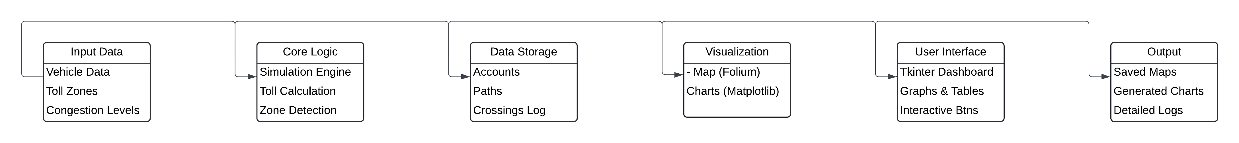
Integrated Development Environment (IDE)
PyCharm / VS Code / Jupyter Notebook
Popular IDEs and code editors for developing and testing Python applications.
Facilitate writing, debugging, and running Python code efficiently.
Deployment and Execution
Local Machine
The project is designed to run locally, utilizing the user's system resources for simulation and visualization.
Ensures fast execution and direct access to generated files and visualizations

Slide 12
INITIALIZATION
PROCESS FLOW
OUTPUT AND REVIEW
SIMULATION
START
USER INTERFACE INTEGRATION
TOLL ZONE
DEDUCTION
PROCESS FLOW
VISUALIZATION
CONGESTION
LEVEL
DETERMINATION
FINANCIAL
TRANSACTIONS
TOLL
CALCULATION

Slide 13
Conclusion
Summary of Achievements
.Successfully designed and implemented a comprehensive simulation system for vehicle movement and toll calculations.
. Developed an interactive and user-friendly dashboard using Tkinter, integrating visualizations from Folium and Matplotlib.
. Demonstrated the ability to detect toll zone crossings and dynamically calculate toll charges based on congestion levels.
Key Takeaways
Real-Time Simulation:
The project showcased the power of real-time simulations in understanding vehicle movements and toll zone interactions.
Dynamic Toll Calculation:
Implemented a flexible toll calculation mechanism that adjusts based on traffic conditions, highlighting the importance of adaptive systems in transportation management.

Slide 14
Interactive Visualizations:
Emphasized the value of interactive visualizations for analyzing complex data, making it accessible and understandable to users.
Challenges Overcome
Algorithm Optimization:
Efficiently optimized the core algorithms for toll zone detection and dynamic toll calculation.
Data Integration:
Successfully integrated various data sources and visualization tools into a cohesive system.
User Interface Design:
Developed an intuitive and responsive user interface that enhances user interaction and experience.
Future Enhancements
Real-Time Data Integration:
Incorporate real-time traffic and congestion data for more accurate and dynamic toll calculations.

Slide 15
Advanced Visualizations:
Enhance visualization features with additional layers of data and interactive elements.
Scalability:
Scale the system to handle larger datasets and more complex simulations, including multiple routes and additional toll zones.
Machine Learning:
Explore the use of machine learning algorithms for predictive analytics and enhanced decision-making in toll management.

Slide 16
Future Enhancements
Real-Time Data Integration:
Incorporate real-time traffic and congestion data for more accurate and dynamic toll calculations.
Advanced Visualizations:
Enhance visualization features with additional layers of data and interactive elements.
Scalability:
Scale the system to handle larger datasets and more complex simulations, including multiple routes and additional toll zones.
Machine Learning:
Explore the use of machine learning algorithms for predictive analytics and enhanced decision-making in toll management.

Slide 17
Team Members and Contributions
1. AASIKHA A
Role: Project Lead, Simulation Developer
Contributions:
Designed the overall project architecture and flow.
Implemented the vehicle movement simulation and toll calculation algorithms.
Coordinated team activities and ensured timely progress.
2. DEVARAJ V
Role: Data Analyst, Visualization Expert
Contributions:
Developed data visualization components using Matplotlib.
Created interactive maps with Folium to display vehicle paths and toll zones.
Analyzed simulation data to generate meaningful insights and visual representations.

Slide 18
3. AFIYA A
• Role: UI/UX Designer, Tkinter Developer
• Contributions:
o Designed and developed the Tkinter-based user interface.
o Integrated data visualizations and interactive elements into the dashboard.
o Ensured a user-friendly and intuitive interface for better user experience.
4. AAFIYAH TASNEEM H
• Role: Data Scientist, Algorithm Specialist
• Contributions:
o Developed and optimized algorithms for toll zone detection and dynamic toll calculation.
o Implemented the Haversine formula for distance computation.
o Conducted performance analysis and optimization of
algorithms.

Slide 19
5. AASHA RASINA
• Role: Quality Assurance, Documentation Lead
• Contributions:
o Conducted thorough testing and debugging of the simulation and visualization modules.
o Documented the entire project workflow, including code comments, user guides, and technical reports.
o Ensured code quality and maintained version control throughout the project development.

Slide 20
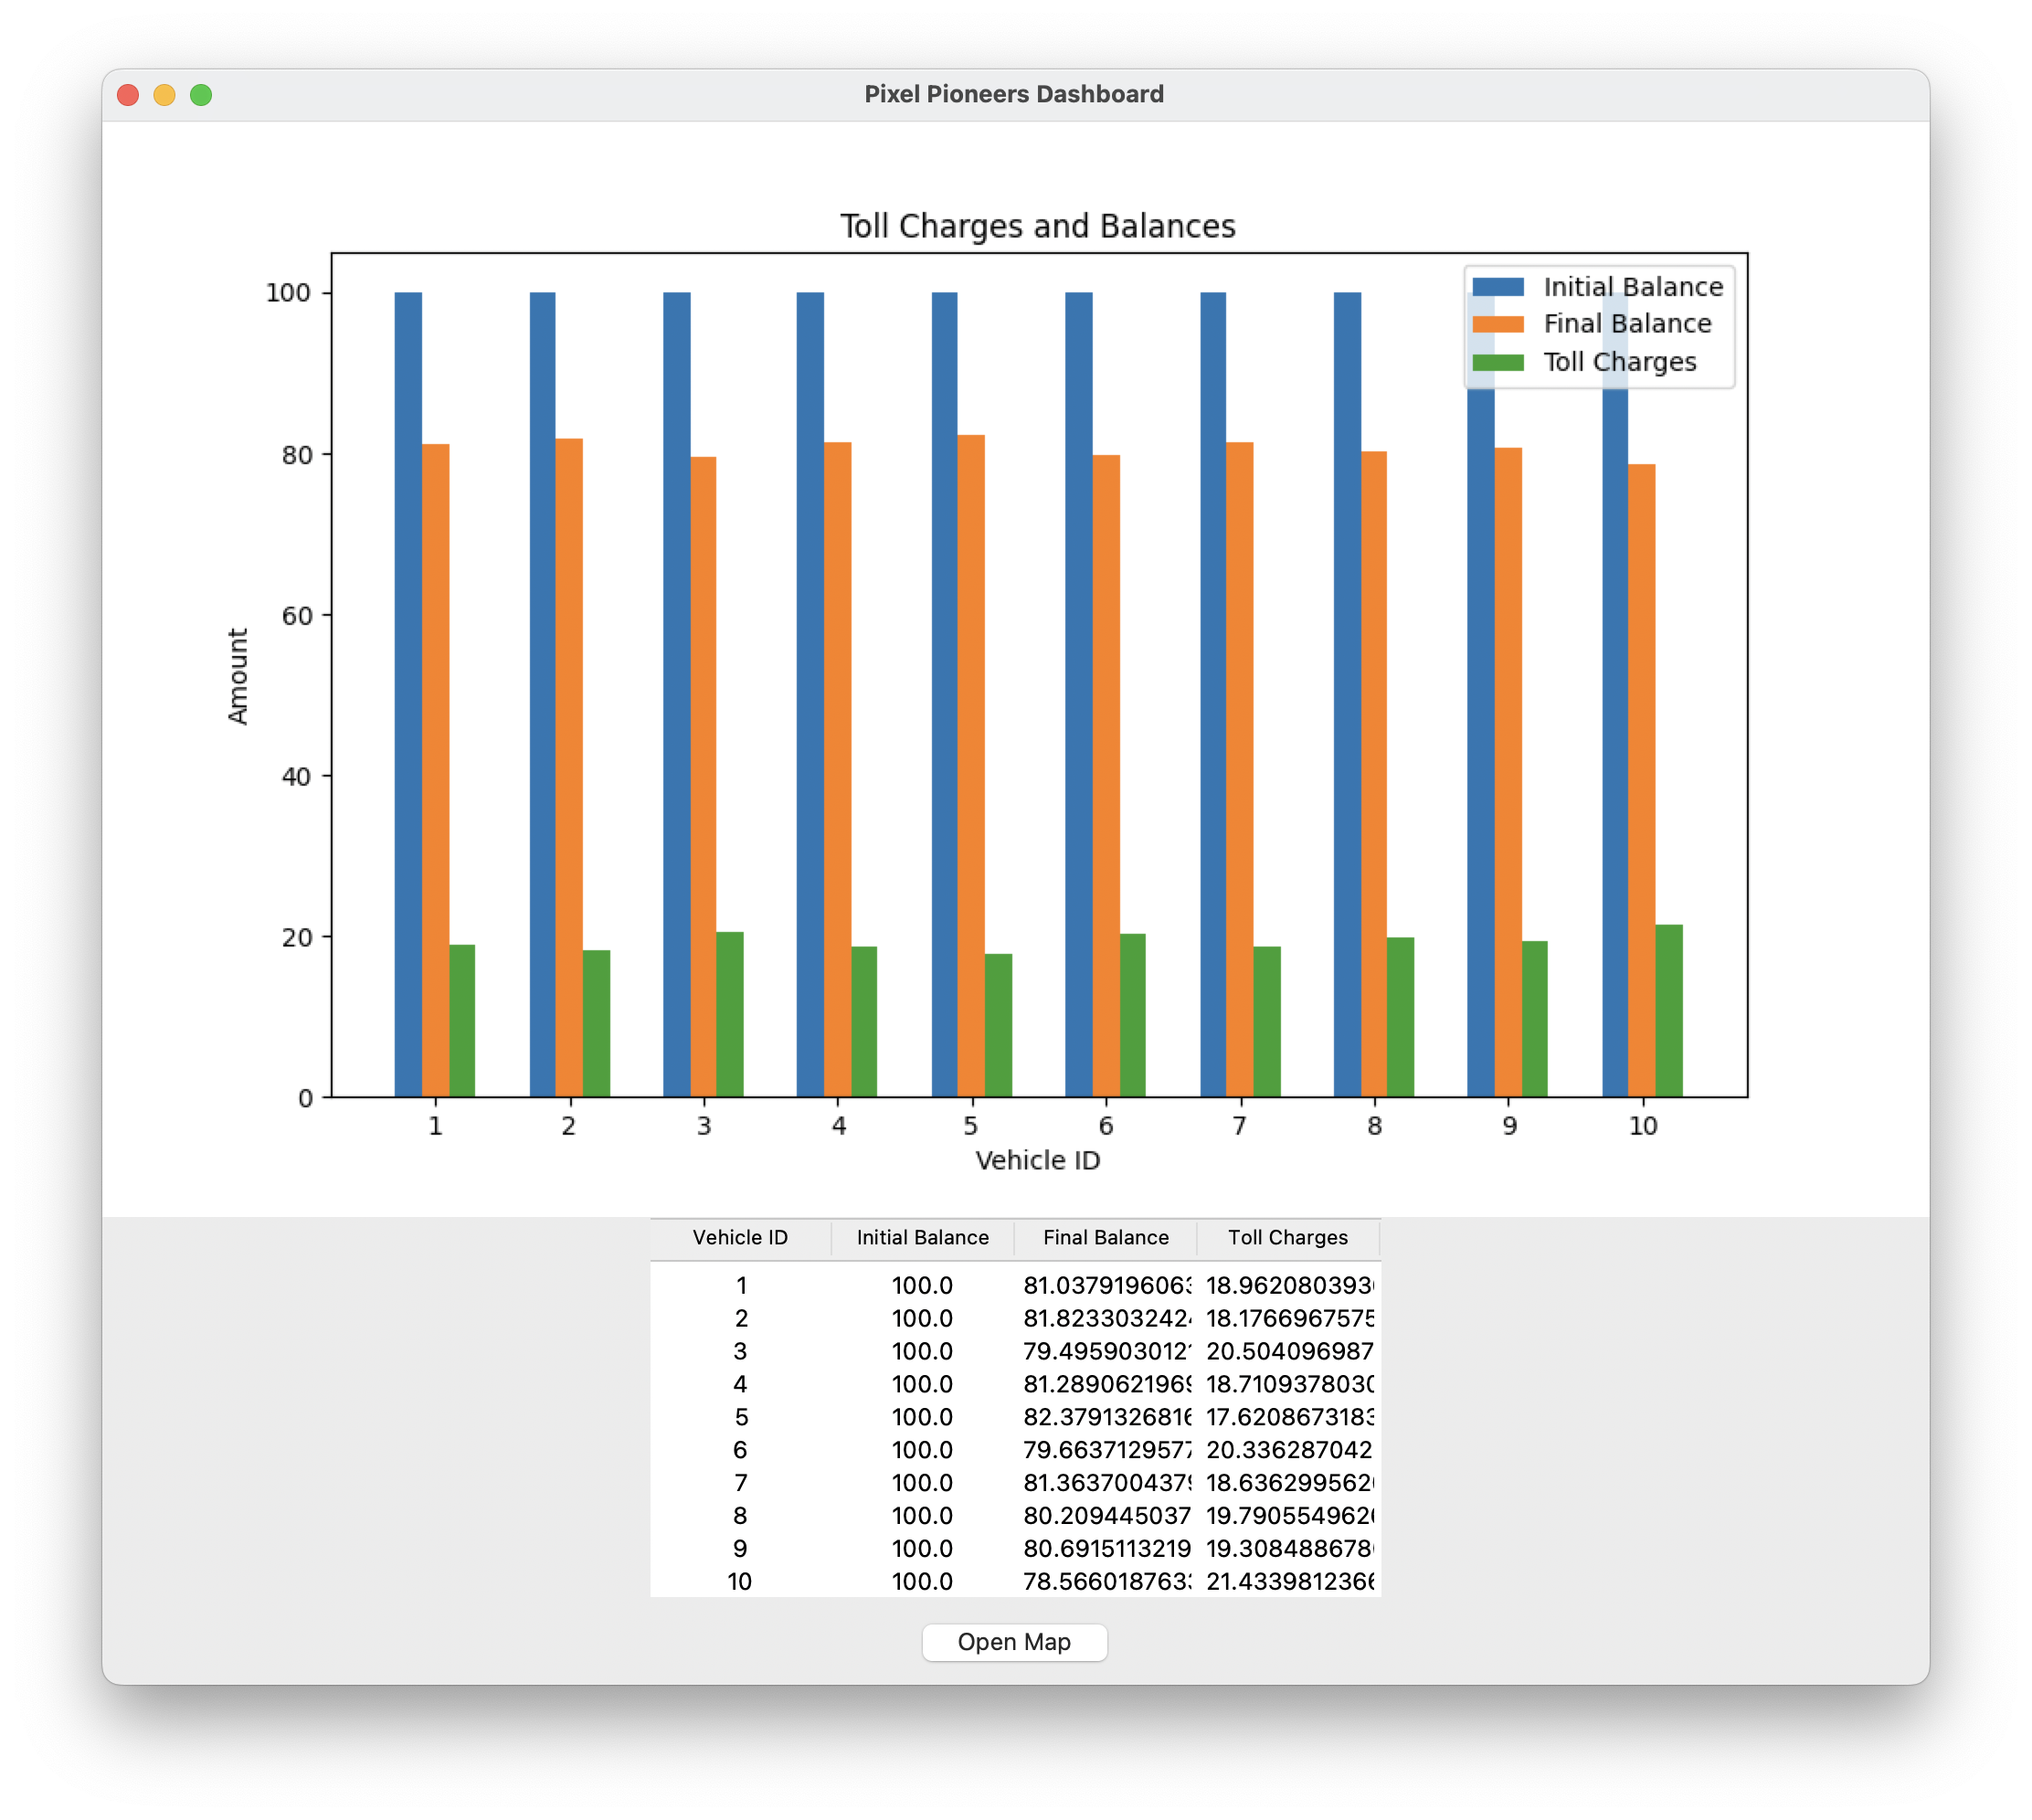
RESULT

