Slide 1
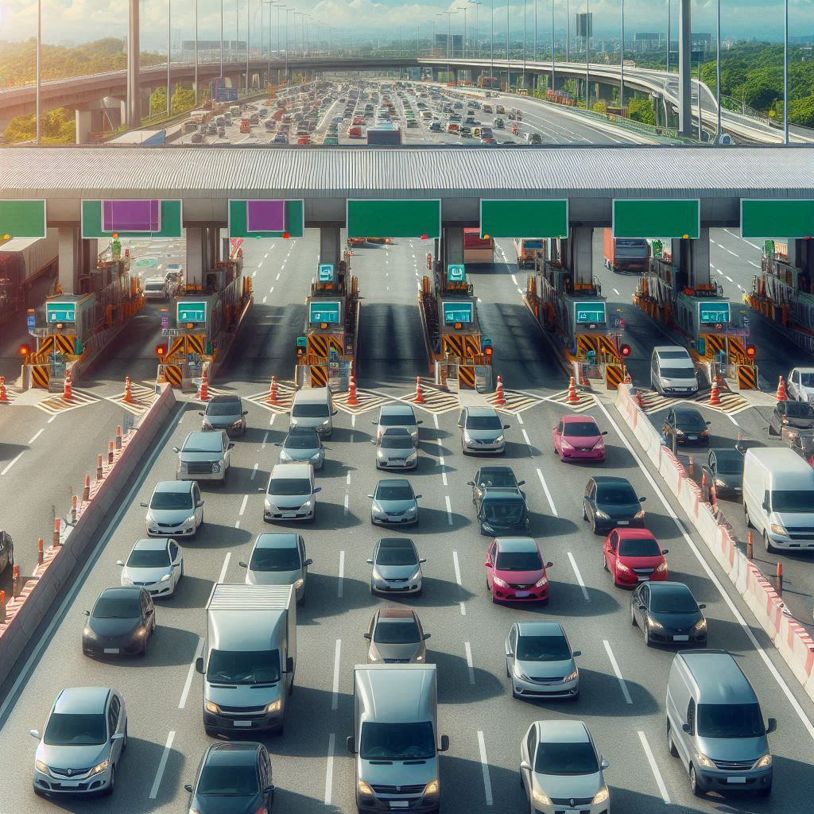
INTEL® UNNATI INDUSTRIAL TRAINING PROGRAM 2024
PIXEL PIONEERS
GPS TOLL-BASED SYSTEM SIMULATION USING PYTHON
SUBMISSION DATE – 15/07/2024
AASIKHA A [LEAD]
AAFIYAH TASNEEM
AFIYA.A
DEVARAJ V
AASHA RASINA
MENTOR : Ms. A. SNEGAA
USING PYTHON

Slide 2

PROBLEM STATEMENT
Managing dynamic toll charges and vehicle movements in a simulated environment.
Visualizing vehicle paths, toll zones, and associated financial impacts.

Slide 3

UNIQUE IDEA BRIEF (SOLUTION)
Dynamic Toll Calculation:
Adaptive toll rates based on real-time congestion levels and distance travelled.
Real-time adjustments for low, medium, and high congestion scenarios.
Real-Time Simulation:
Realistic simulation of vehicle movements from start to end locations.
Detailed tracking of vehicle paths and toll zone crossings.
Core Algorithms:
Haversine formula for precise distance calculation between GPS coordinates.
Polygon containment algorithm for accurate toll zone crossing detection.
Simulation Details:
Simulation of multiple vehicles with unique start and end locations.
Step-wise movement simulation for realistic travel paths.

Slide 4
Folium for Map Visualization:
Interactive maps displaying vehicle paths and toll zones.
Dynamic highlighting of toll zone crossings.
Matplotlib for Data Representation:
Bar charts illustrating initial balances, final balances, and toll charges.
Clear visual representation of financial impacts on each vehicle.
User Interface
Tkinter Dashboard:
Integrated graphs and data tables for comprehensive
analysis.
Interactive button to open and view the map in a web
browser.
Outcomes and Benefits
Enhanced Understanding:
Clear visualization of vehicle movements and financial deductions.
Insightful data on the impact of dynamic toll charges.
Practical Application:
Potential use in real-world toll management systems.
Foundation for further development in traffic and toll management solutions.

Slide 5
FEATURES OFFERED
Dynamic Toll Calculation
Adaptive Toll Rates: Adjusts based on congestion levels for dynamic tolling.
Distance-Based Calculation: Uses Haversine formula for accurate, proportional toll charges.
Real-Time Vehicle Simulation
Step-Wise Movement: Simulates realistic vehicle travel in defined steps.
Vehicle Tracking: Monitors locations and detects toll zone crossings.
Advanced Visualization
Interactive Maps with Folium: Displays vehicle paths and toll zones; highlights crossings.
Graphical Data Representation with Matplotlib: Bar charts for initial/final balances and toll charges.
Comprehensive User Interface
Tkinter Dashboard: Integrates map visualization, data charts, and detailed tables.
Interactive Map Link: Opens map in a web browser for enhanced user engagement.

Slide 6
Detailed Financial Tracking
Account Management: Tracks initial and final balances,
and toll charges.
Transaction Transparency: Clear breakdown of toll
deductions and balances.
Scalability and Flexibility
Expandable Features: Designed for more vehicles and
complex toll zones in future updates.
Future-Ready: Potential for live traffic data integration
and enhanced user experience.

Slide 7
TECHNOLOGIES USED
Python: Core for simulation logic, toll calculations, data handling, visualization, and GUI development.
Libraries and Frameworks
Math: Functions for operations, Haversine formula for distance.
Random: Generates random start/end locations for diverse scenarios.
Geospatial Visualization
Folium: Interactive maps, visualizes vehicle paths, toll zones
polygons, markers.
Data Visualization
Matplotlib: Static/animated/interactive visualizations, bar
charts for financial data.
Graphical User Interface (GUI)
Tkinter: Standard interface to Tk GUI toolkit, creates integrated dashboard with graphs, tables, interactive buttons.
Data Handling
Collections: Efficient storage and manipulation, dictionaries for vehicle paths and account data.

Slide 8
INITIALIZATION
PROCESS FLOW
OUTPUT AND REVIEW
SIMULATION
START
USER INTERFACE INTEGRATION
TOLL ZONE
DEDUCTION
PROCESS FLOW
VISUALIZATION
CONGESTION
LEVEL
DETERMINATION
FINANCIAL
TRANSACTIONS
TOLL
CALCULATION

Slide 9
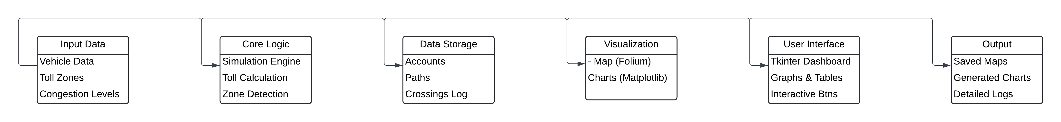
ARCHITECTURE DIAGRAM

Slide 10
Team Members and Contributions
AASIKHA A
Role: Project Lead, Simulation Developer
Contributions: Designed project architecture, implemented vehicle movement simulation, coordinated team activities.
DEVARAJ V
Role: Data Analyst, Visualization Expert
Contributions: Developed Matplotlib visualizations, created interactive maps with Folium, analyzed simulation data.
AFIYA A
Role: UI/UX Designer, Tkinter Developer
Contributions: Designed Tkinter UI, integrated data visualizations, ensured user-friendly interface.

Slide 11
AAFIYAH TASNEEM H
Role: Data Scientist, Algorithm Specialist
Contributions: Developed toll calculation algorithms, implemented distance computation using Haversine formula, optimized algorithms.
AASHA RASINA
Role: Quality Assurance, Documentation Lead
Contributions: Conducted testing and debugging, documented project workflow, ensured code quality and version control.

Slide 12
CONCLUSION
ACHIEVEMENTS
Implemented a vehicle movement and toll calculation simulation system.
Developed an interactive Tkinter dashboard with Folium and Matplotlib visualizations.
Created dynamic toll calculation based on traffic conditions.
KEY TAKEAWAYS
Real-Time Simulation: Highlighted the benefits of real-time simulations in understanding vehicle movements and toll interactions.
Dynamic Toll Calculation: Emphasized adaptive toll systems for effective transportation management.

