Slide 1
Heart Disease Prediction Using Machine Learning
DEVAMANI T
University College of Engineering Villupuram

Slide 2
Problem Statement
Heart disease is a leading cause of death globally.
Early detection is critical for prevention.
Goal: Predict heart disease risk from patient health data.

Slide 3
Dataset & Features
Features: Age, cholesterol, blood pressure, ECG, etc.
Total records: [Insert Number]
Preprocessing: Cleaned missing values, encoded categorical data, normalized numeric features.

Slide 4
Model & Evaluation
Model Used: Random Forest Classifier
Evaluation Metrics:
- Accuracy: 89.13%
- Precision: 0.89
- Recall: 0.89
- F1-Score: 0.89

Slide 5
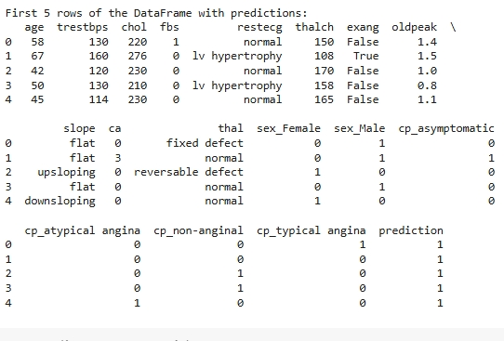
Prediction Results
Model predicts heart disease risk successfully.
Sample output can be added here (screenshot from Colab or chart).

Slide 6
Conclusion & Future Work
Conclusion:
ML can help in early detection of heart disease.
Supports doctors and patients in preventive healthcare.
Future Work:
Build a web app for real-time predictions.
Include more patient features for better accuracy.

