Slide 1

Performance Analysis of Software Defined Networks (SDN) Through Simulation Using Mininet and OpenFlow
CSA0712-COMPUTER NETWORKS
Presented by:
A Venkat Dharahas(192412570)
Palaji Obulesh(192312243)
G Devendra Nath Reddy(192425204)
Guide By:
Dr.S.SALINI

Slide 2


Introduction
Software Defined Networking (SDN) separates the control plane from the data plane.
A centralized controller manages network switches and traffic flow.
Mininet is used to simulate hosts, switches, and network links.
OpenFlow enables communication between the controller and switches.
The project analyzes throughput, latency, packet loss, jitter, and bandwidth.

Slide 3

Problem Statement
Traditional networks are difficult to manage because devices make independent forwarding decisions.
Network configuration and monitoring become complex as the network grows.
SDN performance can be affected by traffic load, bandwidth, delay, and network size.
A low-cost simulation system is needed to test and analyze SDN performance.

Slide 4
Objectives
Design and simulate an SDN network using Mininet.
Implement OpenFlow communication between the controller and switches.
Generate TCP and UDP network traffic.
Measure throughput, latency, packet loss, jitter, and bandwidth.
Analyze SDN performance under different network conditions.

Slide 5

Literature Review
Year | Author / Study | Technology / Tools | Main Contribution
2020 | POX Controller and OpenFlow Performance Evaluation in SDN Using Mininet Emulator | Mininet, POX, OpenFlow | Evaluated bandwidth utilization, CPU load, packet loss, latency, and throughput using different numbers of switches.
2021 | Altangerel et al. | Mininet, POX, Floodlight, OpenDaylight | Compared SDN controllers using TCP/UDP throughput and Round-Trip Time (RTT) in mesh and tree topologies.
2021 | Costa et al. | OpenFlow 1.0/1.3, POX, ONOS | Evaluated OpenFlow data-plane performance across hardware.

Slide 6
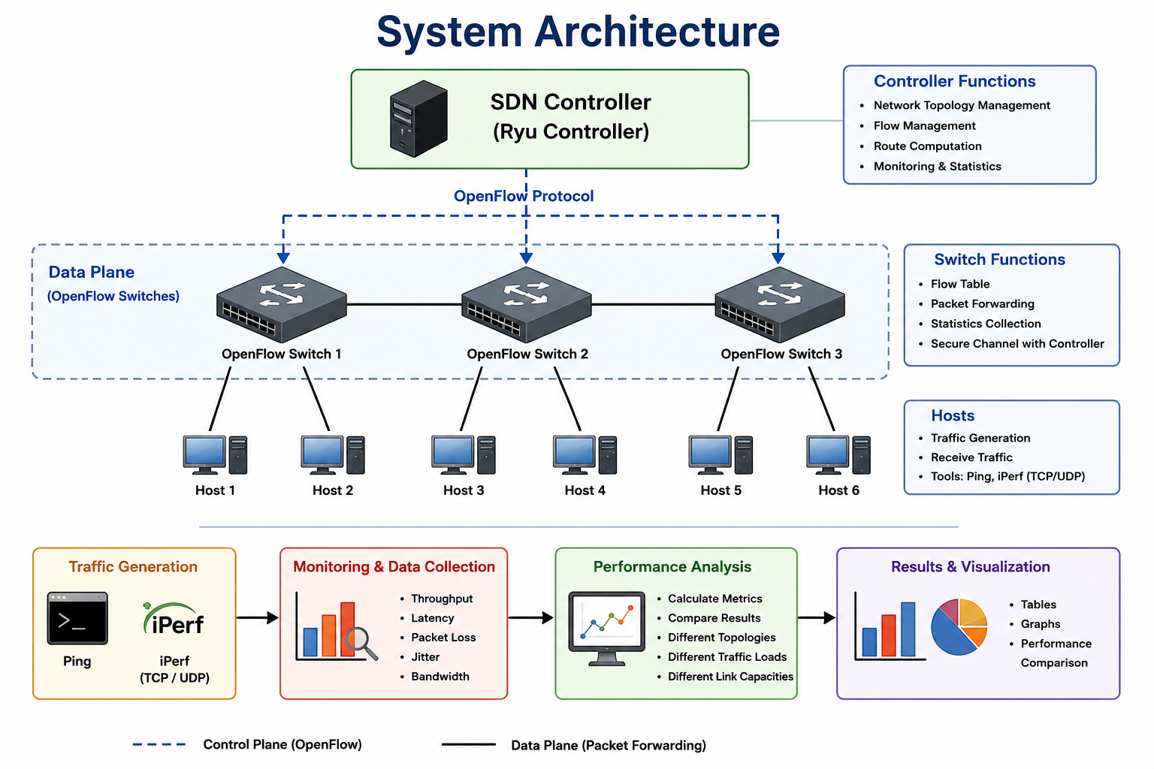

Slide 7
Existing System
Traditional networks use distributed control mechanisms.
Each network device makes its own forwarding decisions.
Configuration must be performed on individual devices.
Network monitoring and management are more complex.
Real network testing can require expensive physical equipment.

Slide 8
Proposed System
Uses Mininet to create a virtual SDN environment.
Uses an SDN controller for centralized network management.
Uses OpenFlow switches for traffic forwarding.
Generates TCP and UDP traffic using Ping and iPerf.
Collects and analyzes performance metrics under different conditions.

Slide 9
Module 1 – SDN Network Simulation
Create the network topology using Mininet.
Add virtual hosts, OpenFlow switches, and links.
Connect switches to the SDN controller.
Configure the simulated network.
Test connectivity between hosts.
Output: A working SDN network simulation.

Slide 10
Module 2 – Traffic Generation and Monitoring
Generate TCP and UDP traffic between hosts.
Use Ping to test connectivity and delay.
Use iPerf to measure network throughput.
Monitor packet transmission and bandwidth.
Collect latency, packet loss, and jitter data.
Output: Network performance data.

Slide 11
Module 3 – Performance Analysis and Results
Analyze the collected performance data.
Compare network performance under different traffic loads.
Compare TCP and UDP traffic.
Evaluate throughput, latency, packet loss, and jitter.
Display results using tables and graphs.
Output: Final performance comparison.

Slide 12
Results
The SDN network was successfully simulated using Mininet and OpenFlow.
Hosts communicated successfully through OpenFlow switches.
Ping and iPerf were used for network testing.
Throughput decreased when traffic load increased.
Latency and jitter increased during congestion.
Packet loss increased under heavy traffic conditions.
The SDN controller provided centralized network control.

Slide 13
Conclusion
The project successfully demonstrates SDN performance analysis in a simulated environment.
Mininet provides a low-cost platform for creating virtual networks.
OpenFlow enables communication between the controller and switches.
Traffic load, bandwidth, delay, and topology affect network performance.
The proposed system helps study SDN without expensive physical equipment.
Centralized control is a major advantage of SDN.

Slide 14
References
B. Lantz, B. Heller, and N. McKeown, “A Network in a Laptop: Rapid Prototyping for Software-Defined Networks,” 2010.
N. McKeown et al., “OpenFlow: Enabling Innovation in Campus Networks,” ACM SIGCOMM, 2008.
Mininet Official Website: mininet.org
Open Networking Foundation – OpenFlow resources.
Ryu SDN Framework: ryu-sdn.org

