Slide 1

Agentic AI Food Donation Management System using Service-Oriented Architecture with ChatGPT, GitHub Copilot, Lucidchart AI, Jira AI and Postman Agent Mode
SOA Project Review-1
Date& Time
 | Under the Guidance of Dr.Nelima Gogineni Department of Computer Science and Engineering, KLH CSE Bowrampet Campus
Team Members P.Devaansh Sai (Roll No:2420030787) BHUVAN (Roll No: 2420030767) V.Abhignan (Roll No: 2420030731)

Slide 2

Outline of Project Work
Focus
Introduction
Literature Survey
Challenges
Research Objectives
Conclusion & Future Work
References
Publications Details

Slide 3
Problem Statement
Rural communities face significant challenges in accessing essential services, resources, and timely information due to limited infrastructure, connectivity, and availability of organized support systems.
Existing rural service and resource-distribution processes are often fragmented, manual, and difficult to coordinate, making it challenging for people to identify and access the right resources when they are needed.
The lack of a centralized and intelligent platform results in delayed assistance, inefficient utilization of available resources, and limited coordination between rural communities, service providers, and supporting organizations.
There is a need for a scalable digital platform that enables real-time resource discovery, intelligent matching, transparent coordination, and efficient delivery of essential services to underserved rural communities.

Slide 4
Objectives
Develop a digital platform to improve access to essential services, resources, and information for people living in rural communities.
Connect rural users with relevant service providers, government schemes, local organizations, and available resources through a centralized platform.
Use intelligent recommendation and matching mechanisms to identify suitable services and resources based on the user's needs, location, and eligibility.
Reduce delays, information gaps, and dependency on manual processes by providing real-time updates, notifications, and transparent access to available support.
Provide data-driven insights and analytics to help organizations and authorities identify rural needs, monitor service utilization, and improve resource allocation.

Slide 5
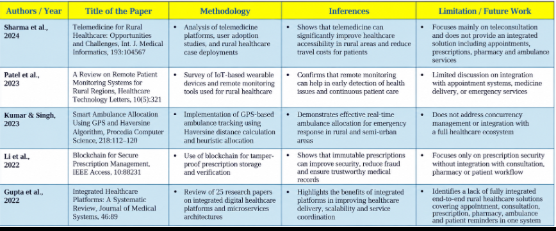
Literature Survey

Slide 6
Problem Gap Identification
Existing rural service platforms mainly provide basic information or individual services; they do not integrate service discovery, intelligent recommendations, real-time updates, and resource coordination within a single platform.
Most existing systems rely on manual searching and user-driven interaction rather than using AI-based matching to identify the most suitable services or resources according to user needs, location, and eligibility.
Limited real-time data integration makes it difficult for rural users to receive updated information about service availability, government schemes, local resources, and support programs.
Existing solutions provide limited data-driven insights for organizations and authorities to understand changing rural needs, identify service gaps, and optimize the allocation of available resources.
Therefore, a unified AI-enabled platform is required to connect rural communities with relevant services and resources while improving accessibility, personalization, coordination, and decision-making.

Slide 7
Innovation, Creativity, and Novelty
Uses AI-based recommendations to identify the most suitable government schemes, welfare services, healthcare, education, employment, and other resources according to each user's needs, location, and eligibility.
Provides intelligent matching between rural users and relevant service providers or resources by considering factors such as distance, availability, requirements, and priority rather than relying only on basic keyword-based searches.
Introduces real-time updates and automated notifications for service availability, scheme changes, application status, important announcements, and location-specific opportunities.
Generates data-driven insights from rural service requests and platform activity to identify underserved communities, recurring needs, resource demand, and gaps in service delivery.
Combines service discovery, AI recommendations, real-time information, coordination, and analytics in one integrated platform, providing a more comprehensive solution than isolated rural service applications.

Slide 8
Feasibility and Project Plan
Technical Feasibility: The proposed rural healthcare platform is technically feasible using a microservices-based architecture with Spring Boot, Spring Cloud Eureka Server, Spring Cloud API Gateway, JWT-based authentication, and Next.js 16. The system is divided into independent services for authentication, users, doctors, appointments, consultations, prescriptions, medicines, pharmacies, reminders, and ambulance services.
Functional Feasibility: The implemented services support essential healthcare operations such as doctor management, appointment scheduling with slot locking, consultations, immutable prescriptions, medicine reminders, pharmacy stock reservation, and ambulance location-based allocation, providing a complete healthcare service workflow.
Integration Feasibility: The backend services have been integrated through the Eureka Service Registry and API Gateway, with 11/11 backend modules successfully tested, demonstrating that the individual services can communicate and operate together as an integrated system.
Security Feasibility: JWT-based authentication and authorization provide secure access to the platform, while service-level separation helps protect user, medical, prescription, and operational data.
Scalability and Reliability: The microservices architecture allows individual services to be developed, deployed, maintained, and scaled independently. Concurrency controls for appointment slot locking, pharmacy stock reservation, and ambulance allocation help prevent conflicts during simultaneous requests.
Project Plan
Phases 1–3: Establish the project foundation, configure the Eureka Server (8761) for service discovery, and implement the Spring Cloud API Gateway (8080).
Phases 4–6: Develop and verify the Authentication Service with JWT, followed by the User Service and Doctor Service.
Phases 7–9: Implement the core healthcare workflow through the Appointment Service with slot locking, Consultation Service, and Prescription Service with immutable prescriptions.
Phases 10–12: Develop the supporting healthcare services including Medicine & Reminders, Pharmacy with stock reservation, and Ambulance with Haversine-based location calculation and concurrency locking.
Phases 13–14: Complete end-to-end backend integration, achieve 100% test success across all 11 modules, and develop the Next.js 16 client portal for user interaction.
Final Outcome: Deliver an integrated and scalable rural healthcare platform connecting patients, doctors, pharmacies, and emergency ambulance services through a secure, modular, and reliable system.

