Slide 1
University search application using Semantic Data technologies
D Prathyusha
2015832

Slide 2
Introduction
Purpose- The inspiration to build this application was two-fold: the first was a theoretical re-implementation of the university’s system (aru.ac.uk) using semantic data technologies, and the second was the discovery of the use of semantic data technologies.
Aim - To describe how a semantic web application is developed, from the Ontology design, queries composition, and its connection to a web interface for the end- user. Explaining in detail the developing tools used as well as challenges and possible solutions around in this process.

Slide 3
Design and workflow
Create classes and subclasses
Add properties – Object Properties and Data Properties
Add Instances and Execute Reasoner
Evaluation with SPARQL Queries
User Interface

Slide 4
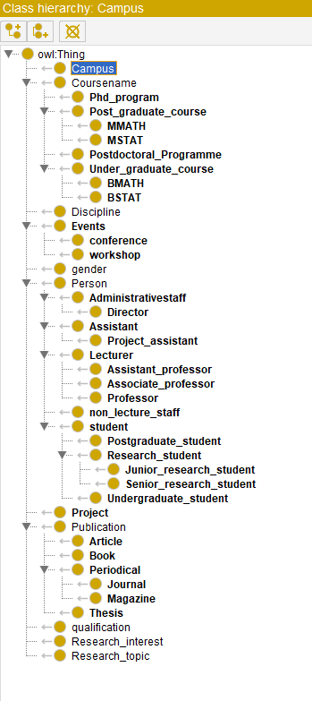
Classes and Subclasses
40 classes
The main classes are Campus, Course name, Discipline, qualification, research interest, Events, gender, Publications, and Person. The subclasses represent the category division for every class. For example, Article, Book, Periodical, and Thesis are subclasses of publications.

Slide 5

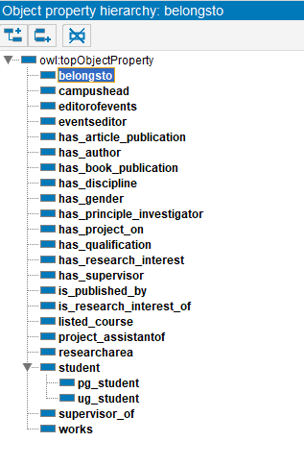

Object Properties
25 Object Properties, 2 subclass, and 4 inverse object properties
There are characteristics of object properties like Functional, Inverse Functional, Symmetric, Asymmetric, Reflexive, Irreflexive, and Transitive to define the type of relationship between domain and range in a relationship. For example, In the Person belongsto campus relates to many to one relation which says that the relation is functional.

Slide 6
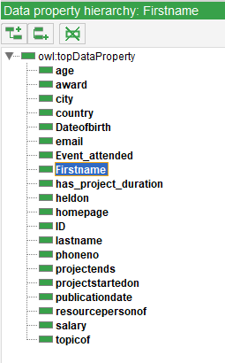
Data properties
20 data properties
The data property is going to be used to identify all the data on our Ontology. Every data property can be set a data type while creating in protégé. For identifying Persons (students, lecturers, non-staff) who have first name, last name, ID, Email-id, award, city, and some properties are set to string type based on individuals’ data type. Age, salary, and project duration are integer type. The remaining data properties date of birth, project started on, and publication date are type date.

Slide 7
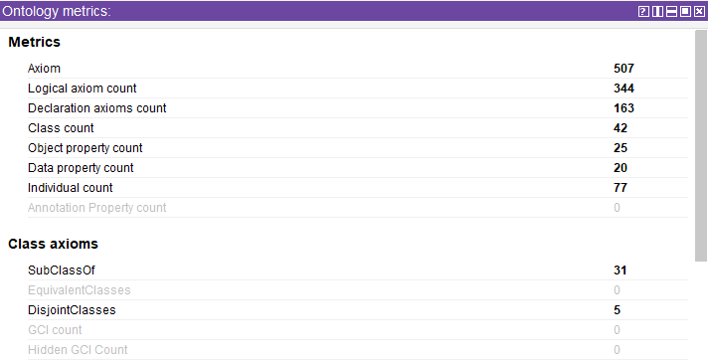
Ontology Metrics
It consists of 507 axioms, 1346 triples, 77 individuals, 42 classes, 25 object properties, and 20 data properties in total. Of those 50 classes, 31 are subclasses — classes nested within other classes in the hierarchy. 5 of those 50 classes are considered ‘disjointed’ which means that they cannot be linked with the same individual because they are opposed to each other in some way.

Slide 8
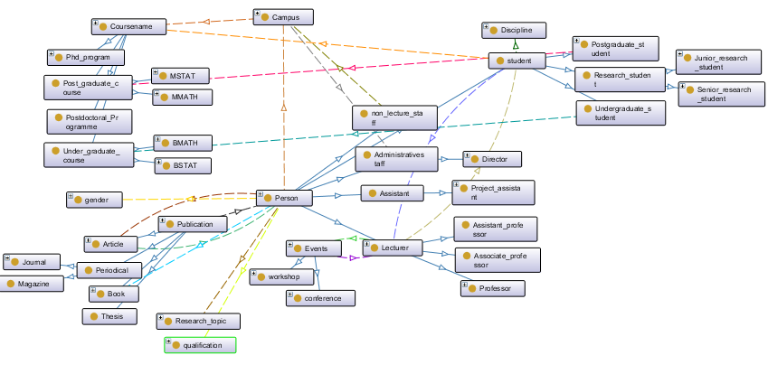

Slide 9
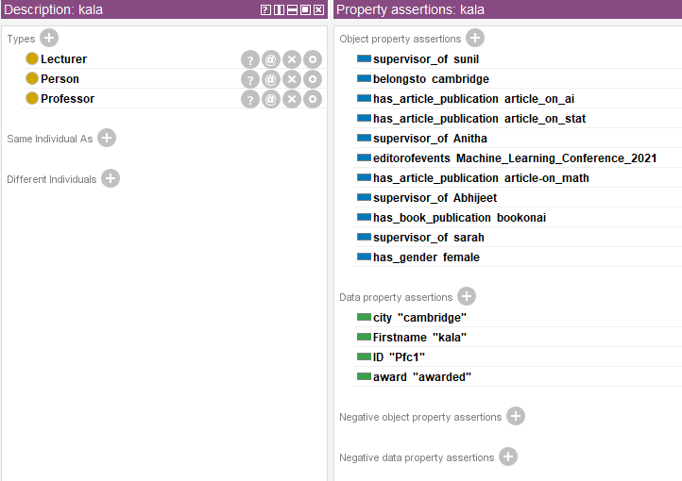
Instances
77 Individuals
The instances of the relationships with the data and object properties are called individuals. Individuals which share common characteristics are categorized as members of a class. For instance, name of student is an individual of the class student with all the data and object properties of the Ontology created for the application.

Slide 10
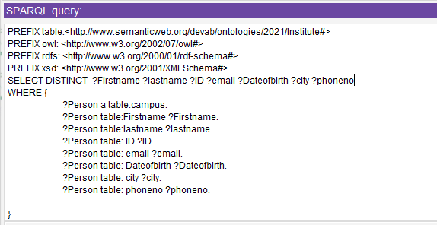
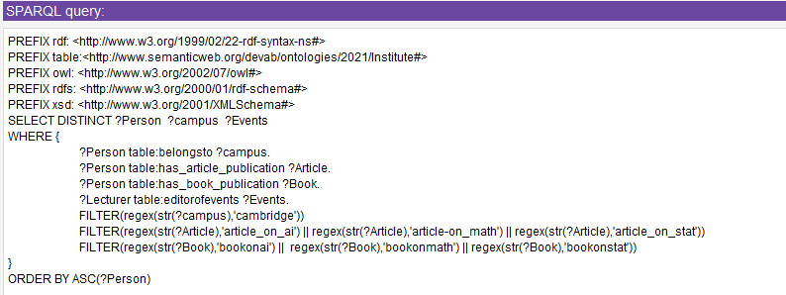
Evaluation
SPARQL query for filters
Query to count the occurrences of all RDF names
Query individuals with conditions
Query for presenting data – student details
Query individuals with selected filter:

Slide 11
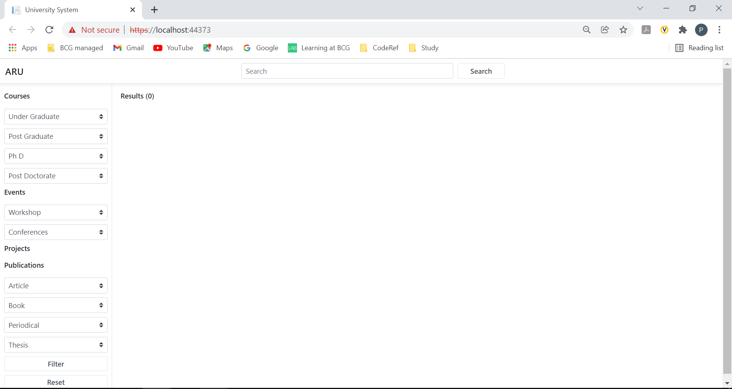

Slide 12
References
Shubhi Shrivastava, Iti Mathur, and Nisheeth Joshi, 2018. “AN ONTOLOGY DEVELOPMENT FOR UNIVERSITY”. Available at: < https://ieeexplore.ieee.org/stamp/stamp.jsp?tp=&arnumber=8933803>
Naveen Malviya, Nishchol Mishra, Santosh Sahu,” Developing University Ontology using protégé OWL Tool: Process and Reasoning”, International Journal of Scientific & Engineering Research Volume 2, Issue 9, September-2011 1 ISSN 2229-5518. (online) Available at: < https://www.ijser.org/researchpaper/Developing_University_Ontology.pdf>
Giuseppe Lugano, December 15, 2005 “Semantic Web Technologies and the FOAF Project” (online) Available at: https://www.researchgate.net/profile/Giuseppe-Lugano/publication/265188150_Semantic_Web_Technologies_and_the_FOAF_Project/links/54e485960cf2dbf60696c7fd/Semantic-Web-Technologies-and-the-FOAF-Project.pdf
Protégé.stanford.edu,2019. Protégé .[online] Available at:https://protégé.stanford.edu
Tauberer, J.,2006. “What is RDF”.[online] Available at: https://www.xml.com/pub/a/2001/01/24.rdf.html> [Accessed 6 Dec 2019].

