Slide 1
Database Management System

Slide 2
Data Models
A set of concepts to describe the structure of a database, and certain constraints that the database should obey.
Data Model Operations: Operations for specifying database retrievals and updates by referring to the concepts of the data model.
Operations on the data model may include basic operations and user-defined operations.

Slide 3
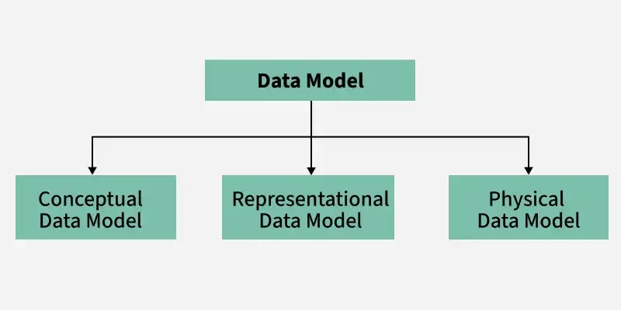
Categories of data models

Slide 4
Categories of data models
Conceptual (high-level, semantic) data models: Provide concepts that are close to the way many users perceive data. (Also called entity-based or object-based data models.)
Implementation (representational) data models: Turns the conceptual ideas into a structure that can be represented in a database
Physical (low-level, internal) data models: Provide concepts that describe details of how data is stored in the computer.

Slide 5
Schemas versus Instances
Database Schema: The description of a database. Includes descriptions of the database structure and the constraints that should hold on the database.
Schema Diagram: A diagrammatic display of (some aspects of) a database schema.
Schema Construct: A component of the schema or an object within the schema, e.g., STUDENT, COURSE.
Database Instance: The actual data stored in a database at a particular moment in time. Also called database state (or occurrence).

Slide 6
Database Schema Vs. Database State
Database State: Refers to the content of a database at a moment in time.
Initial Database State: Refers to the database when it is loaded
Valid State: A state that satisfies the structure and constraints of the database.
Distinction
  The database schema changes very infrequently. The database state changes every time the database is updated.
  Schema is also called intension, whereas state is called extension.

Slide 7
Three-Schema Architecture
It support DBMS characteristics of:
  Program-data independence.
  Support of multiple views of the data.

Slide 8
Three-Schema Architecture
Internal schema at the internal level to describe physical storage structures and access paths. Typically uses a physical data model.
Conceptual schema at the conceptual level to describe the structure and constraints for the whole database for a community of users. Uses a conceptual or an implementation data model.
External schemas at the external level to describe the various user views. Usually uses the same data model as the conceptual level.

Slide 9
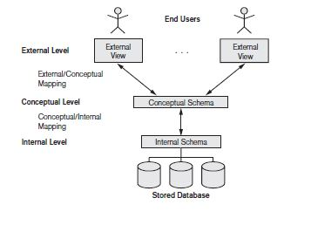
Three schema Architecture

Slide 10
Three schema Architecture
Mappings among schema levels are needed to transform requests and data. Programs refer to an external schema, and are mapped by the DBMS to the internal schema for execution.

Slide 11
Data Independence
Logical Data Independence: The capacity to change the conceptual schema without having to change the external schemas and their application programs.
Physical Data Independence: The capacity to change the internal schema without having to change the conceptual schema

Slide 12
Data Independence
When a schema at a lower level is changed, only the mappings between this schema and higher-level schemas need to be changed in a DBMS that fully supports data independence. The higher-level schemas themselves are unchanged. Hence, the application programs need not be changed since they refer to the external schemas.

Slide 13
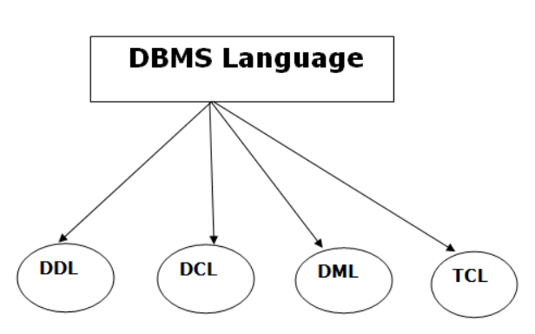
Types of Database Languages

Slide 14
Data Definition Language (DDL)
DDL stands for Data Definition Language. It is used to define database structure or pattern.
It is used to create schema, tables, indexes, constraints, etc. in the database.
Using the DDL statements, you can create the skeleton of the database.
Data definition language is used to store the information of metadata like the number of tables and schemas, their names, indexes, columns in each table, constraints, etc.

Slide 15
Create: It is used to create objects in the database.
Alter: It is used to alter the structure of the database.
Drop: It is used to delete objects from the database.
Truncate: It is used to remove all records from a table.
Rename: It is used to rename an object.

Slide 16
CREATE: Used to create a new database object like a table, view, or index.
CREATE TABLE table_name ( column1 datatype constraint, column2 datatype constraint, ... );
ALTER: Used to modify an existing table.
ALTER TABLE table_name ADD column_name datatype;
ALTER TABLE table_name DROP COLUMN column_name;

Slide 17
DROP: Used to delete a database object.
  DROP TABLE table_name;
  DROP DATABASE database_name;
TRUNCATE: Used to delete all rows in a table without logging individual row deletions.
TRUNCATE TABLE table_name;

Slide 18
Renaming a Table
RENAME TABLE old_table_name TO new_table_name;
Renaming a Column
ALTER TABLE table_name CHANGE old_column_name new_column_name datatype;
Renaming a Database
RENAME DATABASE old_database_name TO new_database_name;

Slide 19
Data Manipulation Language (DML)
DML stands for Data Manipulation Language.
It is used for accessing and manipulating data in a database.
It handles user requests

Slide 20
Select: It is used to retrieve data from a database.
Insert: It is used to insert data into a table.
Update: It is used to update existing data within a table.
Delete: It is used to delete all records from a table.

Slide 21
INSERT: Used to add new rows to a table.
INSERT INTO table_name (column1, column2, ...) VALUES (value1, value2, ...);
UPDATE: Used to modify existing rows in a table.
UPDATE table_name SET column1 = value1, column2 = value2 WHERE condition;

Slide 22
DELETE: Used to delete rows from a table.
DELETE FROM table_name WHERE condition;
SELECT: Used to retrieve data from a database
SELECT column1, column2, ... FROM table_name WHERE condition ORDER BY column_name ASC|DESC;

Slide 23
Data Control Language (DCL)
DCL stands for Data Control Language. It is used to retrieve the stored or saved data.
The DCL execution is transactional. It also has rollback parameters.
(But in Oracle database, the execution of data control language does not have the feature of rolling back.)

Slide 24
Here are some tasks that come under DCL:
  Grant: It is used to give user access privileges to a database.
  Revoke: It is used to take back permissions from the user.

Slide 25
GRANT: Provide user access rights.
GRANT privilege_name ON object_name TO user_name;
REVOKE: Remove user access rights.
REVOKE privilege_name ON object_name FROM user_name;

Slide 26
Examples for DCL Commands
GRANT SELECT, INSERT ON employees TO user1;
GRANT ALL PRIVILEGES ON employees TO user1;
GRANT UPDATE, DELETE ON employees TO user1, user2;
REVOKE SELECT, INSERT ON employees FROM user1;
REVOKE ALL PRIVILEGES ON employees FROM user1;
REVOKE UPDATE, DELETE ON employees FROM user1, user2;

Slide 27
Transaction Control Language (TCL)
TCL is used to run the changes made by the DML statement. TCL can be grouped into a logical transaction.
Here are some tasks that come under TCL:
  Commit: It is used to save the transaction on the database.
  Rollback: It is used to restore the database to original since the last Commit.
  SAVEPOINT – Creates a point in a transaction to which you can later roll back.

Slide 28
COMMIT: Save changes made by the transaction.
COMMIT;
ROLLBACK: Undo changes made by the transaction.
ROLLBACK;
SAVEPOINT: Set a point within a transaction to which you can later roll back.
SAVEPOINT savepoint_name;

Slide 29
*------------------- Permanently save the changes to database ----------------------*
START TRANSACTION;
INSERT INTO employees (id, name, salary) VALUES (1, 'Alice', 5000);
UPDATE employees SET salary = 6000 WHERE id = 1;
COMMIT;
*----------------------undo the changes (now the Bob will not be added )----------------*
START TRANSACTION;
INSERT INTO employees (id, name, salary) VALUES (2, 'Bob', 4000);
ROLLBACK;

Slide 30
*----partially undo the changes (ROLLBACK TO sp2 restores Charlie’s record while keeping the salary update)--------------*
START TRANSACTION;
INSERT INTO employees (id, name, salary) VALUES (3, 'Charlie', 4500);
SAVEPOINT sp1;
UPDATE employees SET salary = 5000 WHERE id = 3;
SAVEPOINT sp2;
DELETE FROM employees WHERE id = 3;
ROLLBACK TO sp2; ( Undo the DELETE, but keep the UPDATE)
COMMIT;

Slide 31
Administrative commands
USE: Select a database to work with
USE database_name;
SHOW: Display database information.
SHOW DATABASES;
SHOW TABLES;
DESCRIBE (DESC): Show the structure of a table.
DESCRIBE table_name;

Slide 32
Centralized and Client-Server Architectures
Centralized DBMS: combines everything into single system including- DBMS software, hardware, application programs and user interface processing software.
Centralized database is stored in a single location.
It is maintained and modified from that location only.
It is accessed using internet connection like LAN,WAN etc.
It is used in organizations such as bank, colleges etc.

Slide 33
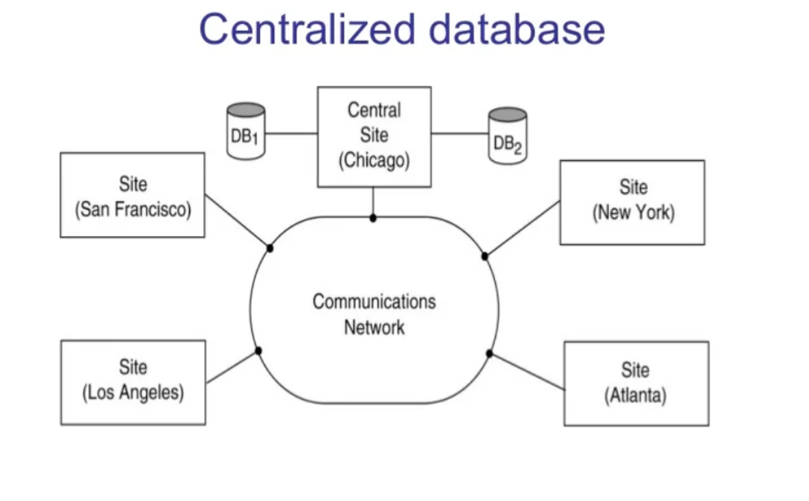

Slide 34
Basic Client-Server Architectures
Specialized Servers with Specialized functions
Clients
DBMS Server

Slide 35
Server is a system containing both hardware and software that provides services to client, such as printing, file access and database access etc.
Generally it contains a large number of PCs, workstation, file server,printers,database servers and web servers are connected via a network.
Example: a number of PCs are connected to file server as a client ,and the server can maintains the files of the client machines.

Slide 36
Specialized Servers with Specialized functions
File Servers
Printer Servers
Web Servers
E-mail Servers

Slide 37
Clients:
Provide appropriate interfaces and a client-version of the system to access and utilize the server resources.
Clients maybe disk less machines or PCs or Workstations with disks with only the client software installed.
Connected to the servers via some form of a network.
(LAN: local area network, wireless network, etc.)

Slide 38
DBMS Server
Provides database query and transaction services to the clients
Sometimes called query and transaction servers

Slide 39
Two Tier Client-Server Architecture
User Interface Programs and Application Programs run on the client side
Interface called ODBC (Open Database Connectivity ) provides an Application program interface (API) allow client side programs to call the DBMS. Most DBMS vendors provide ODBC drivers.

Slide 40
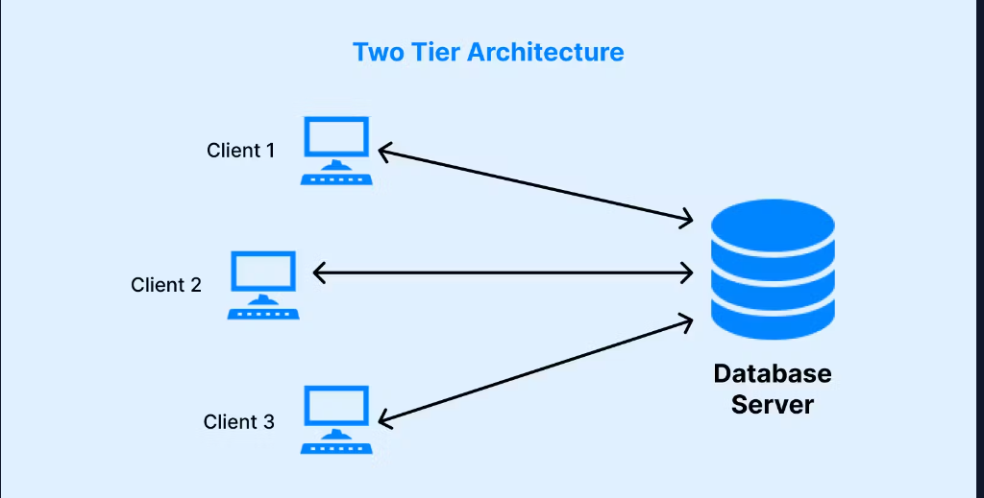

Slide 41
Two Tier Client-Server Architecture
A client program may connect to several DBMSs.
Other variations of clients are possible: e.g., in some DBMSs, more functionality is transferred to clients including data dictionary functions, optimization and recovery across multiple servers, etc. In such situations the server may be called the Data Server.

Slide 42
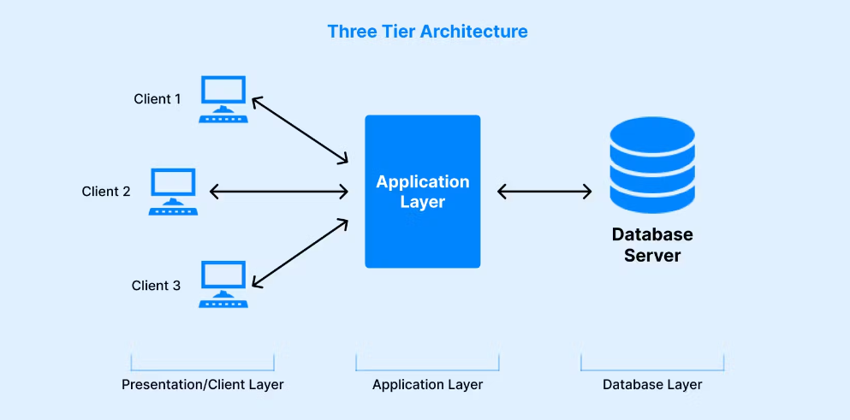
Three Tier Client-Server Architecture

Slide 43
Three Tier Client-Server Architecture
Common for Web applications
Intermediate Layer called Application Server or Web Server:
Stores the web connectivity software and the rules and business logic (constraints) part of the application used to access the right amount of data from the database server
acts like a conduit for sending partially processed data between the database server and the client.
Additional Features- Security:
  encrypt the data at the server before transmission
  decrypt data at the client

Slide 44
Classification of DBMSs
Based on the data model used:
Traditional: Relational, Network, Hierarchical.
Emerging: Object-oriented, Object-relational.
Other classifications:
Single-user (typically used with micro- computers) vs. multi-user (most DBMSs).
Centralized (uses a single computer with one database) vs. distributed (uses multiple computers, multiple databases)

Slide 45
Classification of DBMSs
Distributed Database Systems have now come to be known as client server based database systems because they do not support a totally distributed environment, but rather a set of database servers supporting a set of clients

Slide 46
Different types of DBMS
Hierarchical DBMS
Network DBMS
Relational DBMS (RDBMS)
Object-Oriented DBMS (OODBMS)
Document-Oriented DBMS (NoSQL)

Slide 47
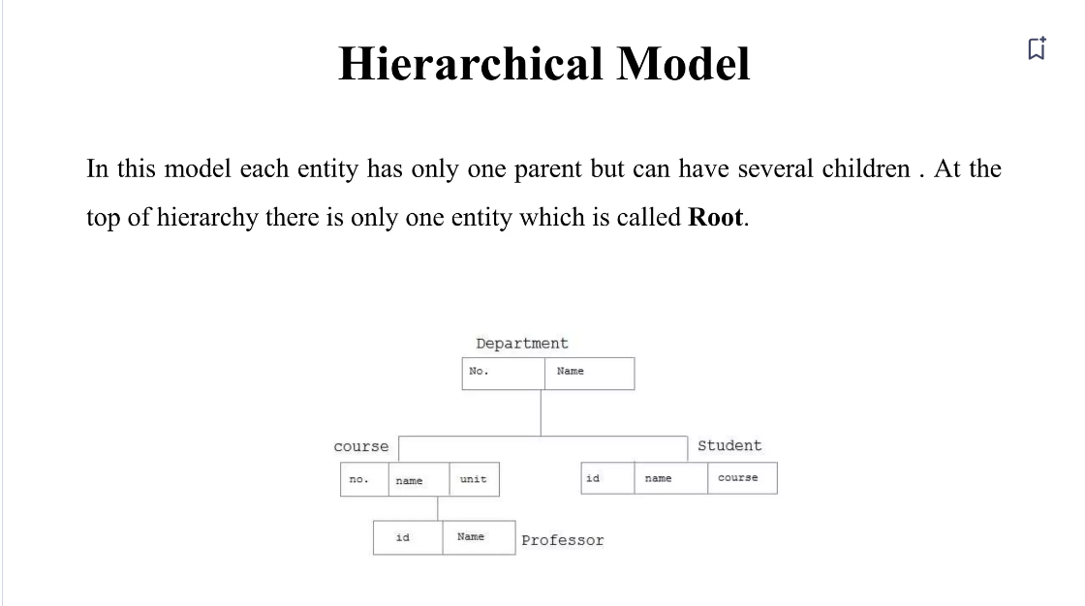
Organizes data in a tree-like structure.
Uses parent-child relationships (one-to-many).
Example: IBM Information Management System (IMS).

Slide 48
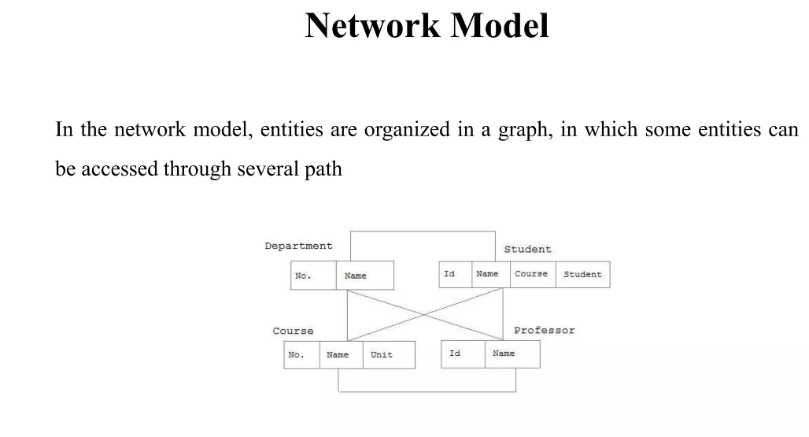

Slide 49
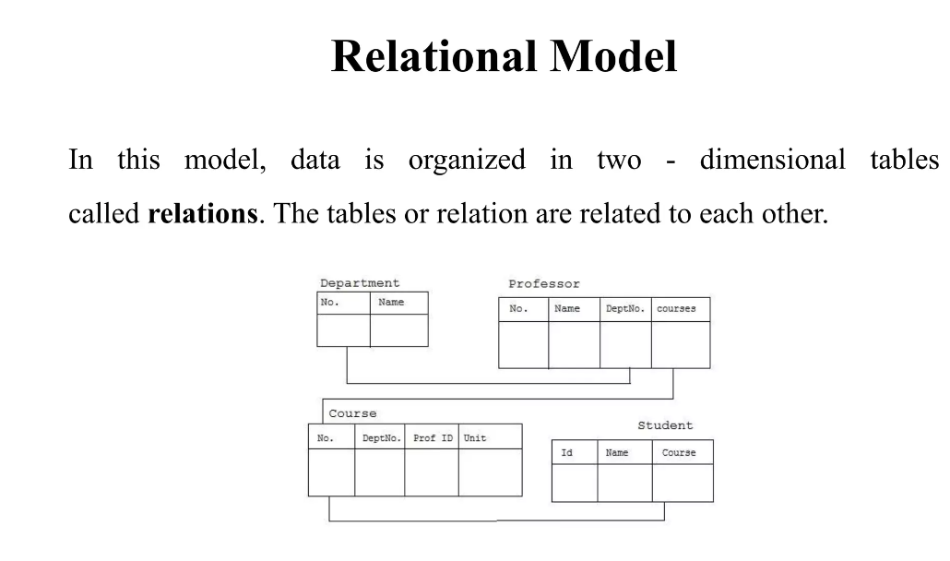

Slide 50
NoSQL Database Management System
NoSQL databases overcome the drawbacks of strict table-based schemas, making them suitable for various data types, topologies, and scalability requirements.
Developers designed them to handle the vast amounts of unstructured or semi-structured data modern applications generate.

Slide 51
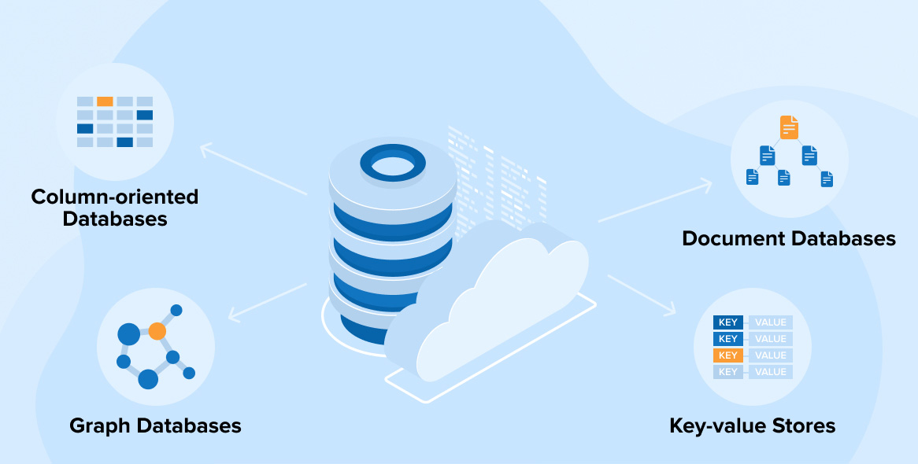

Slide 52
Object-Oriented Database Management System
An OODBMS stores data as objects with characteristics and methods, unlike conventional relational databases, which store data as tables, rows, and columns.
This architecture closely adheres to object-oriented programming principles and enables a more natural representation of real-world items and their interactions.

Slide 53
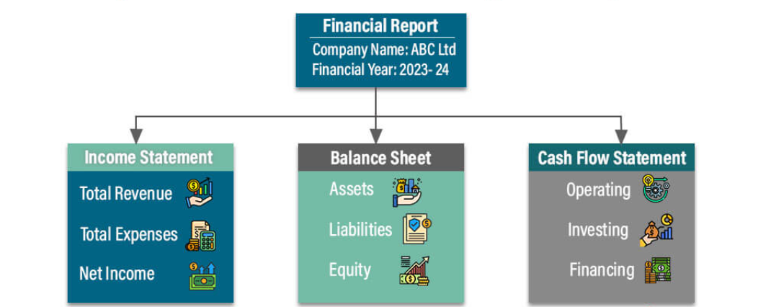
Object-Oriented Database Management System

Slide 54
Data types
1.Numeric Data Types
Used for storing numbers, both integers and floating-point values.
INT / INTEGER – Whole numbers (e.g., 10, -5)
SMALLINT – Smaller range of integers
BIGINT – Large integer values
DECIMAL / NUMERIC – Fixed-point precision (e.g., 10.25)
FLOAT / REAL / DOUBLE – Floating-point numbers

Slide 55
CREATE TABLE Employee (
EmpID INT PRIMARY KEY,
Salary DECIMAL(10,2),
Bonus FLOAT
);
INSERT INTO Employee (EmpID, Salary, Bonus)
VALUES (101, 50000.75, 500.50);
SELECT * FROM Employee;

Slide 56
2.String (Character) Data Types
Used for storing text or string values.
CHAR(n) – Fixed-length string (e.g., CHAR(10) always stores 10 characters)
VARCHAR(n) – Variable-length string (saves space)
TEXT / CLOB – Large text storage

Slide 57
CREATE TABLE Students (
StudentID INT PRIMARY KEY,
Name VARCHAR(50),
Gender CHAR(1)
);
INSERT INTO Students (StudentID, Name, Gender)
VALUES (1, 'Rahul Kumar', 'M');
SELECT * FROM Students;

Slide 58
Date & Time Data Types
Used for handling dates and timestamps.
DATE – Stores date values (YYYY-MM-DD)
TIME – Stores time values (HH:MM:SS)
DATETIME / TIMESTAMP – Stores both date and time

Slide 59
CREATE TABLE Orders (
OrderID INT PRIMARY KEY,
OrderDate DATE,
DeliveryTime TIME,
OrderTimestamp TIMESTAMP DEFAULT CURRENT_TIMESTAMP
);
INSERT INTO Orders (OrderID, OrderDate, DeliveryTime)
VALUES (1, '2024-02-14', '14:30:00');
SELECT * FROM Orders;

Slide 60
Boolean Data Type
Used for storing TRUE or FALSE values.
BOOLEAN – Stores TRUE or FALSE (or 1 and 0)
CREATE TABLE Users (
UserID INT PRIMARY KEY,
Name VARCHAR(50),
IsActive BOOLEAN
);
INSERT INTO Users (UserID, Name, IsActive)
VALUES (1, 'Aditi Sharma', TRUE);
SELECT * FROM Users;

Slide 61
Binary Data Types
Used for storing raw binary data like images, audio, or files.
BLOB (Binary Large Object) – Stores large binary data
VARBINARY(n) – Variable-length binary data
CREATE TABLE Images (
ImageID INT PRIMARY KEY,
ImageData BLOB
);

Slide 62
Example program
CREATE TABLE Data_Types_Example (
EmpID NUMBER(5) PRIMARY KEY, -- Numeric Type
Name VARCHAR2(50), -- String Type
Salary NUMBER(10,2), -- Decimal Numeric Type
JoiningDate DATE, -- Date Type
WorkHours INTERVAL DAY TO SECOND, -- Time Interval
IsActive CHAR(1) CHECK (IsActive IN ('Y', 'N')), -- Boolean-like using CHAR
ProfilePicture BLOB -- Binary Large Object
);
INSERT INTO Data_Types_Example (EmpID, Name, Salary, JoiningDate, WorkHours, IsActive, ProfilePicture) VALUES (101, 'Rahul Kumar', 50000.75, TO_DATE('2024-02-14', 'YYYY-MM-DD'), INTERVAL '8:30:00' HOUR TO SECOND, 'Y', EMPTY_BLOB());
SELECT * FROM Data_Types_Example;
;

