Slide 1
Transaction Management

Slide 2
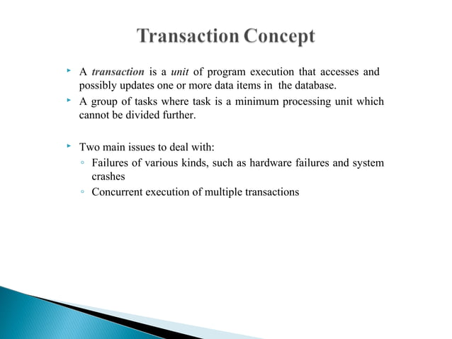

Slide 3
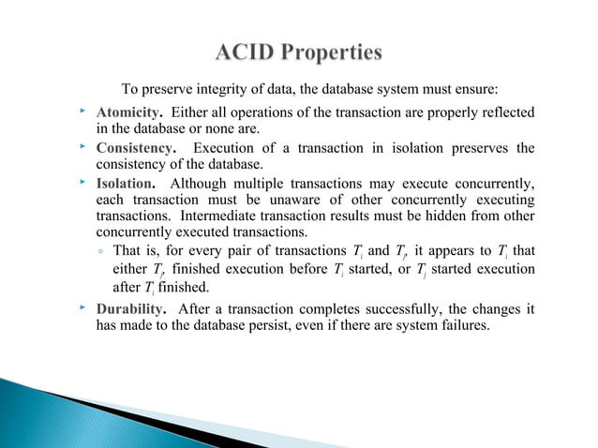

Slide 4
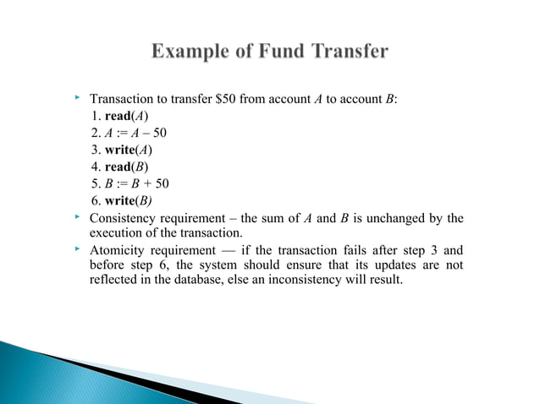

Slide 5
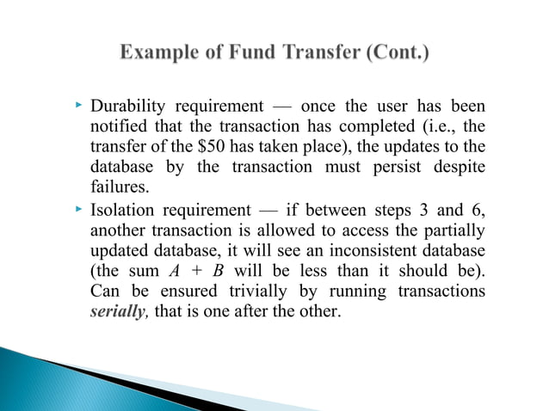

Slide 6
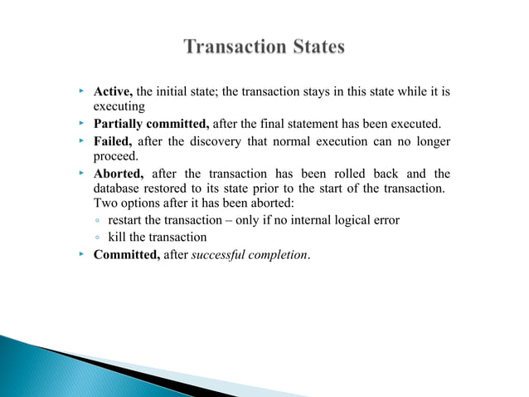

Slide 7
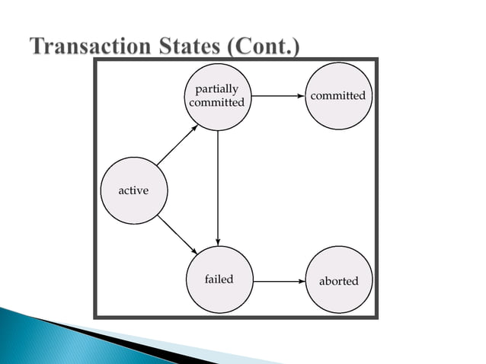

Slide 8
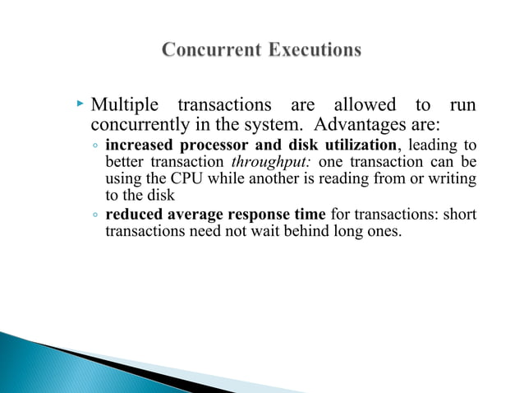

Slide 9
Transaction processing
Single-User System: At most one user at a time can use the system.
Multiuser System: Many users can access the system concurrently.
Concurrency
Interleaved processing: concurrent execution of processes is interleaved in a single CPU
Parallel processing: processes are concurrently executed in multiple CPUs.

Slide 10
Transaction Processing
Basic operations are read and write
  read_item(X): Reads a database item named X into a program variable. To simplify our notation, we assume that the program variable is also named X.
  write_item(X): Writes the value of program variable X into the database item named X.

Slide 11
read_item(X) command includes the following steps:
Find the address of the disk block that contains item X.
Copy that disk block into a buffer in main memory (if that disk block is not already in some main memory buffer).
Copy item X from the buffer to the program variable named X

Slide 12
write_item(X) command includes the following steps:
Find the address of the disk block that contains item X.
Copy that disk block into a buffer in main memory (if that disk block is not already in some main memory buffer).
Copy item X from the program variable named X into its correct location in the buffer.
Store the updated block from the buffer back to disk (either immediately or at some later point in time).

Slide 13
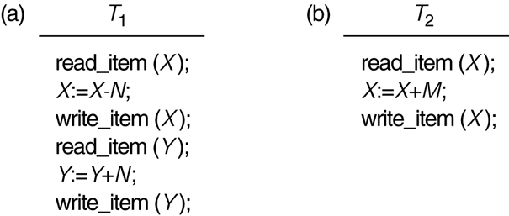
Two sample transactions. (a) Transaction T₁.
(b) Transaction T₂.

Slide 14
Concurrency
Concurrency in DBMS refers to the ability of the system to allow multiple transactions to access the database simultaneously without interfering with each other or violating data integrity.
Advantages:
  Improves performance by allowing parallel execution of transactions.
  Maximizes resource utilization (CPU, memory, I/O).

Slide 15
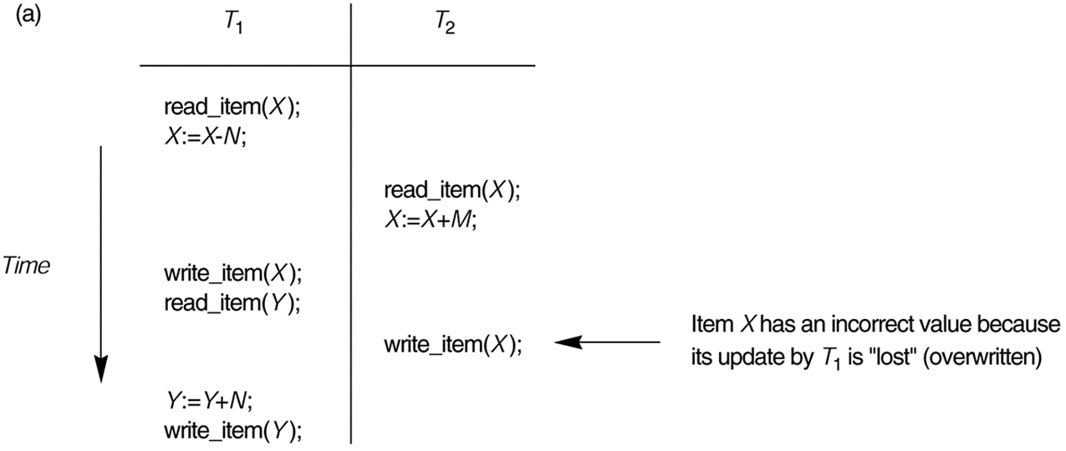
Problems due to Concurrency :
The Lost Update Problem.
This occurs when two transactions that access the same database items have their operations interleaved in a way that makes the value of some database item incorrect.

Slide 16
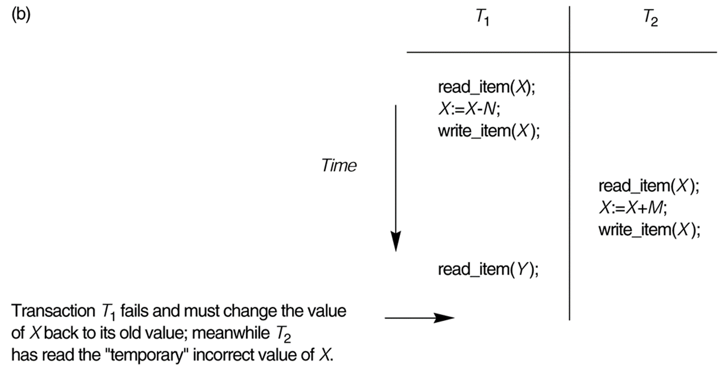
The Temporary Update (or Dirty Read) Problem.
This occurs when one transaction updates a database item and then the transaction fails for some reason.
The updated item is accessed by another transaction before it is changed back to its original value.

Slide 17
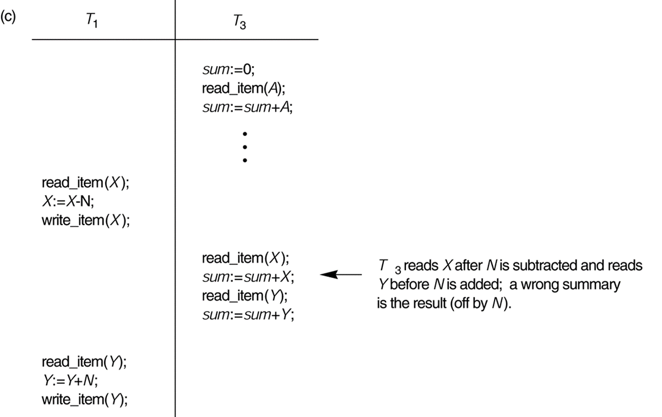
The Incorrect Summary Problem .
If one transaction is calculating an aggregate summary function on a number of records while other transactions are updating some of these records, the aggregate function may calculate some values before they are updated and others after they are updated.

Slide 18
Concurrency Control Techniques
1.Lock-Based Protocols
Lock-Based Protocols in DBMS ensure that a transaction cannot read or write data until it gets the necessary lock.
Locks help multiple transactions work together smoothly by managing access to the database items.
Locking is a common method used to maintain the serializability of transactions.

Slide 19
Example:
Transaction 1 (T1): Withdraw ₹200
Transaction 2 (T2): Deposit ₹100
Steps:
  T1 puts a lock on the account — no one else can use it now.
  T1 reads ₹1000,
  subtracts ₹200 → new balance ₹800.
  T1 writes ₹800 and releases the lock.
  Now T2 can access the account.
  T2 reads ₹800, adds ₹100 → new balance ₹900.
  T2 writes ₹900 and finishes.
  Final Balance = ₹900

Slide 20
Types of Locks in Lock-Based Protocols
Shared Lock (S)Also called a Read-only Lock.
  Allows a transaction to read a data item, but not modify it.
  Multiple transactions can hold a Shared Lock on the same data item at the same time.
  A transaction requests a Shared Lock using the lock-S instruction.
  Example: If Transaction T1 is reading a data item with a Shared Lock, Transaction T2 can also read it—but neither can write to it.
Exclusive Lock (X)
  Allows a transaction to both read and write a data item.
  No other transaction can read or write the item while it is locked exclusively.
  A transaction requests an Exclusive Lock using the lock-X instruction
  Example: If Transaction T1 has an Exclusive Lock on a data item, T2 cannot access that item at all until T1 releases the lock.

Slide 21
Types of Lock-Based Protocols
1.Simplistic Lock Protocol
It is the simplest method for locking data during a transaction. Simple lock-based protocols enable all transactions to obtain a lock on the data before inserting, deleting, or updating it. It will unlock the data item once the transaction is completed.
Example: Consider a database with a single data item X = 10.
  Transactions: T1: Wants to read and update X.
  T2: Wants to read X.
Steps:
T1 requests an exclusive lock on X to update its value. The lock is granted.
  T1 reads X = 10 and updates it to X = 20.
T2 requests a shared lock on X to read its value. Since T1 is holding an exclusive lock, T2 must wait.
T1 completes its operation and releases the lock.
T2 now gets the shared lock and reads the updated value X = 20.

Slide 22
2. Pre-Claiming Lock Protocol
Before the transaction begins, it requests the database management system to grant locks on all necessary data elements.
If all the requested locks are successfully acquired, the transaction proceeds.
Once the transaction is completed, all locks are released.
However, if any of the locks are unavailable, the transaction rolls back and waits until all required locks are granted before restarting.
Once T1 finishes, it releases the locks on X and Y. The system now grants the read lock on X to T2, allowing it to proceed.
This method is simple but may lead to inefficiency in systems with a high number of transactions.

Slide 23
Example:
Consider two transactions T1 and T2 and two data items, X&Y
Transaction T1 declares that it needs:
A write lock on X.
A read lock on Y.
Since both locks are available, the system grants them. T1 starts execution:
It updates X.
It reads the value of Y.
While T1 is executing, Transaction T2 declares that it needs:
A read lock on X.
However, since T1 already holds a write lock on X, T2’s request is denied. T2 must wait until T1 completes its operations and releases the locks.

Slide 24
3.Two-Phase Locking Protocol (2PL):
  The Two-Phase Locking Protocol ensures that all lock requests happen before any lock releases in a transaction.
  Phase 1 – Growing: A transaction can acquire locks, but not release any.
  Phase 2 – Shrinking: A transaction releases locks, but cannot acquire new ones.
  Key rule:Once a transaction releases its first lock, it cannot request any new locks.

Slide 25
Example:
Transaction T1 wants to read and update two data items A and B.
Step-by-step:
Growing Phase:
  T1: lock-S(A) → Reads A
  T1: lock-X(B) → Updates B
Shrinking Phase:
  T1: unlock(B)
  T1: unlock(A)
After releasing any lock (e.g., on B), no more lock requests are allowed.

Slide 26
4.Strict Two-Phase Locking Protocol
Strict Two-Phase Locking requires that in addition to the 2-PL all Exclusive(X) locks held by the transaction be released until after the Transaction Commits.

Slide 27
Problem With Locking
Lock-Based Protocols can cause delays, conflicts, and failures when multiple transactions compete for the same data items.
1.Deadlock
Two or more transactions wait forever for each other to release locks.
Example:
T1 locks data A, needs B
T2 locks data B, needs A
→ Both are stuck waiting forever.

Slide 28
2.Starvation
It is also possible if concurrency control manager is badly designed.
A transaction keeps waiting because others are always getting the lock first.
For example:
A transaction may be waiting for an X-lock on an item, while a sequence of other transactions request and are granted an S-lock on the same item.
This may be avoided if the concurrency control manager is properly designed.
Cause: Poor scheduling or unfair locking priority.
Effect: Some transactions may never complete.

Slide 29
Why recovery is needed:
A deadlock occurs when two or more transactions are waiting for each other’s locks and can never proceed.
Once a deadlock is detected (e.g., through a wait-for graph), the DBMS needs a way to break the cycle.
The only way to do that is to abort (roll back) one or more transactions, which is what we call recovery.

Slide 30
What causes a Transaction to fail
1. A computer failure (system crash): A hardware or software error occurs in the computer system during transaction execution. If the hardware crashes, the contents of the computer’s internal memory may be lost.
2. A transaction or system error : Some operation in the transaction may cause it to fail, such as integer overflow or division by zero. Transaction failure may also occur because of erroneous parameter values or because of a logical programming error. In addition, the user may interrupt the transaction during its execution

Slide 31
3. Local errors or exception conditions detected by the transaction:
- certain conditions necessitate cancellation of the transaction. For example, data for the transaction may not be found. A condition, such as insufficient account balance in a banking database, may cause a transaction, such as a fund withdrawal from that account, to be canceled.
- a programmed abort in the transaction causes it to fail.
4. Concurrency control enforcement: The concurrency control method may decide to abort the transaction, to be restarted later, because it violates serializability or because several transactions are in a state of deadlock

Slide 32
5. Disk failure: Some disk blocks may lose their data because of a read or write malfunction or because of a disk read/write head crash. This may happen during a read or a write operation of the transaction.
6. Physical problems and catastrophes: This refers to an endless list of problems that includes power or air-conditioning failure, fire, theft, sabotage, overwriting disks or tapes by mistake, and mounting of a wrong tape by the operator.

Slide 33
Recovery manager keeps track of the following operations:
begin_transaction: This marks the beginning of transaction execution.
read or write: These specify read or write operations on the database items that are executed as part of a transaction.
end_transaction: This specifies that read and write transaction operations have ended and marks the end limit of transaction execution. At this point it may be necessary to check whether the changes introduced by the transaction can be permanently applied to the database or whether the transaction has to be aborted because it violates concurrency control or for some other reason

Slide 34
commit_transaction: This signals a successful end of the transaction so that any changes (updates) executed by the transaction can be safely committed to the database and will not be undone.
rollback (or abort): This signals that the transaction has ended unsuccessfully, so that any changes or effects that the transaction may have applied to the database must be undone.

Slide 35
Recovery techniques use the following operators:
undo: Similar to rollback except that it applies to a single operation rather than to a whole transaction.
redo: This specifies that certain transaction operations must be redone to ensure that all the operations of a committed transaction have been applied successfully to the database.

Slide 36
Recovery Methods in DBMS
1.Log-Based Recovery
The DBMS keeps a log file (also called a journal) that records every change made by transactions.
Two types of log entries: Log is written before changes are made to the database.
Types:
Undo Logging: Reverts the changes of uncommitted transactions.
Redo Logging: Reapplies changes of committed transactions.
Undo/Redo: Most common – undoes uncommitted and redoes committed ones.

Slide 37
2. Checkpointing
A checkpoint is a snapshot of the database taken at a certain time, written to disk
Use:
Speeds up recovery by avoiding scanning the entire log.
Only logs after the last checkpoint are needed during recovery.

Slide 38
3. Shadow Paging
Keeps two copies (shadow and current) of data pages.
Updates are made to a new copy (current page).
If the transaction commits, new pages replace the shadow ones.
If it fails, shadow pages remain unchanged.
Advantages:
No need to redo or undo.
Easy recovery.
Disadvantages:
Expensive to copy pages frequently.
Hard to manage in large systems.

Slide 39
4. ARIES (Advanced Recovery Algorithm)
Widely used in real DBMS (e.g., IBM DB2). Uses:
Write-Ahead Logging
Repeating history during redo
Logging undo actions
Steps:
Analysis – Identify active transactions and dirty pages.
Redo – Redo all committed transactions.
Undo – Roll back incomplete transactions.

