Slide 1

Graph

Slide 2
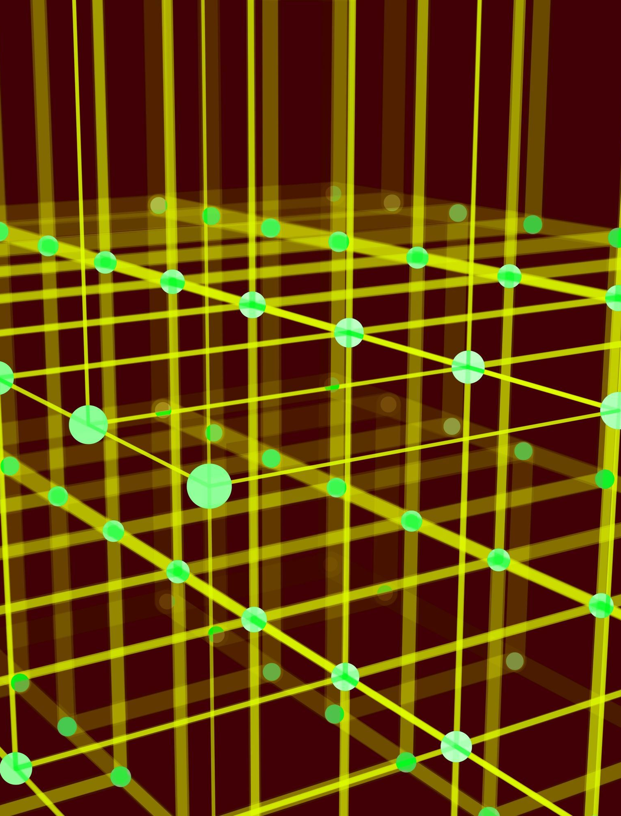
Graph
Graph is a non-linear data structure consisting of vertices and edges.
The vertices are sometimes also referred to as nodes and the edges are lines or arcs that connect any two nodes in the graph.
More formally a Graph is composed of a set of vertices( V ) and a set of edges( E ). The graph is denoted by G(E, V).
V(G) represents the set of vertices and E(G) represents the set of edges which are used to connect these vertices.

Slide 3
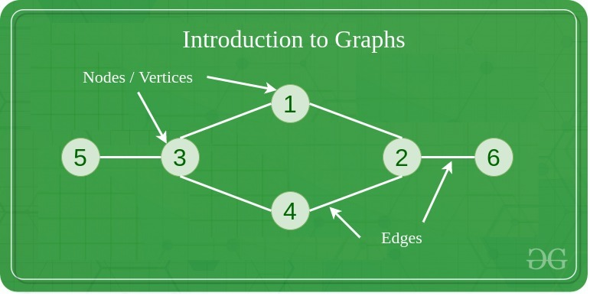
Graph

Slide 4
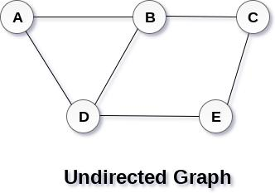
Graph
Graph G(V, E) with 5 vertices (A, B, C, D, E) and six edges ((A,B), (B,C), (C,E), (E,D), (D,B), (D,A)) is shown in the following figure.

Slide 5
Directed Graph and Undirected Graph
undirected graph, edges are not associated with the directions with them. If an edge exists between vertex A and B then the vertices can be traversed from B to A as well as A to B.
directed graph, edges form an ordered pair. Edges represent a specific path from some vertex A to another vertex B. Node A is called initial node while node B is called terminal node.

Slide 6
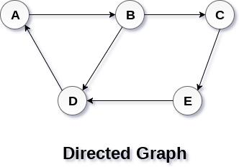
Directed Graph and Undirected Graph

Slide 7
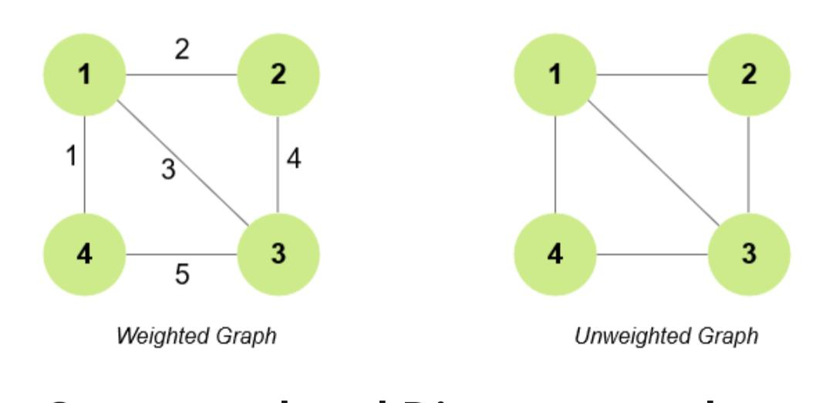
Weighted graph and Unweighted graph
Weighted graph: There is some weight over the edges of the graph.
Unweighted graph: There is no weight over the edges of the graph

Slide 8
Graph Terminology
path can be defined as the sequence of nodes that are followed in order to reach some terminal node V from the initial node U.
path will be called as closed path if the initial node is same as terminal node.
cycle can be defined as the path which has no repeated edges or vertices except the first and last vertices.
degree of a node is the number of edges that are connected with that node. A node with degree 0 is called as isolated node.
Adjacency: A vertex is said to be adjacent to another vertex if there is an edge connecting them.

Slide 9
Representation of Graph
a graph representation is a technique to store graph into the memory of computer.
To represent a graph, we just need the set of vertices, and for each vertex the neighbors of the vertex

Slide 10
Adjacency Matrix
Adjacency matrix is a sequential representation.
It is used to represent which nodes are adjacent to each other. i.e. Is there any edge connecting nodes to a graph.
In this representation, we have to construct a nXn matrix A. If there is any edge from a vertex i to vertex j, then the corresponding element of A, ai,j = 1, otherwise ai,j= 0.

Slide 11
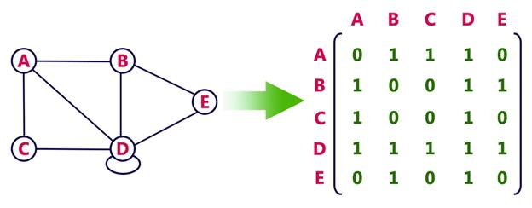
Undirected Graph

Slide 12
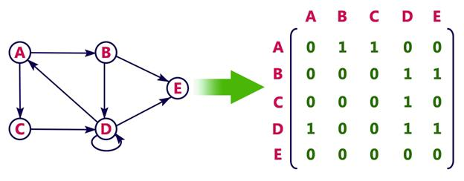
Directed Graph

Slide 13
Adjacency list
Adjacency list is a linked representation.
In this representation, for each vertex in the graph, we maintain the list of its neighbors. It means, every vertex of the graph contains list of its adjacent vertices.
We have an array of vertices which is indexed by the vertex number and for each vertex v, the corresponding array element points to a singly linked list of neighbors of v.

Slide 14
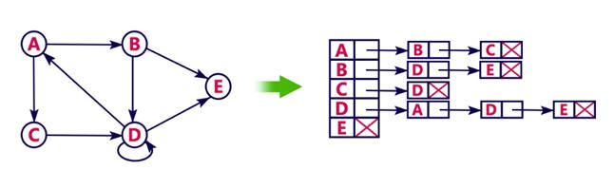
Adjacency list

Slide 15
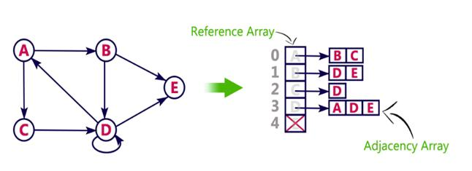
Adjacency list

Slide 16
Traversing a Graph
Traversing or searching is one of the most used operations that are undertaken while working on graphs.
stands for Breadth First Search. It is also known as level order traversal. The Queue data structure is used for the Breadth First Search traversal. When we use the BFS algorithm for the traversal in a graph, we can consider any node as a root node.
. It is a recursive algorithm to search all the vertices of a tree or graph data structure. BFS puts every vertex of the graph into two categories - visited and non-visited. It selects a single node in a graph and, after that, visits all the nodes adjacent to the selected node.

Slide 17
Traversing a Graph
To implement such an order, you use a queue data structure which First-in, First-out approach.

Slide 18
BFS
categorize each vertex of the graph into two categories:
Visited
Not Visited

Slide 19
BFS
BFS algorithm working:
Start by selecting a starting vertex or node.
Add the starting vertex to the end of the queue.
Mark the starting vertex as visited and add it to the visited array/list.
While the queue is not empty, do the following steps:
  Remove the front vertex from the queue.
  Visit the removed vertex and process it.
  Enqueue all the adjacent vertices of the removed vertex that have not been visited yet.
  Mark each visited adjacent vertex as visited and add it to the visited array/list.
Repeat step 4 until the queue is empty.

Slide 20
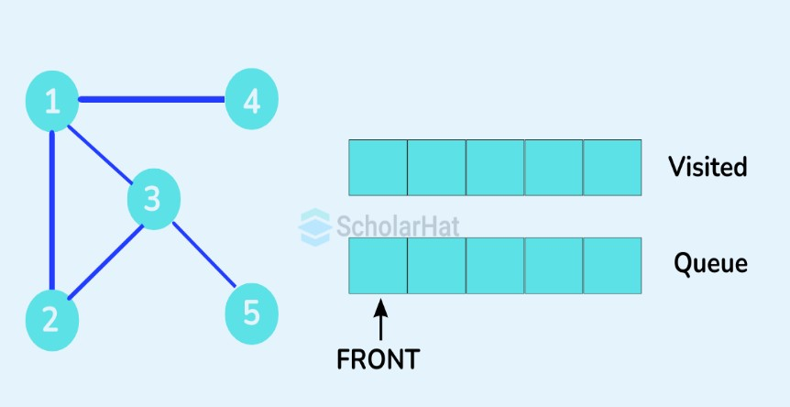

Slide 21
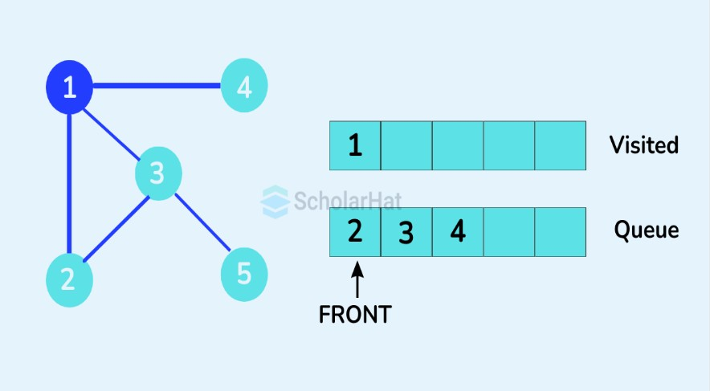

Slide 22
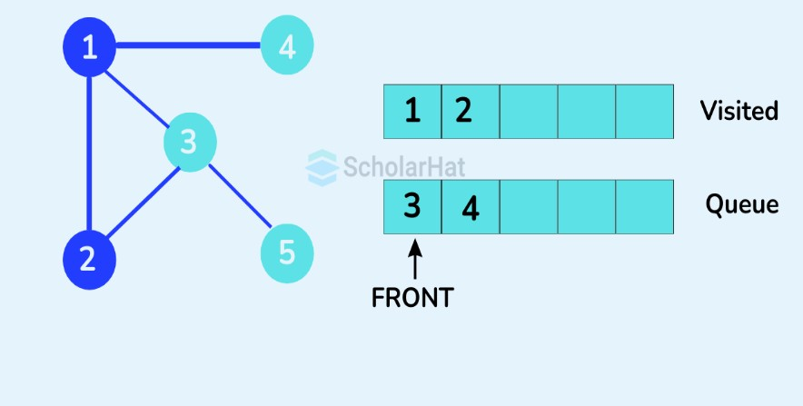

Slide 23
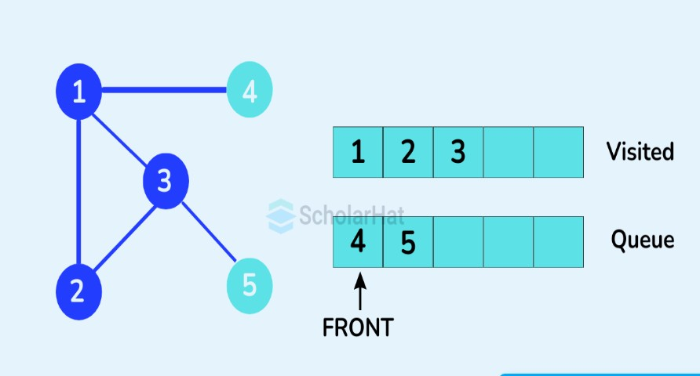

Slide 24
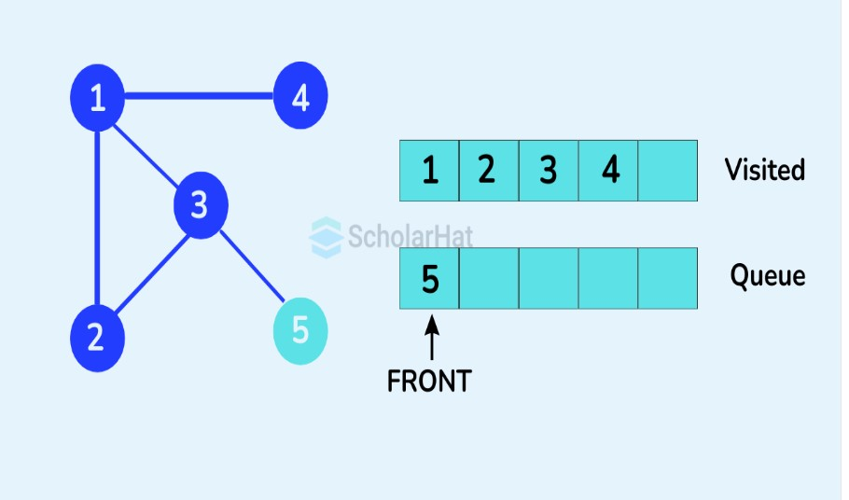

Slide 25
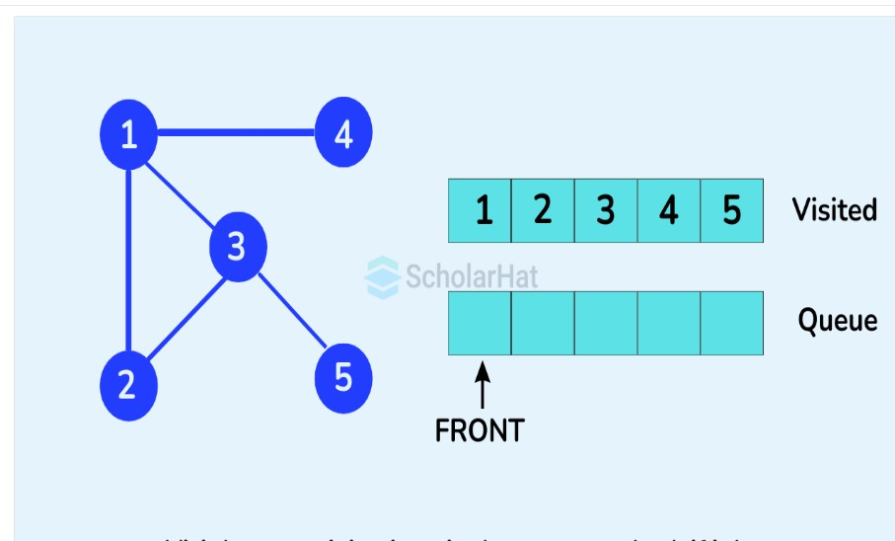

Slide 26
Time Complexity of BFS
O(V+E)

Slide 27
Applications of Breadth First Search Algorithm
Peer-to-peer networking: In Peer-to-peer networking, to find the neighboring peer from any other peer, the Breadth-First Search is used.
Crawlers in search engines: Search engines need to crawl the internet. To do so, they can start from any source page, follow the links contained in that page in the Breadth-First Search manner, and therefore explore other pages.
GPS navigation systems: To find locations within a given radius from any source person, we can find all neighboring locations using the Breadth-First Search, and keep on exploring until those are within the K radius.
Broadcasting in networks: While broadcasting from any source, we find all its neighboring peers and continue broadcasting to them, and so on.
Path Finding: To find if there is a path between 2 vertices, we can take any vertex as a source, and keep on traversing until we reach the destination vertex. If we explore all vertices reachable from the source and cannot find the destination vertex, then that means there is no path between these 2 vertices

Slide 28
Traversing a Graph-DFS
Depth-first search is an algorithm for traversing or searching tree or graph data structures. The algorithm starts at the root node (selecting some arbitrary node as the root node in the case of a graph) and explores as far as possible along each branch before backtracking

Slide 29
step-by-step explanation of how the DFS algorithm works
Start by selecting a starting vertex or node.
Add the starting vertex on top of a stack.
Take the top item of the stack and add it to the visited list/array.
Create a list of that vertex's adjacent nodes. Add the ones that aren't in the visited list to the top of the stack.
Keep repeating steps 3 and 4 until the stack is empty.

Slide 30
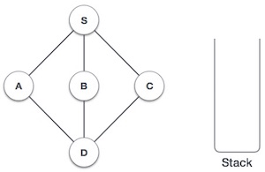
Traversing a Graph
Initialize the stack.

Slide 31
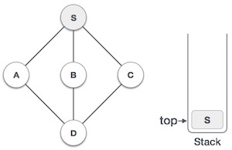
Traversing a Graph
Mark S as visited and put it onto the stack. Explore any unvisited adjacent node from S. We have three nodes and we can pick any of them. For this example, we shall take the node in an alphabetical order.

Slide 32
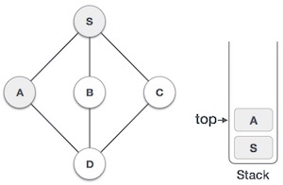
Traversing a Graph
Mark A as visited and put it onto the stack. Explore any unvisited adjacent node from A. Both S and D are adjacent to A but we are concerned for unvisited nodes only

Slide 33
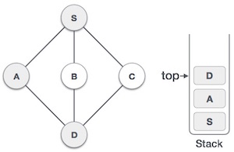
Traversing a Graph
Visit D and mark it as visited and put onto the stack. Here, we have B and C nodes, which are adjacent to D and both are unvisited. However, we shall again choose in an alphabetical order.

Slide 34
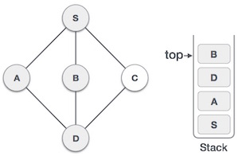
Traversing a Graph
We choose B, mark it as visited and put onto the stack. Here B does not have any unvisited adjacent node. So, we pop B from the stack

Slide 35
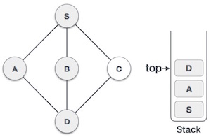
Traversing a Graph
We check the stack top for return to the previous node and check if it has any unvisited nodes. Here, we find D to be on the top of the stack.

Slide 36
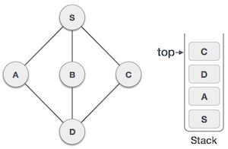
Traversing a Graph
Only unvisited adjacent node is from D is C now. So we visit C, mark it as visited and put it onto the stack

Slide 37
Time complexity of DFS
O(V+E)

Slide 38
Applications of DFS
Cycle Detection in Graphs: This is one of the great applications of DFS where it helps to detect cycle in both directed and undirected graphs. By keeping track of visited nodes and recursion stack (for directed graphs).DFS can identify back edges that form cycles which is a critical task in detecting deadlocks and circular dependencies.
Pathfinding in Maps:Pathfinding in maps is one of the famous applications of DFS among developers or students because we will able to understand Depth First Search algorithm very easily through maps. Because during path finding in maps, DFS algorithm uses their finding of short path approach seems perfect that provides us shortest path with the help of this algorithm

Slide 39
Web Crawling
When crawling websites DFS can be used to go deep into the site by following one link at a time like going from one page to the next and so on. It keeps going deeper into the website structure before coming back and checking other links. This is helpful when we want to explore all the pages under a section or see how deep a website goes.
Artificial Intelligence and Game Theory
Artificial Intelligence and game theory again a very good applications of dfs or depth first search algorithm. In AI, DFS helps explore all possible moves in games like chess or tic-tac-toe to plan ahead. It is the basic idea behind smarter algorithms like Minimax that make better decisions.

Slide 40
Connected components in Graph
DFS can help find connected parts in an undirected graph. This means it can show which nodes are linked together and form a group. This is useful in things like social networks where we want to find groups of friends who are all connected in finding separate groups in a network. It also helps in clustering where we group similar items together and in spotting parts of a system that are not connected to others.

Slide 41
Spanning Tree
spanning tree can be defined as the subgraph of an undirected connected graph. It includes all the vertices along with the least possible number of edges.
If any vertex is missed, it is not a spanning tree. A spanning tree is a subset of the graph that does not have cycles, and it also cannot be disconnected.
spanning tree consists of (n-1) edges, where 'n' is the number of vertices (or nodes). Edges of the spanning tree may or may not have weights assigned to them.
All the possible spanning trees created from the given graph G would have the same number of vertices, but the number of edges in the spanning tree would be equal to the number of vertices in the given graph minus 1.

Slide 42
Spanning Tree
complete undirected graph can have n^{n-2} number of spanning trees where n is the number of vertices in the graph. Suppose, if n = 5, the number of maximum possible spanning trees would be 5⁵⁻² = 125.
spanning tree is used to find a minimum path to connect all nodes of the graph.

Slide 43
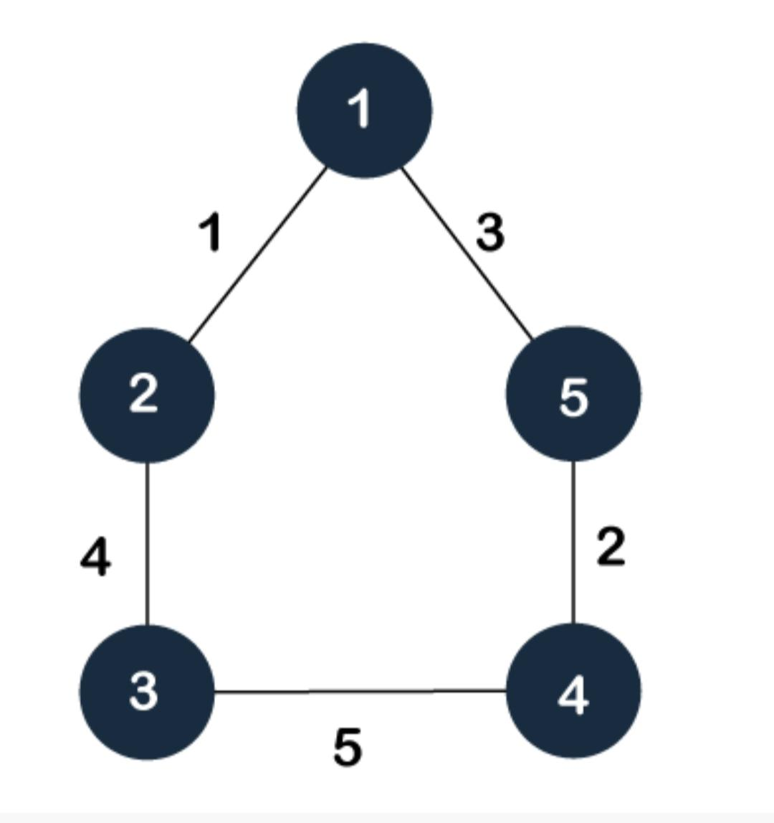
Spanning Tree

Slide 44
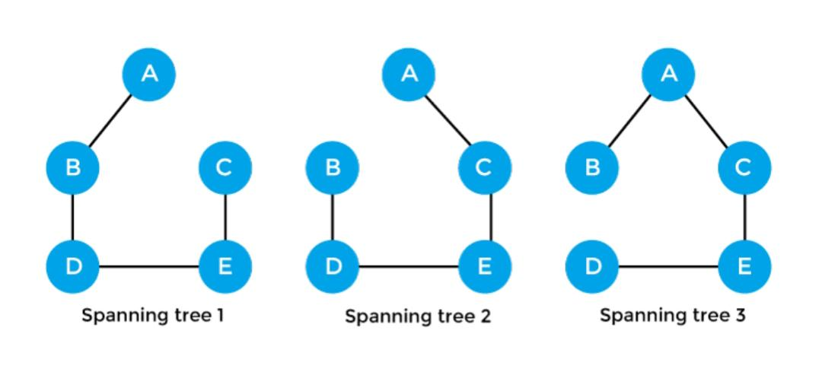
Spanning Tree

Slide 45
Properties of spanning tree
There can be more than one spanning tree of a connected graph G.
A spanning tree does not have any cycles or loop.
A spanning tree is minimally connected
There can be a maximum n^n-2 number of spanning trees that can be created from a complete graph.
there is no spanning tree of a disconnected graph.

Slide 46
Minimum Spanning Tree
minimum spanning tree can be defined as the spanning tree in which the sum of the weights of the edge is minimum.
The weight of the spanning tree is the sum of the weights given to the edges of the spanning tree.
In the real world, this weight can be considered as the distance, traffic load, congestion, or any random value.

Slide 47
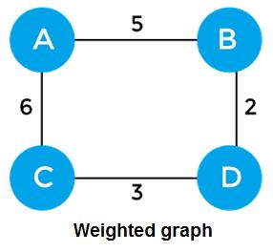
Minimum Spanning Tree
sum of the edges of the above graph is 16

Slide 48
Minimum Spanning Tree
Minimum spanning Tree should contain n vertices and n-1 edges

Slide 49
Algorithm for Minimum Spanning Tree
minimum spanning tree can be found from a weighted graph by using the algorithms given below -
Prim's Algorithm
Kruskal's Algorithm

Slide 50
Kruskals Algorithm
First, sort all the edges from low weight to high.
Now, take the edge with the lowest weight and add it to the spanning tree. If the edge to be added creates a cycle, then reject the edge.
Continue to add the edges until we reach all vertices, and a minimum spanning tree is created.

Slide 52
Prims algorithm
Prim's Algorithm is a greedy algorithm that is used to find the minimum spanning tree from a graph.
Prim's algorithm finds the subset of edges that includes every vertex of the graph such that the sum of the weights of the edges can be minimized.
Prim’s algorithm starts with the single node and explores all the adjacent nodes with all the connecting edges at every step.
The edges with the minimal weights causing no cycles in the graph got selected.

Slide 53
Prims algorithm
First, we have to initialize an MST with the randomly chosen vertex.
Now, we have to find all the edges that connect the tree in the above step with the new vertices. From the edges found, select the minimum edge and add it to the tree.
Repeat step 2 until the minimum spanning tree is formed.

