Slide 1
Functions

Slide 2
Program routines
In order to manage the complexity of a large problem, it is broken down into smaller subproblems.
Each subproblem can be focused on and solved separately.
Programs are divided into manageable pieces called program routines (or simply routines).
It is a form of abstraction
Reusability
Python’s built-in functions: len, range etc.

Slide 3
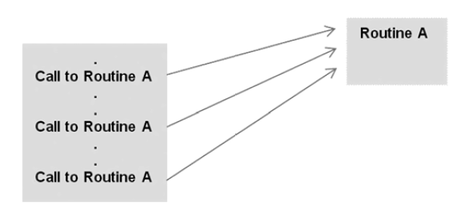
Program routines
A routine is a named group of instructions performing some task.
A routine can be invoked ( called ) as many times as needed in a given program.
When a routine terminates, execution automatically returns to the point from which it was called.

Slide 4
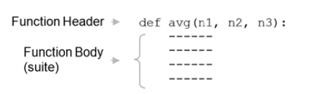
Functions
A block of organized and reusable program code that performs a single, specific, and well-defined task.
Define new functions:
A function header starts with the keyword def, followed by an identifier (avg), which is the function’s name.
list of identifiers (n1, n2, n3) called formal parameters.

Slide 5
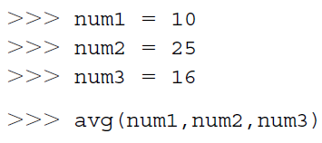
Functions
The number of items in a parameter list indicates the number of values that must be passed to the function, called actual arguments (or “arguments”).
Functions are generally defined at the top of a program.
Every function must be defined before it is called.

Slide 6
Need of Functions
Readability - The program is better organized and easy to understand.
Reduces code length - As the same code is not required to be written at multiple places in a program.
Reusability: As a function can be called from another function or another program. We can reuse or build upon already defined functions and avoid repetitions of writing the same piece of code.

Slide 7
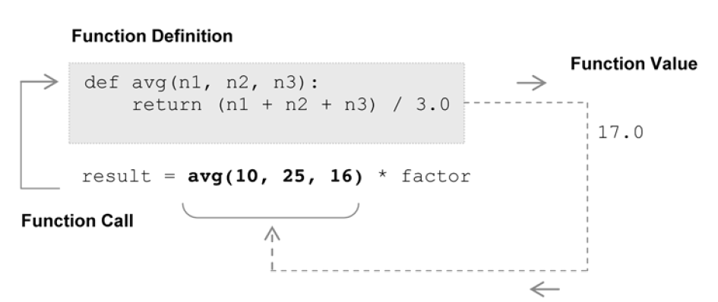
Value-Returning Functions
A value-returning function is a program routine called for its return value.

Slide 8
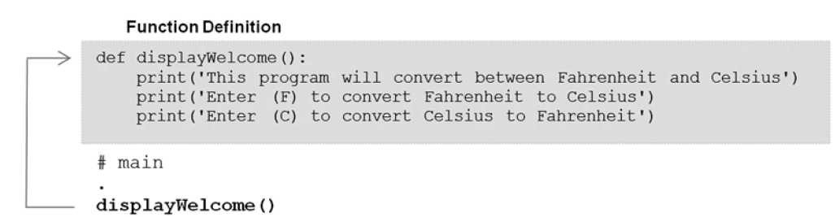
Non-Value-Returning Functions
A non-value-returning function is called not for a returned value, but for its side effects (e.g. displaying output on the screen).
Void functions
The function call is a statement.
Python is technically a value-returning function since any function that does not explicitly return a function value (via a return statement) automatically returns the special value None.

Slide 9
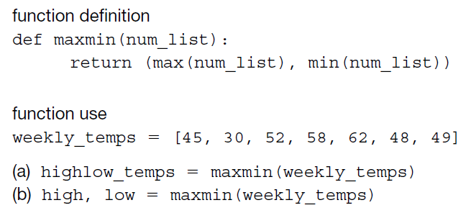
Calling Value-Returning Functions

Slide 10

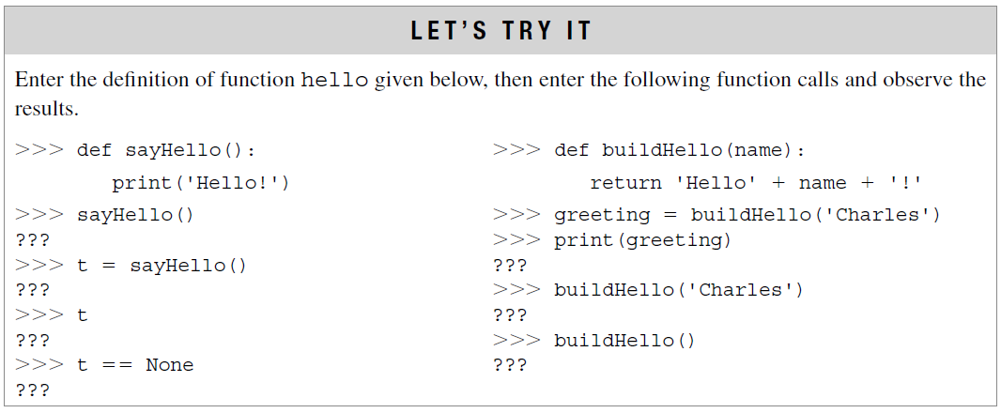
Calling Non-Value-Returning Functions
No returned function values.
These functions can be used anywhere that an executable statement is allowed.

Slide 11
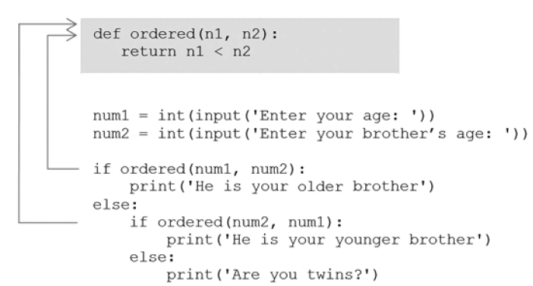
Parameter passing
Actual Arguments vs. Formal Parameters

Slide 12
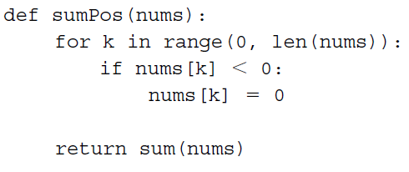

Example
Write a program using user defined function that accepts length and breadth of a rectangle and returns the area and perimeter of the rectangle.
Write a python program using functions to calculate the sum of all positive numbers in a list.

Slide 13
Python Argument Types
Python provides several ways to pass arguments to functions, making them flexible and reusable. Understanding these types can help you write cleaner and more efficient code. Below are the main types of arguments in Python:
1. Positional Arguments
Positional arguments are assigned to parameters based on their position in the function call. The order of arguments matters, and mismatching the order can lead to unexpected results.
def greet(name, age):
print(f"Name: {name}, Age: {age}")
greet("Alice", 25) # Correct order
greet(25, "Alice") # Incorrect order

Slide 14
2. Keyword Arguments
Keyword arguments allow you to specify arguments by their parameter names, making the function call more readable and flexible. The order of keyword arguments does not matter.
def greet(name, age):
print(f"Name: {name}, Age: {age}")
greet(age=25, name="Alice") # Order doesn't matter

Slide 15
3. Default Arguments
Default arguments have predefined values that are used if no value is provided during the function call. They make certain arguments optional.
def greet(name, age=18):
print(f"Name: {name}, Age: {age}")
greet("Alice") # Uses default age
greet("Bob", 25) # Overrides default age

Slide 16
4. Arbitrary Arguments
Arbitrary arguments allow you to pass a variable number of arguments to a function. There are two types:
*args (Non-Keyword Arguments): Collects extra positional arguments into a tuple.
**kwargs (Keyword Arguments): Collects extra keyword arguments into a dictionary.

Slide 17
Output:-
Python
is
Fun
language: Python
level: Intermediate
# Using *args
def print_args(*args):
for arg in args:
print(arg)
print_args("Python", "is", "fun")
# Using **kwargs
def print_kwargs(**kwargs):
for key, value in kwargs.items():
print(f"{key}: {value}")
print_kwargs(language="Python", level="Intermediate")

Slide 18
5. Lambda Function Arguments
Lambda functions are anonymous functions that can take any number of arguments but only one expression. They are often used for short, simple operations.
# Single argument
square = lambda x: x ** 2
print(square(5)) # Output: 25
# Multiple arguments
add = lambda a, b: a + b
print(add(3, 4)) # Output: 7

Slide 19
Important Considerations
Default arguments must follow non-default arguments in the function definition.
Keyword arguments must follow positional arguments in function calls.
No argument should receive a value more than once.
Mixing positional and keyword arguments is allowed, but keyword arguments must come after positional ones.

