Slide 1
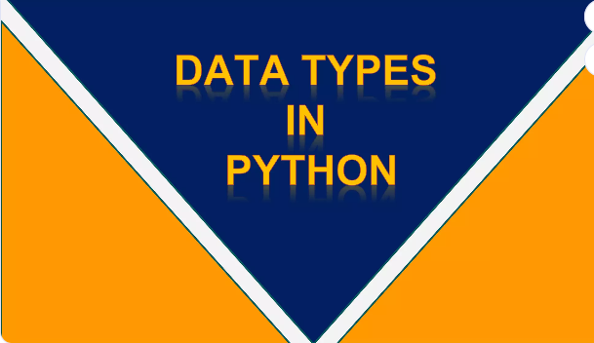

Slide 2
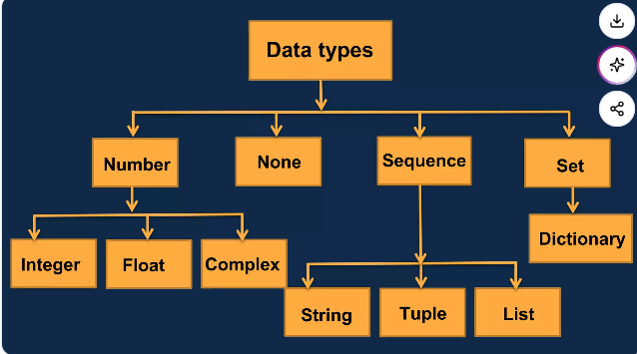

Slide 3
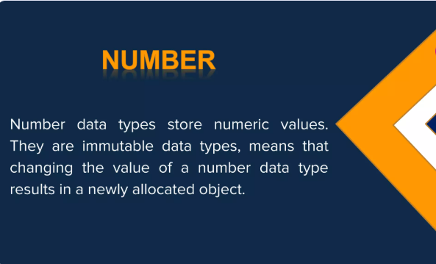

Slide 4
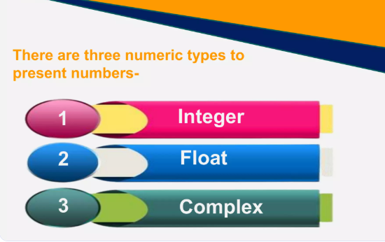

Slide 5
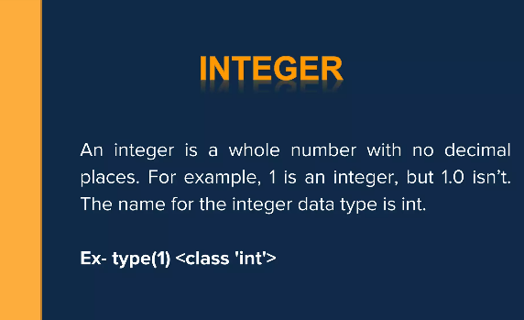

Slide 6
x = 1 # int
y = 2.8 # float
z = 1j # complex
To verify the type of any object in Python, use the type() function:
Output:-
<class ‘int'>
<class 'float'>
<class ‘complex'>
print(type(x))
print(type(y))
print(type(z))

Slide 7
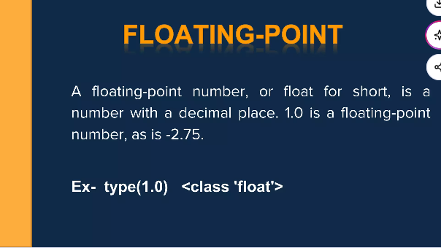

Slide 8
x = 1.10
y = 1.0
z = -35.59
To verify the type of any object in Python, use the type() function:
Output:-
<class 'float'>
<class 'float'>
<class 'float'>
print(type(x))
print(type(y))
print(type(z))

Slide 9
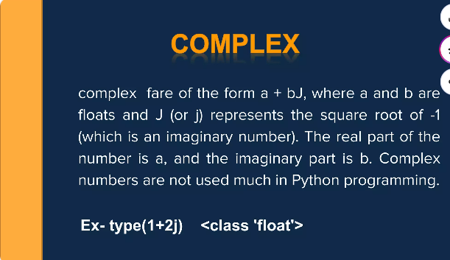

Slide 10
x = 3+5j
y = 5j
z = -5j
To verify the type of any object in Python, use the type() function:
Output:-
<class 'complex'>
<class 'complex'>
<class 'complex'>
print(type(x))
print(type(y))
print(type(z))

Slide 11
Type Conversion
You can convert from one type to another with the int(), float(), and complex() methods:
Example
Convert from one type to another:
x = 1 # int
y = 2.8 # float
z = 1j # complex
#convert from int to float:
a = float(x)
#convert from float to int:
b = int(y)
#convert from int to complex:
c = complex(x)

Slide 12
print(a)
print(b)
print(c)
print(type(a))
print(type(b))
print(type(c))
Output:-
1.0
2
(1+0j)
<class 'float'>
<class 'int'>
<class 'complex'>
Note: You cannot convert complex numbers into another number type.

Slide 13
Random Number
Python does not have a random() function to make a random number, but Python has a built-in module called random that can be used to make random numbers:
Example
Import the random module, and display a random number from 1 to 9:
Program:-
import random
print(random.randrange(1, 10))
Output:-7

Slide 14
Question
Which is NOT a legal numeric data type in Python:
A, int
B, long
C, float

Slide 15
Question
Which is NOT a legal numeric data type in Python:
A, int
B, long
C, float
ANSWER IS
B ,long

Slide 16
Python - Variable Names
Variable Names
A variable can have a short name (like x and y) or a more descriptive name (age, carname, total_volume).
Rules for Python variables:
A variable name must start with a letter or the underscore character
A variable name cannot start with a number

Slide 17
A variable name can only contain alpha-numeric characters and underscores (A-z, 0-9, and _ )
Variable names are case-sensitive (age, Age and AGE are three different variables)
A variable name cannot be any of the Python keywords.

Slide 18
Legal variable names:
myvar = "John"
my_var = "John"
_my_var = "John"
myVar = "John"
MYVAR = "John"
myvar2 = "John"

Slide 19
Illegal variable names:
2myvar = "John"
my-var = "John"
my var = "John"

Slide 20
Multi Words Variable Names
Variable names with more than one word can be difficult to read.
There are several techniques you can use to make them more readable:
Camel Case
Each word, except the first, starts with a capital letter:
myVariableName = "John"

Slide 21
Pascal Case
Each word starts with a capital letter:
MyVariableName = "John"
Snake Case
Each word is separated by an underscore character:
my_variable_name = "John"

Slide 22
Q1.Which is NOT a legal variable name?
A,my-var = 20
B,my_var = 20
C,Myvar = 20
D._myvar = 20

Slide 23
Q1.Which is NOT a legal variable name?
A,my-var = 20
B,my_var = 20
C,Myvar = 20
D._myvar = 20
ANSWER : A

Slide 24
Q2.Create a variable named carname and assign the value Volvo to it.

Slide 25
Assign Multiple Values
Many Values to Multiple Variables
Python allows you to assign values to multiple variables in one line:
Eg:
x, y, z = ”Orange”, ”Banana”, "Cherry"
print(x)
print(y)
print(z)
Note: Make sure the number of variables matches the number of values, or else you will get an error.

Slide 26
One Value to Multiple Variables
And you can assign the same value to multiple variables in one line:
Example
x = y = z = "Orange"
print(x)
print(y)
print(z)
OR
x = y = z = "Orange"
print(x,”\n”,y,”\n”,z)

Slide 27
Q1.What is a correct syntax to add the value 'Hello World', to 3 variables in one statement?
A. x, y, z = 'Hello World'
B. x = y = z = 'Hello World'
C. x|y|z = 'Hello World'

Slide 28
Q1.What is a correct syntax to add the value 'Hello World', to 3 variables in one statement?
A. x, y, z = 'Hello World'
B. x = y = z = 'Hello World'
C. x|y|z = 'Hello World‘
ANSWER: B

Slide 29
Insert the correct syntax to assign values to multiple variables in one line:
x -- y -- z = "Orange", "Banana", "Cherry"

Slide 30
Python operators
Operators are integral to Python programming because they combine values and identifiers to form expressions and statements. They act as fundamental building blocks, enabling various operations, such as mathematical calculations, logical comparisons, assignment of values, and more, for writing effective Python code.

Slide 31
Operators and Operands
Python operators are symbols that are used to perform mathematical or logical manipulations. Operands are the values or variables with which operators are applied, and the values of operands can be manipulated using operators.
Let us take a Scenario:
6 + 2, where there are two operands, a plus is the "+" operator, and the result will be 8.
In the above text, a single operator is used to manipulate the values. The "+" operator performs addition, "-" performs subtraction, "*" performs multiplication, "/" performs division, and "**" performs exponentiation.
Python programming language is rich with built-in operators.

Slide 32
Python supports the following types of operators:
Arithmetic Operators
Assignment Operators
Comparison (Relational) Operators
Logical Operators
Identity Operators
Bitwise Operators
Membership Operators

Slide 33
Python Arithmetic Operators
Symbol | Operator Name | Description
+ | Addition | Adds the values on either side of the operator and calculates a result.
- | Subtraction | Subtracts values of right-side operand from left-side operand.
* | Multiplication | Multiplies the values on both sides of the operator.
/ | Division | Divides the left-side operand with the right-side operand.
% | Modulus | It returns the remainder by dividing the left-side operand with the right-side operand.
** | Exponent | Calculates the exponential power
// | Floor Division | Here the result is the quotient in which the digits after decimal points are not considered.

Slide 34
Simple if
if condition:
statements
#simple if else in short form
a = 2
b = 330
print(a) if a > b else print(b)

Slide 35
if condition:
statements
Elif condition :
statements
else:
statements

Slide 36
if a > b and a > c:
print("a is greater")
elif b > a and b > c:
print("b is greater")
else:
print("C is greater")

Slide 38
Python Assignment operators
Symbol | Operator Name | Description
= | Equal | Assigns the values of the right-side operand to the left-side operand.
+= | Add AND | Adds right-side operand value to the left-side operand value and assigns the results to the left.
-= | Subtract AND | Subtracts right-side operand value to the left-side operand value and assigns the results to the left operand.
*= | Multiply AND | Similarly, it does their respective operations and assigns the operator value to the left operand.
/= | Division AND
%= | Modulus AND
**= | Exponent AND
//= | Floor Division AND

Slide 39
Comparison (relational operator)
Symbol | Operator Name | Description
== | Double Equal | If the two values of its operands are equal, then the condition becomes true, otherwise false
!= or <> | Not Equal To | If two operands' values are unequal, the condition becomes true. Both operators define the same meaning and function.
> | Greater Than | If the value of the left-hand operand is greater than that of the right-hand operand, the condition becomes true.
< | Less Than | If the value of the left-hand operand is less than that of the right, then the condition becomes true.
<= | Less Than Equal To | If the value of the left-hand operand is less than or equal to that of the right-hand operand, the condition becomes true.
>= | Greater Than Equal To | If the value of the left-hand operand is greater than or equal to that of the right-hand operand, the condition becomes true.

Slide 40
Python logical operator
Symbol | Operator Name | Description
or | Logical OR | The condition is true if any of the two operands are non-zero.
and | Logical AND | If both the operands are true, then the condition is true.
not | Logical NOT | It is used to reverse the logical state of its operand.

Slide 41
For comparing the memory locations of two objects, identity operators are used.
There are two types of identity operators. These are:
Python Identity Operators
Symbol | Operator Name | Description
is | is | The result becomes true if values on either side of the operator point to the same object and False otherwise.
is not | is not | The result becomes False if the variables on either side of the operator point to the same object.

Slide 42
For comparing the memory locations of two objects, identity operators are used.
There are two types of identity operators. These are:
Python Identity Operators
Symbol | Operator Name | Description
is | is | The result becomes true if values on either side of the operator point to the same object and False otherwise.
is not | is not | The result becomes False if the variables on either side of the operator point to the same object.

Slide 43
hese operators are used to manipulate bits, & perform bit-by-bit operations.
There are six types of bitwise operators supported by Python. These are:
Python Bitwise Operators
Symbol | Operator Name | Description
& | Binary AND | This operator copies the bit to the result if it exists in both operands.
| | Binary OR | This operator copies the bit if it exists in either of the operands.
^ | Binary XOR | This operator copies the bit if it is set in one operand but not both.
~ | Binary 1s Complement | This is a unary operator and can 'flip' bits.
<< | Binary Left Shift | The left operand value is moved left by the number of bits specified by the right operand using this operator.
>> | Binary Right Shift | The left operand value is moved right by the number of bits specified by the right operand using this operator.

Slide 44
Python Membership Operators
symbol | Operator Name | Description
in | in | The result of this operation becomes True if it finds a value in a specified sequence & False otherwise.
not in | not in | The result of this operation becomes True if it doesn't find a value in a specified sequence and False otherwise.

Slide 45
# 1. Arithmetic Operators a = 10 b = 3 print("Arithmetic Operators:") print(f"{a} + {b} = {a + b}") # Addition print(f"{a} - {b} = {a - b}") # Subtraction print(f"{a} * {b} = {a * b}") # Multiplication print(f"{a} / {b} = {a / b}") # Division (float) print(f"{a} // {b} = {a // b}") # Floor Division print(f"{a} % {b} = {a % b}") # Modulus print(f"{a} ** {b} = {a ** b}") # Exponentiation print()

Slide 46
# 2. Comparison Operators print("Comparison Operators:") print(f"{a} == {b} : {a == b}") # Equal print(f"{a} != {b} : {a != b}") # Not equal print(f"{a} > {b} : {a > b}") # Greater than print(f"{a} < {b} : {a < b}") # Less than print(f"{a} >= {b} : {a >= b}") # Greater or equal print(f"{a} <= {b} : {a <= b}") # Less or equal print()

Slide 47
# 3. Logical Operators x = True y = False print("Logical Operators:") print(f"{x} and {y} : {x and y}") # AND print(f"{x} or {y} : {x or y}") # OR print(f"not {x} : {not x}") # NOT print()

Slide 48
# 4. Bitwise Operators m = 5 # 0101 in binary n = 3 # 0011 in binary print("Bitwise Operators:") print(f"{m} & {n} = {m & n}") # AND print(f"{m} | {n} = {m | n}") # OR print(f"{m} ^ {n} = {m ^ n}") # XOR print(f"~{m} = {~m}") # NOT (inverts bits) print(f"{m} << 1 = {m << 1}") # Left shift print(f"{m} >> 1 = {m >> 1}") # Right shift print() # 5. Assignment Operators p = 7 print("Assignment Operators:") p += 3 # p = p + 3 print("p += 3 ->", p) p -= 2 # p = p - 2 print("p -= 2 ->", p) p *= 4 # p = p * 4 print("p *= 4 ->", p) p /= 3 # p = p / 3 print("p /= 3 ->", p) p %= 5 # p = p % 5 print("p %= 5 ->", p) print()

Slide 49
# 5. Assignment Operators p = 7 print("Assignment Operators:") p += 3 # p = p + 3 print("p += 3 ->", p) p -= 2 # p = p - 2 print("p -= 2 ->", p) p *= 4 # p = p * 4 print("p *= 4 ->", p) p /= 3 # p = p / 3 print("p /= 3 ->", p) p %= 5 # p = p % 5 print("p %= 5 ->", p) print()

Slide 50
# 6. Membership Operators list1 = [1, 2, 3, 4] print("Membership Operators:") print(f"2 in list1 : {2 in list1}") print(f"5 not in list1 : {5 not in list1}") print()

Slide 51
# 7. Identity Operators q = [1, 2] r = q s = [1, 2] print("Identity Operators:") print(f"q is r : {q is r}") # Same object print(f"q is s : {q is s}") # Different objects with same content print(f"q == s : {q == s}") # Same content

Slide 52
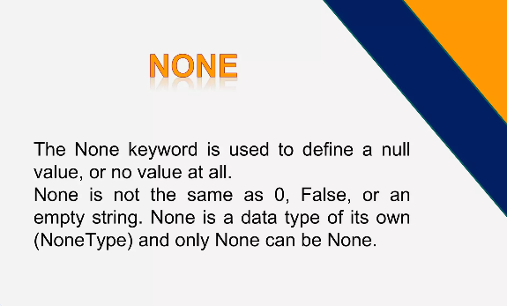

Slide 53
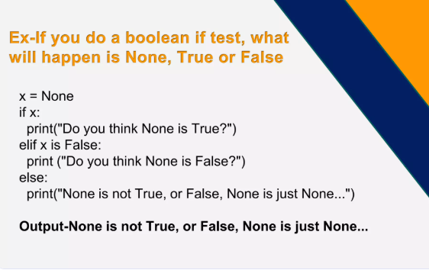

Slide 54
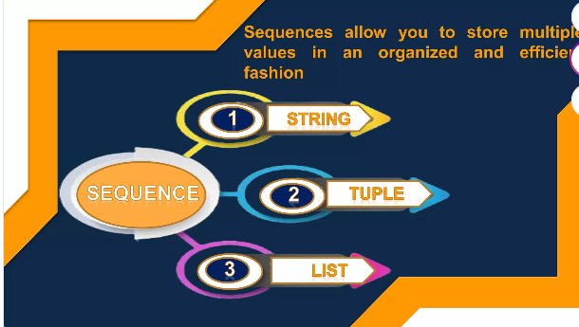

Slide 55
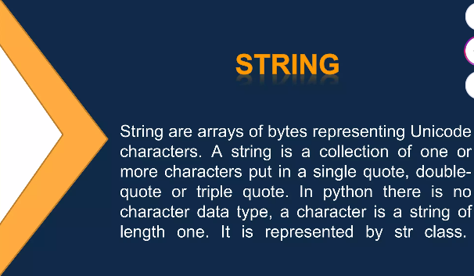

Slide 56
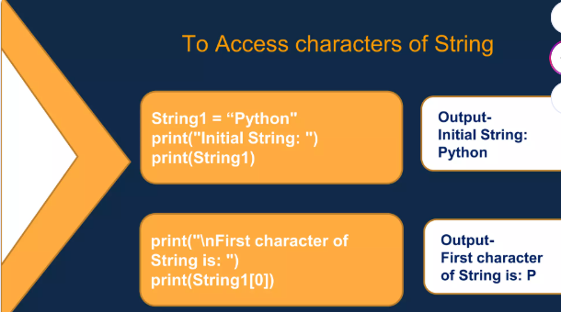

Slide 57
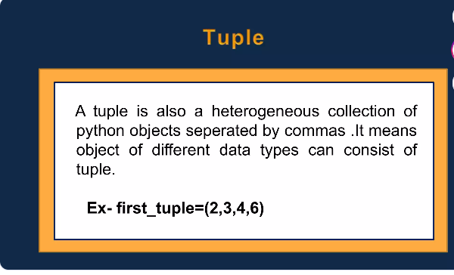

Slide 58
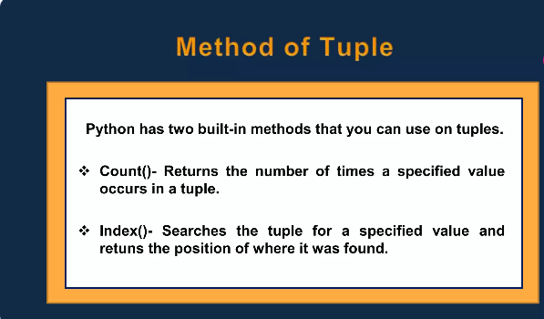

Slide 59
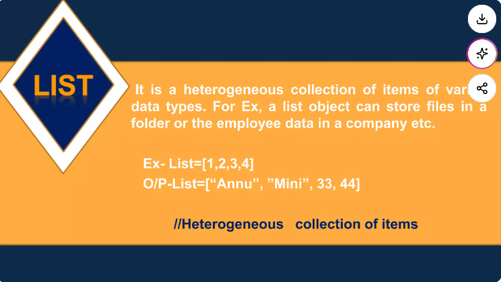
various

Slide 60
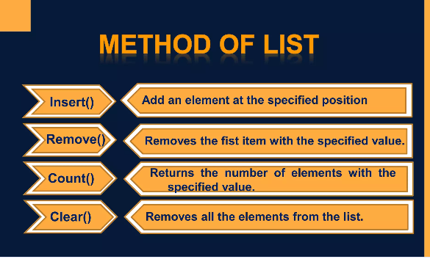

Slide 61
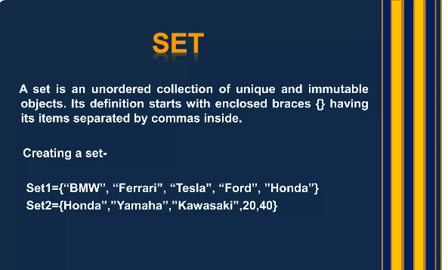

Slide 62
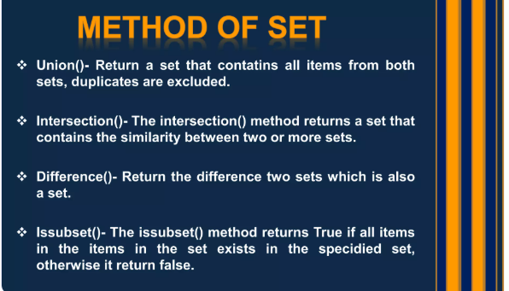

Slide 63
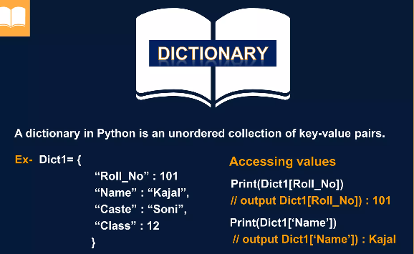

Slide 64
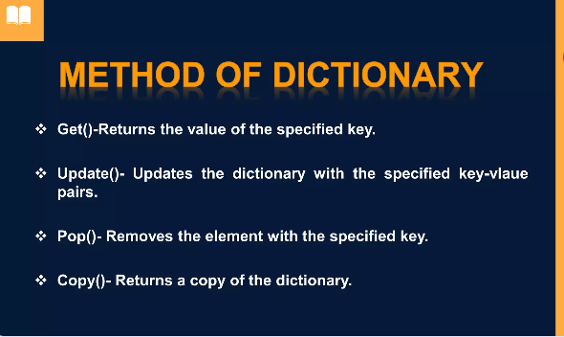

Slide 65


