Slide 1
List
Lists are used to store multiple items in a single variable.
Lists are one of 4 built-in data types in Python used to store collections of data, the other 3 are Tuple, Set, and Dictionary, all with different qualities and usage.
Lists are created using square brackets:
Example
Create a List: thislist = ["apple", "banana", "cherry"] print(thislist)

Slide 2
A list is a kind of collection
A collection allows us to put many values in a single variable
A collection is nice because we can carry many values around in one convenient package.
List constants are surrounded by square brackets and the elements in the list are separated by commas
A list element can be any Python object(the elements can be of varying types) – even another list
A list can be empty (Also a list can contain any number of objects, from zero to as many as your computer’s memory will allow)

Slide 3
Lists are ordered.
List elements can be accessed by index.
Lists are mutable.
Lists are dynamic.
Lists can contain any arbitrary objects & Lists can be nested to arbitrary depth.
The order in which you specify the element when you define a list is an innate characteristic of that list and is maintained for that list’s lifetime

Slide 4
List Items
List items are ordered, changeable(mutable), and allow duplicate values.
List items are indexed, the first item has index [0], the second item has index [1] etc.
Ordered
When we say that lists are ordered, it means that the items have a defined order, and that order will not change.
If you add new items to a list, the new items will be placed at the end of the list.
Note: There are some list methods that will change the order, but in general: the order of the items will not change.

Slide 5
Changeable
The list is changeable, meaning that we can change, add, and remove items in a list after it has been created.
Allow Duplicates
Since lists are indexed, lists can have items with the same value:
Example:-
Lists allow duplicate values:
thislist = ["apple", "banana", "cherry", "apple", "cherry"]
print(thislist)
Output:-
['apple', 'banana', 'cherry', 'apple', 'cherry']

Slide 6
List Length
To determine how many items a list has, use the len() function:
Example
Print the number of items in the list:
thislist = ["apple", "banana", "cherry"]
print(len(thislist))
Output:
3

Slide 7
List Items - Data Types
List items can be of any data type:
Example
String, int and boolean data types:
list1 = ["apple", "banana", "cherry"]
list2 = [1, 5, 7, 9, 3]
list3 = [True, False, False]

Slide 8
A list can contain different data types:
Example
A list with strings, integers and boolean values:
list1 = ["abc", 34, True, 40, "male"]

Slide 9
type()
From Python's perspective, lists are defined as objects with the data type 'list':
<class 'list'>
Example
What is the data type of a list?
mylist = ["apple", "banana", "cherry"]
print(type(mylist))
Output:-
<class 'list'>

Slide 10
The list() Constructor
It is also possible to use the list() constructor when creating a new list.
Example
Using the list() constructor to make a List:
thislist = list(("apple", "banana", "cherry")) # note the double round-brackets
print(thislist)
Output:-
['apple', 'banana', 'cherry']

Slide 11
Python Collections (Arrays)
There are four collection data types in the Python programming language:
List is a collection which is ordered and changeable. Allows duplicate members.
Tuple is a collection which is ordered and unchangeable. Allows duplicate members.
Set is a collection which is unordered, unchangeable*, and unindexed. No duplicate members.
Dictionary is a collection which is ordered** and changeable. No duplicate members.
*Set items are unchangeable, but you can remove and/or add items whenever you like.
**As of Python version 3.7, dictionaries are ordered. In Python 3.6 and earlier, dictionaries are unordered.

Slide 12
When choosing a collection type, it is useful to understand the properties of that type. Choosing the right type for a particular data set could mean retention of meaning, and, it could mean an increase in efficiency or security.

Slide 13
1.What will be the result of the following syntax:
mylist = ['apple', 'banana', 'cherry']
print(mylist[1])
A, apple
B , banana
C, cherry

Slide 14
Access Items
List items are indexed and you can access them by referring to the index number:
Example:
Print the second item of the list:
thislist = ["apple", "banana", "cherry"]
print(thislist[1])
Output:
Banana
Note: The first item has index 0.

Slide 15
Access Items
List elements can be accessed by index
Individual elements in a list can be accessed using an index in square brackets.
This is exactly analogous to accessing individual characters in a string.
List indexing is zero-based as it is with strings.

Slide 16
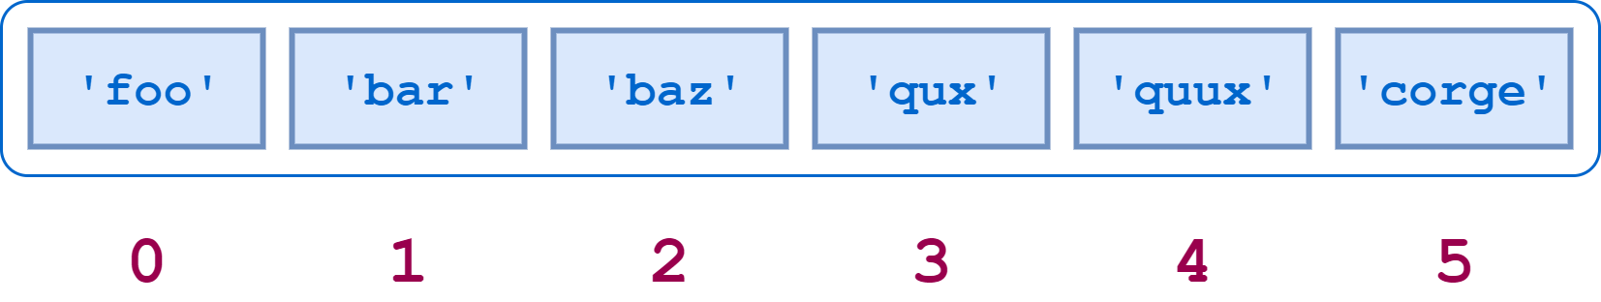
>>> a = ['foo', 'bar', 'baz', 'qux', 'quux', 'corge']
List Indices

Slide 17
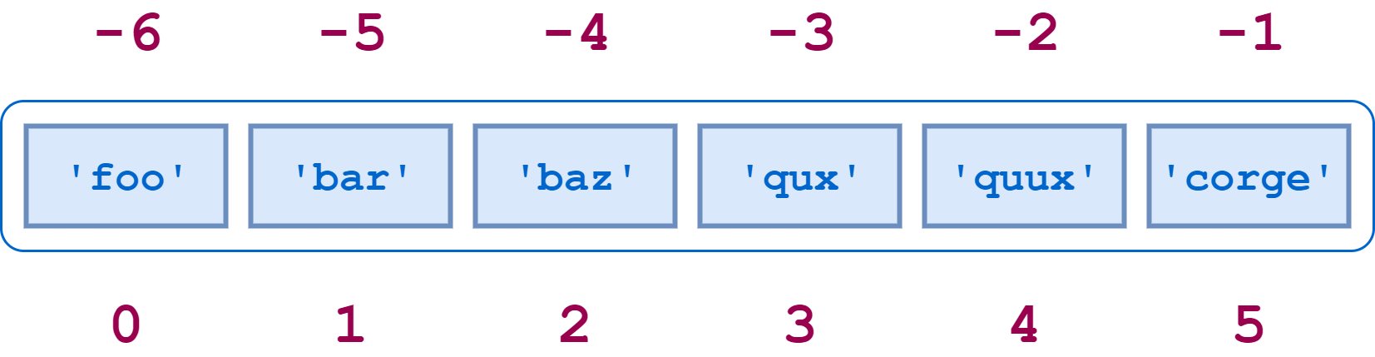
Indexing
Negative Indexing
Positive Indexing

Slide 18
Negative Indexing
Negative indexing means start from the end
-1 refers to the last item, -2 refers to the second last item etc.
Example
Print the last item of the list:
thislist = ["apple", "banana", "cherry"]
print(thislist[-1])
Output:
cherry

Slide 19
Range of Indexes
You can specify a range of indexes by specifying where to start and where to end the range.
When specifying a range, the return value will be a new list with the specified items.

Slide 20
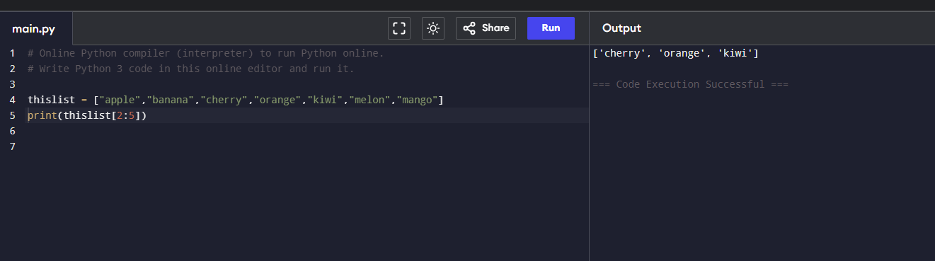
Example
Return the third, fourth, and fifth item:
thislist = ["apple", "banana", "cherry", "orange", "kiwi", "melon", "mango"]
print(thislist[2:5])
Note: The search will start at index 2 (included) and end at index 5 (not included).

Slide 21
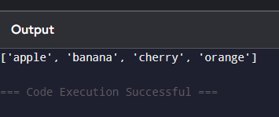
Remember that the first item has index 0.
By leaving out the start value, the range will start at the first item:
Example
This example returns the items from the beginning to, but NOT including, "kiwi":
thislist = ["apple", "banana", "cherry", "orange", "kiwi", "melon", "mango"]
print(thislist[:4])

Slide 22
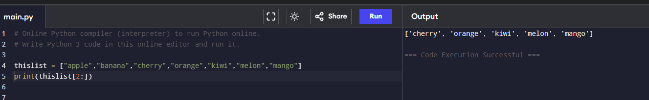
By leaving out the end value, the range will go on to the end of the list:
Example
This example returns the items from "cherry" to the end:
thislist = ["apple", "banana", "cherry", "orange", "kiwi", "melon", "mango"]
print(thislist[2:])

Slide 23
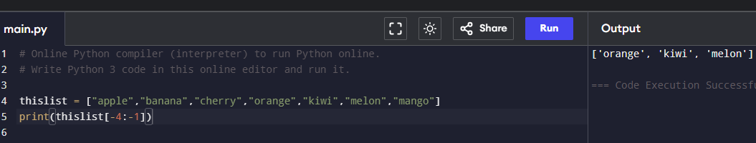
Range of Negative Indexes
Specify negative indexes if you want to start the search from the end of the list:
Example
This example returns the items from "orange" (-4) to, but NOT including "mango" (-1):
thislist = ["apple", "banana", "cherry", "orange", "kiwi", "melon", "mango"]
print(thislist[-4:-1])

Slide 24
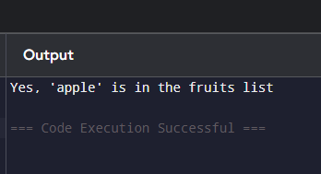
Check if Item Exists
To determine if a specified item is present in a list use the in keyword:
Example
Check if "apple" is present in the list:
thislist = ["apple", "banana", "cherry"]
if "apple" in thislist:
print("Yes, 'apple' is in the fruits list")

Slide 25
What will be the result of the following syntax:
mylist = ['apple', 'banana', 'cherry']
print(mylist[-1])
apple
banana
cherry

Slide 26
Change Item Value
To change the value of a specific item, refer to the index number:
Example
Change the second item:
thislist = ["apple", "banana", "cherry"]
thislist[1] = "blackcurrant"
print(thislist)
output:-
['apple', 'blackcurrant', 'cherry']

Slide 27
Change a Range of Item Values
To change the value of items within a specific range, define a list with the new values, and refer to the range of index numbers where you want to insert the new values:

Slide 28
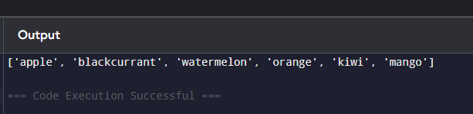
Example
Change the values "banana" and "cherry" with the values "blackcurrant" and "watermelon":
thislist = ["apple", "banana", "cherry", "orange", "kiwi", "mango"]
thislist[1:3] = ["blackcurrant", "watermelon"]
print(thislist)

Slide 29
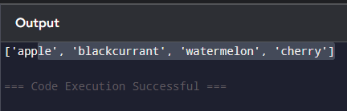
If you insert more items than you replace, the new items will be inserted where you specified, and the remaining items will move accordingly:
Example
Change the second value by replacing it with two new values:
thislist = ["apple", "banana", "cherry"]
thislist[1:2] = ["blackcurrant", "watermelon"]
print(thislist)
Note: The length of the list will change when the number of items inserted does not match the number of items replaced.

Slide 30

If you insert less items than you replace, the new items will be inserted where you specified, and the remaining items will move accordingly:
Example
Change the second and third value by replacing it with one value:
thislist = ["apple", "banana", "cherry"]
thislist[1:3] = ["watermelon"]
print(thislist)

Slide 31
insert() method
The insert() method inserts the specified value at the specified position.
Syntax
list.insert(pos, elmnt)
Parameter values
Parameter | Description
pos | Required. A number specifying in which position to insert the value
elmnt | Required. An element of any type (string, number, object etc.)

Slide 32
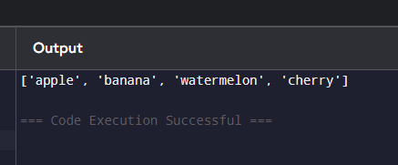
Insert Items
To insert a new list item, without replacing any of the existing values, we can use the insert() method.
The insert() method inserts an item at the specified index:
Example
Insert "watermelon" as the third item:
thislist = ["apple", "banana", "cherry"]
thislist.insert(2, "watermelon")
print(thislist)

Slide 33
Append Items
To add an item to the end of the list, use the append() method:
Example
Using the append() method to append an item:
thislist = ["apple", "banana", "cherry"]
thislist.append("orange")
print(thislist)

Slide 34
Extend List
To append elements from another list to the current list, use the extend() method.
Example
Add the elements of tropical to thislist:
thislist = ["apple", "banana", "cherry"]
tropical = ["mango", "pineapple", "papaya"]
thislist.extend(tropical)
print(thislist)
The elements will be added to the end of the list.

Slide 35
Add Any Iterable
The extend() method does not have to append lists, you can add any iterable object (tuples, sets, dictionaries etc.).
Example
Add elements of a tuple to a list:
thislist = ["apple", "banana", "cherry"]
thistuple = ("kiwi", "orange")
thislist.extend(thistuple)
print(thislist)

Slide 36
Remove List Items
Remove Specified Item
The remove() method removes the specified item.
Example
Remove "banana":
thislist = ["apple", "banana", "cherry"]
thislist.remove("banana")/ thislist.remove(thislist[1])
print(thislist)

Slide 37
If there are more than one item with the specified value, the remove()method removes the first occurrence:
Example
Remove the first occurrence of "banana":
thislist = ["apple", "banana", "cherry", "banana", "kiwi"]
thislist.remove("banana")
print(thislist)

Slide 38
Remove Specified Index
The pop() method removes the specified index.
Example
Remove the second item:
thislist = ["apple", "banana", "cherry"]
thislist.pop(1)
print(thislist)

Slide 39
If you do not specify the index, the pop() method removes
the last item.
Example
Remove the last item:
thislist = ["apple", "banana", "cherry"]
thislist.pop()
print(thislist)

Slide 40
The del keyword also removes the specified index:
Example
Remove the first item:
thislist = ["apple", "banana", "cherry"]
del thislist[0]
print(thislist)

Slide 41
The del keyword can also delete the list completely.
Example
Delete the entire list:
thislist = ["apple", "banana", "cherry"]
del thislist

Slide 42
Clear the List
The clear() method empties the list.
The list still remains, but it has no content.
Example
Clear the list content:
thislist = ["apple", "banana", "cherry"]
thislist.clear()
print(thislist)

Slide 43
Loop Through a List
You can loop through the list items by using a for loop:
Example
Print all items in the list, one by one:
thislist = ["apple", "banana", "cherry"]
for x in thislist:
print(x)

