Slide 1
FILES

Slide 2
A file is a contiguous set of bytes used to store data. This data is organized in a specific format and can be anything as simple as a text file or as complicated as a program executable. In the end, these byte files are then translated into binary 1 and 0 for easier processing by the computer
Files on most modern file systems are composed of three
main parts:
Header: metadata about the contents of the file (file name, size, type, and so on)
Data: contents of the file as written by the creator or editor
End of file (EOF): special character that indicates the end of the file

Slide 3
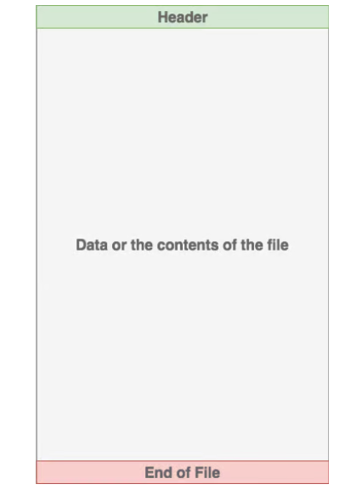

Slide 4
Here are some of the functions in Python that allow you to read and write to files:
read() : This function reads the entire file and returns a string
readline() : This function reads lines from that file and returns as a string. It fetch the line n, if it is been called nth time.
readlines() : This function returns a list where each element is single line of that file.
readlines() : This function returns a list where each element is single line of that file.
write(string) : This function writes the string to the file.
writelines(seq) : This function writes a list of string.
append() : This function append string to the file instead of overwriting the file.

Slide 5
Modes & Description
r
Opens a file for reading only. The file pointer is placed at the beginning of the file. This is the default mode.
rb
Opens a file for reading only in binary format. The file pointer is placed at the beginning of the file. This is the default mode.
r+
Opens a file for both reading and writing. The file pointer placed at the beginning of the file.
rb+
Opens a file for both reading and writing in binary format. The file pointer placed at the beginning of the file.
w
Opens a file for writing only. Overwrites the file if the file exists. If the file does not exist, creates a new file for writing.
wb
Opens a file for writing only in binary format. Overwrites the file if the file exists. If the file does not exist, creates a new file for writing.
w+
Opens a file for both writing and reading. Overwrites the existing file if the file exists. If the file does not exist, creates a new file for reading and writing.
wb+
Opens a file for both writing and reading in binary format. Overwrites the existing file if the file exists. If the file does not exist, creates a new file for reading and writing.
a
Opens a file for appending. The file pointer is at the end of the file if the file exists. That is, the file is in the append mode. If the file does not exist, it creates a new file for writing.
ab
Opens a file for appending in binary format. The file pointer is at the end of the file if the file exists. That is, the file is in the append mode. If the file does not exist, it creates a new file for writing.
a+
Opens a file for both appending and reading. The file pointer is at the end of the file if the file exists. The file opens in the append mode. If the file does not exist, it creates a new file for reading and writing.
ab+
Opens a file for both appending and reading in binary format. The file pointer is at the end of the file if the file exists. The file opens in the append mode. If the file does not exist, it creates a new file for reading and writing.

Slide 6
The common reading modes for files:
‘r’ : This mode indicate that file will be open for reading only
‘w’ : This mode indicate that file will be open for writing only. If file containing that name does not exists, it will create a new one
‘a’ : This mode indicate that the output of that program will be append to the previous output of that file
‘r+’ : This mode indicate that file will be open for both reading and writing
'rb' or 'wb'Open in binary mode (read/write using byte data)

Slide 7
File Paths
When you access a file on an operating system, a file path is required. The file path is a string that represents the location of a file.
Example: "E:\demos\files\read_demo.txt“
If the file is located in a different location, you will have to specify the file path, like this:
Example
Open a file on a different location:
f = open("D:\\myfiles\welcome.txt")
print(f.read())

Slide 8
Using the with statement we can also use the with statement when opening a file:
Example: with open("demofile.txt") as f: print(f.read())

Slide 9
Open a File on the Server
Assume we have the following file, located in the same folder as Python: demofile.txt
Hello! Welcome to demofile.txt
This file is for testing purposes.
Good Luck!
To open the file, use the built-in open() function.
The open() function returns a file object, which has a read() method for reading the content of the file:

Slide 10
Example: f = open("demofile.txt") print(f.read())
Read Only Parts of the File
By default the read() method returns the whole text, but you can also specify how many characters you want to return:
Example:
Return the 5 first characters of the file: with open("demofile.txt") as f: print(f.read(5))

Slide 11
Read Lines
You can return one line by using the readline() method:
Example
Read one line of the file: with open("demofile.txt") as f: print(f.readline())

Slide 12
By calling readline() two times, you can read the two first lines:
Example
Read two lines of the file: with open("demofile.txt") as f: print(f.readline()) print(f.readline())
Loop through the file line by line:
By looping through the lines of the file, you can read the whole file, line by line:
Example: with open("demofile.txt") as f: for x in f: print(x)

Slide 13
Write to an Existing File
To write to an existing file, you must add a parameter to the open() function:
"a" - Append - will append to the end of the file
"w" - Write - will overwrite any existing content
Example
Open the file "demofile.txt" and append content to the file:
with open("demofile.txt", "a") as f:
f.write("Now the file has more content!")
#open and read the file after the appending:
with open("demofile.txt") as f:
print(f.read())

Slide 14
Close Files
It is a good practice to always close the file when you are done with it.
If you are not using the with statement, you must write a close statement in order to close the file:
Example
Close the file when you are finished with it: f = open("demofile.txt") print(f.readline()) f.close()

Slide 15
Overwrite Existing Content
To overwrite the existing content to the file, use the w parameter:
Example
Open the file "demofile.txt" and overwrite the content: with open("demofile.txt", "w") as f: f.write("Woops! I have deleted the content!")
#open and read the file after the overwriting: with open("demofile.txt") as f: print(f.read())

Slide 16
Delete a File
To delete a file, you must import the OS module, and run its os.remove() function:
import os
os.remove("demofile.txt")
Check if File exist:
To avoid getting an error, you might want to check if the file exists before you try to delete it:
Check if file exists, then delete it:
import os
if os.path.exists("demofile.txt"):
os.remove("demofile.txt")
else:
print("The file does not exist")

Slide 17
Delete Folder
To delete an entire folder, use the os.rmdir() method:
Example
Remove the folder "myfolder":
import os
os.rmdir("myfolder")
Note: You can only remove empty folders.

