Slide 1
What is Matplotlib?
Matplotlib is a low level graph plotting library in python that serves as a visualization utility.
Matplotlib was created by John D. Hunter.
Matplotlib is open source and we can use it freely.
Matplotlib is mostly written in python, a few segments are written in C, Objective-C and Javascript for Platform compatibility.
Where is the Matplotlib Codebase?
The source code for Matplotlib is located at this github repository https://github.com/matplotlib/matplotlib

Slide 2
Matplotlib Pyplot
Pyplot
Most of the Matplotlib utilities lies under the pyplot submodule, and are usually imported under the plt alias:
import matplotlib.pyplot as plt
Now the Pyplot package can be referred to as plt.
Example
Draw a line in a diagram from position (0,0) to position (6,250):
import matplotlib.pyplot as plt
import numpy as np
xpoints = np.array([0, 6])
ypoints = np.array([0, 250])
plt.plot(xpoints, ypoints)
plt.show()

Slide 3
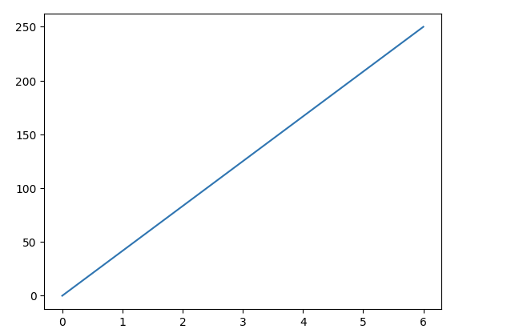
Result:

Slide 4
Matplotlib Plotting
Plotting x and y points
The plot() function is used to draw points (markers) in a diagram.
By default, the plot() function draws a line from point to point.
The function takes parameters for specifying points in the diagram.
Parameter 1 is an array containing the points on the x-axis.
Parameter 2 is an array containing the points on the y-axis.
If we need to plot a line from (1, 3) to (8, 10), we have to pass two arrays [1, 8] and [3, 10] to the plot function.
Example
Draw a line in a diagram from position (1, 3) to position (8, 10):
import matplotlib.pyplot as plt
import numpy as np
xpoints = np.array([1, 8])
ypoints = np.array([3, 10])
plt.plot(xpoints, ypoints)
plt.show()

Slide 5
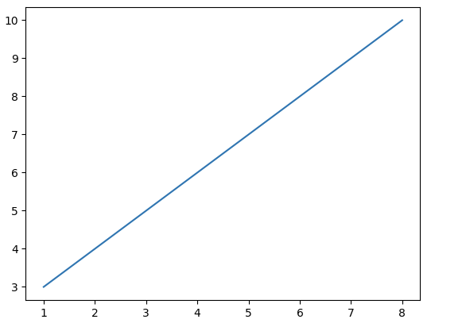

Slide 6
Matplotlib Bars
Creating Bars
With Pyplot, you can use the bar() function to draw bar graphs:
Example
Draw 4 bars:
import matplotlib.pyplot as plt
import numpy as np
x = np.array(["A", "B", "C", "D"])
y = np.array([3, 8, 1, 10])
plt.bar(x,y)
plt.show()

Slide 7
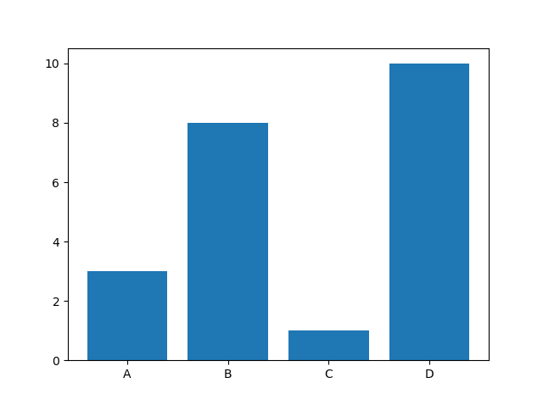

Slide 8
Matplotlib Pie Charts
Creating Pie Charts
With Pyplot, you can use the pie() function to draw pie charts:
Example
A simple pie chart:
import matplotlib.pyplot as plt
import numpy as np
y = np.array([35, 25, 25, 15])
plt.pie(y)
plt.show()

Slide 9


