Slide 1
Assignment 1
File created on: 17-11-2023 14:55:26

Slide 2
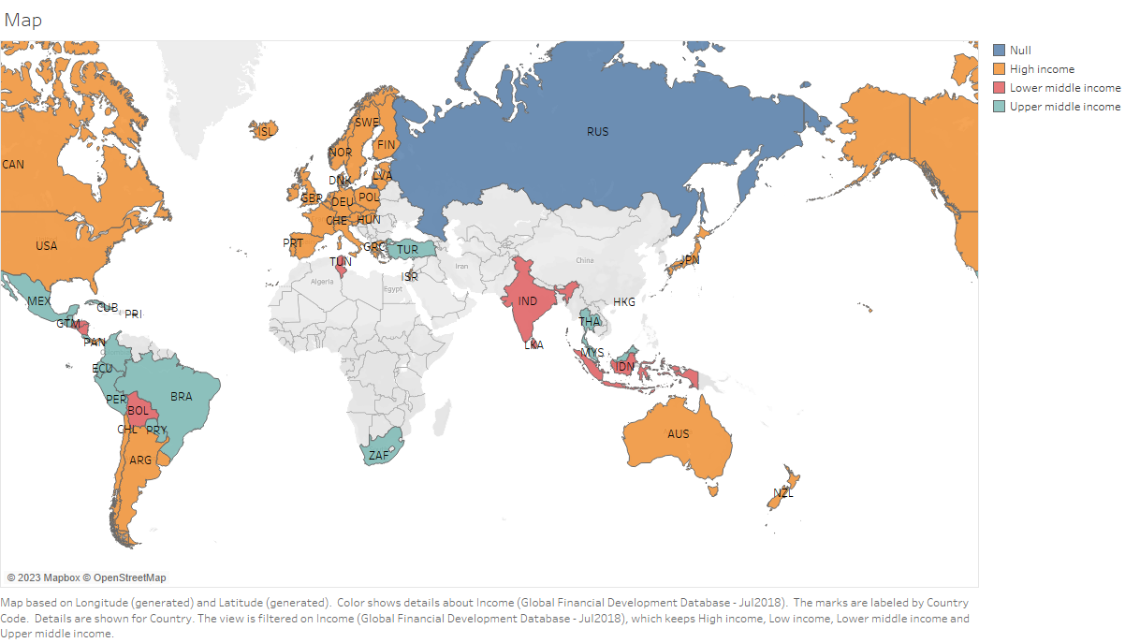

Slide 3
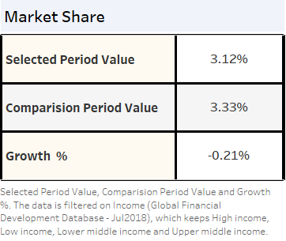

Slide 4
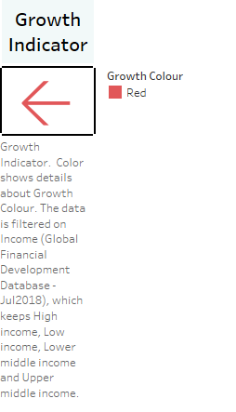

Slide 5
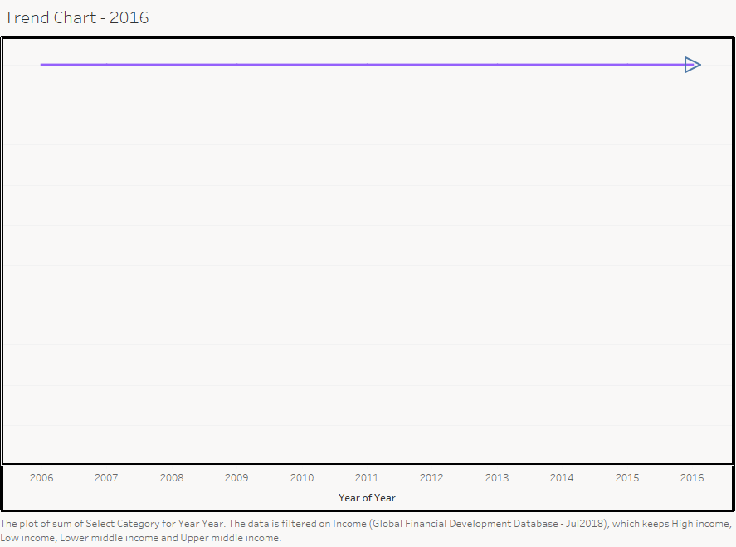

Slide 6
