Slide 1
JAVA FULL STACK INTERNSHIP A PROJECT PRESENTATION ON Academic requirement Under the guidance of Srikanth - Senior technical Consultant DLithe
Presented by :-
Team member :- Abhishek H(144CS21004),
Chethan R S (144CS21008), Deepak (144CS21010),
Dileep (144CS21011), Karthik (144CS21014),
Prasad (144CS21024), Vikram V K (144CS21037)

Slide 2
CONTENTS
Introduction
Problem Statement
Objectives
Methodology
Implementation
Results and analysis
Conclusion
References

Slide 3
INTRODUCTION
Backend programming with java and MySQL and
Design and server-side logic and databases management
Purpose of training report is to overview of backend programming with java and MySQL and its applications.

Slide 4
PROBLEM STATEMENT
Data Entry Errors:
Manual entries leading to inaccuracies in the data.
Time-Consuming:
Manually processing is time-consuming
Data Security:
A risk of unauthorized access, loss, or damage to sensitive
Difficulty in Tracking:
Tracking the progress of each student application manually can be
challenging, leading to potential oversight or missed deadlines.
Inefficient Communication:
relying on phone calls or in-person visits.

Slide 5
OBJECTIVES
Registration:
To create simple CRUD Application .
Allow students to register with the system by providing their personal information.
Verify and store student registration details securely in the system database.
Provide a user-friendly interface for students to easily complete the registration process.
Marks Viewing:
Enable students to view their academic performance by accessing their marks or grades
Display marks in a clear and organized manner .
Confidentiality and security of student marks data, allowing access only to authorized users.

Slide 6
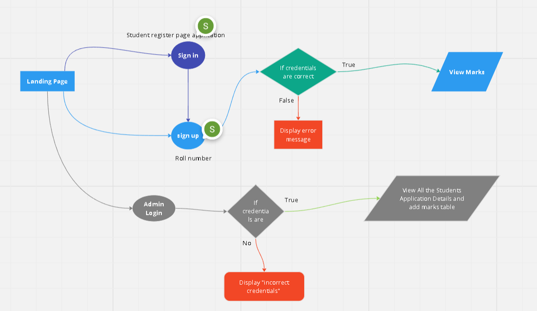
METHODOLOGY

Slide 7
IMPLEMENTATION
The user comes to the homepage.
The Students gets Redirected to student application form.
The Student can fill the necessary information in the application form.
The Student can then view their marks in the marks page.
The Admin can view the records of students in the Admin page.

Slide 8
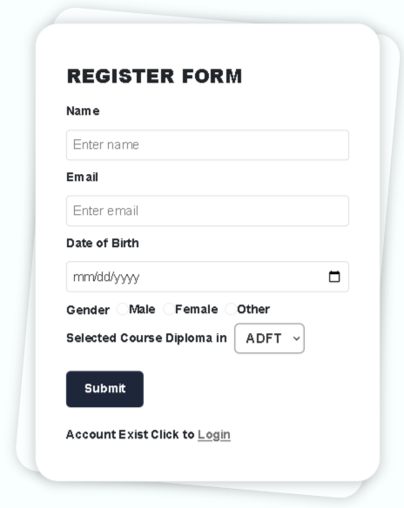
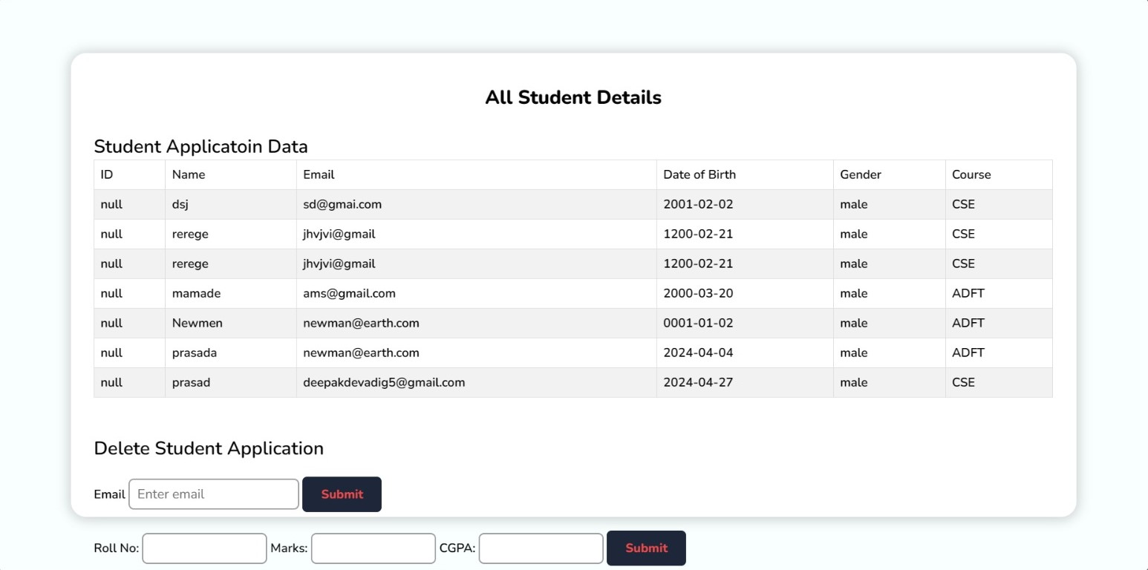
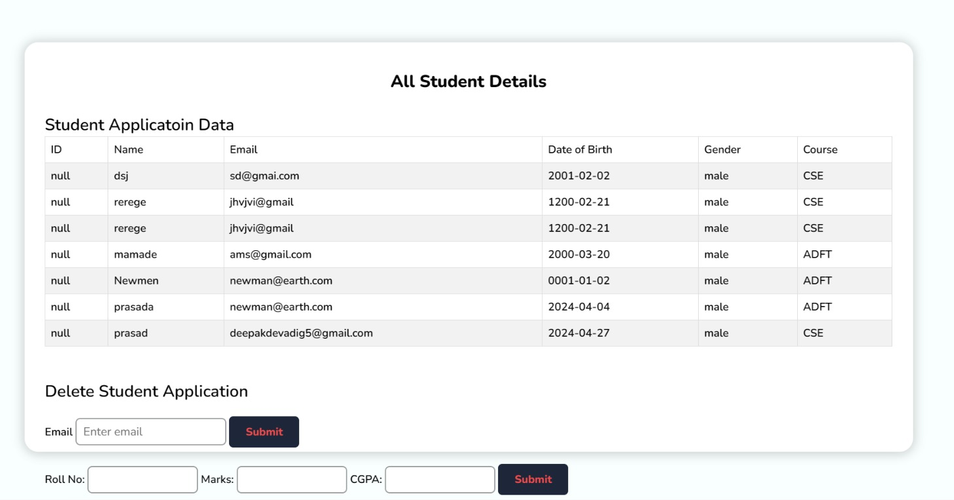
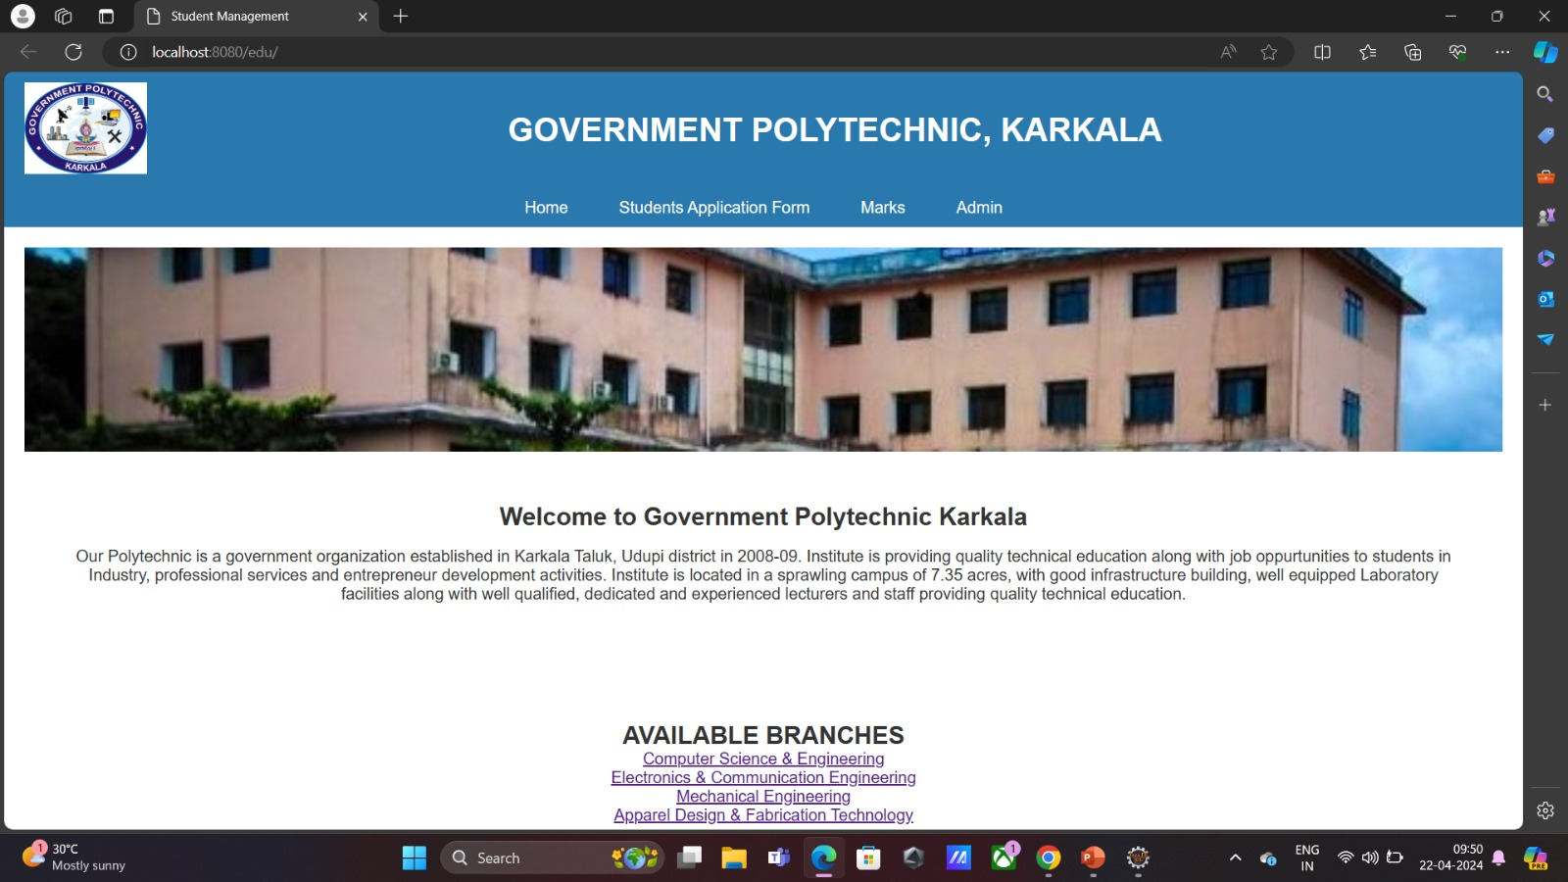
RESULTS & ANALYSIS
Create Operation
Read Operation

Slide 9
CONCLUSION
It’s a simple CRUD Application
This application Allows students to register with the system by providing their personal information.
The app Verifies and stores student registration details securely in the system database.
It Provides a user-friendly interface for students to easily complete the registration process.
This app Enable students to view their academic performance by accessing their marks or grades
The application Displays marks in a clear and organized manner.
This application has Confidentiality and security of student marks data, allowing access only to authorized users.

Slide 10





REFERENCES

Slide 11
THANK YOU
From :-
Abhishek H ,Chethan R S, Deepak, Dileep, Karthik, Prasad, Vikram
Mr Shrikanth

