Slide 1

Automating GitHub Copilot Chat: The Missing Bridge Inside Visual Studio
Shadow Pilot – Visual Studio Copilot Extension - AI Workflow. One Click
Initial Version
Arun Devadiga SHS TE DC IND DI-CT

Slide 2
Why this Extension is important?
Limitation on GitHub Copilot Side
Agent Mode exists only in VS Code
Copilot in Visual Studio exposes zero APIs
No way to inject system prompts or submit messages programmatically
Limitation on Visual Studio Side
VSIX API cannot reach Copilot’s chat UI
No official way to build Copilot automation or agents
Copilot chat is essentially a black box
It’s a combined limitation
Visual Studio → No extensibility API for Copilot
GitHub Copilot → No support for agents or prompt injection in Visual Studio
Visual Studio has no API for Copilot, and GitHub Copilot doesn’t expose Agent Mode in Visual Studio.

Slide 3
Advantages
Bring Agent-like Experience to Visual Studio
Enables structured AI workflows inside Visual Studio
Mimics agent behavior without official APIs
No need to switch IDEs Impact: Teams stay in their primary development environment
One-Click AI Workflow Execution
Click an agent → Opens Copilot Chat
Injects structured prompts automatically
Triggers execution instantly Impact: Reduces manual copy-paste effort Standardizes AI usage across teams
Centralized & Always Updated Instructions
Reads agent instructions from shared location
Ensures everyone uses the latest version
Eliminates outdated prompt usage Impact: Governance + consistency across projects

Slide 4
Advantages
Multi-File Instruction Bundling Automatically loads:
Architecture guidelines
Coding standards
Test rules
Injects everything together
Impact: Enterprise-grade prompt orchestration
Instruction Layering with Precedence Supports ordered layers:
Org-level rules
Project-level rules
Agent-level instructions
User prompt
Higher priority rules are never overridden.
Impact: Strong compliance + controlled AI behavior
Enterprise Productivity Booster
Reduces repetitive prompting
Encourages standardized Copilot usage
Improves onboarding for new developers
Enables scalable AI adoption

Slide 5
Next….
AI Policy Enforcement Engine Before injecting prompt:
Check for restricted keywords
Enforce secure coding policy
Prevent unsafe instructions
Impacts:
Compliance & security control
Aligns with corporate AI policy
Context-Aware Injection
Detects project type / language
Injects relevant instructions dynamically
Avoids static one-size-fits-all prompts
Impact: Smarter, context-sensitive AI usage
Prompt Execution History & Replay
Store executed agent prompts
Allow replay with:
Same instructions:
Modified user input
Compare outputs
Impacts:
Debug AI behavior
Knowledge reuse
Audit traceability

Slide 6
Next….
Team Analytics Dashboard Track:
Which agents are used most
Frequency of usage
Adoption per team
Productivity patterns
Impacts:
Enterprise AI governance
Measure ROI of Copilot usage

Slide 7
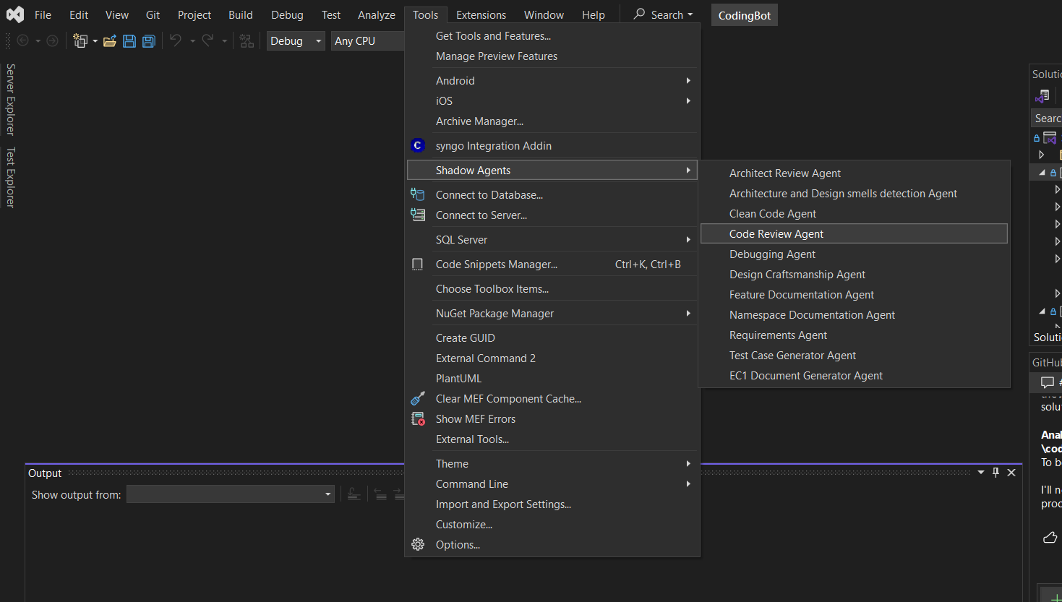
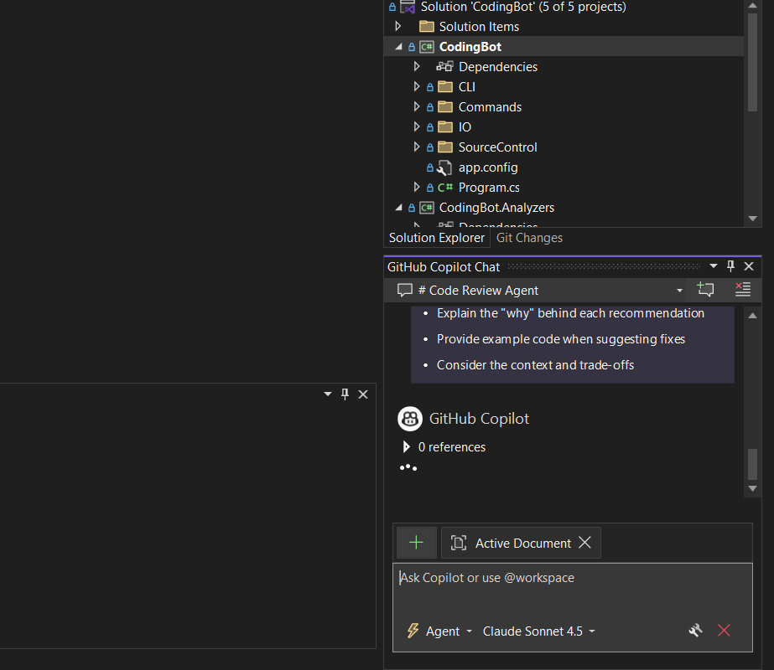
Shadow Pilot

Slide 8
How Shadow Pilot solved the Problem
Shadow Pilot – The Bridge
Opens Copilot Chat
Writes structured prompts into the chat input
Triggers execution
Mimics agent behavior until Microsoft makes it official
When Microsoft introduces native agent APIs, this workaround may be deprecated or unnecessary and Shadow Pilot can directly use those APIs

Slide 9
Limitations of the Solution
Shadow Pilot – Agent Emulator
Not Fully Reliable: Requires Copilot chat window focus; user interaction during prompt injection can disrupt the process.
Relies on UI Workarounds: No official Copilot or Visual Studio API; depends on text-buffer access and SendKeys, which may break with UI changes, but very less likely
One-Way Automation: Cannot read Copilot’s response or detect completion; no feedback loop or error handling.

Slide 10
Closing Message - Q&A
Shadow Pilot transforms GitHub Copilot from an ad-hoc assistant into a structured, governed AI workflow engine inside Visual Studio. Copilot is a productivity amplifier only when it's integrated into real workflows. Focus on use-case relevance, developer education, and continuous improvement rather than just license utilization.

