Slide 1

Automating GitHub Copilot Chat: The Missing Bridge Inside Visual Studio
ShadowPilot – Visual Studio Copilot Extension - AI Workflow. One Click
Initial Version
Arun Devadiga SHS TE DC IND DI-CT

Slide 2
Why ShadowPilot?
Limitation on GitHub Copilot Side
Agent Mode APIs exists only in VS Code
Copilot in Visual Studio exposes zero APIs
No API to inject system prompts or submit messages programmatically
Limitation on Visual Studio Side
VSIX API cannot reach Copilot’s chat UI
No official way to build Copilot automation or agents
Copilot chat is essentially a black box
It’s a combined limitation
Visual Studio → No extensibility API for Copilot
GitHub Copilot → No support for agents or prompt injection in Visual Studio
Visual Studio has no API for Copilot, and GitHub Copilot doesn’t expose Agent Mode in Visual Studio.

Slide 3
How Shadow Pilot solved the Problem
Shadow Pilot – The Bridge
Opens Copilot Chat
Writes structured prompts into the chat input
Triggers execution
Mimics agent behavior until Microsoft makes it official
When Microsoft introduces native agent APIs, this workaround may be deprecated or unnecessary and Shadow Pilot can directly use those APIs

Slide 4
Limitations of the Solution
Shadow Pilot – Agent Emulator
Not Fully Reliable: Requires Copilot chat window focus; user interaction during prompt injection can disrupt the process.
Relies on UI Workarounds: No official Copilot or Visual Studio API; depends on text-buffer access and SendKeys, which may break with UI changes, but very less likely
One-Way Automation: Cannot read Copilot’s response or detect completion; no feedback loop or error handling.

Slide 5
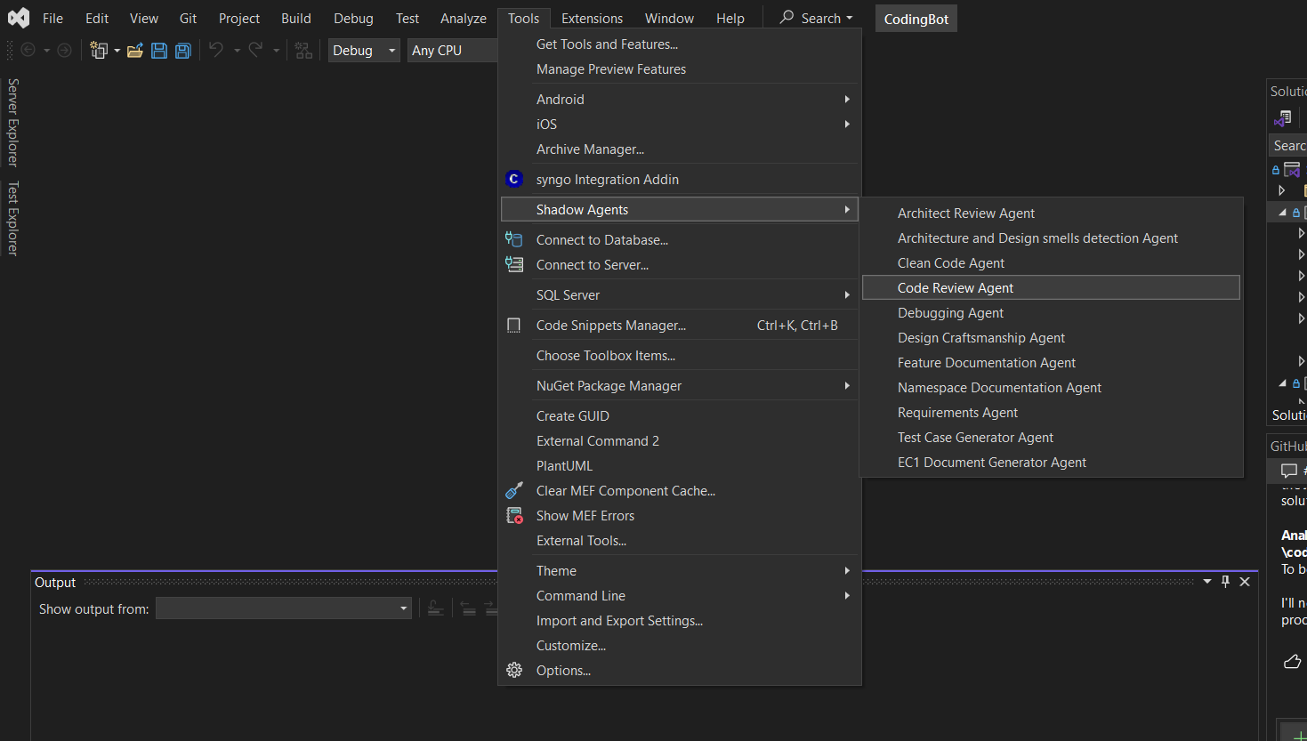
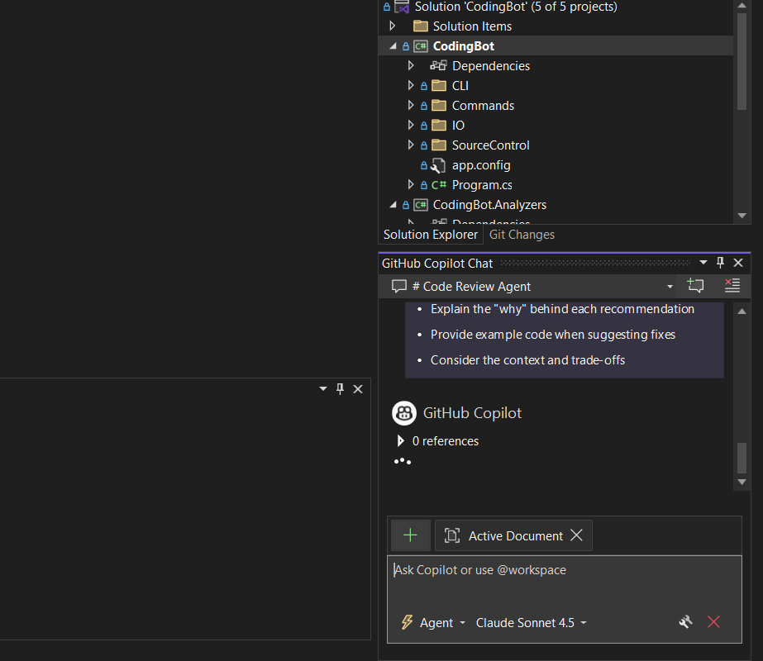
Shadow Pilot

Slide 6
Closing Message - Q&A
Transform GitHub Copilot into a team of specialized AI agents — instantly accessible from your Visual Studio IDE.
Copilot is a productivity amplifier only when it's integrated into real workflows. Focus on use-case relevance, developer education, and continuous improvement rather than just license utilization.

