Slide 1

Time Series Classification ITEC5920 – Applied Deep Learning
Georges Ankenmann – 100 935 237
Davood Akhavannasab – 101 133 274

Slide 2
Agenda
Literature Review
First Steps
Making it Better
Challenges
Results

Slide 3
Literature Review

Slide 4
First Paper
Topic: Deep Learning-Based Real-Time Auto Classification of Smartphone Measured Bridge Vibration Data
Authors: Ashish Shrestha and Ji Dang
Goal: Real-time bridge vibration measurements using smartphones through customizable convolution neural network
Input: Multichannel long-term time-series signals obtained from built-in accelerometer sensors
Output: Predefined vibration categories
Evaluation: They have utilized a separate test set acquired from same bridge (Not used in training)
Result: High accuracy classification through CNN

Slide 5
Second Paper
Topic: Network Traffic Prediction Using Recurrent Neural Networks
Authors: Nipun Ramakrishnan and Tarun Soni
Goal: Network traffic prediction (volume prediction, protocol classification, and protocol distribution prediction) through RNN and LSTM
Input: Network traffic collected from nodes in a computer network
Output: Categories of Network traffic amount and protocol
Result: High accuracy classification through RNN and LSTM

Slide 6
Our Project
Input: The dataset has 336 sensor measurements, and each sensor measurement contains 3000 data sample
Goal: classifying current sensor information by the deep learning architectures such as CNN, MLP, and LSTM
Challenge: Imbalanced data

Slide 7
First Steps

Slide 8



Making a model…
Time series classification?
Imbalanced data? {0: 149, 1: 187}
CNN, MLP, LSTM, other?
How many layers?
Metrics?
Activation functions?
Optimizer?
Epochs?

Slide 9
Making it Better

Slide 10
How do we make it better?
Oversampling?
Automatic tuning?
New models?
Magic?

Slide 11
Results

Slide 12
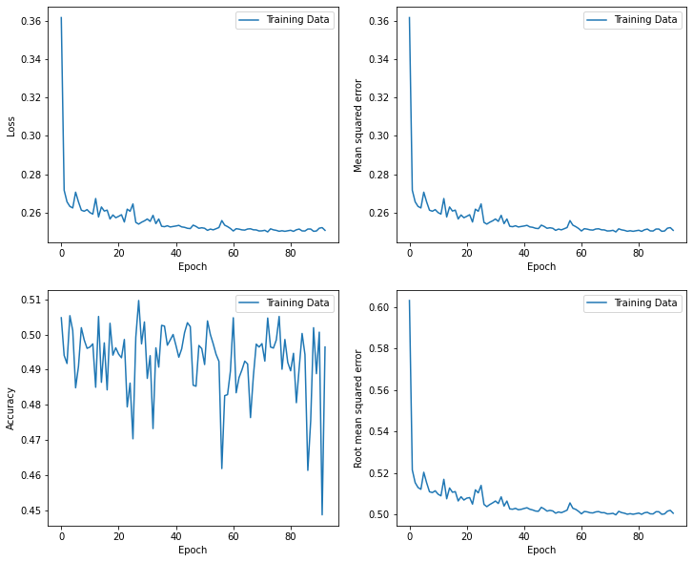
Results – CNN Base Model

Slide 13
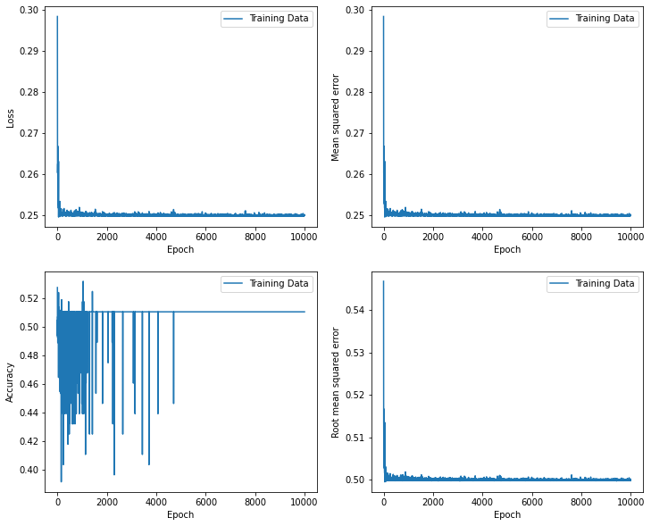
Results – CNN Overtrained Model
Notes:
22 minutes, not that much better

Slide 14
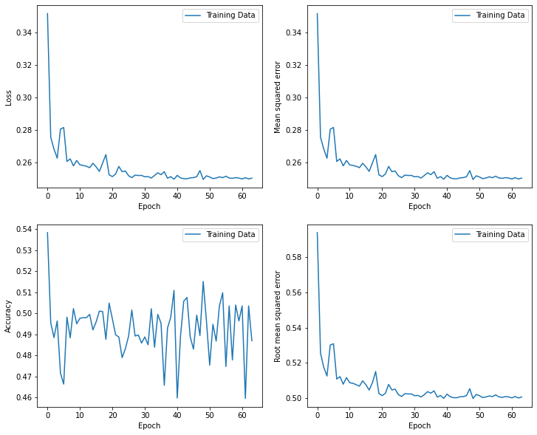
Results – MLP Base Model

Slide 15
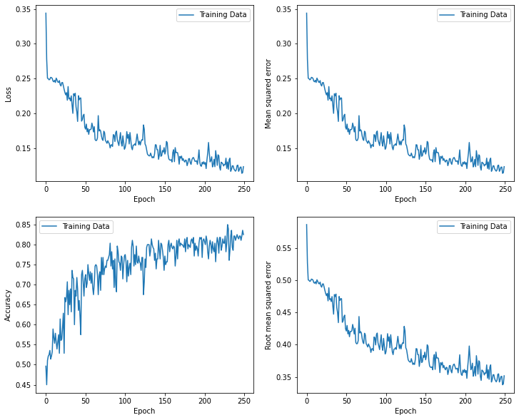
Results – LSTM Base Model

Slide 16
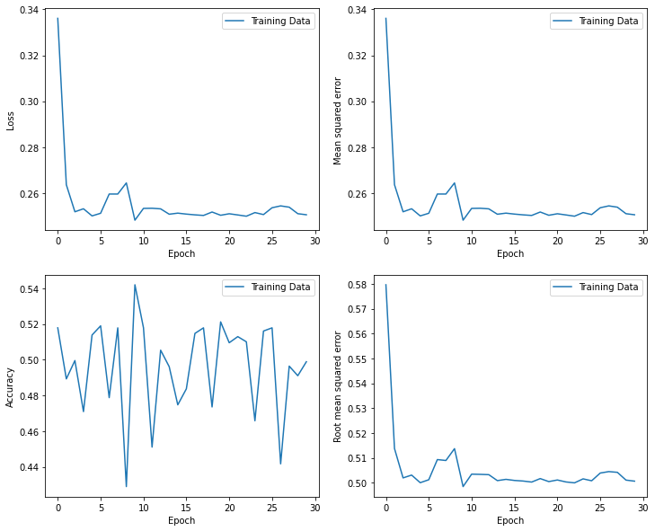
Results – “Better” Model – N-BEATS
https://github.com/philipperemy/n-beats

Slide 17
Conclusion

Slide 18
Conclusion
Good start, but much more work can be done
New projects are always being developed
Different approaches on how to solve the problem

Slide 19
Thank you!

