Slide 1
Sales & Demand Forecasting for Businesses
Internship Project Prepared by: Devagiri Siva Nagendra Reddy Using Machine Learning for Business Forecasting

Slide 2
Problem Statement
Businesses need accurate sales forecasts to optimize inventory, reduce costs, and improve decision-making. This project predicts future sales using historical data.

Slide 3
Dataset Overview
• Historical sales records • Order Date and Sales columns • Time-series sales analysis • Data used to identify trends and patterns

Slide 4
Data Cleaning
• Removed missing values • Converted date formats • Verified data consistency • Prepared dataset for modeling

Slide 5
Feature Engineering
• Extracted Year, Month, Day • Created time-based features • Improved forecasting capability • Enabled trend analysis

Slide 6
Forecasting Model
Linear Regression Model Benefits: • Simple and interpretable • Captures sales trends • Generates future predictions

Slide 7
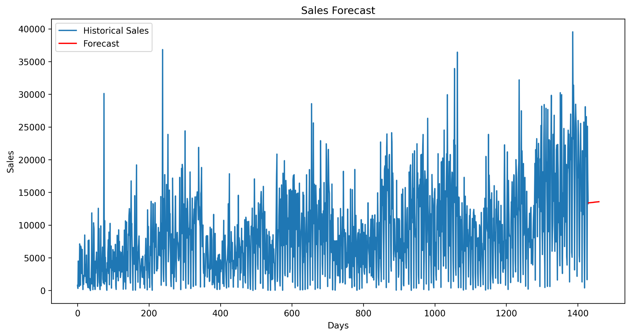
Forecast Results
The graph below shows historical sales and forecasted future sales generated by the model.

Slide 8
Business Insights
• Sales show an overall upward trend • Better inventory planning • Improved resource allocation • Supports strategic business decisions

Slide 9
Conclusion
The project successfully forecasted future sales and provided actionable insights for business growth and planning.

