Slide 1

Convolutional/Deconvolutional Neural Network
By: Jonathan Blanchette, Binghao Wang

Slide 2
Outline
Data pre-processing
Pre-training
Training

Slide 3

Pre-processing
Resize & shuffle
Extract top 3 principle components
10 folds cross-validation

Slide 4
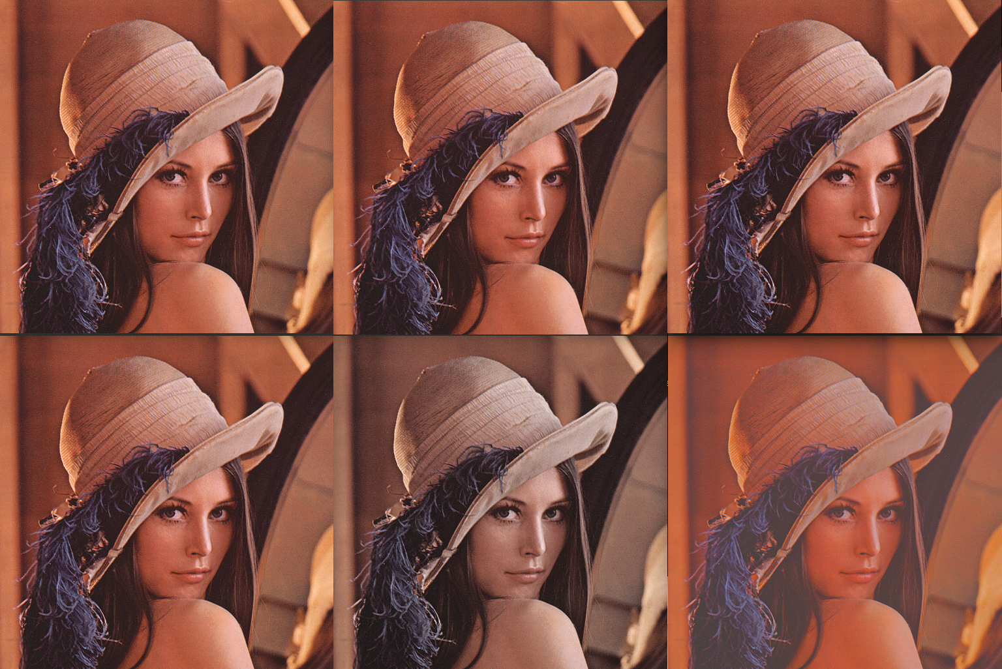
Pre-training
Parameter setting:
Learning rate=1e-3
momentum= .1
weight decay=1e-5
learning rate decay=1e-7
Random brightness/saturation/contrast;
Random lighting(using p.c.)
Data normalization wrt training set

Slide 5
Model
Convolution(3 -> 64, 12 x 4)
Maxpool(3 x 3, 2, 2, 1, 1)
ReLU
Convolution(64 -> 64, 3 x 3, 1, 1, 1, 1)
ReLU
Convolution(64 -> 64, 3 x 3, 1, 1, 1, 1)
Maxpool
ReLU
Convolution(64 -> 256, 9 x 9)
Dropout(0.5)
ReLU
Reshape(256)
Linear(256 -> 6)
Softmax

Slide 6
Training
Batch size: 128
Epoch: 400(each network)
Time: 4-5 hours(each network)

Slide 7
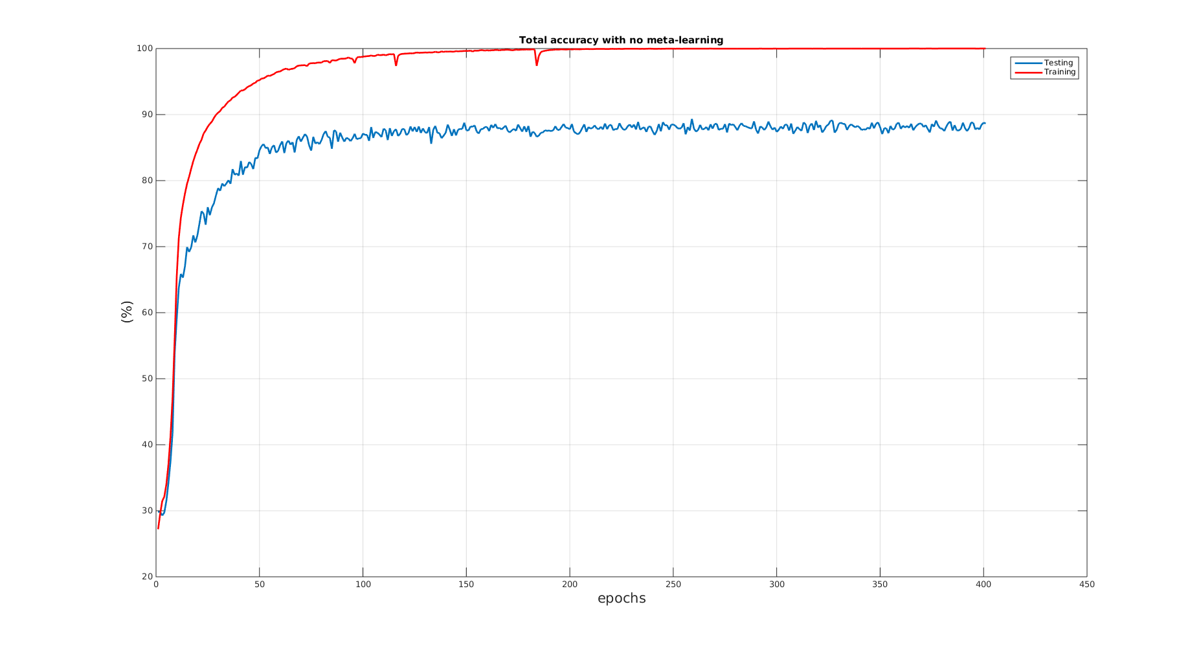
Total accuracy(without meta-learning)

Slide 8
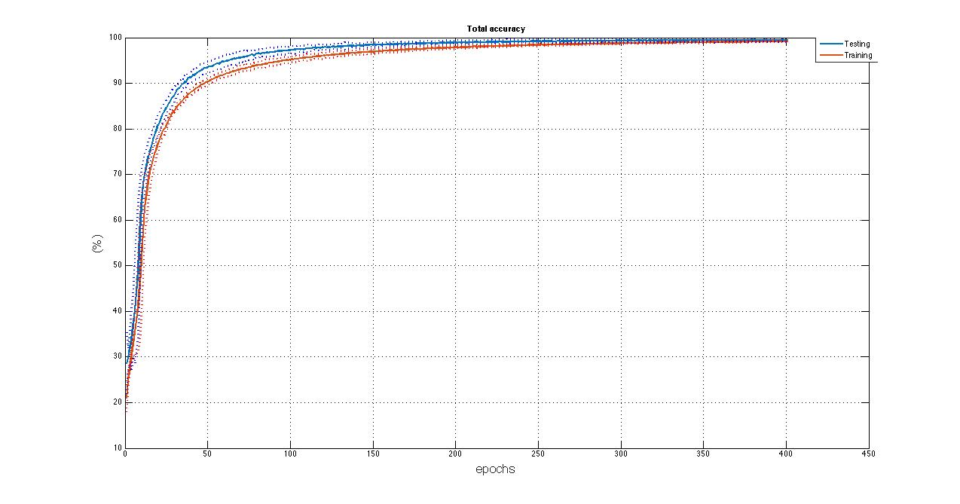
Total accuracy(with meta-learing)

Slide 9
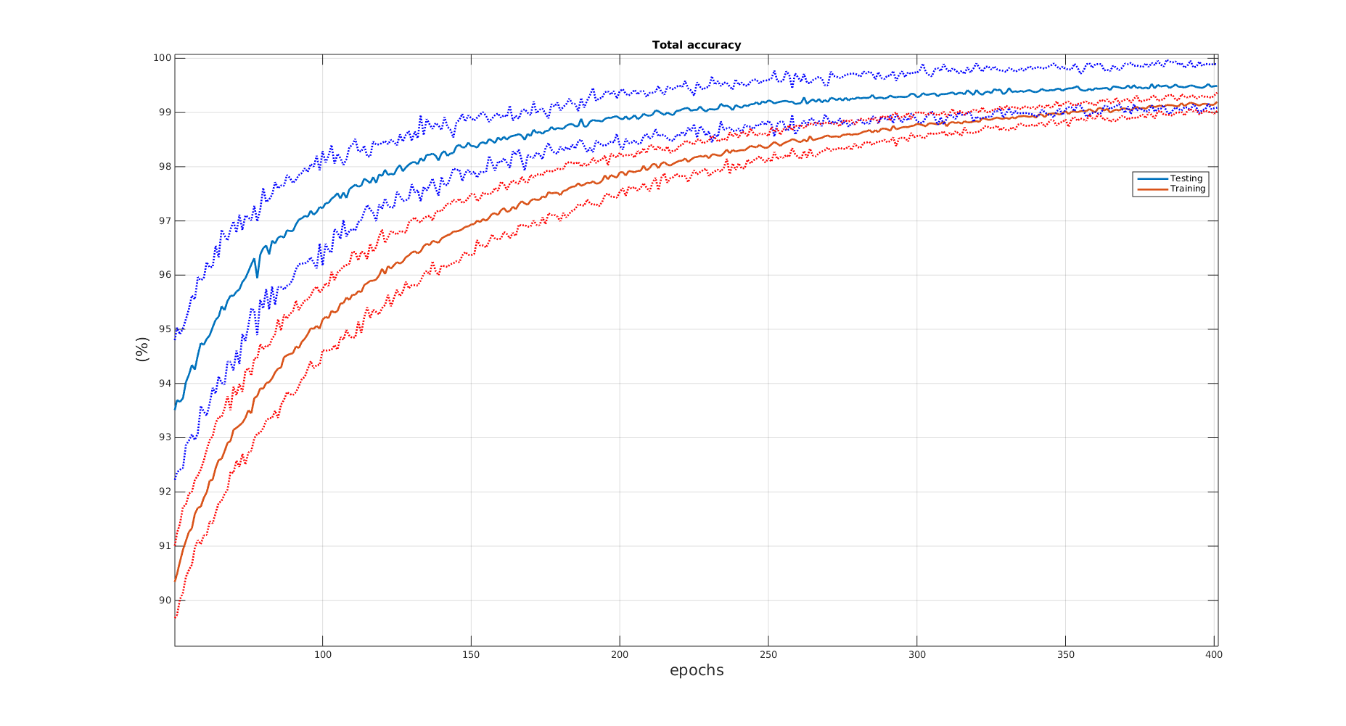
Total accuracy(with meta-learing)

Slide 10
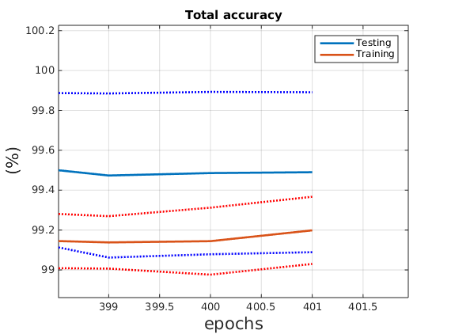
Total accuracy: prediction
Estimate: 99.4%(biased)
std: .18%

Slide 11
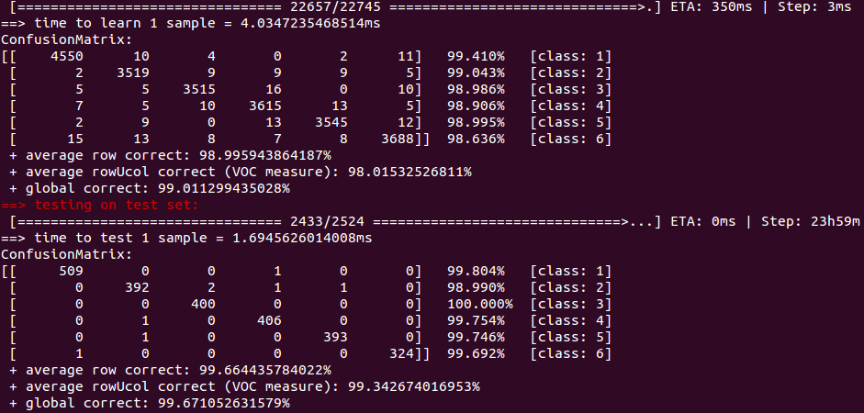
Confusion matrix

Slide 12
Deconvolutional Neural Network
torch lib

