Slide 1

ADDRESSING
SCHEME
PRESENTED BY: Ronan Olivo Gallardo
Gil Diamante Nilo Jr.

Slide 2

Introduction to Addressing Scheme
An addressing scheme is a framework that assigns unique identifiers to devices in a network, ensuring efficient communication. It's like a postal code system for digital messages, guiding data to its destination.
Through IP, MAC, or physical addresses, these schemes organize devices and facilitate seamless connectivity globally. Understanding addressing schemes is key to mastering network communication.

Slide 3

Two Types of Addressing
Scheme…
IP Address
DNS (Domain Name System)

Slide 4
IP Address
An IP (Internet Protocol) address is a numerical label assigned to each device connected to a computer network that uses the Internet Protocol for communication. It serves two principal functions: host or network interface identification and location addressing. Essentially, it's like a unique identifier for devices on a network, allowing them to communicate with each other and facilitating data transfer across the internet.
Two Types Of IP Address:
IPv4
IPv6

Slide 5
IPv4 Address Structure
An IPv4 address is a 32-bit numerical identifier that consists of four octets, each ranging from 0 to 255, separated by periods. This structure allows for approximately 4.3 billion unique IP addresses, which was sufficient for the early stages of the internet.
Each octet represents a decimal value from 0 to 255.
The four octets are separated by periods (e.g., 192.168.1.100).
The 32-bit address space provides a finite number of unique IPv4 addresses.

Slide 6
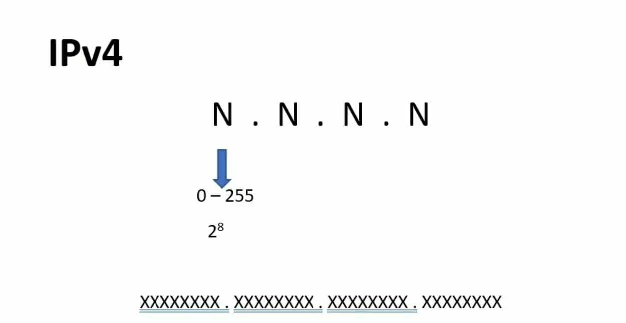
IPv4
32-bit
Consist of 4 Octet

Slide 7
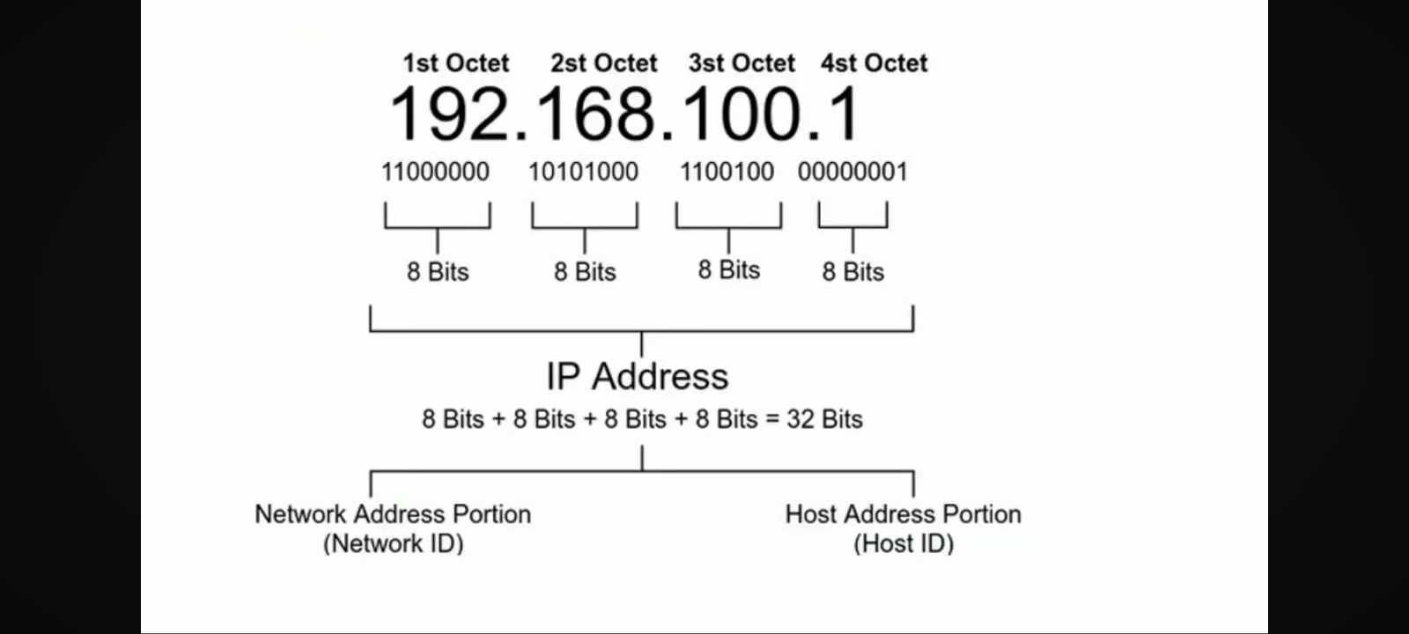
IPv4…

Slide 8
IPv4 Address Classes
Class A
Class B
Starts with 0 followed by 7 bits of network ID and 24 bits of host ID.
Starts with 10 followed by 14 bits of network ID and 16 bits of host ID.
Reserved for large networks with a small number of hosts, using the first octet to identify the network and the remaining three octets for host addresses.
Designed for medium-sized networks, utilizing the first two octets for network identification and the remaining two octets for host addresses.
Class C
Class D and Class E
Starts with 110 followed by 21 bits of network ID and 8 bits of host ID.
Starts with 1110 followed by 28 bits and starts with 1111 followed by 28 bits
Suitable for smaller networks, with the first three octets identifying the network and the last octet used for host addresses.
Class D is reserved for multicast addresses, while Class E is for experimental and future use, not intended for general deployment.

Slide 9
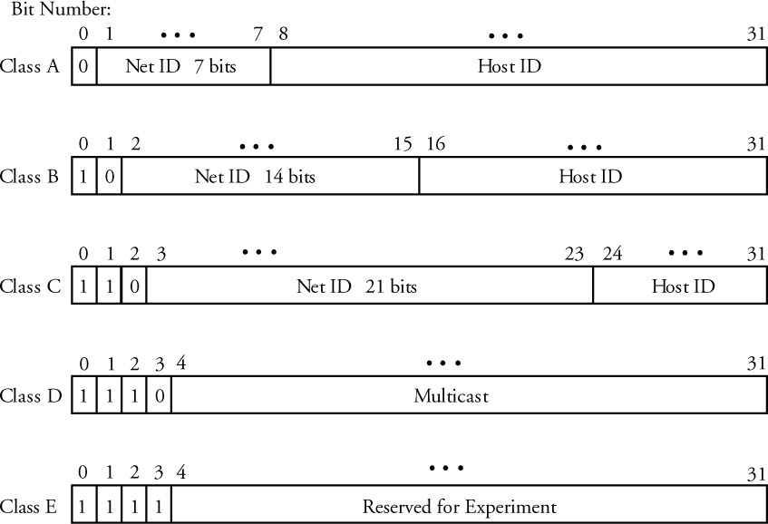
Lengths of corresponding fields for each class:

Slide 10
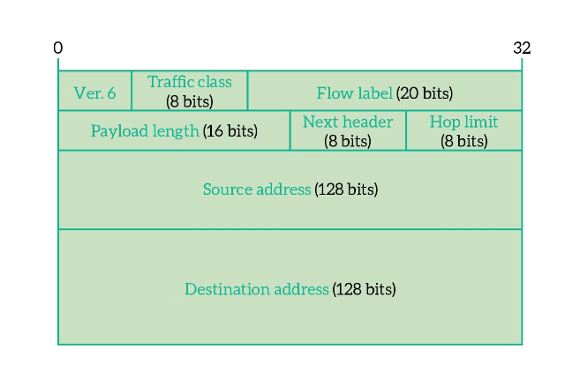
IPv6 Address Structure
IPv6 addresses are 128-bit numeric identifiers that provide a vastly expanded address space compared to IPv4. The IPv6 address is typically represented as eight groups of four hexadecimal digits, separated by colons.
This structure allows for over 340 undecillion (3.4 x 10^38) unique IP addresses, addressing the IPv4 address depletion issue and enabling future growth of the internet.

Slide 11
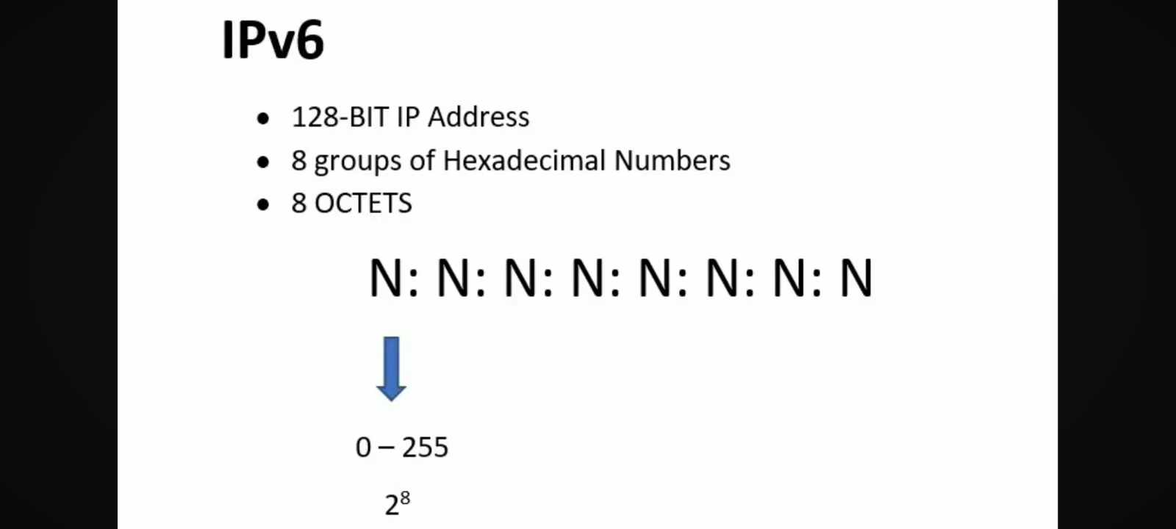
IPv6…
XXXXXXXX : XXXXXXXX : XXXXXXXX : XXXXXXXX : XXXXXXXX : XXXXXXXX : XXXXXXXX : XXXXXXXX

Slide 12
3 Types of IPv6 Address…
Unicast Addresses
Multicast Addresses
Anycast Addresses

Slide 13
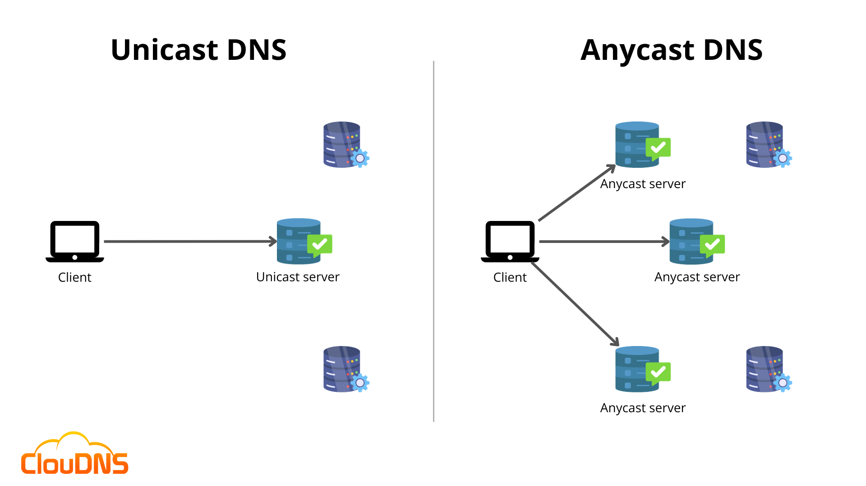
IPv6 Address
Types :
Unicast Address
Unicast addresses
identify a single network interface, allowing for direct one-to-one communication between a source and destination device.
Source
Destination

Slide 14
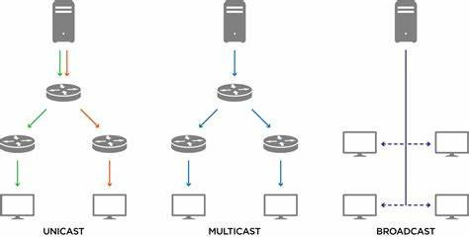
IPv6 Address Types:
2. Multicast Addresses..
multicast address is a type
of IP address used
for one-to-many
communication, where a
single
sender can efficiently send
data packets to multiple
recipients. Unlike unicast
addresses which are used
for one-to-one
communication, multicast
addresses
enable the delivery of data
to a group of devices
that have expressed interest
in receiving it.
Anycast Addresses

Slide 15
IPv6 Address
Types :
Address
3. Anycast addresses
Anycast addresses identify a group of network interfaces, but data is delivered to the nearest or most optimal interface within the group.
Destination
Source
Destination
Destination

Slide 16
What is
Subnet
Masking??

Slide 17

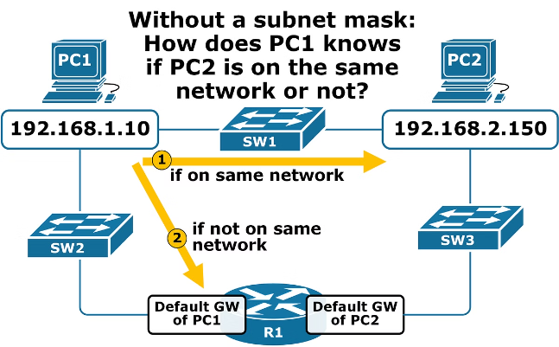
Subnet Masking
Subnet masking is a technique used to divide a larger IP network into smaller, more manageable subnetworks. By applying a subnet mask, network administrators can control the number of available hosts and enhance routing efficiency within the network.
The subnet mask consists of a 32-bit binary number that is applied to the IP address to determine the network and host portions. This allows for the creation of custom network sizes, tailored to the specific needs of an organization or environment.

Slide 18
What is DNS
(Domain Name System)?

Slide 19
DNS (Domain Name System)
The Domain Name System (DNS) is like the internet's phonebook.
It translates domain names (like www.example.com) into
IP addresses that computers use to identify each other on the
network.
This translation is crucial because humans find it easier
to remember domain names, while computers rely on
IP addresses to locate each other and communicate.
DNS plays a vital role in enabling users to access websites and
services using human-readable names rather than complex
numerical addresses.

Slide 20
THANK YOU !

