Slide 1
Subnetting an IPv4 in Networking

Slide 2
IP ADDRESS
An IPv4 address is a 32-bit address that uniquely and universally defines the connection of a device (for example, a computer or a router) to the internet.
An IPv4 address is 32 bits long.
Two devices on the internet can never have the same address at the same time.
The address space of IPv4 is 2(32) or 4,294,967,295 (more than 4 billion).

Slide 3
NOTATIONS
There are two prevalent notations to show an IPv4 address: binary notation and dotted decimal notation
- Binary Notation: 01110101 10010101 00011101 00000010
Dotted-Decimal Notation: 117.149.29.2
Notation of IPv4 address: A, B,C,D (Only 4 octets)
- 0 < A, B, C, D < 255
- 0.0.0.0 to 255.255.255.255

Slide 4
VALID IP ADDRESS
INVALID IP ADDRESS
56.89.1.2.5
10.065.34.56
200.28.256.6
256.01.28.10
10.10.56.80
240.230.330.440
1.2.3.4
99.88.67.89

Slide 5
ACTIVITY TIME!!
Identify if the given IP Addresses is Invalid or Invalid.
1.111.56.045.78
2. 221.34.7.8.20
3. 75.45. 301.14
4.11100010.23.14.67
5. 148.65.41.64

Slide 6
SUBNETTING AN IPv4 IN NETWORKING

Slide 7
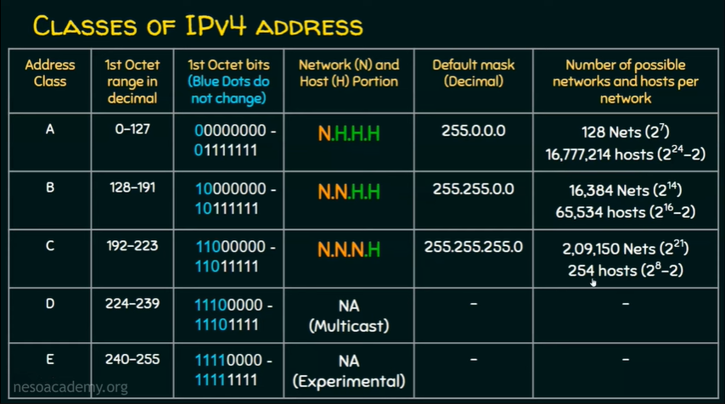

Slide 8
SUBNETTING:
A subnetwork or subnet is a logical subdivision of an IP network.
The practice of dividing a network into two or more networks is called subnetting.
Computers that belong to a subnet are addressed with an identical most-significant bit-group in their IP addresses.

Slide 9
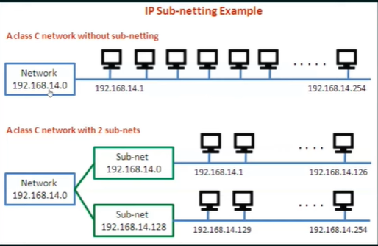

Slide 10
SUBNETTING- 5 STEPS
Identify the class of the IP address and note the Default Subnet Mask.
Convert the Default Subnet Mask into Binary.
Note the number of hosts required per subnet and find the Subnet Generator (SG) and octet position.
Generate the new subnet mask.
Use the SG and generate the network ranges (subnets) in the appropriate octet position.

