Slide 1
Operators
Presented by:
Nubtahil
Aiman Zahid

Slide 2
Js operators
What is operator?
A operator is a symbol which is use to perform some mathematical task on operand.
What is operand?
An operand is the value on which operator perform it’s function.

Slide 3
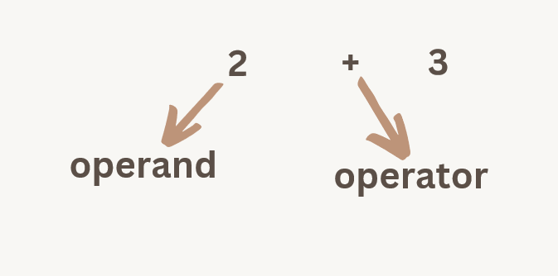
Example:

Slide 4
Arithmetic operator
To perform mathematical operations we use Arithmetic operators like given below.
Addition operator (+):
To add two numbers, we use addition operator
We can also add strings
Subtraction operator (-):
To Subtract two values we use subtraction operator
Multipication(*):
We use an asterisk instead of a cross sign.
It is use for multiplying values

Slide 5
Division(/):
to divide values
Modulus(%):
To get the remainder of division.
Increment(++)
To increase the value by one OR we can use any number instead of one
Decrement(--):
to decrease the value by one OR we can use any value instead of one
Exponentiation(**):
Operation that is raises a number to power

Slide 6

Assignmnet Operator(=):
Assignment operators assign values to JavaScript variables.
In these operators we are assigning and performing action in just one step.
x = 12
Addition Assignment Operator
The Addition Assignment Operator adds a value to a variable.
what is happening below?
we have value of ‘K’ which is 10.
Now we add value of ‘K’ and integer 5. (k + 5;)
In end, we are assigning(updating) the added value in variable ‘k’. (k = 15)
let k = 10;
k += 5;

Slide 7
Subtraction Assignment Operator
The Subtraction Assignment Operator subtracts a value from a variable.
Exponentiation Assignment Operator
The Exponentiation Assignment Operator raises a variable to the power of the operand.
Remainder Assignment Operator
The Remainder Assignment Operator assigns a remainder to a variable.
Division Assignment Operator
The Division Assignment Operator divides a variable.

Slide 8
Comparison operator:
Used to compare two values.
Always return true or false.
Examples: Checking if numbers are equal, greater, or smaller.
Common in if statements and conditions.

Slide 9
Types of Comparison Operators
Operator | Meaning | Example | Result
== | Equal to | 5 == 5 | true
=== | Equal to & type | 5 === ‘5’ | false
!= | Not equal to | 5 != 3 | true
!== | Not equal or not same type | 5 !== ‘5’ | true

Slide 10
More Comparison Operators
Operator | Meaning | Example | Result
> | Greater than | 10 > 5 | true
< | Less than | 2 < 5 | true
>= | Greater or equal | 5 >= 5 | true
<= | Less or equal | 4 <= 5 | true

Slide 11
Logical Operators
Used to combine multiple conditions.
Also return true or false.
Commonly used in decision-making.
Examples: &&, ||, !

Slide 12
Types of Logical Operators
Operator | Name | Meaning | Example | Result
&& | AND | True if both are true | (5 > 3 && 8 < 6) | false
|| | OR | True if ONE are true | (5 > 3 || 8 < 6) | true
! | NOT | Reverses the result | !(5 > 3) | false

Slide 13


