Slide 1
Disaster Tweets Classification
By
Jonathan James
Lakshmi Narasimha Koushik Devalapalli

Slide 2
Project Idea & Competition Rationale
Task: classify tweets as disaster-related (1) vs. non-disaster (0).
We chose the Disaster Tweets competition because it provides real, noisy, short posts with ground-truth labels, letting us benchmark classic ML vs. transformers on a realistic moderation/triage task
Notes:
“Social platforms must quickly spot crisis-related posts. The Kaggle Disaster Tweets dataset mirrors that problem with labeled, real tweets—perfect for testing models that separate real emergencies from everyday chatter.”

Slide 3
Data Exploration (highlights)
Columns: id, keyword, location, text, target.
Class balance ≈ 47%/53% (may vary slightly after cleaning).
Noisy short text: hashtags, URLs, mentions, emojis.
Checked duplicates/outliers; top keywords/locations; tweet-length patterns.

Slide 4
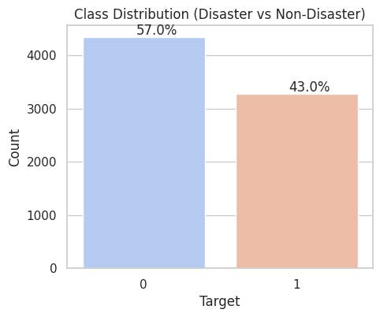
EDA — Class Distribution

Slide 5
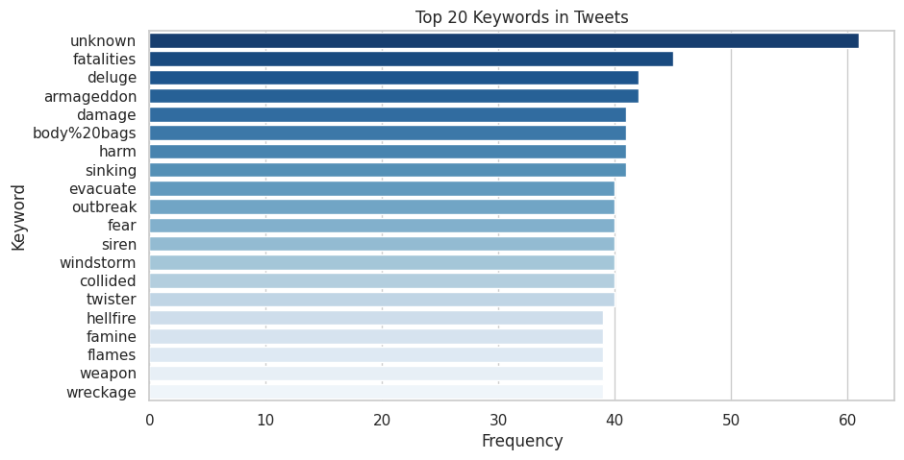
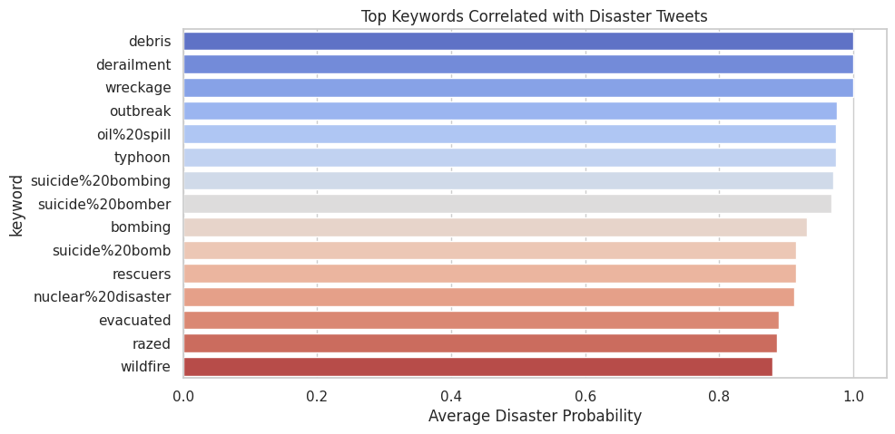
EDA — Top Keywords

Slide 6
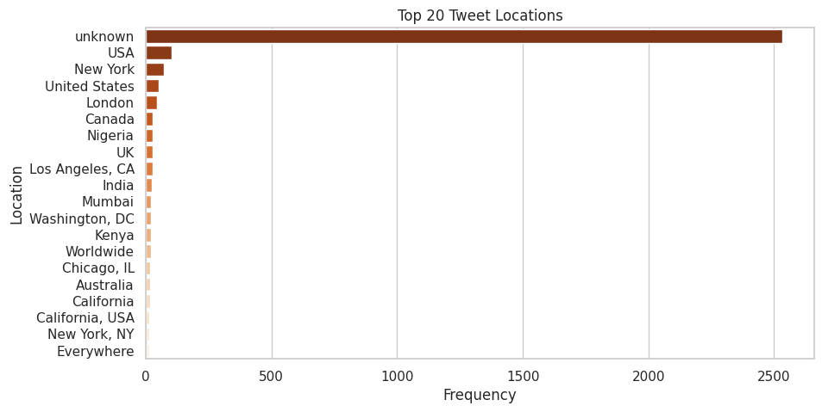
EDA — Top Locations

Slide 7
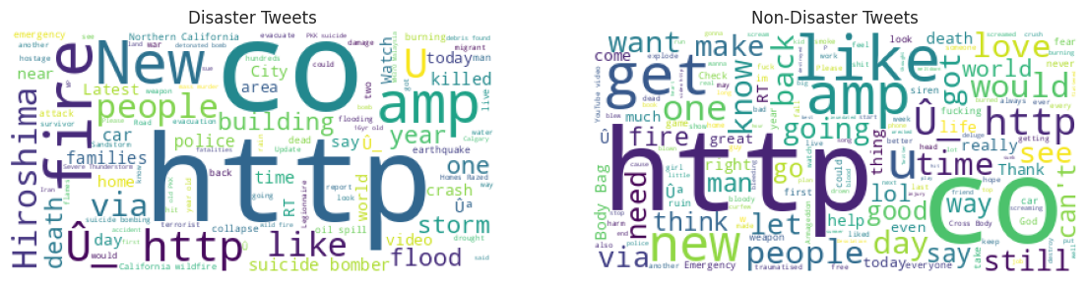
Word Clouds
Notes:
What the wordclouds show
Left = Disaster tweets, Right = Non-disaster tweets. Bigger words = appear more often.
Both sides are dominated by tokens like “http” and “amp” (HTML entity from “&”) → tweets often contain links and scraped artifacts.
Class-specific signals
Disaster side: words like fire, flood, earthquake, killed, police, evacuate, storm, bomb(er) — concrete event/impact terms.
Non-disaster side: like, get, back, good, day, lol, love — conversational/emotive language.

Slide 8
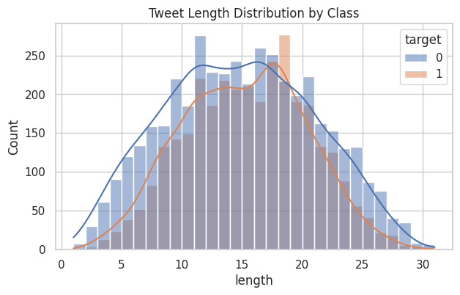
EDA — Length / Histogram

Slide 9
Models Tried
Baselines: TF‑IDF + Logistic Regression; LinearSVC (word 1–2g, char_wb 3–5g).
RNN: SimpleRNN classifier (Embedding → RNN → Dense).
RNN+: BiLSTM + mean–max pooling (stable baseline).
Transformers: DistilBERT fine‑tuned; BERTweet fine‑tuned.

Slide 10

Transformers
What they are
A neural architecture that replaces recurrence with self-attention.
Looks at all tokens at once and learns which words should pay attention to which other words.
Core ideas
Token → Embedding: turn words/sub-words/emojis/hashtags into vectors.
Positional encoding: add order info (since there’s no recurrence).
Self-attention: each token forms a weighted average of all tokens; weights = “how relevant is token j to token i?”
Stacks of layers: repeat attention + small feed-forward nets → rich contextual representations.
Why they beat RNN/LSTM on text
Parallel over tokens ⇒ faster training.
Can model long-range dependencies (e.g., “not … good”).
Scale well (BERT, GPT, T5…).
How we use them here
Start from a pretrained model (learned from huge text).
Fine-tune a small classifier head on Kaggle tweets (disaster vs not).
DistilBERT: general English.
BERTweet: pretrained on Twitter; understands hashtags, emojis, slang.
Notes:
Unlike LSTMs that read left-to-right, Transformers look at the whole sentence at once. Each token computes attention scores to every other token and pulls in the most relevant info. We add positions so order isn’t lost. Stacking these layers creates context-aware embeddings. We fine-tune pretrained models like DistilBERT or BERTweet on our tweet labels; BERTweet is especially good here because it was pretrained on Twitter, so it ‘gets’ hashtags/emojis.

Slide 11
Preprocessing Strategies
Classical (TF‑IDF/LinearSVC/LogReg): lowercase, strip punctuation; replace URLs/@; drop #.
Neural baselines (RNN/BiLSTM): Keras Tokenizer + padding (e.g., max_len=50).
DistilBERT: minimal normalization; tokenizer handles casing/subwords.
BERTweet: light clean (keep emojis/hashtags) + optional KEYWORD/LOCATION prompt.

Slide 12
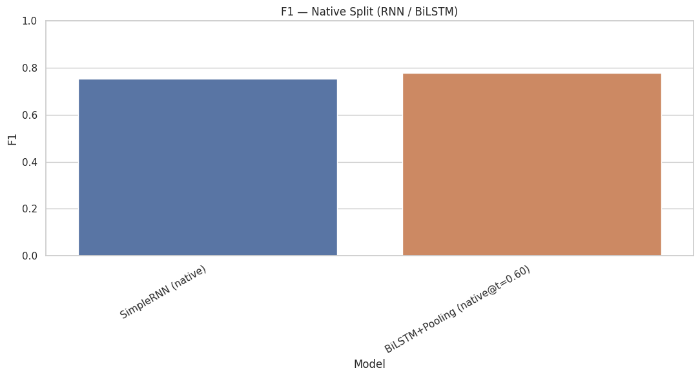
Model Comparison — F1 (Native Split)

Slide 13
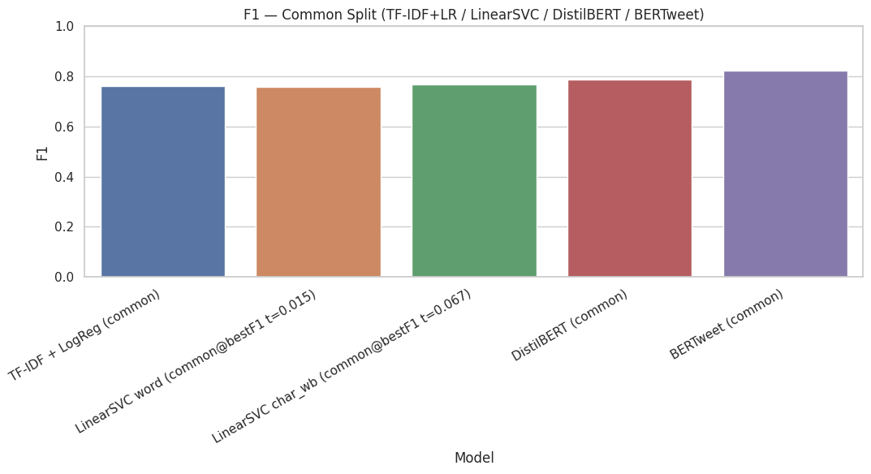
Model Comparison — F1 (Common Split)

Slide 14
Best Model & Why
Best model: BERTweet on the common split (F1 ≈ 0.82). It wins because it’s pretrained on Twitter data → better handling of hashtags, slang, emojis, and short context.
Transformers (DistilBERT/BERTweet) typically top F1 on short/noisy tweets.
Char-gram LinearSVC competitive on slang/misspellings/hashtags.
BiLSTM+Pooling > SimpleRNN, but below modern Transformers.

Slide 15
Task-Specific Efforts
Decision threshold tuning for best F1.
Included metadata (keyword/location) in BERTweet prompt.
Evaluated multiple cleaning variants per model family.
Tracked ROC‑AUC and PR‑AUC for robustness.
Notes:
Tuned the decision threshold on the validation set to maximize F1 (not fixed at 0.50).
Let the model see context by injecting metadata (keyword/location) into BERTweet inputs.
Matched cleaning to model family: light/emoji-preserving for transformers; punctuation/URL normalization for TF-IDF/SVC.
Reported ROC-AUC and PR-AUC in addition to accuracy/F1 to reflect class-imbalance robustness.
Ran ablation checks (with/without metadata, different cleaners) to confirm what actually helped.
Saved and compared models on a common split for fair head-to-head, and on native splits for internal baselines

Slide 16
Error Analysis
Metaphors/sarcasm (“my phone is on fire”) → false positives.
Sparse context (“evacuating now”) → some false negatives.
Potential fixes: keyword lexicons, augmentation, char‑SVC ensemble.

Slide 17
Social Impact
Faster situational awareness: flag disaster-related tweets in near-real time → earlier alerts for emergency ops centers.
Better triage & resource allocation: prioritize locations/keywords tied to true incidents, reducing response time and cost.
Public information quality: helps surface credible reports and reduce attention on benign chatter (“my phone is on fire”).
Operational efficiency: lightweight classic models can run on edge/low-cost servers; BERTweet can be used for high-accuracy back-end verification.

Slide 18
Conclusion
Our BERTweet model achieves strong F1 and beats simple baselines.
Strong runner-ups: DistilBERT (F1 ≈ 0.79) > LinearSVC (char n-grams) ≈ TF-IDF+LogReg > SimpleRNN. Character n-grams help with noisy spelling; classic TF-IDF remains a solid, fast baseline.
Data decisions that helped: keep rows, fill keyword/location with placeholders, and skip missing meta in BERTweet prompts.
Preserved sample size and avoided injecting “unknown” noise.

