Slide 1

Building Dynamic Web Apps With the Power of HTML
Alex White
April 18, 2024

Slide 2
welcome.html
Notes:
I started building web applications in my early teenage years.
Back then, it was HTML, CSS, PHP and a ton of tables.

Slide 3
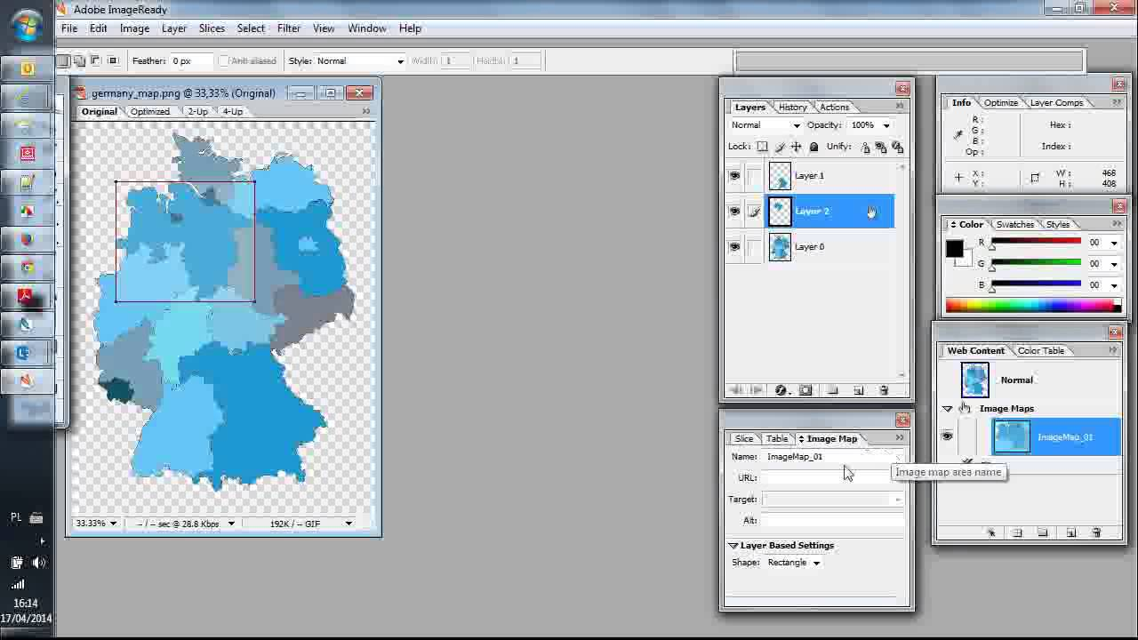
Notes:
Oh and image maps...horrible image maps.

Slide 4
The Tech Stack Grew
jQuery
Knockout
Bower
Bootstrap
HTML5 🎉
Notes:
As I kept building websites in College, the tech stack grew substantially. But even then, it all followed the same pattern.
Monolith backend that serves static HTML files, enhanced by JavaScript where needed.

Slide 5
HTML5
Semantic and accessibility first
Canvas tag
Separation of concerns (JS, CSS, HTML)
Notes:
With the recommendation by the W3C for HTML5 in October of 2014, it became even easier to build websites without hacky methods.
Unfortunately though, an evil presence had risen a year before...

Slide 6

Notes:
On May 29, 2013, ReactJS was unleashed on the world.
As a result, the web eventually began to put on some weight...

Slide 7
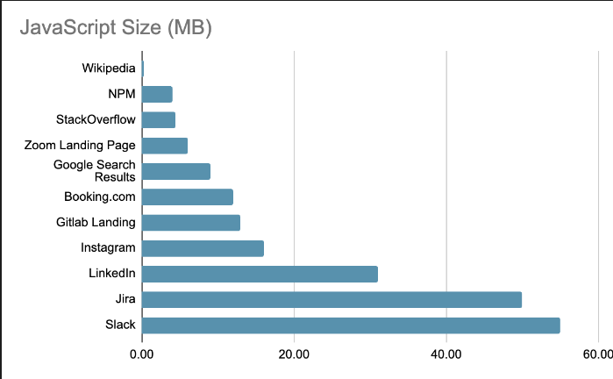

Notes:
Here we can see the size of JavaScript downloaded for a few major websites.
This graph shows ONLY the JavaScript sizes, not CSS/Images/Videos.

Slide 8

Why Did SPAs Become Popular?
Responsive
Testable
Modular
Powerful
Notes:
Of course there are many valid reasons why React and the SPA pattern took over the world.
- Responsive
Whereas navigation in HTML requires a full page reload, SPAs provide a better, smoother transition. They also allow async loading parts of a page
- Testable and modular
SPAs can be broken down on the component level & each component independently tested
- Powerful
SPAs fill in a lot of the gaps of HTML. HTML doesn’t allow:
- Only forms/links can make requests
- Only submit and click events trigger request
- Only POST and GET are supported

Slide 9
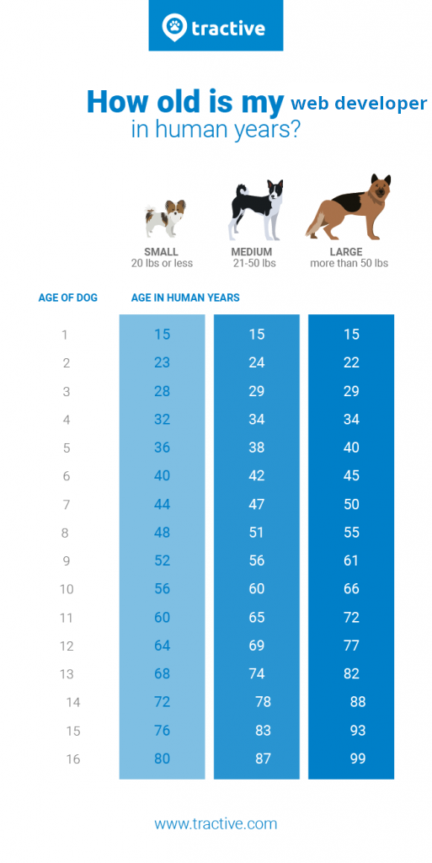
Notes:
Now I realize things change, and best practices adapt to technology.
In fact, if you convert my years as a web developer to human years, you’d find I’m downright ancient.
Actually….let’s do that.

Slide 10
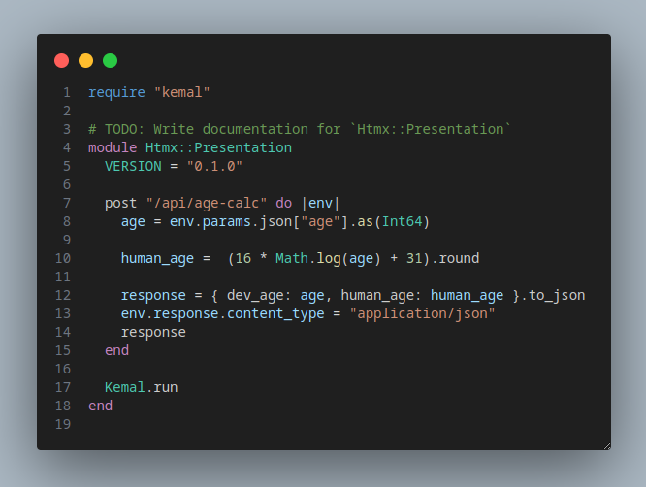
Let’s assume we have the following backend:

Slide 11
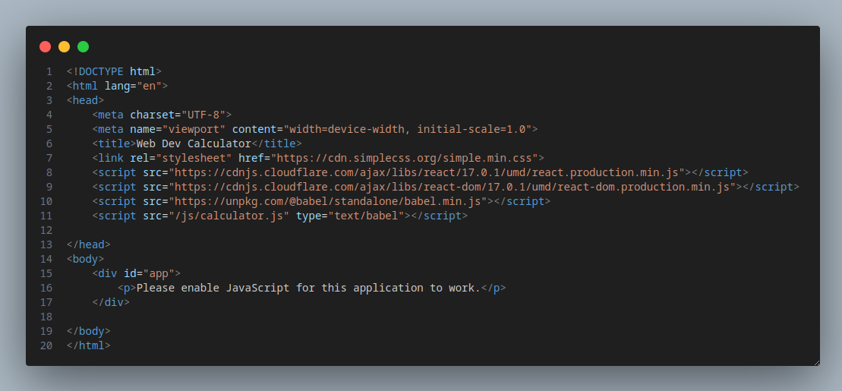
Now let’s do some frontend! First, our HTML.
Notes:
For our purposes, we’ll rely on the react CDN. And React DOM. Oh and Babel CDN to handle our JSX. Then our main script JS.
And of course a fallback if you don’t have JS! Who wouldn’t want JS to see their human age!?!

Slide 12
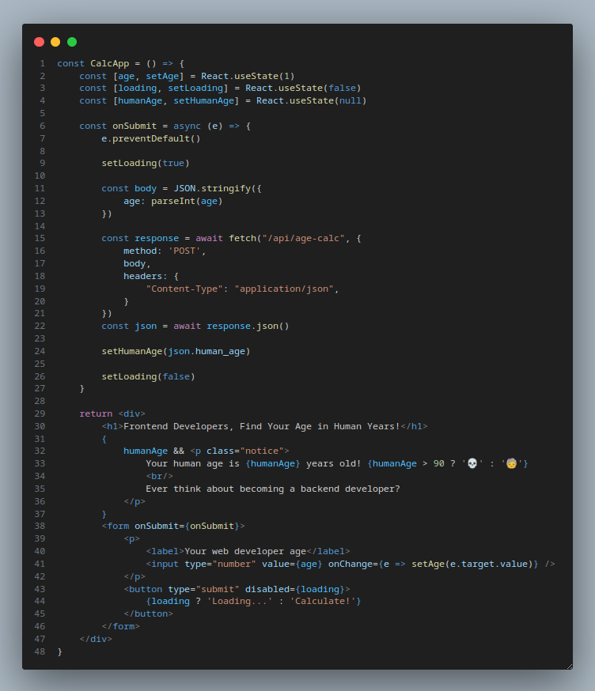
A little React...
Notes:
We’ll show a simple form with a input and submit button.
On submit, we’ll show a loading state, disabling the button and displaying “loading”. We’ll make an AJAX request to our endpoint.
After the server responds, we’ll convert to JSON and extract the value we need. Then we’ll show it to the user and remove the loading state!
Don’t take note that we’ve written more code to do this than our backend…

Slide 13
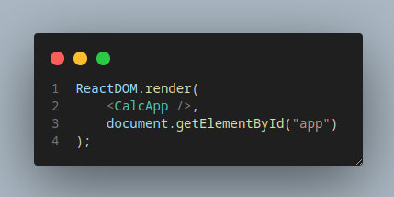
Bootstrap the React application.
Notes:
We’ll show a simple form with a input and submit button.
On submit, we’ll show a loading state, disabling the button and displaying “loading”. We’ll make an AJAX request to our endpoint.
After the server responds, we’ll convert to JSON and extract the value we need. Then we’ll show it to the user and remove the loading state!

Slide 14
Viola!
Notes:
Easy peezy, now we have a modern, responsive React app for figuring out my real age!!
But it’s still not perfect...I think if someone has used React we should add 10 more years to the calculation. Let’s make that change.

Slide 15
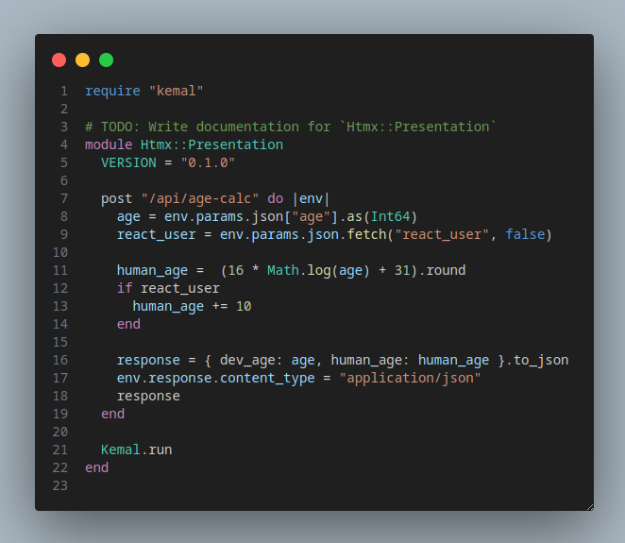
Updated backend code
Notes:
First we’ll update our backend to accept a ‘react_user’ parameter. This will add 10 years to the developers human age.

Slide 16
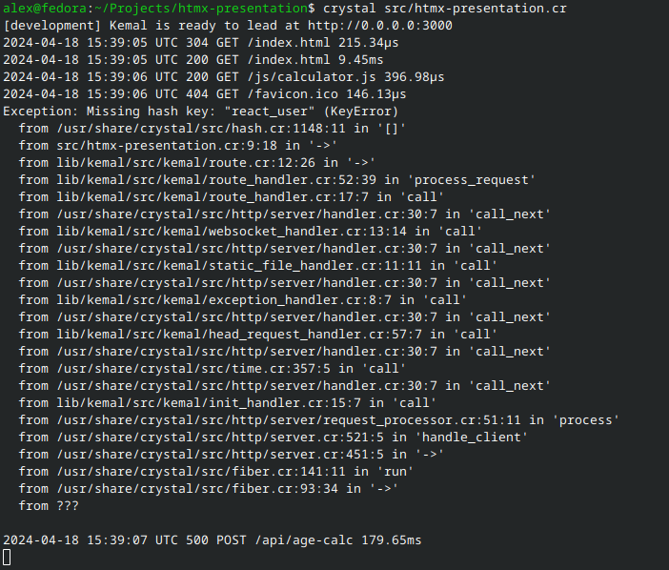
Houston, we have a problem.
Notes:
Our frontend is broken now as it doesn’t know about this new, required parameter. Whoops!
Let’s update the frontend to account for this.

Slide 17
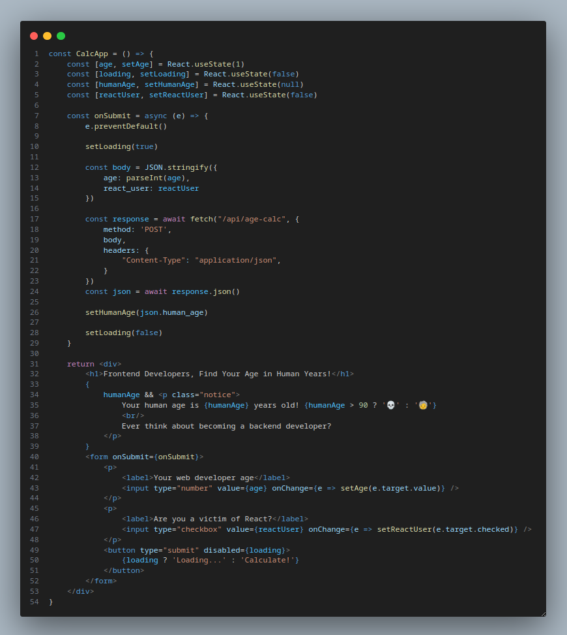
A few tweaks...
Notes:
We’ll add a react_user flag and link it up with a checkbox. Then we’ll add this to our payload to the server.

Slide 18
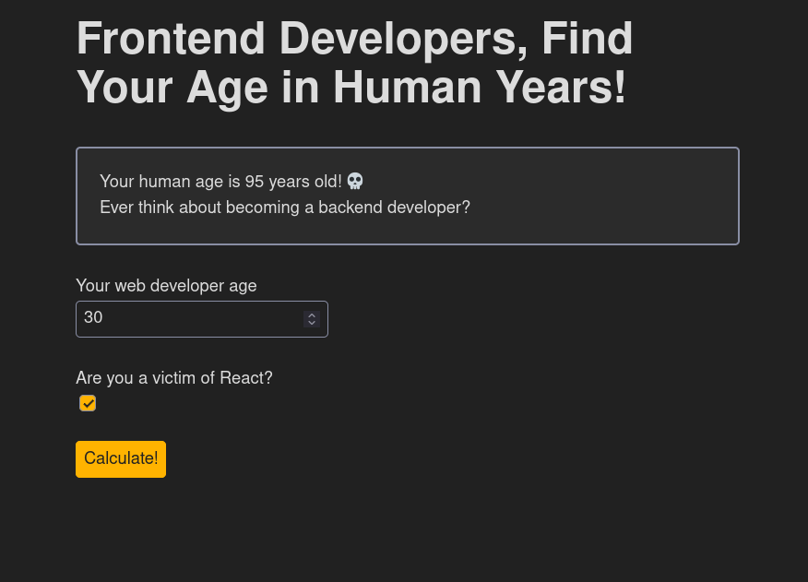
Viola (part 2)!
Notes:
Easy peezy, now we have a modern, responsive React app for figuring out my real age!!
But it’s still not perfect...I think if someone has used React we should add 10 more years to the calculation. Let’s make that change.

Slide 19
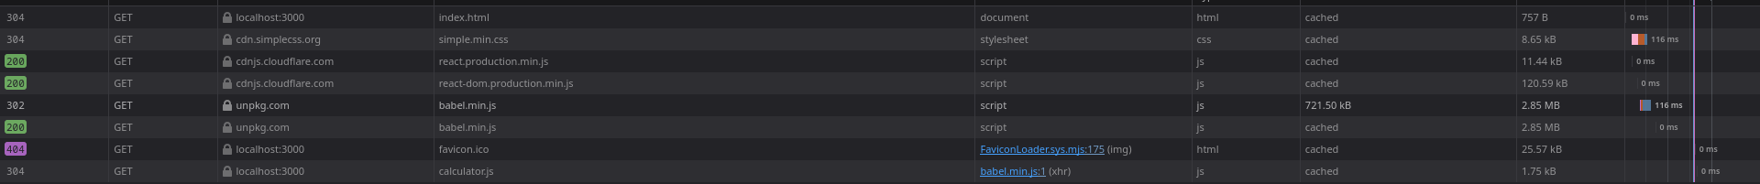
Only 2.98MB!
🥹
Notes:
This includes minimized versions of React and React DOM. The bigger hitter is Babel, and typically this would be handled with a Webpack compilation process. But still...

Slide 20
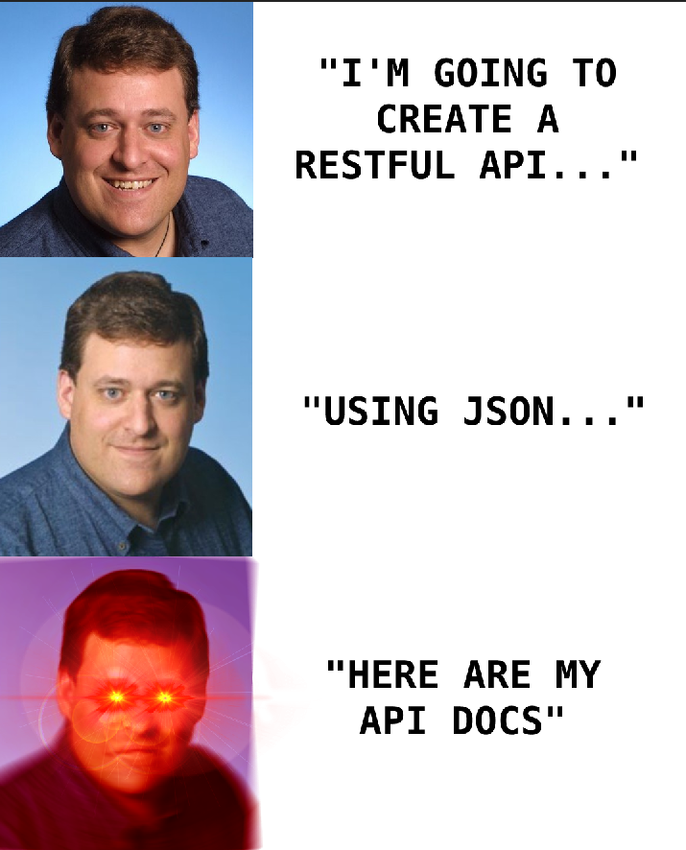
Can we do better?
Notes:
So what issues did we see with that example?
- Large JavaScript download size
- Large amount of boilerplate code for such a simple task
- Client needs to know the details of the application and maintain an API contract
What if I told you we could accomplish the same user experience with HTML?
But first, let’s dive into a refresher on HTML

Slide 21
HyperText
Notes:
Hypertext describes text documents with references to other documents.
These references are referred to HyperLinks (aka a tags)
HTML is used in HyperMedia systems, systems in which hyperlinks reference HyperText, as well as photos, videos and more.

Slide 22
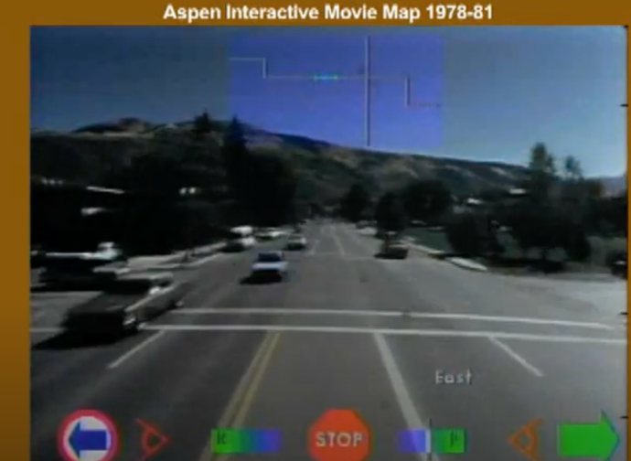
Aspen Movie Map
Notes:
The Aspen Movie Map is regarded one of the first HyperMedia systems.
It was an interactive tour of a town. HyperLinks connected images together, allowing you to virtually drive around (an early Google Street View).

Slide 23

HyperText Markup Language
Notes:
HTML is a language for HyperText.
The first draft of HTML was proposed by Tim Berners-Lee (pictured) and Don Connolly in 1993 as a CERN project for sharing documents.

Slide 24
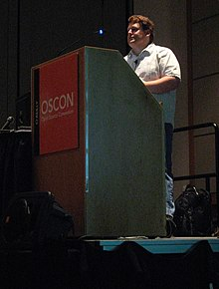
REST & HATEOAS
Notes:
In 2000, computer scientist Roy Fielding described the RESTful architecture pattern and the term HATEOAS.
HATEOAS, or HyperMedia as The Engine of Application State describes a pattern in which the server maintains the application state and serves HyperMedia to the client.
In this pattern, the client need not know anything about the application beyond the entry point.
Each HyperMedia response contains HyperLinks that enable further discovery of the application.
This effectively decouples server and client.

Slide 25

Most web applications today are not RESTful
Notes:
Today, the term is typically used to describe the structure of APIs as CRUD.
Servers do not respond with a HyperMedia representation of the resource, instead they respond with JSON.
Server responses to no enable discovery, instead the client must know the URL and payload type for each resource.
State management is shifted to the client, with the client parsing, displaying and modifying resources.

Slide 26
HTMX
Notes:
So how can we return to the HATEOAS and truly RESTful architecture, while also maintaining the modern features of SPA based web applications?
That’s where HTMX, or HyperText Markup Extensions come in.

Slide 27
HTMX
14Kb of JavaScript
Any event can trigger a server request
Any element can trigger a server request
Server responses can partially update a document
HTML can trigger PUT, PATCH, DELETE, POST & GET
Notes:
HTMX extends HTML with modern features, through the introduction of a micro sized JavaScript library.
- The only valid HyperMedia Controls in HTML are buttons and forms, and only clicks and submits trigger events.
- In HTMX, any DOM element can respond to any event to trigger a request.
- HTML is limited to POST and GET, HTMX extends this to the PUT, PATCH and DELETE verbs
- Most importantly, HTMX allows partial updates, instead of requiring the entire document to be replaced upon server response.

Slide 28
HTMX
WebSockets
CSS Transitions
Server Sent Events
Notes:
But wait, there’s more!
HTMX also introduces support for:
- CSS Transitions
- WebSockets
- Server Sent Events

Slide 29
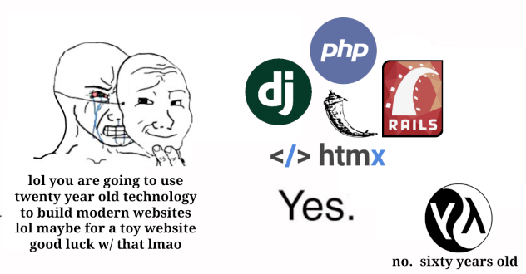
Notes:
With these enhancements to HTML, let’s revisit our calculator app.

Slide 30
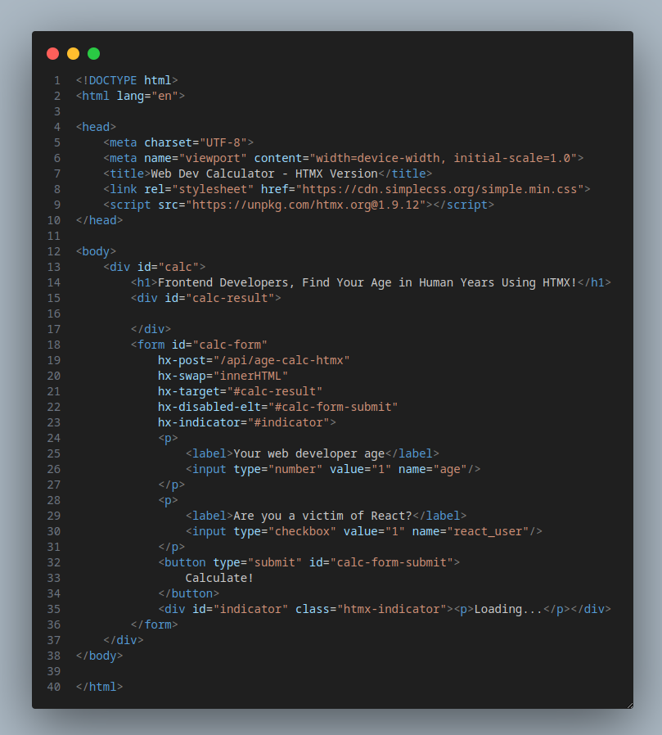
Let’s start with our HTML
Notes:
Mostly the same as our React code, but you know...without React.
We include HTMX as the only JavaScript dependency.
On the form we introduce some HTMX attributes:
- hx-post
- hx-swap
- hx-target
- hx-disabled-elt
- hx-indicator
Beyond these, it’s all standard HTML.

Slide 31
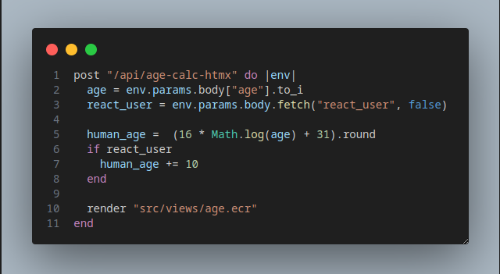
Now for the backend.
Notes:
Backend is easy, and actually simpler than the React example.
We extract the form values posted to the endpoint.
Perform our calculation.
And return a…..HTML VIEW???
Remember, in the HATEOAS architecture, the server maintains the application state and communicates via hypermedia that contains hyperlinks to discover the application.
The HTML on the previous slide was the entry point. The submit button is the HyperMedia control that uncovers the next state, returned by the server as HyperMedia.

Slide 32
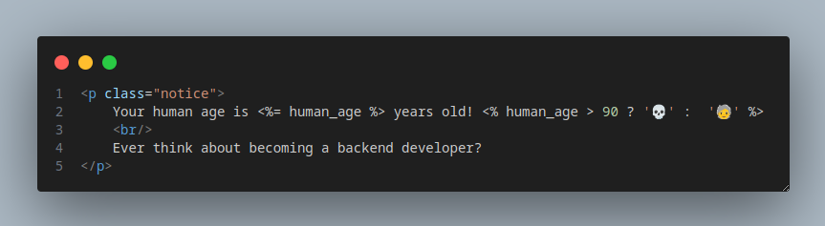
The view returned by the server.
Notes:
This simple view represents the response from our calculation endpoint.
Instead of JSON that the client needs to understand and parse, the client now needs only render the view.

Slide 33
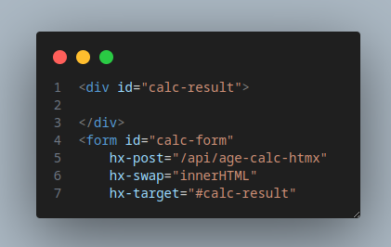
Notes:
Thanks to HTMX, this view will be swapped into the application.
HTMX has extended HTML to the point that we can support the HATEOAS architecture, while still maintaining a modern user experience with AJAX.

Slide 34
Notes:
As you can see, the application functions exactly the same. But we didn’t write a single line of JavaScript, and our total JavaScript download size is 14Kb!
Now let’s say we also want to show the user how many years old they would be if they choose to use HTMX instead of React.

Slide 35
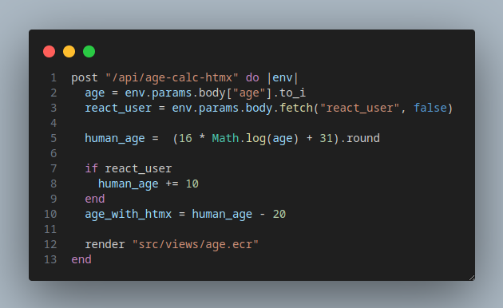
Updating the backend.
Notes:
We’ll make a change to our controller.
Using the power of science, we can determine that using HTMX reduces your human age by 20 years!! Doctors take note!
At this point, our application would still work just fine, but it wouldn’t show the new data point. Let’s update our age partial view.

Slide 36
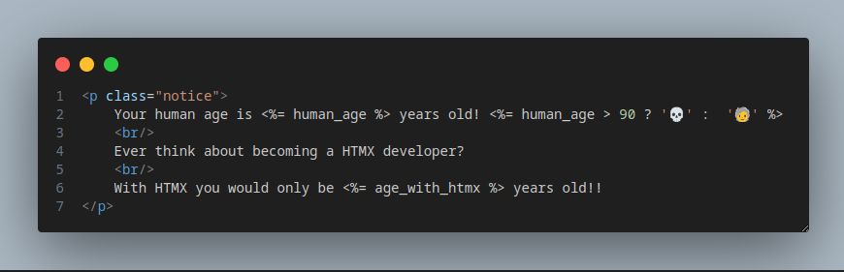
Updating our partial.
Notes:
We’ll simply change the verbage and add a new sentence with the data point.

Slide 37
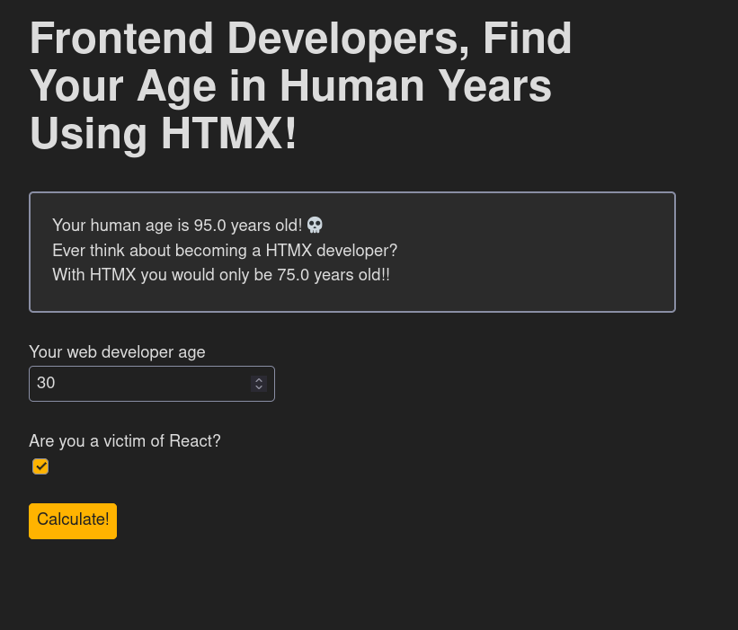
Notes:
And our change is live! We didn’t have to touch the entry point HTML file, we simply update the partial view and see the change.

Slide 38
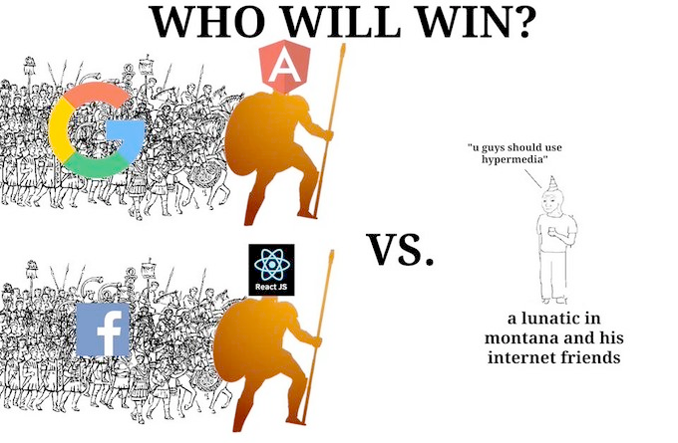
Notes:
You’ve seen what HTMX and HTML can do, so does that mean you should rip out React/Svelte/Vue and use HTMX?
No. But it does mean you should keep it in your mind as an available tool.
Modern SPA arch. Is useful in large team environments and highly interactive applications.
But most of the sites on the internet don’t need that. They are basic CRUD applications that would vastly benefit from increased load time, less reliance on JS and faster development times.

Slide 39
Beyond HTML
HyperMedia systems are not limited to HTML/HTMX
Notes:
As mentioned earlier, HTML is an implementation of a HyperText language. It’s not the only one.
Another relatively new project brings the concept of HATEOAS and HTMX to mobile.

Slide 40
Hyperview
Notes:
Hyperview is a HyperMedia system that uses Hyperview XML (HXML) to define iOS/Android screens.
A Hyperview application also follows the HATEOAS pattern, the server maintains the state of application, sending HXML to the client which is then rendered with the Hyperview React Native client.
A primary advantage of Hyperview is the ability to make changes to an application without resubmitting to the app store.

Slide 41
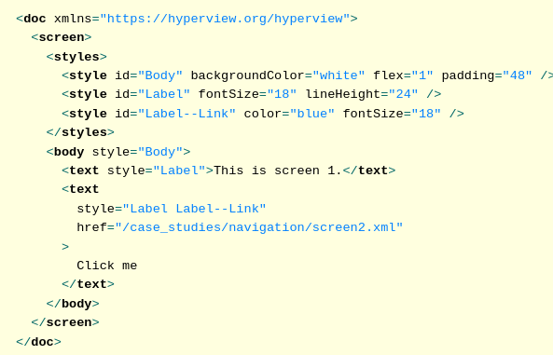
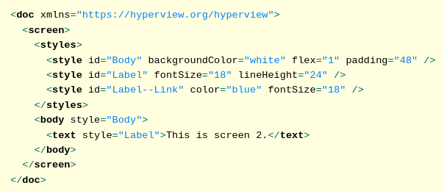
Screen 1 HXML
Screen 2 HXML

Slide 42
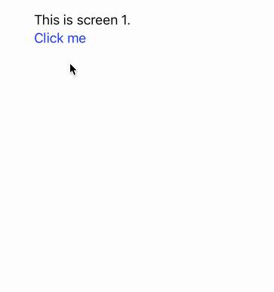

Slide 43

Resources
Hypermedia Systems Book
https://htmx.org/
https://hyperview.org/
https://hyperscript.org/

