Slide 1

Adjust the table format maybe narrower.
Edit font style and color like SANAD Service description font and color on top.
Font and desgin

Slide 2
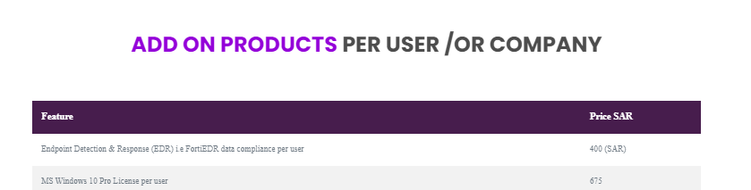
Edit title
Change title to :
Addons

Slide 3
Adjust the table format and use the same table format of “Service Contents”

Slide 4


Move the orange box- under the price of the first table.

Slide 5
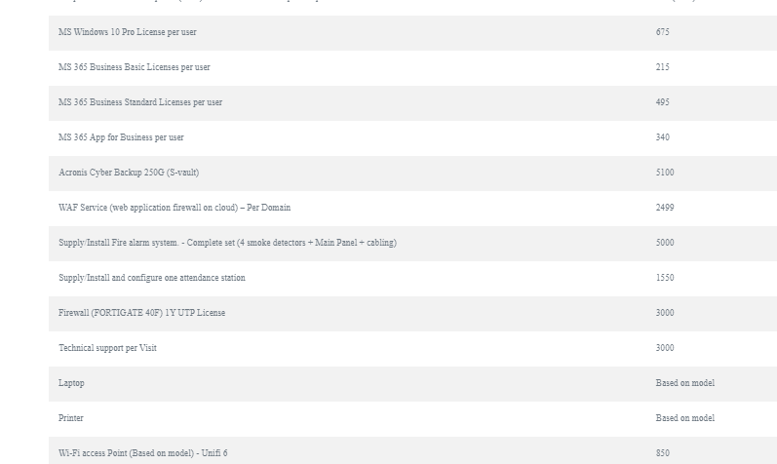
Use the same font to all page and desgin

Slide 6
Revise highlighted text
SANAD Service include and cover certain responsibilities with the following benefits:
Install remote desktop client on all users’ workstations.
Install new local network devices (Workstations, Servers, Printers, Wi-Fi AP’s). *
*Note: Duct cabling, and civil works are not included, and it will be determined and priced separately. >>>> please let this appear as a note under the above point
Install and maintain licensed anti-virus software on users’ workstations.
Update users’ workstations operating system.
Setup, Install and configure customer Router/Firewall/Access Point/Controller.
Provide Service (MRS) & (MFS) Service - (Install, configure, add/change policy, troubleshoot).
Supply FTTB Data link (Based on availability).
Unlimited remote support service via Sahara Net call center and support team.
Trouble shoot faulty local network devices and hardware (Workstations, Servers, Printers, Wi-Fi AP’s).
Professional network consultation.
12 preventive support visits yearly.
2375* SAR
*Price per user for one year
5

Slide 7
Revise highlighted text (table and title)
Addons
Service Description
Price
Add on products per user /Or Company | Price SAR
Endpoint Detection & Response (EDR) i.e FortiEDR data compliance per user | 400
MS Windows 10 Pro License per user | 675
MS 365 Business Basic Licenses per user | 215
MS 365 Business Standard Licenses per user | 495
MS 365 App for Business per user | 340
Acronis Cyber Backup 250G (S-vault) | 5100
WAF Service (web application firewall on cloud) – Per Domain | 2,499
Supply/Install Fire alarm system. - Complete set (4 smoke detectors + Main Panel + cabling) | 5,000
Supply/Install and configure one attendance station | 1,550
Firewall (FORTIGATE 40F) 1Y UTP License | 3,000
Technical support per Visit | 500 to 3000
Laptop (Based on model) | Based on model
Printer (Based on model) | Based on model
Wi-Fi access Point (Based on model) - Unifi 6 | 850
Dedicated business grade internet link with 2 IP’s - Per Mbps | 600
6

