Slide 1
CHAINSCOPE
Supply-chain answers you can trace to the source.
Governed conversational analytics for Snowflake CoCo CLI Hackathon - Problem Statement 05
Devam Kakoty | Team size: 1 | Bengaluru, India
Synthetic demonstration data | Public repository and live replay included

Slide 2
01 PROBLEM BRIEF
A late shipment is not yet an explanation.
Operations teams need the affected commitment, approved metric and evidence in one governed answer.
Pain today
Target users
Result
Supplier, inventory and customer-risk signals live in separate views.
Free-form assistants can mix definitions, invent joins or disclose commercial values.
Supply planners
Procurement teams
Plant operations
Commercial analysts
Governance and audit teams
Trace an inbound problem to specific open demand.
Return deterministic metrics, approved SQL and exact source records - or refuse the question.

Slide 3
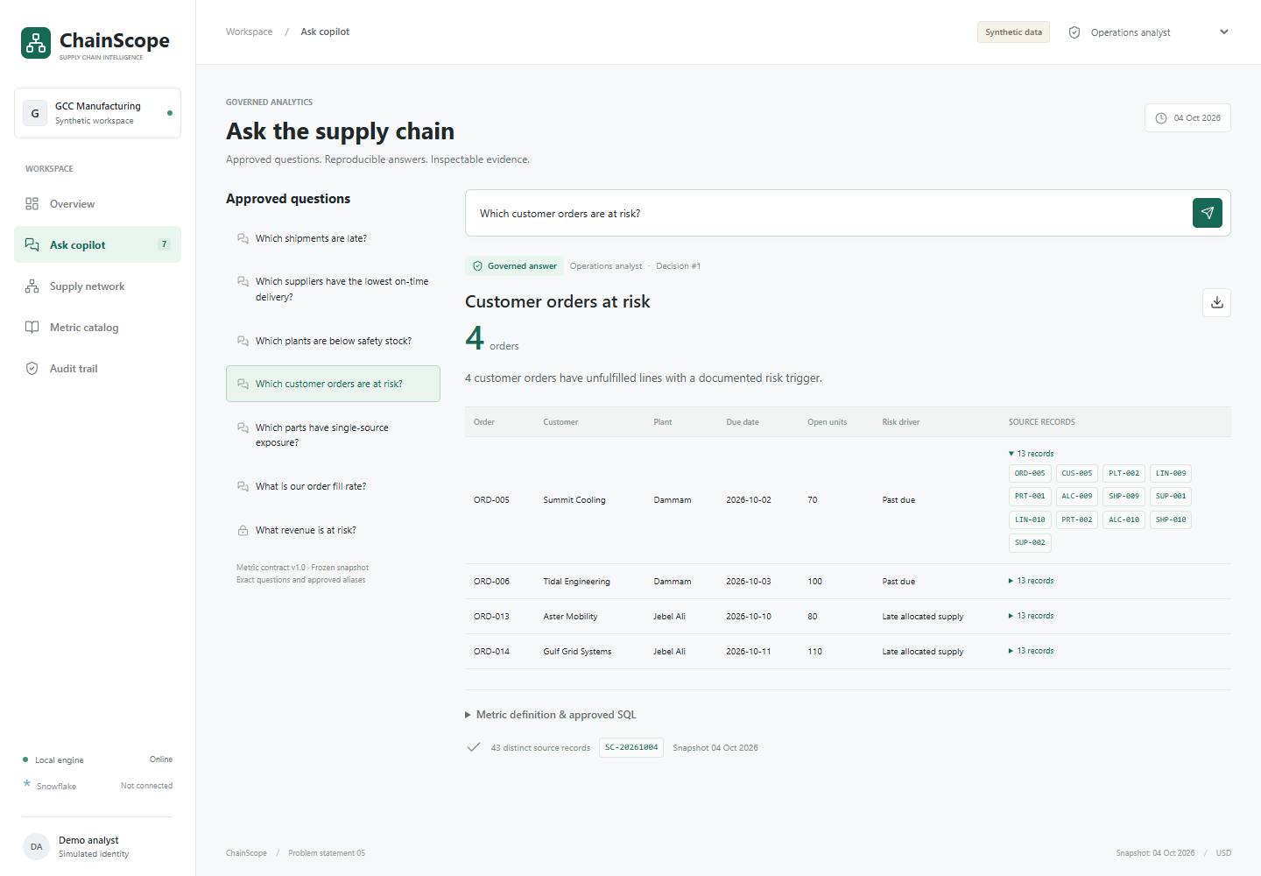
02 WORKING PROTOTYPE
Ask -> govern -> calculate -> cite.
Seven business questions are mapped to explicit metric contracts and source evidence.
Live path
1. User selects an approved question
2. Role and field policy are checked before execution
3. Shared SQL metric runs at a defined grain
4. Result returns source IDs and records
5. Decision is written to the session audit trail

Slide 4
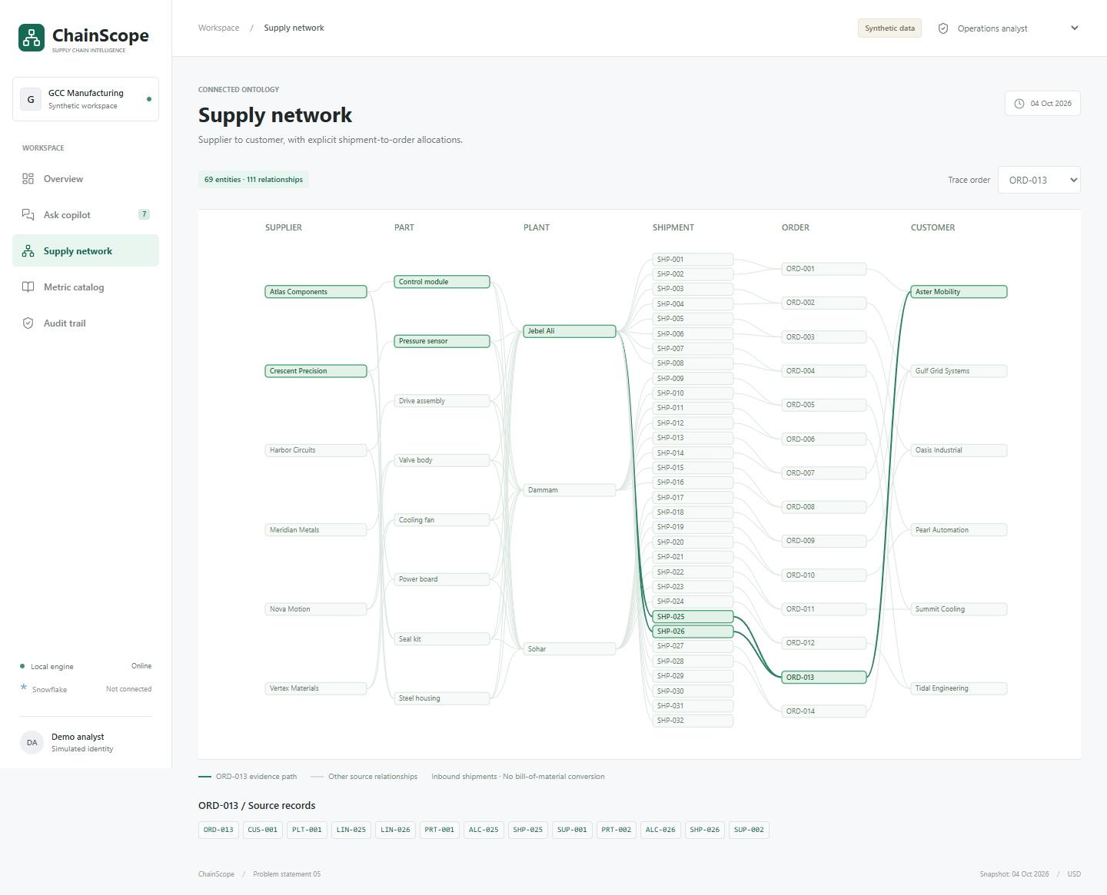
03 ARCHITECTURE
One ontology, shared metric contracts.
The local app proves behavior; Snowflake assets define the account deployment path.
Data layer
Suppliers -> parts -> plants -> shipments -> order lines -> customers
Governance layer
Question allowlist, role checks, redaction, source citations, audit chain
Snowflake path
Load SQL, shared views, native Semantic Views, object grants, Cortex Analyst request and CoCo review prompts

Slide 5
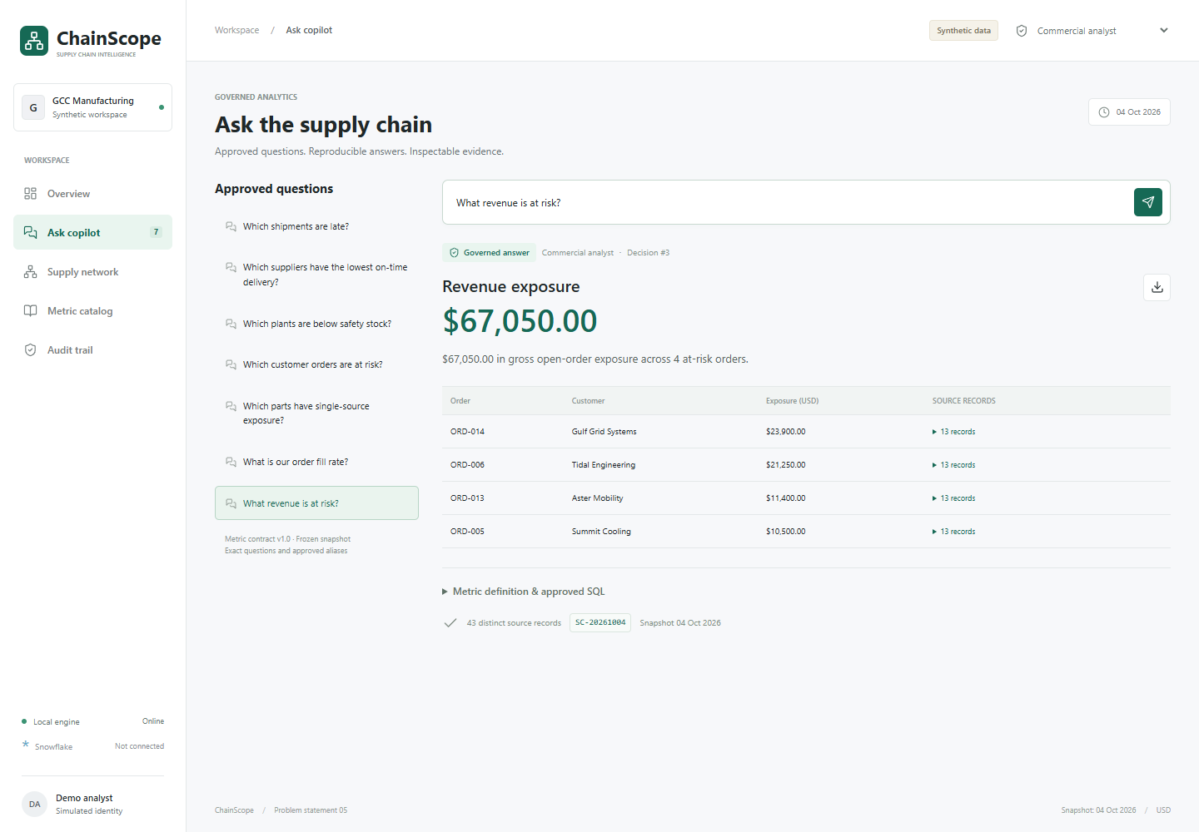
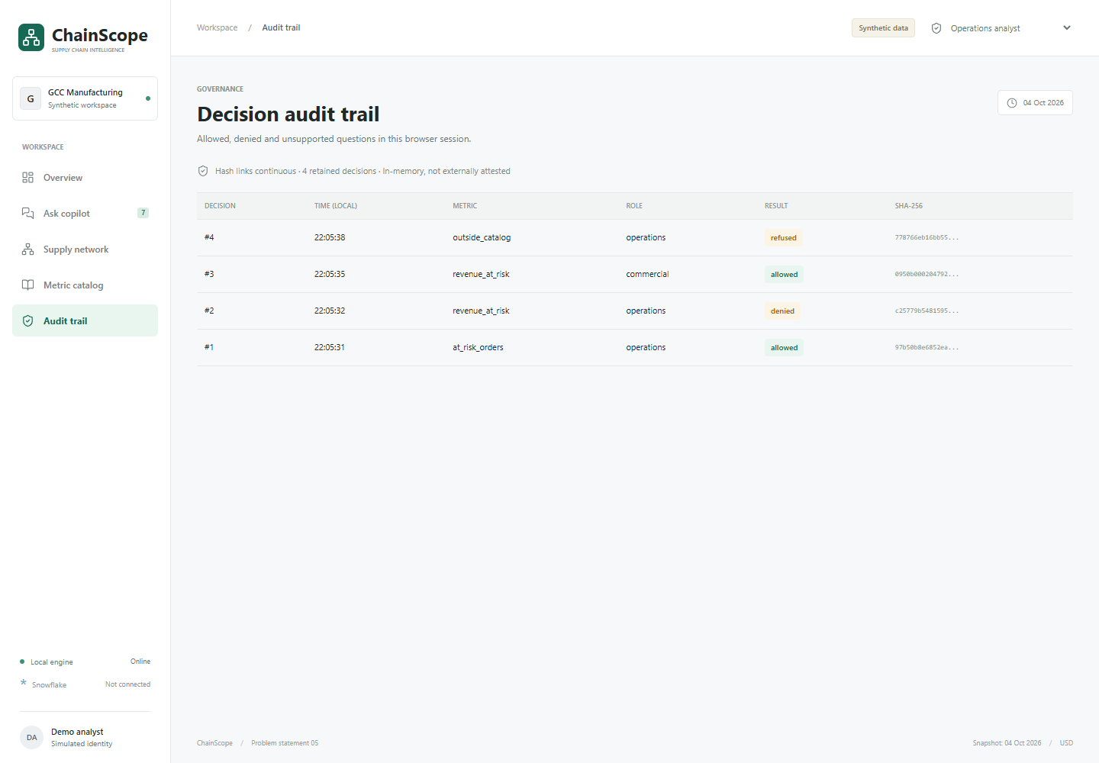
04 GOVERNANCE BY DESIGN
The right answer for the right role.
Commercial exposure is calculated from at-risk lines and denied before query for operations users.
Operations: denied | Commercial: USD 67,050 gross open-order exposure | Unsupported predictions: refused

Slide 6
05 IMPACT & EVIDENCE
Built to be inspected, extended and deployed.
Every figure below is from the reproducible synthetic snapshot - not a claimed client outcome.
56 tests passed
58 browser checks
7 governed metrics
163 records
Metrics, integrity, API, security and static replay.
29 local + 29 static; desktop and mobile.
Late supply, risk, inventory, fill, sourcing and exposure.
11 tables, 32 shipments, 14 orders.
Measured demo outputs
Reusable path
5 overdue inbound shipments
4 at-risk customer orders
55.2% supplier on-time delivery
41.6% unit fill
Static public replay + local app + CLI
Snowflake Semantic Views and least-privilege grants
Deterministic synthetic-data generator
GitHub-ready source and documentation
Repository: github.com/devamkakoty/chainscope-snowflake-coco | Demo: devamkakoty.github.io/chainscope-snowflake-coco/

