Slide 1

Mistry Devam Nareshbhai Roll no. 87 Enrollment no.: 23002170210059 IT-C3

Slide 2
PhysioFlex

Slide 3
Responsive web application

Slide 4
Enhance user interaction and accessibility

Slide 5

basic structure of the website

Slide 6

styling and making the layout visually appealing

Slide 7

add interactivity and dynamic features

Slide 8

ensure responsiveness and make the website mobile-friendly

Slide 9
Interactive buttons

Slide 10
smooth transitions

Slide 11
well-structured layout

Slide 12
ensure consistency across different devices and screen sizes.

Slide 13
The website consists:
Navigation bar

Slide 14
The website consists:
content areas

Slide 15
The website consists:
Footer

Slide 16
While working on this project, I faced a few challenges, such as:
Ensuring cross-browser compatibility

Slide 17
While working on this project, I faced a few challenges, such as:
Managing responsiveness across different screen sizes

Slide 18
While working on this project, I faced a few challenges, such as:
Debugging JavaScript for smooth interactions

Slide 19
However, overcoming these helped me improve my problem-solving skills

Slide 20
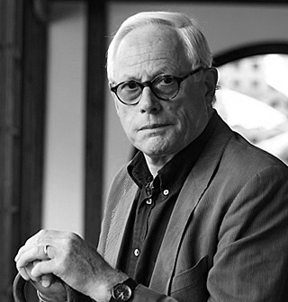
Dieter Rams
German designer

Slide 21
philosophy — 'Less, but better.'

Slide 22
philosophy — 'Less, but better.'
using minimal colors and maintaining a clean layout

Slide 23

Monochromatic Color Schemes
single shade of color throughout the website

Slide 24
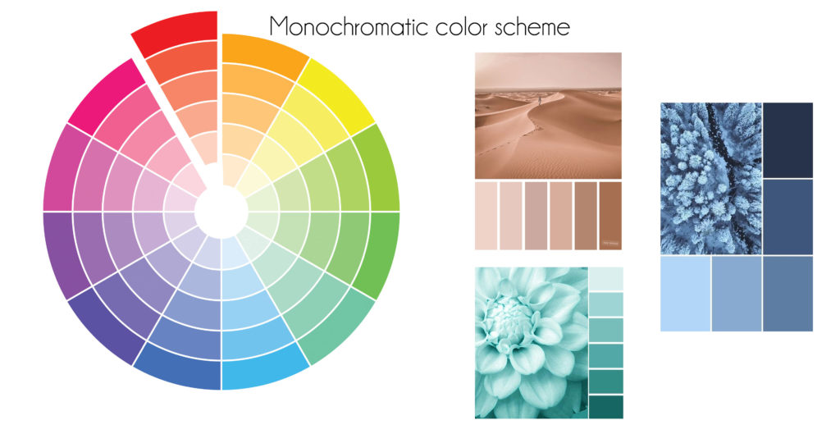

Slide 25
Thank you for your time.

