Slide 1
Unit-1
Introduction of Data Structure

Slide 2
Unit-1
Introduction of Data
Introduction of Data type
Introduction of Data Structure
Primitive and non-primitive data structure
Complexity of Data Structure
Analysis of Algorithm

Slide 3
Introduction of Data
Data is distinct pieces of information.
Data can exist in a variety of forms:
Numbers or texts on pieces of paper
Bits or bytes stored in electronic memory
Facts stored in human’s mind
People have used the word DATA to mean computer information that is transmitted or stored.
Strictly speaking data is a plural of datum, a single piece of information.
In practice, however, people use data as both the singular and plural form of the word.

Slide 4
Introduction of Datatype
Data types specify how we enter data into our programs and what type of data we enter.
C language has some predefined set of data types to handle various kinds of data that we can use in our program.
C data types are used to:
Identify the type of the variable when it is declared.
Identify the type of the return value of a function.
Identify the type of the parameter expected by a function.

Slide 5
Introduction of Datatype
C language supports three different data types:
Primary data types
Derived data types
User defined data types
Primary (Built-in) Data types:
void, int, char, float and double
Derived Data types:
Arrays and Pointers
User Defined Data types:
Structure, Union and Enumeration

Slide 6
Primary Datatype
Table : Primary data types in C
Data Type | Keyword used | Size in bytes | Range | Use
Character | char | 1 | -128 to 127 | To store characters
Integer | int | 2 | -32768 to 32767 | To store integer numbers
Floating point | float | 4 | 3.4E -38 to 3.4E +38 | To store floating point numbers
Double | double | 8 | 1.7E -308 to 1.7E +308 | To store big floating point numbers
Valueless | void | 0 | Valueless | -----

Slide 7
Derived Data type
Array
An array is a collection of data items, all of the same type, accessed using a common name. A one-dimensional array is like a list, A two dimensional array is like a table.

Slide 8
Derived Data type
#include<stdio.h>
#include<conio.h>
void main()
{
int a[50],i,n;
clrscr();
printf("\n Enter Limit : ");
scanf("%d",&n);
for(i=0;i<n;i++)
{
printf("\n Enter Value %d : ",i+1);
scanf("%d",&a[i]);
}
printf("\n Entered Values are as follows \n");
for(i=0;i<n;i++)
{
printf("\n%d",a[i]);
}
getch();
}

Slide 9
Derived Data type
Pointer
A pointer is a variable whose value is the address of another variable, i.e., direct address of the memory location. Like any variable or constant, you must declare a pointer before using it to store any variable address.

Slide 10
Derived Data type
#include<stdio.h>
#include<conio.h>
void swap(int *,int *);
void main()
{
int a=10,b=20;
clrscr();
printf("\n Before Swap A : %d and b : %d",a,b);
swap(&a,&b);
printf("\n After Swap A : %d and b : %d",a,b);
getch();
}
void swap(int *a,int *b)
{
int temp;
temp=*a;
*a=*b;
*b=temp;
}

Slide 11
User Defined Datatype
Structure
Structure is a user-defined data type in C language which allows us to combine data of different types together. Structure helps to construct a complex data type which is more meaningful. It is somewhat similar to an Array, but an array holds data of similar type only.
#include<stdio.h>
#include<conio.h>
struct student
{
int rollno;
char name[20];
};

Slide 12
User Defined Datatype
void main()
{
struct student s1;
clrscr();
printf("\n Enter Roll Number : ");
scanf("%d",&s1.rollno);
printf("\n Enter Name : ");
fflush(stdin);
gets(s1.name);
printf("\n Student Data is as follows ");
printf("\n ***************************");
printf("\n Roll Number is : %d",s1.rollno);
printf("\n Name is : %s",s1.name);
getch();
}

Slide 13
User Defined Datatype
Union
A union is a special data type available in C that allows to store different data types in the same memory location. You can define a union with many members, but only one member can contain a value at any given time.
#include<stdio.h>
#include<conio.h>
union student
{
int rollno;
};

Slide 14
User Defined Datatype
void main()
{
union student s1;
clrscr();
printf("\n Enter Roll Number : ");
scanf("%d",&s1.rollno);
printf("\n Student Data is as follows ");
printf("\n ***************************");
printf("\n Roll Number is : %d",s1.rollno);
getch();
}

Slide 15
User Defined Datatype
Enum
Enumeration is a user defined datatype in C language. It is used to assign names to the integral constants which makes a program easy to read and maintain. The keyword “enum” is used to declare an enumeration.

Slide 16
User Defined Datatype
#include<stdio.h>
#include<conio.h>
enum week{Mon,Tue,Wed,Thu,Fri,Sat,Sun};
void main()
{
enum week w;
clrscr();
w=Tue;
printf("\n Constant Value of Tue is : %d",w);
getch();
}

Slide 17
Introduction of Data Structure
Data structure is a way of collecting and organizing data in such a way that we can perform operations on these data in an effective way.
Data structure is about rendering (providing) data elements in terms of some relationship, for better organization and storage.

Slide 18
Introduction of Data Structure
For example, we have data player’s name “Hitesh” and age 26.
Here we have two data elements:
Player’s name: string datatype
Player’s age: integer datatype
We can organize this data as a record like Player record.
Now we can collect and store Player’s records in a file or database as a data structure.
For example, “Gayle” 30, “Sachin” 31, “Parth” 33.
In simple language, Data structures are structures programmed to store ordered data, so that various operations can be performed easily.

Slide 19
Introduction of Data Structure
Anything that can store data can be called as a data structure, hence Integer, Float, Boolean, Char etc… are also called data structures. They are also known as Primitive Data Structures/ In-Built Data Structures.
Complex type of data structures are also available, which are used to store large and connected data. They are also known as Non-Primitive Data Structures/ Derived Data Structures/ Abstract Data Structures. For example, Array, Stack, Queue, Linked list, Tree, Graph etc….

Slide 20
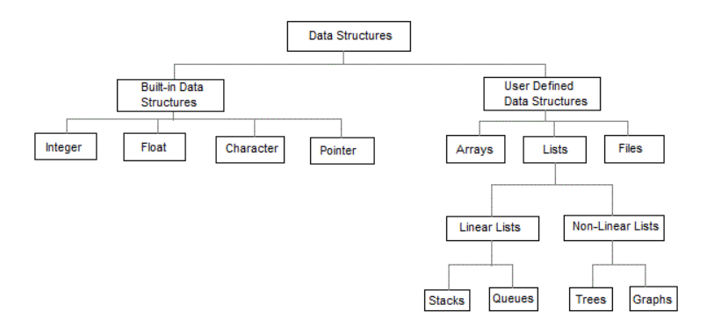
Introduction of Data Structure
Primitive
Data structure
Figure : Classification of Data Structures

Slide 21
Introduction of Data Structure
The data structures can also be classified on the basis of the following characteristics:
Linear :
In Linear data structures, the data items are arranged in a linear sequence.
Example: Array,Stack,Queue
Non-Linear:
In Non-Linear data structures data items are not in sequence.
Example: Tree, Graph

Slide 22
Introduction of Data Structure
Homogeneous :
In Homogeneous data structures, the elements are of same type.
Example: Array
Non- Homogeneous :
In Non- Homogeneous data structures all elements may or may not be of same type.
Example: Structures

Slide 23
Introduction of Data Structure
Static :
Static data structures are those whose sizes and structures associated memory locations are fixed at compile time.
Example: Array
Dynamic :
Dynamic data structures are those which expands and shrinks depending upon the program need and its execution.
Also their associated memory locations change.
Example: Linked lists created using pointers

Slide 24
Introduction of Data Structure
The data in the data structures are processed by certain operations.
The particular data structure chosen, largely depends on the frequency of the operation that needs to be performed on the data structure.
Traversing
Searching
Insertion
Deletion
Sorting
Merging

Slide 25
Complexity of Data Structure
Complexity is a rough approximation of the number of steps necessary to execute an algorithm.
Two types of Complexity of Data Structure
Time Complexity
Space Complexity

Slide 26
Complexity of Data Structure
Time Complexity
The time complexity of an algorithm is basically the running time of a program as a function of the input size.
for(i=0; i < N; i++)
{
statement;
}
The time complexity for the above algorithm will be Linear. The running time of the loop is directly proportional to N. When N doubles, so does the running time.

Slide 27
Complexity of Data Structure
2. Space Complexity
Space complexity of an algorithm represents the amount of memory space needed the algorithm in its life cycle.
Space needed by an algorithm is equal to the sum of the following two components
A fixed part that is a space required to store certain data and variables (i.e. simple variables and constants, program size etc.), that are not dependent of the size of the problem.
A variable part is a space required by variables, whose size is totally dependent on the size of the problem. For example, recursion stack space, dynamic memory allocation etc.

Slide 28
Analysis of Algorithm
We can analyze algorithm in Three Different ways as follows.
Best Case
Worst Case
Average Case

Slide 29
Analysis of Algorithm
Best Case
The best-case complexity of the algorithm is the function defined by the minimum number of steps taken on any instance of size n.
The term ‘best-case performance’ is used to analyse an algorithm under optimal conditions.

Slide 30
Analysis of Algorithm
Worst Case
The worst-case complexity of the algorithm is the function defined by the maximum number of steps taken on any instance of size n.
The worst-case running time of an algorithm is an upper bound on the running time for any input.
Therefore, having the knowledge of worst-case running time gives us an assurance that the algorithm will never go beyond this time limit.

Slide 31
Analysis of Algorithm
3. Average Case
The average-case running time of an algorithm is an estimate of the running time for an ‘average’ input.
It specifies the expected behaviour of the algorithm when the input is randomly drawn from a given distribution.

Slide 32
Thank You...!!!!

